Slide 1
Lecture 15 Persistence More Hardware: RAID

Slide 2
Seek, Rotate, Transfer
Must accelerate, coast, decelerate, settle
Seeks often take several milliseconds!
Settling alone can take 0.5 - 2 ms.
Entire seek often takes 4 - 10 ms.

Slide 3
Seek, Rotate, Transfer
Depends on rotations per minute (RPM).
7200 RPM is common, 15000 RPM is high end.
1 / 7200 RPM = 1 minute / 7200 rotations = 1 second / 120 rotations = 8.3 ms / rotation
so it may take 4.2 ms on avg to rotate to target (0.5 * 8.3 ms)

Slide 4
Seek, Rotate, Transfer
Pretty fast — depends on RPM and sector density.
100+ MB/s is typical.
1s / 100 MB = 10 ms / MB = 4.9 us / sector (assuming 512-byte sector)

Slide 5
Workload
So…
seeks are slow
rotations are slow
transfers are fast
What kind of workload is fastest for disks?
Sequential: access sectors in order (transfer dominated)
Random: access sectors arbitrarily (seek+rotation dominated)

Slide 6
Only One Disk?
Sometimes we want many disks — why?
capacity
performance
reliability
Challenge: most file systems work on only one disk.

Slide 7
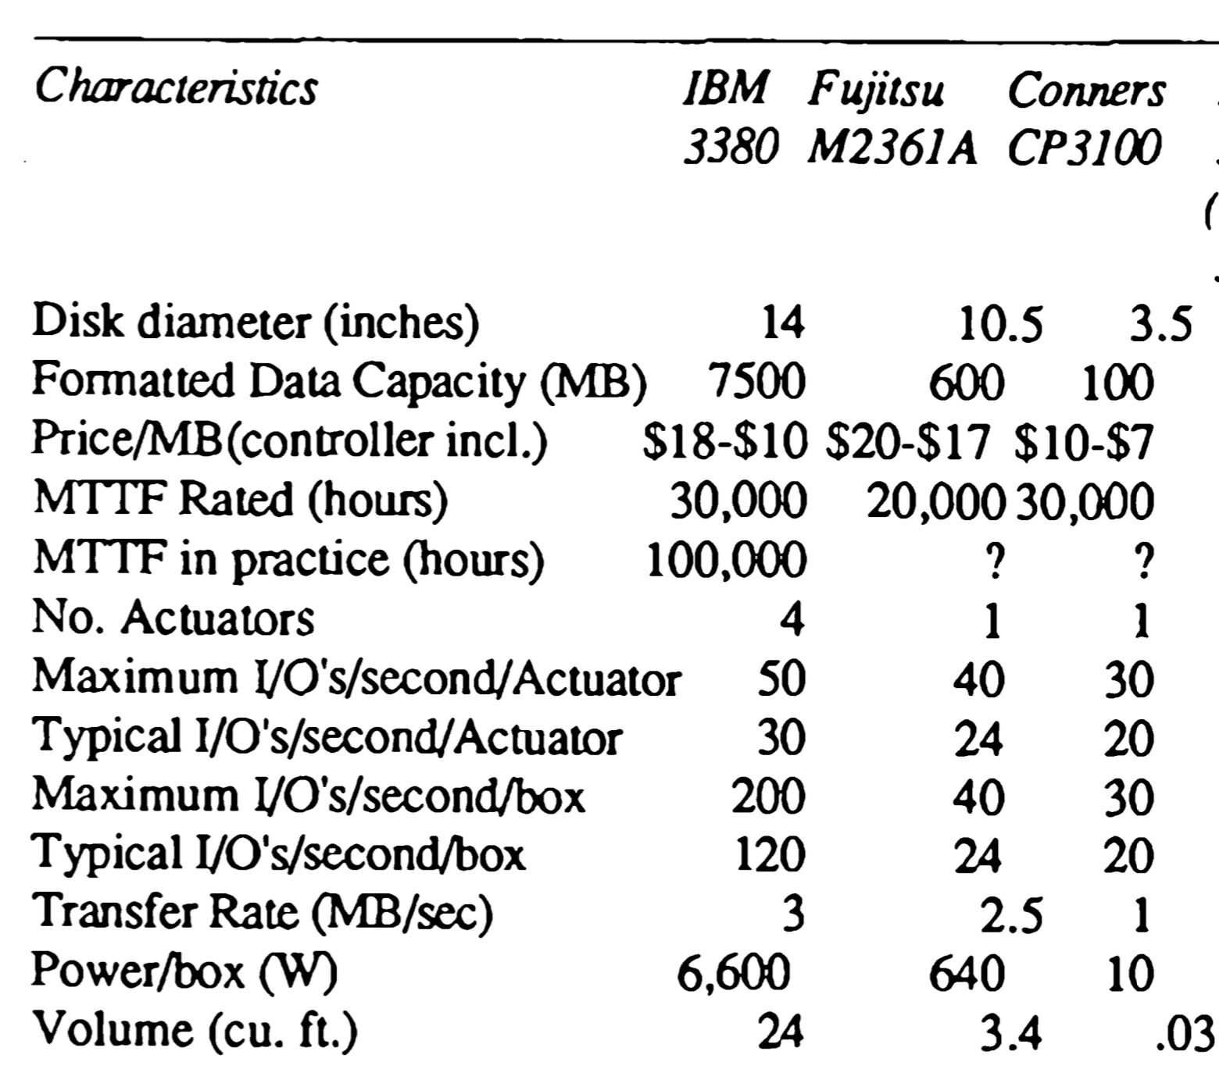
“A Case for Redundant Arrays of Inexpensive Disks”, Patterson, et al.

Slide 8
Solution 1: JBOD
JBOD: Just a Bunch Of Disks
Application is smart, stores different files on different file systems.
Application
FS
FS
FS
FS

Slide 9
Solution 2: RAID
RAID: Redundant Array of Inexpensive Disks
Transparent and deployable
Capacity and performance
Reliability?
Application
FS
RAID Disk Controller

Slide 10
Why Inexpensive Disks?
Economies of scale! Cheap disks are popular.
You can often get many commodity H/W components for the same price as a few expensive components.
Strategy: write S/W to build high-quality logical devices from many cheap devices.
Alternative to RAID: buy an expensive, high-end disk.

Slide 11
General Strategy
Build fast, large disk from smaller ones.
Add even more disks for reliability.
0 100 200
RAID
Disk
Disk
Disk
Disk
0 100 0 100
0 100 0 100

Slide 12
Redundancy
Redundancy: how many copies?
System engineers are always trying to increase or decrease redundancy.
Increase: replication (e.g., RAID)
Decrease: deduplication (e.g., code sharing)
One strategy: reduce redundancy as much is possible. Then add back just the right amount.

Slide 13
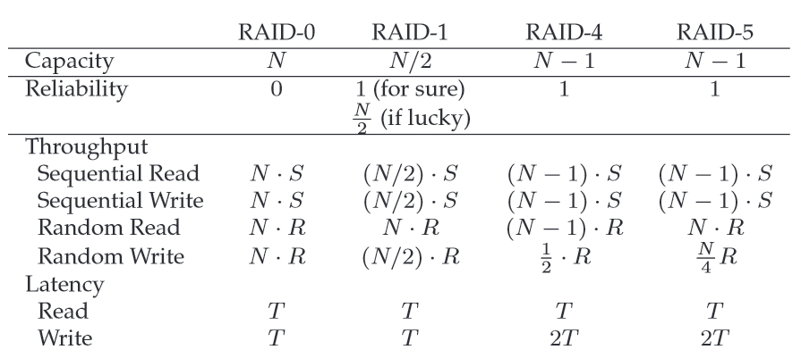

Slide 14
Reasoning About RAID
Workload: types of reads/writes issued by app
Reads and writes
One operation and steady I/O
Sequential and random
RAID: system for mapping logical to physical addrs
Which logical blocks map to which physical blocks?
How do we use extra physical blocks (if any)?
Metrics
Capacity: how much space can apps use?
Reliability: how many disks can we safely lose?
Performance: how long does each workload take?

Slide 15
RAID-0: Striping
Optimize for capacity.
No redundancy (weird name).
Logical Blocks
Disk 0 Disk 1

Slide 16
RAID-0 with 4 disks
Disk 0 Disk 1 Disk 2 Disk 3
0 1 2 3
4 5 6 7
8 9 10 11
12 13 14 15
stripe
How to map given logical address A:
Disk = A % disk_count
Offset = A / disk_count

Slide 17
Chunk Size
Disk 0 Disk 1 Disk 2 Disk 3
0 2 4 6
1 3 5 7
8 10 12 14
9 11 13 15
stripe
When are small chunks better?
When are large chunks better?
Notes:
How to map given logical address with chunk size K?

Slide 18
RAID-0: Analysis
What is capacity?
N * C
How many disks can fail?
0
Throughput?
?
Latency for one-op (read or write) performance
T
Notes:
Throughput: N*R, N*S

Slide 19
RAID-0: Analysis
Performance: what is steady-state throughput for
sequential reads
sequential writes
random reads
random writes
N * S
N * S
N * R
N * R

Slide 20
RAID-1: Mirroring
Keep two copies of all data.
Logical Blocks
Disk 0 Disk 1

Slide 21
4 disks
Disk 0 Disk 1 Disk 2 Disk 3
0 0 1 1
2 2 3 3
4 4 5 5
6 6 7 7
How many disks can fail?

Slide 22
Assumptions
Assume disks are fail-stop.
they work or they don’t
we know when they don’t
Tougher Errors:
latent sector errors
silent data corruption

Slide 23
RAID-1: Analysis
What is capacity?
N / 2 * C
How many disks can fail?
1 (or maybe N / 2)
Throughput?
???
Latency for one-op performance
T for read, T+ for write

Slide 24
RAID-1: Throughput
Performance: what is steady-state throughput for
sequential reads
sequential writes
random reads
random writes
N/2 * S
N/2 * S
N * R
N/2 * R

Slide 25
Crashes
Operations: write (A) to 2
What if crash in between the writes to two disks?
Logical Blocks
Disk 0 Disk 1
Consistent-update problem

Slide 26
Consistent-update problem
Write-ahead log
Run recovery procedure upon a system failure
H/W Solution:
Use non-volatile RAM in RAID controller.

Slide 27
RAID-4 with 5 disks
parity
Disk 0 Disk 1 Disk 2 Disk 3 Disk 4
0 1 2 3 PA0
4 5 6 7 PA1
8 9 10 11 PA2
12 13 14 15 PA3
How to calculate parity
XOR is a good one

Slide 28
RAID-4: Analysis
What is capacity?
(N-1) * C
How many disks can fail?
1
Throughput?
???
Latency for one-op performance
T for read, 2T+ for write

Slide 29
RAID-4: Throughput
Performance: what is steady-state throughput for
sequential reads
sequential writes
random reads
random writes
additive parity
subtractive parity
(N-1) * S
(N-1) * S
(N-1) * R
R/2
How to avoid parity bottleneck?

Slide 30
RAID-5
Disk 0 Disk 1 Disk 2 Disk 3 Disk 4
0 1 2 3 PA0
5 6 7 PA1 4
10 11 PA2 8 9
15 PA3 12 13 14
PA4 16 17 18 19

Slide 31
RAID-5: Analysis
What is capacity?
(N-1) * C
How many disks can fail?
1
Throughput?
???
Latency for one-op performance
T for read, 2T+ for write

Slide 32
RAID-5: Throughput
Performance: what is steady-state throughput for
sequential reads
sequential writes
random reads
random writes
(N-1) * S
(N-1) * S
N * R
N/4 * R

Slide 33
All RAID
 | Reliability | Capacity
RAID-0 | 0 | N
RAID-1 | 1 | N / 2
RAID-4 | 1 | N - 1
RAID-5 | 1 | N - 1

Slide 34
All RAID
 | Read Latency | Write Latency
RAID-0 | T | T
RAID-1 | T | T
RAID-4 | T | 2T
RAID-5 | T | 2T
RAID-5 can do more in parallel

Slide 35
All RAID
 | Seq R | Seq W | Rand R | Rand W
RAID-0 | N*S | N*S | N*R | N*R
RAID-1 | N/2 * S | N/2 * S | N*R | N/2 * R
RAID-4 | (N-1)*S | (N-1)*S | (N-1)*R | R/2
RAID-5 | (N-1)*S | (N-1)*S | N*R | N/4 * R
RAID-5 is strictly better than RAID-4
RAID-0 is always fastest and has best capacity.
RAID-5 better than RAID-1 for sequential.
RAID-1 better than RAID-5 for random write.

Slide 36
Next time
File systems, API

