Slide 1
Lecture 16 File System APIs and Implementation

Slide 2
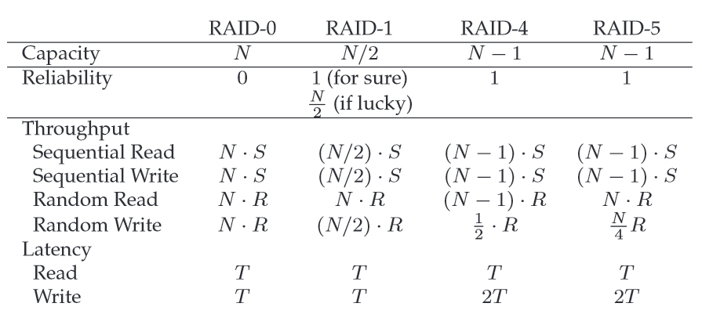

Slide 3
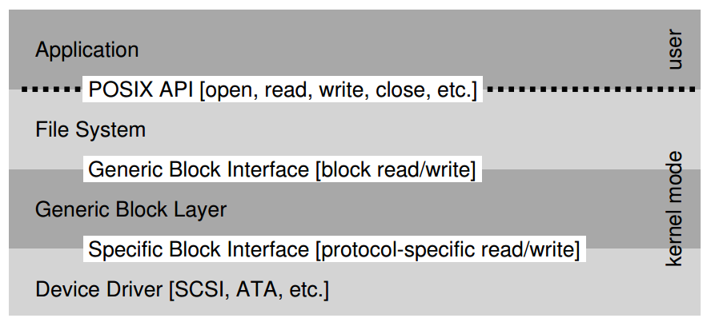
The (UNIX) File System Stack

Slide 4
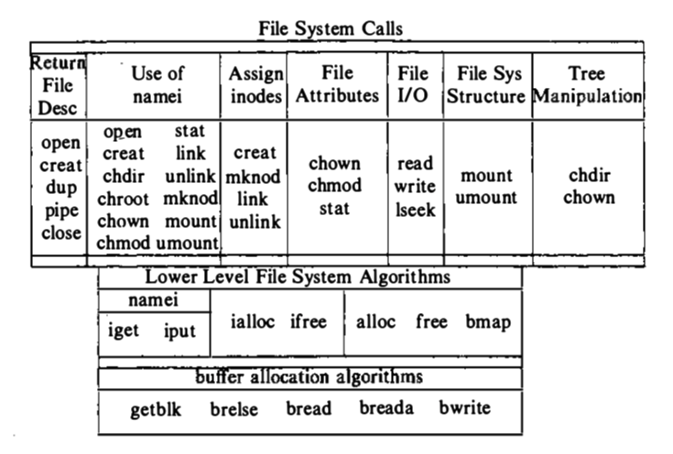
Bach, “Design of the UNIX Operating System”
NOTE: Where’s mkdir?
NOTE: Doesn’t show hardware device interface

Slide 5
Files and File Names
What is a File?
Array of bytes.
Ranges of bytes can be read/written.
File system consists of many files, and files need names so programs can choose the right one.
inode
path
file descriptor

Slide 6
Inodes
Contraction of “index node”
Contains the information describing a file
Timestamps
Ownership, permissions
Pointers to data blocks
Each file has exactly one inode number, unique (at a given time) within a FS.
Different file systems may use the same number, numbers may be recycled after deletes
At a terminal: Show inodes via stat.

Slide 7
File API (attempt 1)
read(int inode, void *buf, size_t nbyte)
write(int inode, void *buf, size_t nbyte)
seek(int inode, off_t offset)
seek does not cause disk seek unless followed by a read/write
Disadvantages?
names hard to remember

Slide 8
Paths
String names are friendlier than number names.
Store path-to-inode mappings in a predetermined “root” file
Generalize! Store path-to-inode mapping in many files. Call these special files directories.
Reads for getting final inode called “traversal”.

Slide 9
Directory Calls
mkdir: create new directory
readdir: read/parse directory entries
Why no writedir?
Special Directory Entries
.
..

Slide 10
File API (attempt 2)
pread(char *path, void *buf, off_t offset, size_t nbyte)
pwrite(char *path, void *buf, off_t offset, size_t nbyte)
Disadvantages?
Expensive traversal! Goal: traverse once.

Slide 11
File Descriptor (fd)
Idea: do traversal once, and store inode number in descriptor object. Do reads/writes via descriptor. Also remember offset.
A file-descriptor table contains pointers to file descriptors.
The integers you’re used to using for file I/O are indexes into this table.

Slide 12
Code Snippet
int fd1 = open(“file.txt”); // returns 3
read(fd1, buf, 12);
int fd2 = open(“file.txt”); // returns 4
int fd3 = dup(fd2); // returns 5
fd table
0
1
2
3
4
5
fds
offset = 12
inode =
offset = 0
inode =
inode
location = 0
size =
offset = 0
inode =

Slide 13
File API (attempt 3)
int fd = open(char *path, int flag, mode_t mode)
read(int fd, void *buf, size_t nbyte)
write(int fd, void *buf, size_t nbyte)
close(int fd)
advantages:
string names
hierarchical
traverse once
different offsets

Slide 14
Deleting Files
There is no system call “delete” for deleting files!
inode (and associated file) is garbage collected when there are no references
FDs are deleted when:
close(), or process quits

Slide 15
Hard link
When you create a file
Make a structure: the inode
Link a human-readable name to that file, and put that link into a directory
To remove a file, just call unlink
The reference count will be decreased
If the reference count reaches zero, the file inode and related data blocks are removed

Slide 16
Directories
Making Directories: mkdir()
Reading Directories: opendir(), readdir(), and closedir()
Deleting Directories
Directories can also be unlinked with unlink(). But only if empty!
Be careful on using ““rm –rf *”

Slide 17
Special Calls
fsync
rename
Say we want to update file.txt.
write new data to new file.txt.tmp file
fsync file.txt.tmp
rename file.txt.tmp over file.txt, replacing it
Symbolic link or soft link

Slide 18
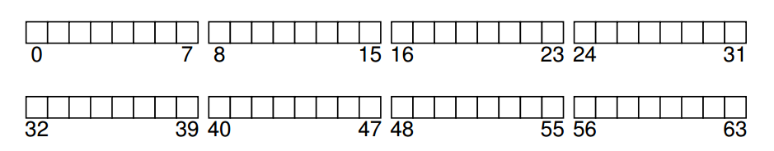
Implementation
On-disk structures
how do we represent files, directories?
Access methods
what steps must reads/writes take?

Slide 19
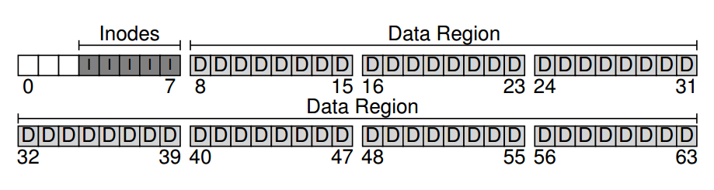
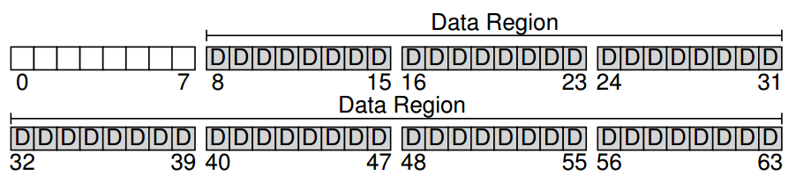
Structures
What data is likely to be read frequently?
data block
inode table

Slide 20
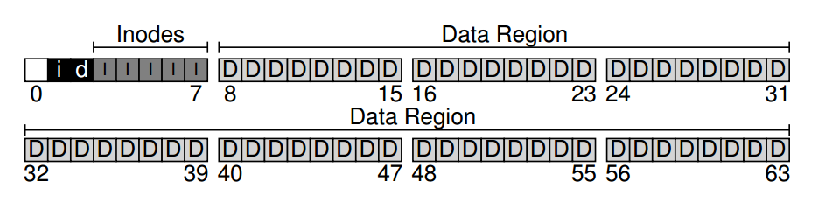
Allocation Structures
V6 source (bio.c, buf.h)
Inode
data

Slide 21
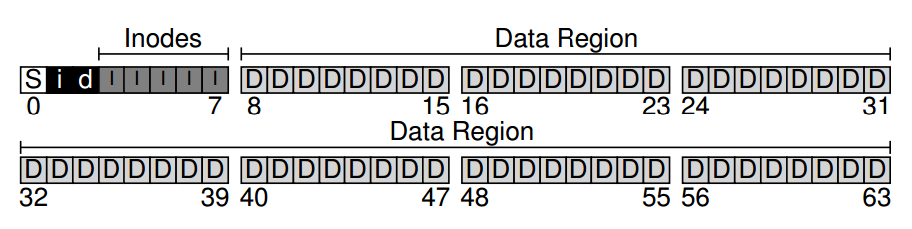
Superblock
The superblock contains information including:
how many inodes and data blocks are in the file system (80 and 56, respectively in this instance)
where the inode table begins (block 3)
a magic number to identify the file system type

Slide 22
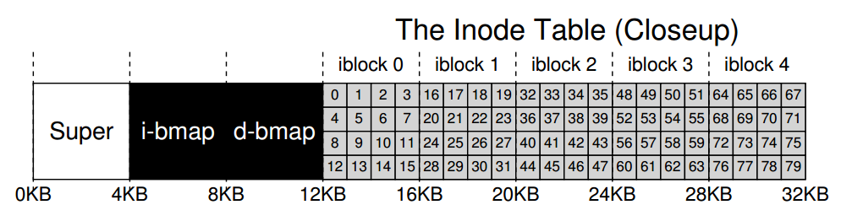
The inode Table
The sector address of an inode block can be calculated

Slide 23
What’s in an inode?
Metadata for a given file
Type: file or directory?
uid: user
rwx: permission
size: size in bytes
blocks: size in blocks
time: access time
ctime: create time
links_count: how many paths
addrs[N]: N data blocks

Slide 24
The Multi-Level Index
An inode may have
some fixed number of direct pointers (e.g., 12)
a single indirect pointer
a double indirect pointer
…
Why direct pointers are kept?
Most files are small
Some systems use tree (ext3), extents (ext4), linked list (FAT)

Slide 25
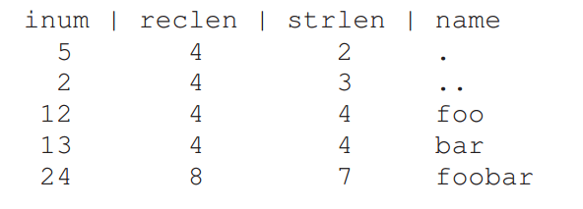
Directory Organization
File systems vary
Common design: just store directory entries in files
Simple list example
More advanced data structures possible, e.g. trees

Slide 26
Free Space Management
How do we find free data blocks or free inodes?
Free list
– Linked list
Bitmaps – Think ‘page table’
Tree

Slide 27
Operations
File
Creat(e)
write
open
read
Close
FS
mkfs
mount

Slide 28
mkfs
Different version for each file system (e.g., mkfs.ext4, mkfs.xfs, mkfs.btrfs, etc)
Initialize metadata (bitmaps, inode table).
Create empty root directory.

Slide 29
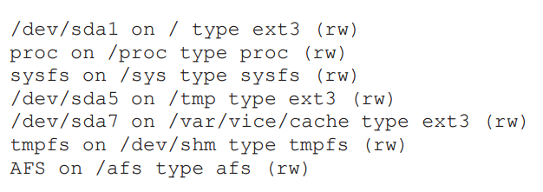
mount
Add the file system to the FS tree. (terminal)

Slide 30
create /foo/bar
Read root inode
Read root data
Read foo inode
Read foo data
Read inode bitmap
Write inode bitmap
Write foo data
Read bar inode
Write bar inode
Write foo inode

Slide 31
Write to /foo/bar
Read bar inode
Read data bitmap
Write data bitmap
Write bar data
Write bar inode

Slide 32
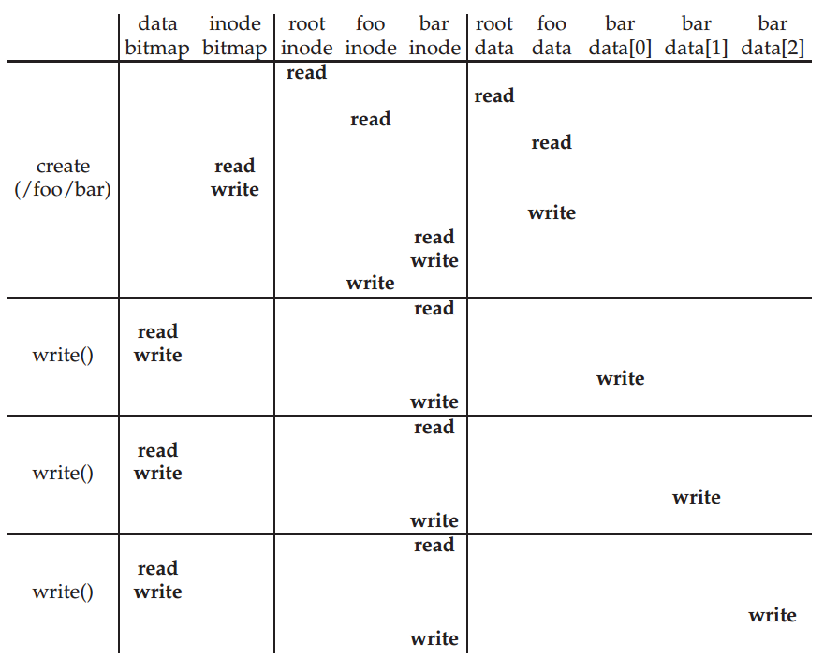

Slide 33
Open /foo/bar
Read root inode
Read root data
Read foo inode
Read foo data
Read bar indoe

Slide 34
Read /foo/bar
Read bar inode
Read bar data
Write bar inode

Slide 35
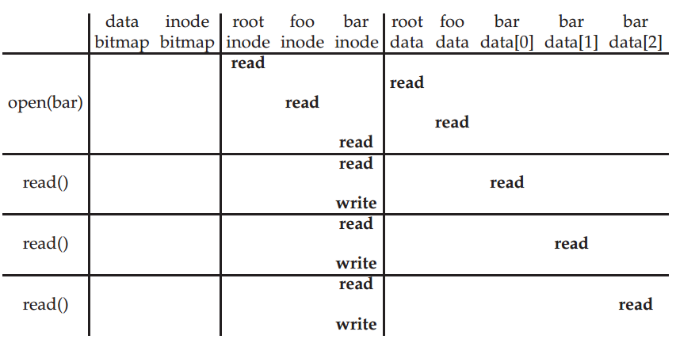

Slide 36
Close /foo/bar
Deallocate the file descriptor
No disk I/Os take place

Slide 37
How to avoid excessive I/O?
Fixed-size cache
Unified page cache for read and write buffering (look at v6 getblk, etc)
Instead of a dedicated file-system cache, draw pages from a common pool for FS and processes.
Cache benefits read traffic more than write traffic
For write: batch, schedule, and avoid
A trade-off between performance and reliability
We decide: how much to buffer, how long to buffer…

Slide 38
Summary/Future
We’ve described a very simple FS.
basic on-disk structures
the basic ops
Future questions:
how to allocate efficiently?
how to handle crashes?

