Slide 1
Lecture 19 Log-structured File Systems (LFS)

Slide 2
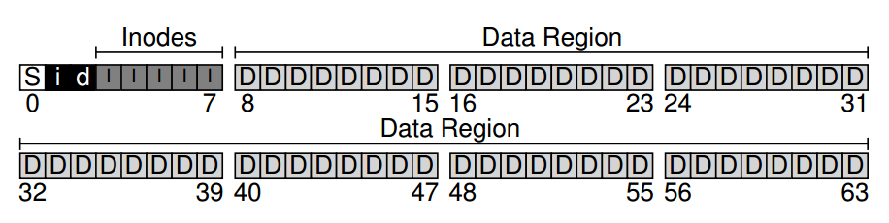
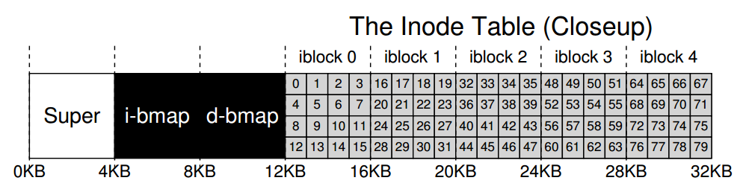
VSFS

Slide 3
FFS
fsck
journaling
S
B
I
D
S
B
I
D
S
B
I
D
Journal
Group 1
Group 2
…
Group N

Slide 4
Data Journaling
1. Journal write: Write the contents of the transaction (containing TxB and the contents of the update) to the log; wait for these writes to complete.
2. Journal commit: Write the transaction commit block (containing TxE) to the log; wait for the write to complete; the transaction is now committed.
3. Checkpoint: Write the contents of the update to their final locations within the file system.
4. Free: Some time later, mark the transaction free in the journal by updating the journal superblock.

Slide 5
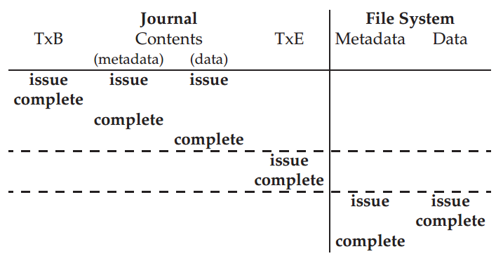
Data Journaling Timeline

Slide 6
Metadata Journaling
1/2. Data write: Write data to final location; wait for completion (the wait is optional; see below for details).
1/2. Journal metadata write: Write the begin block and metadata to the log; wait for writes to complete.
3. Journal commit: Write the transaction commit block (containing TxE) to the log; wait for the write to complete; the transaction (including data) is now committed.
4. Checkpoint metadata: Write the contents of the metadata update to their final locations within the file system.
5. Free: Later, mark the transaction free in journal superblock

Slide 7
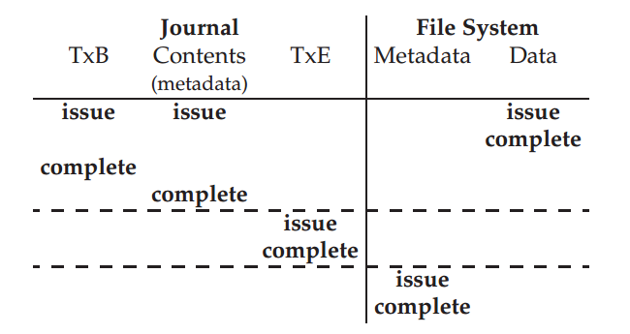
Metadata Journaling Timeline

Slide 8
Existing File System Problems
They spread information around the disk
I-nodes stored apart from data blocks
less than 5% of disk bandwidth is used to access new data
Use synchronous writes to update directories and i-nodes
Required for consistency
Less efficient than asynchronous writes
Metadata is written synchronously
Small file workload make synchronously metadata writes dominating

Slide 9
Observations behind LFS
Larger memory sizes mean larger caches
More reads are serviced from cache
Disk traffic will be dominated by writes
Caches can act as write buffers replacing many small writes by fewer bigger writes
Growing gap between sequential and random I/O performance.
Processor speeds increase at an exponential rate
Main memory sizes increase at an exponential rate
Disk capacities are improving rapidly
Disk access times have evolved much more slowly
Standard file system structure leads to many block writes (e.g creating a file causes six block writes)
Existing file systems not RAID-aware (don’t avoid small writes)
Applications tend to become I/O bound, especially for workload dominated by small file accesses

Slide 10
LFS: Log-Structured File System
“The fundamental idea of a log-structured file system is to improve write performance by buffering a sequence of file system changes in the file cache and then writing all the changes to disk sequentially in a single disk write operation.”
– Rosenblum, Ousterhout, 1991

Slide 11
LFS: Log-Structured File System
Idea: Focus on write performance by using the sequential bandwidth of the disk.
Strategy:
Optimize allocation for writes instead of reads
Buffer updates in an in-memory segment until enough data to optimize for sequential write performance
Write segment in one sequential transfer to unused part of disk
Never overwrite existing data

Slide 12
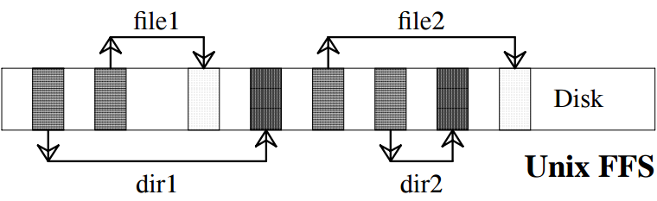
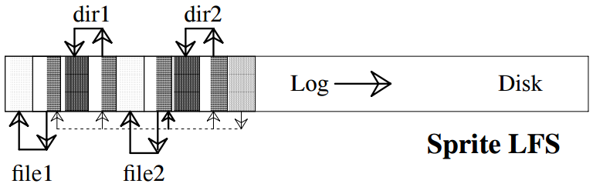

Disk after Creating Two Files

Slide 13
Performance Goal
Ideal: use disk purely sequentially.
Hard for reads -- why?
user might read files X and Y not near each other
Easy for writes -- why?
can do all writes near each other to empty space

Slide 14
Main advantages
Faster recovery after a crash
All blocks that were recently written are at the tail end of log
No need to check whole file system for inconsistencies
Small file performance can be improved
Just write everything together to the disk sequentially in a single disk write operation
Log structured file system converts many small synchronous random writes into large asynchronous sequential transfers.

Slide 15

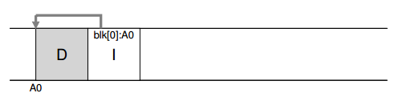
Writing To Disk Sequentially
Write both data blocks and metadata

Slide 16
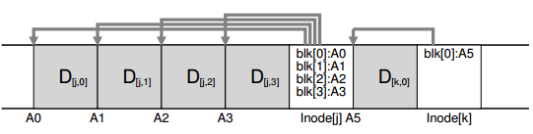
Writing To Disk Effectively
Batch writes into a segment

Slide 17
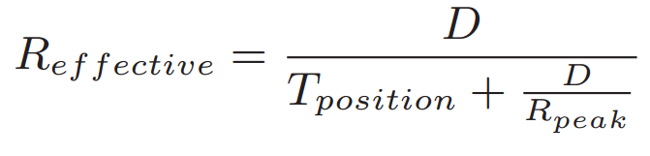
How Much To Buffer?
How large should a segment be?
Maximize amount of data (D) written at peak transfer rate (R_{peak})
Minimize positioning time (T_{position})
Effective transfer rate:

Slide 18
Data Structures
What can we get rid of from FFS?
allocation structures: data + inode bitmaps
inodes are no longer at fixed offset
How to find inodes?

Slide 19
Overwrite Data in /file.txt
I2
D1
I9
D2
I2: root inode
D1: root directory entries
I9: file inode
D2: file data
D2’
I9’
D1’
I2’

Slide 20
Inode Numbers
Problem:
For every data update, we need to do updates all the way up the tree.
How to find inodes?
Why?
We change inode number when we copy it… latest version keeps moving
Solution: keep inode numbers constant. Don’t base on offset.
We found inodes with math before. How now?
Old: Inode = inode table address + inode number * size(inode)

Slide 21
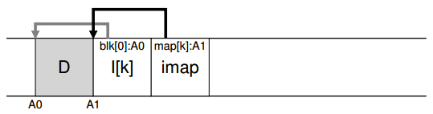
Data Structures
What can we get rid of from FFS?
allocation structures: data + inode bitmaps
Inodes are no longer at fixed offset.
use inode map (imap) struct to map number => inode.
Disk address = imap(inode number)
Write imap in segments, keep pointers to pieces of imap in memory

Slide 22
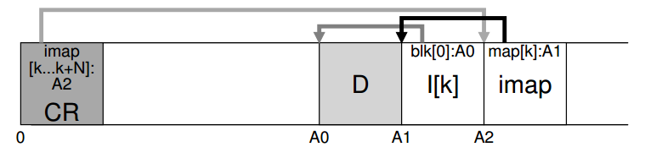
Now we have an imap, but how to find the imap?
The file system must have some known location on disk to begin a file lookup: known as the checkpoint region, periodically updated with latest inode map pointers

Slide 23
Creation of a checkpoint…
At periodic intervals
When file system is unmounted
When system is shutdown

Slide 24
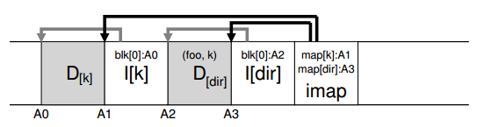
What About Directories?

Slide 25
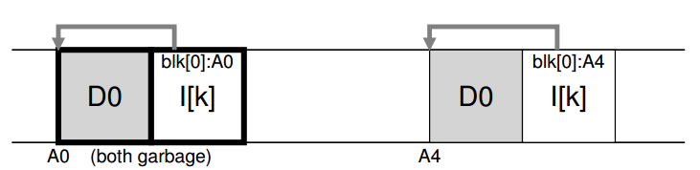
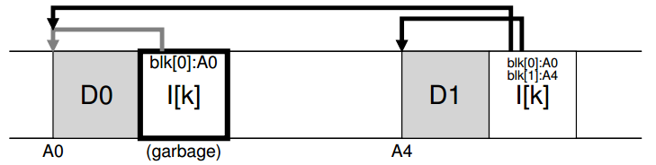
Garbage Collection
Need to reclaim space:
when no more references (any file system)
after a newer copy is created (COW file system)

Slide 26
Versioning File Systems
Garbage can be a feature!
Keep old versions in case the user wants to revert files later.
Like Dropbox, NetApp Write Anywhere File Layout (WAFL)

Slide 27
Garbage Collection
General operation:
pick M segments, compact into N (where N < M).
To free up segments, copy live data from several segments to a new one (ipack live data together).
Read a number of segments into memory
Identify live data
Write live data back to a smaller number of clean segments.
Mark read segments as clean.
Mechanism: how do we know whether data in segments is valid?
Policy: which segments to compact?

Slide 28
Mechanism
Is an inode the latest version?
Check imap to see if it is pointed to (fast).
Is a data block the latest version?
Scan ALL inodes to see if it is pointed to (very slow).
Solution: segment summary that lists inode
corresponding to each data block.

Slide 29
Segments
Segment: unit of writing and cleaning
Segment summary block
Contains each block’s identity : <inode number, offset>
Used to check validness of each block
Each piece of information in the segment is identified (file number, offset, etc.)
Summary Block is written after every partial segment write

Slide 30
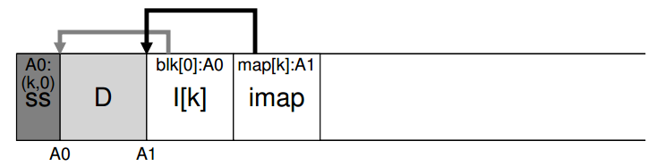
Determining Block Liveness
(N, T) = SegmentSummary[A];
inode = Read(imap[N]);
if (inode[T] == A)
// block D is alive
else
// block D is garbage

Slide 31
Policy: Which Segments To Clean, And When?
When to clean is easier
either periodically
during idle time
when you have to because the disk is full
What to clean is more interesting
A hot segment: the contents are being frequently over-written
A cold segment: may have a few dead blocks but the rest of its contents are relatively stable

Slide 32
Crash Recovery
Start from the checkpoint
Checkpoint often: random I/O
Checkpoint rarely: recovery takes longer
LFS checkpoints every 30s
Crash on log writing
Crash on checkpoint region update

Slide 33
Checkpoint Strategy
Have two checkpoints.
Only overwrite one at a time.
it first writes out a header (with timestamp)
then the body of the CR
finally one last block (also with a timestamp)
Use timestamps to identify the newest consistent one.
If the system crashes during a CR update, LFS can detect this by seeing an inconsistent pair of timestamps

Slide 34
Roll-forward
Scanning BEYOND the last checkpoint to recover max data
Use information from segment summary blocks for recovery
If found new inode in Segment Summary block -> update the inode map (read from checkpoint) -> new data block on the FS
Data blocks without new copy of inode => incomplete version on disk => ignored by FS
Adjusting utilization in the segment usage table to incorporate live data after roll-forward (utilization after checkpoint = 0 initially)
Adjusting utilization of deleted & overwritten segments
Restoring consistency between directory entries & inodes

Slide 35
Conclusion
Journaling: let’s us put data wherever we like.
Usually in a place optimized for future reads.
LFS: puts data where it’s fastest to write.
Other COW file systems: WAFL, ZFS, btrfs.

Slide 36
Major Data Structures
Superblock: Holds static configuration information such as number of segments and segment size. - Fixed
inode: Locates blocks of file, holds protection bits, modify time, etc. Log
Indirect block: Locates blocks of large files. Log
Inode map: Locates position of inode in log, holds time of last access plus version number version number. Log
Segment summary: Identifies contents of segment (file number and offset for each block). Log
Directory change log: Records directory operations to maintain consistency of reference counts in inodes- Log
Segment usage table: Counts live bytes still left in segments, stores last write time for data in segments. Log
Checkpoint region: Locates blocks of inode map and segment usage table, identifies last checkpoint in log. Fixed

Slide 37
Next
SSD
Data Integrity and Protection

