Slide 1
Lecture 21 Solid State Drives (SSD)

Slide 2
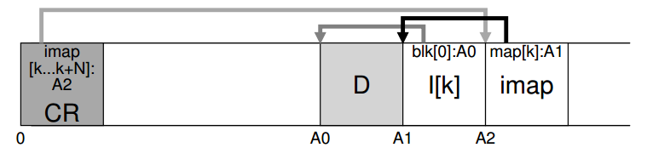
LFS review
Good for …?
Bad for …?
How to write in LFS?
How to read in LFS?

Slide 3
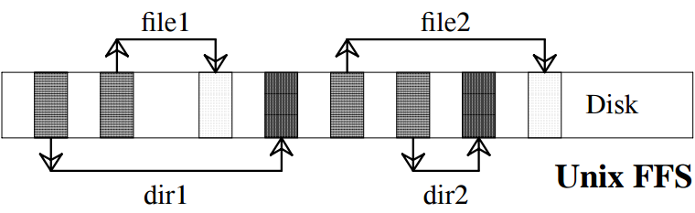
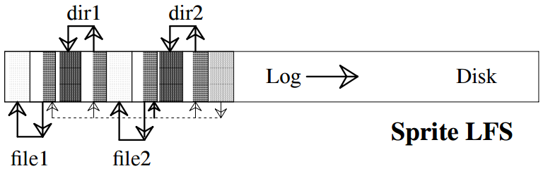

Disk after Creating Two Files

Slide 4
Flash-based Solid-state Storage Disk
A new form of persistent storage device
Unlike hard drives, no mechanical or moving parts
but flash is more expensive
Unlike typical random-access memory, it retains information despite power loss
But flash ‘wears out’
Unlike hard drives and like memory, random-access device

Slide 5
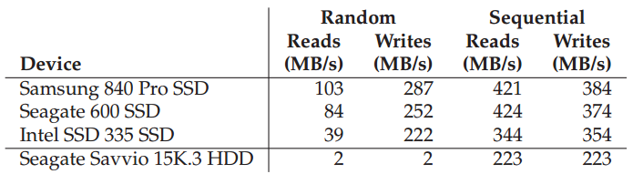
SSD Performance
Fast but expensive
An SSD costs 60 cents per GB
A typical hard drive costs 5 cents per GB

Slide 6
Transistor storage – flash ‘cell’
Store one or more bits in a single transistor
single-level cell (SLC) flash, 1 or 0
multi-level cell (MLC) flash, 00, 01, 10, and 11
triple-level cell (TLC) flash, which encodes 3 bits per cell
SLC chips achieve higher performance and are more expensive

Slide 7
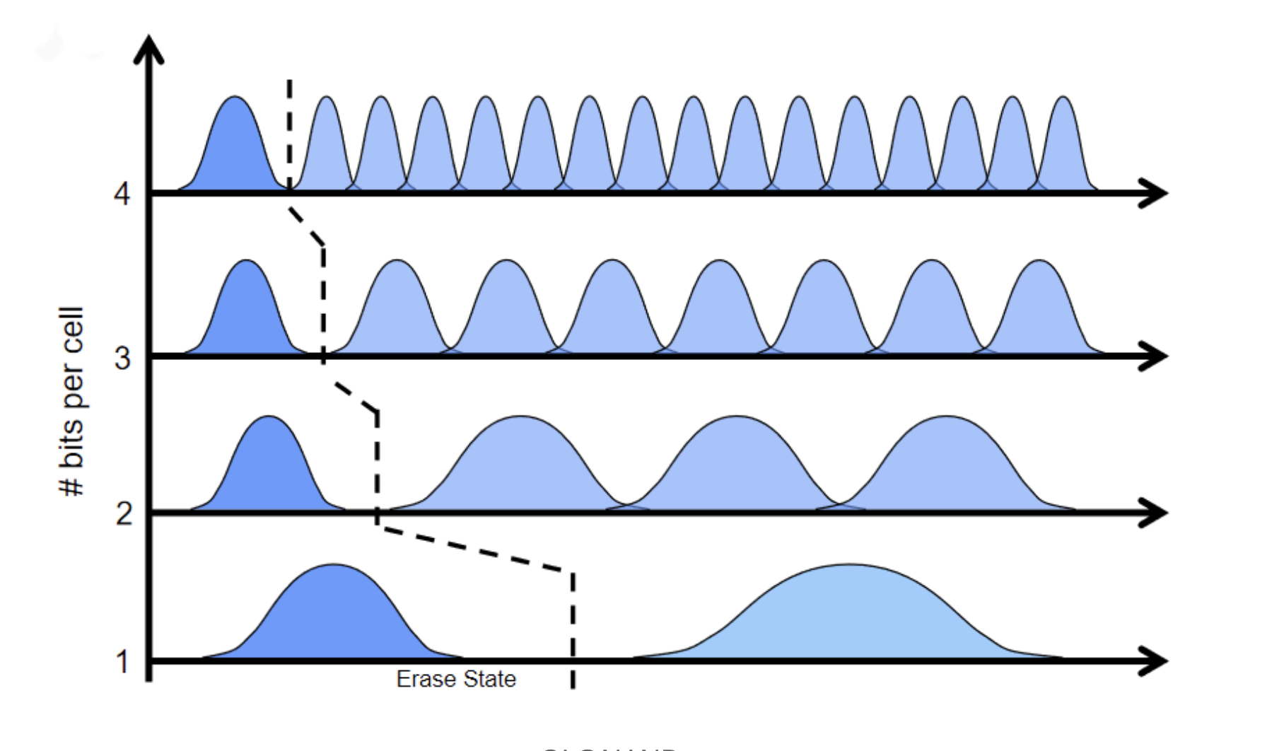
https://www.backblaze.com/blog/hdd-vs-ssd-in-data-centers/

Slide 8
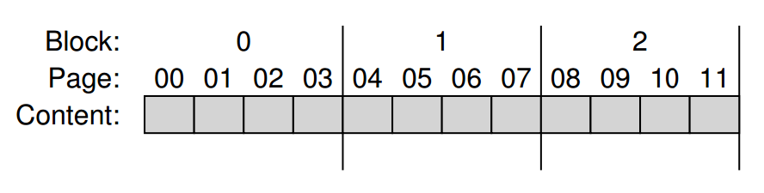
From Bits to Blocks and Pages
Flash chips are organized into banks or planes.
A bank is accessed in two different sized units:
Blocks (erase blocks): 128 KB or 256 KB
Pages: 4KB

Slide 9
Basic Flash Operations
Read (a page): a random access device
Fast, 10s of nanoseconds
Erase (a block):
Set each bit to the value 1
Quite expensive, taking a few milliseconds to complete
Program (a page):
Only if the block has been erased
100s of microseconds - less expensive than erasing a block, but more costly than reading a page
Write is expensive, and frequent erase/program lead to wear out

Slide 10
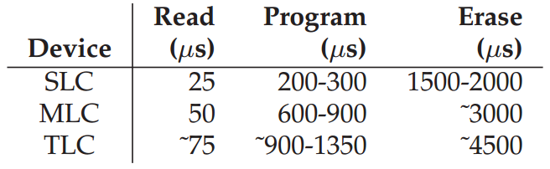
Flash Performance And Reliability
Raw Flash Performance Characteristics
The primary concern is wear out, as a little bit of extra charge is slowly accrued
Disturbance: when accessing (read/program) a particular page within a flash, it is possible that some bits get flipped in neighboring pages
Comparisons
Fastest transfer time from original RAID paper: 3MB/sec
Typical current hard drive:

Slide 11
4-page Block Status
Erase()
Program(0)
Program(0)
Program(1)
Erase()
IIII Initial: pages in block are invalid (I)
→ EEEE State of pages in block set to erased (E)
→ VEEE Program page 0; state set to valid (V)
→ error Cannot re-program page after programming
→ VVEE Program page 1
→ EEEE Contents erased; all pages programmable

Slide 12
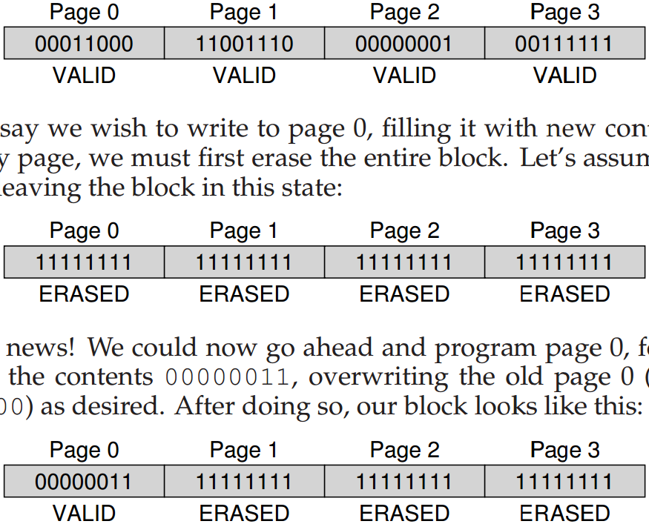
A Detailed Example

Slide 13
Raw Flash → Flash-Based SSDs
The standard storage interface: lots of sectors
Inside SSD: flash chips, RAM for cache, and
Flash translation layer (FTL) – control logic to turn client reads and writes into flash operations
FTL needs to reduce write amplification:
bytes issued to the flash chips by the FTL
divided by
bytes issued by the client to the SSD
FTL takes care of wear out - do wear leveling
FTL takes care of disturbance - access in order

Slide 14
A Bad Approach: Direct Mapped
logical page N is mapped directly to physical page N
Performance is bad
Uneven wear out
What might be a good approach?
Trying to improve write performance
Rotate through pages to even out lifetime

Slide 15
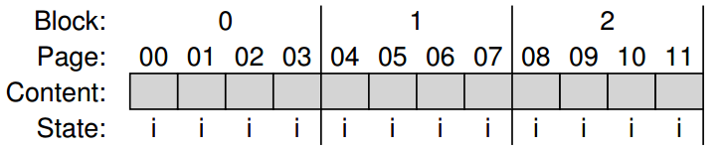
A Log-Structured FTL
Need to add a mapping table
Operations:
Write(100) with contents a1
Write(101) with contents a2
Write(2000) with contents b1
Write(2001) with contents b2

Slide 16
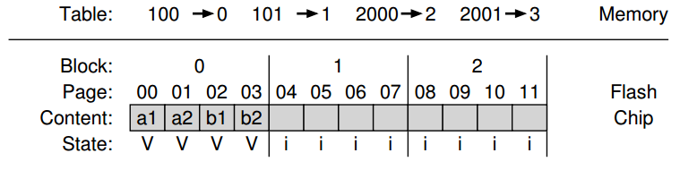
The resulting SSD
How to read?
Wear leveling: FTL now spreads writes across all pages

Slide 17
Keep FTL Mapping Persistent
Record some mapping information with each page
called an out-of-band (OOB) area
When the device looses power and is restarted
Scan OOB areas and reconstruct the mapping table is memory
Logging and checkpointing

Slide 18
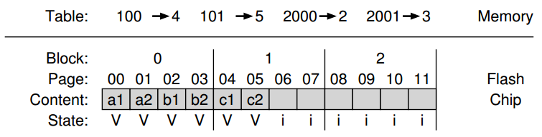
Garbage Collection
Garbage example (the figure has a bug)
“VVii” should be “VVEE”
Determine liveness:
Within each block, store information about which logical blocks are stored within each page
Checking the mapping table for the logical block

Slide 19
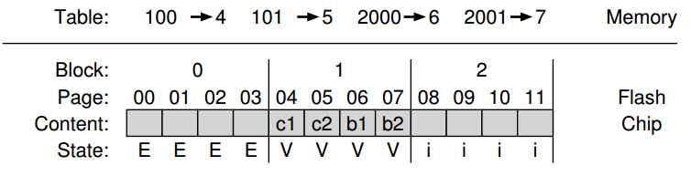
Garbage Collection Steps
Read live data (pages 2 and 3) from block 0
Write live data to end of the log
Erase block 0 (freeing it for later usage)

Slide 20
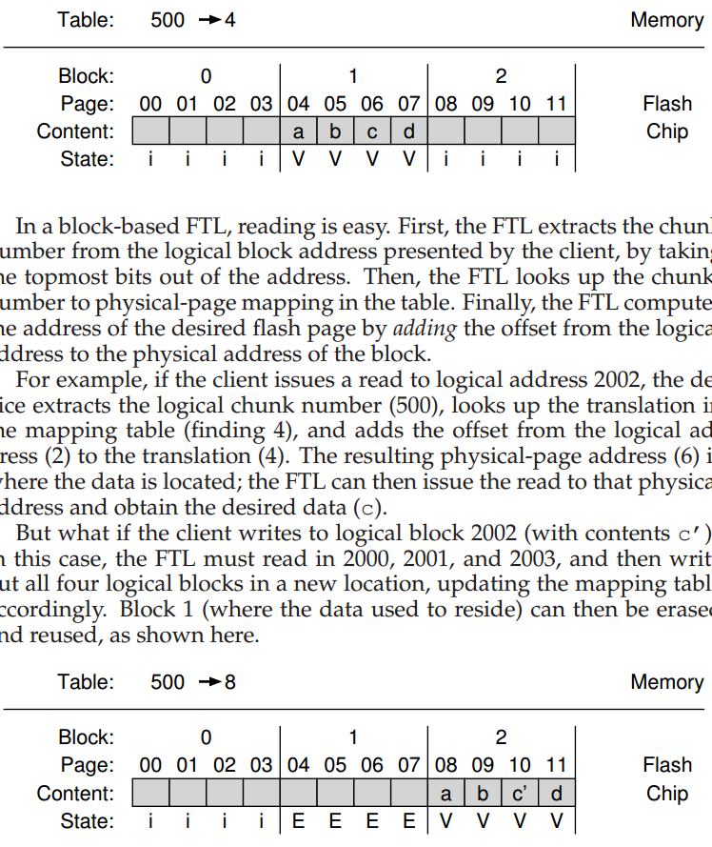
Block-Based Mapping to Reduce Mapping Table Size
Logical address: the least significant two bits as offset
Page mapping: 2000→4, 2001→5, 2002→6, 2003→7
Before
After

Slide 21
Problem with Block-Based Mapping
Small write
The FTL must read a large amount of live data from the old block and copy it into a new one
What might be a good solution?
Page-based mapping is good at …, but bad at …
Block-based mapping is bad at …, but good at …

Slide 22
Hybrid Mapping
Log blocks: a few blocks that are per-page mapped
Call the per-page mapping log table
Data blocks: blocks that are per-block mapped
Call the per-block mapping data table
How to read and write?
How to switch between per-page mapping and per-block mapping?

Slide 23
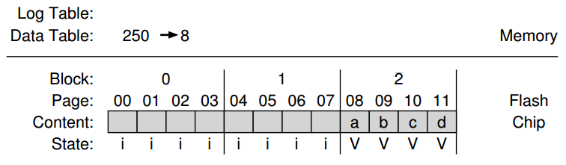
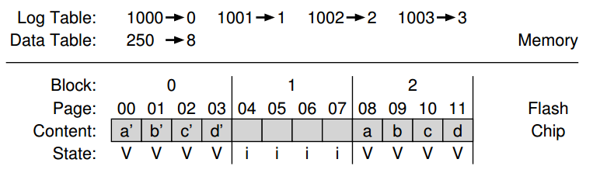
Hybrid Mapping Example
Overwrite each page

Slide 24
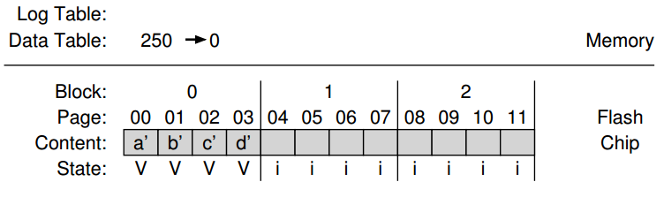
Switch Merge
Before and After

Slide 25
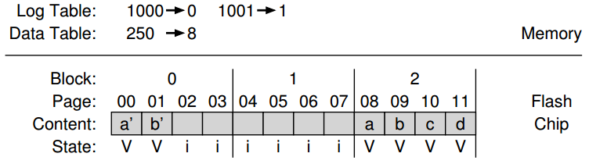
Partial Merge
Before and After

Slide 26
Full Merge
The FTL must pull together pages from many other blocks to perform cleaning
Imagine that pages 0, 4, 8, and 12 are written to log block A

Slide 27
Wear Leveling
The FTL should try its best to spread that work across all the blocks of the device evenly
The log-structuring approach does a good initial job
What if a block is filled with long-lived data that does not get over-written?
Periodically read all the live data out of such blocks and re-write it elsewhere

Slide 28
SSD Performance
Fast but expensive
An SSD costs 60 cents per GB
A typical hard drive costs 5 cents per GB

Slide 29
Data Integrity and Protection
Ensure that the data you put into your storage system is the same when the storage system returns it to you

Slide 30
Integrity
It’s not just whole disks that fail; blocks, sectors, tracks fail
How to detect? How to resolve?

Slide 31
Disk Failure Modes
Fail-stop as assumed by RAID
Fail-partial:
Latent-sector errors (LSEs): a disk sector (or group of sectors) has been damaged in some way, e.g., head crash, cosmic rays
Block corruption: silent faults caused by, e.g., buggy firmware or faulty bus

Slide 32
Findings about LSEs
Costly drives with more than one LSE are as likely to develop additional errors as cheaper drives
For most drives, annual error rate increases in year two
LSEs increase with disk size
Most disks with LSEs have less than 50
Disks with LSEs are more likely to develop additional LSEs
There exists a significant amount of spatial and temporal locality
Disk scrubbing is useful (most LSEs were found this way)

Slide 33
Findings about Corruption
Chance of corruption varies greatly across different drive models within the same drive class
Age affects are different across models
Workload and disk size have little impact on corruption
Most disks with corruption only have a few corruptions
Corruption is not independent with a disk or across disks in RAID
There exists spatial locality, and some temporal locality
There is a weak correlation with LSEs

Slide 34
Latent Sector Errors
Many ways:
head crash
cosmic rays can also flip bits
How to detect:
A storage system tries to access a block, and the disk returns an error (with ECC)
How to fix:
Use whatever redundancy mechanism it has to return the correct data (e.g. RAID parity)

Slide 35
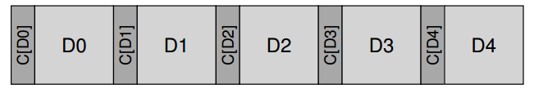
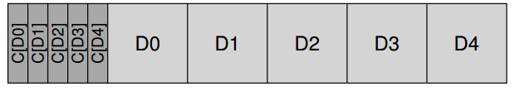
Detecting Corruption: The Checksum
Common Checksum Functions
XOR, addition
Fletcher checksum
Cyclic redundancy check (CRC)
Collision is possible

Slide 36
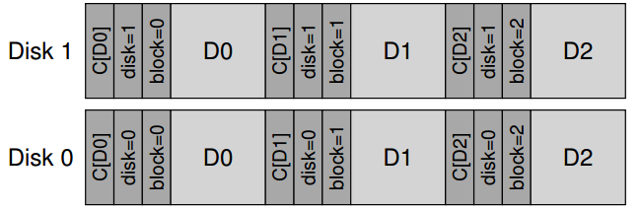
Misdirected Writes
Arises in disk and RAID controllers which write the data to disk correctly, except in the wrong location
Physical identifier (physical ID)

Slide 37
Lost Writes
Occur when the device informs the upper layer that a write has completed but in fact it never is persisted。
Do any of our strategies from above (e.g., basic checksums, or physical ID) help to detect lost writes?

Slide 38
Lost Writes
Occur when the device informs the upper layer that a write has completed but in fact it never is persisted。
Do any of our strategies from above (e.g., basic checksums, or physical ID) help to detect lost writes?
Solutions:
Perform a write verify or read-after-write
Some systems add a checksum elsewhere in the system to detect lost writes
ZFS includes a checksum in each file system inode and indirect block for every block included within a file

Slide 39
Scrubbing
When do these checksums actually get checked?
Many systems utilize disk scrubbing:
Periodically read through every block of the system
Check whether checksums are still valid
Schedule scans on a nightly or weekly basis

Slide 40
Overhead of Checksum-ing
Space
Small
Time
Noticeable
CPU overhead
I/O overhead

Slide 41
Next
Distributed Systems
RPC

