Slide 1
Lecture 24 Sun’s Network File System (NFS)

Slide 2
Local file systems:
Unix v1
vsfs
FFS
LFS
Data integrity and protection
Latent-sector errors (LSEs)
Block corruption
Misdirected writes
Lost writes

Slide 3
Communication Abstractions
Raw messages: UDP
Reliable messages: TCP
PL: RPC call
Make it close to local procedural call semantics
OS: global FS, distributed memory

Slide 4
Sun Network File System (NFS) Architecture
client
client
RPC
RPC
File
Server
client
client
RPC
Local FS
RPC

Slide 5
Primary Goal
Local FS: processes on same machine access shared files.
Network FS: processes on different machines access shared files in same way.
sharing
centralized administration
security

Slide 6
Subgoals
Fast+simple crash recovery
both clients and file server may crash
Transparent access
can’t tell it’s over the network
normal UNIX semantics
Reasonable performance
Machine and OS independence
Support working in mixed environments
Support PCs (‘low end’ machines at that time)

Slide 7
Overview
Architecture
Protocol
Server
Client
API
Write Buffering
Cache

Slide 8
NFS Architecture
client
client
RPC
RPC
File
Server
client
client
RPC
Local FS
RPC

Slide 9
Main Design Decisions
What functions to expose via RPC?
Think of NFS as more of a protocol than a particular file system.
Many companies have implemented NFS: Oracle/Sun, NetApp, EMC, IBM, etc

Slide 10
Today’s Lecture
We’re looking at NFSv2.
There is now an NFSv4 with many changes.
Why look at an old protocol?
To illustrate how the ideas were introduced
To compare and contrast NFS with AFS.

Slide 11
General Strategy: Export FS
mount
Client
Server
read
read
Local FS
NFS
Local FS

Slide 12
Overview
Architecture
API
Write Buffering
Cache

Slide 13
Strategy 1
Wrap regular UNIX system calls using RPC.
open() on client calls open() on server.
open() on server returns fd back to client.
read(fd) on client calls read(fd) on server.
read(fd) on server returns data back to client.

Slide 14
Strategy 1 Problems
What about crashes?
int fd = open(“foo”, O_RDONLY);
read(fd, buf, MAX);
read(fd, buf, MAX);
…
read(fd, buf, MAX);
Imagine server crashes and reboots during reads…

Slide 15
Potential Solutions
Run some crash recovery protocol upon reboot.
complex
Persist fds on server disk.
what if client crashes instead?

Slide 16
Strategy 2: put all info in requests
Use “stateless” protocol
server maintains no state about clients
server still keeps other state, of course
Need API change. One possibility: pread(char *path, buf, size, offset); pwrite(char *path, buf, size, offset);
Specify path and offset each time. Server need not remember. Pros/cons?
Too many path lookups.

Slide 17
Strategy 3: inode requests
inode = open(char *path);
pread(inode, buf, size, offset);
pwrite(inode, buf, size, offset);
This is pretty good! Any correctness problems?
What if file is deleted, and inode is reused?

Slide 18
Strategy 4: file handles
fh = open(char *path);
pread(fh, buf, size, offset);
pwrite(fh, buf, size, offset);
File Handle = <volume ID, inode #, generation #>

Slide 19
NFS Protocol Examples
NFSPROC_GETATTR expects: file handle; returns: attributes
NFSPROC_SETATTR expects: file handle, attributes; returns: nothing
NFSPROC_LOOKUP expects: directory file handle, name of file/directory to look up; returns: file handle
NFSPROC_READ expects: file handle, offset, count; returns: data, attributes
NFSPROC_WRITE expects: file handle, offset, count, data; returns: attributes

Slide 20
NFS Protocol Examples
NFSPROC_CREATE expects: directory file handle, name of file, attributes; returns: nothing
NFSPROC_REMOVE expects: directory file handle, name of file to be removed; returns: nothing
NFSPROC_MKDIR expects: directory file handle, name of directory, attributes; returns: file handle
NFSPROC_RMDIR expects: directory file handle, name of directory to be removed; returns: nothing
NFSPROC_READDIR expects: directory handle, count of bytes to read, cookie; returns: directory entries, cookie (to get more entries)

Slide 21
Client Logic
Build normal UNIX API on client side on top of the RPC-based API we have described.
Client open() creates a local fd object. It contains:
file handle
offset
Client tracks the state for file access
Mapping from fd to fh
Current file offset

Slide 22
File Descriptors
read(5,1024)
pread(fh, 123, 1024)
fd 5
fh=<…>
Off=123
local
RPC
local FS
local

Slide 23
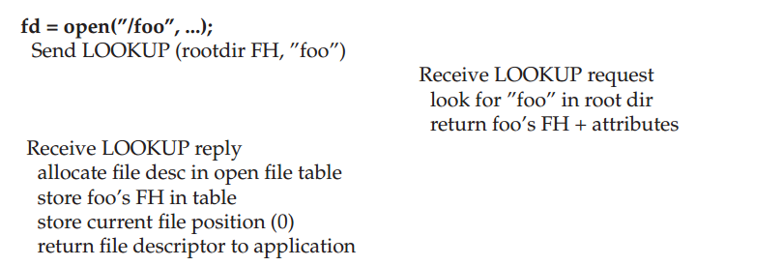
Reading A File: Client-side And File Server Actions

Slide 24
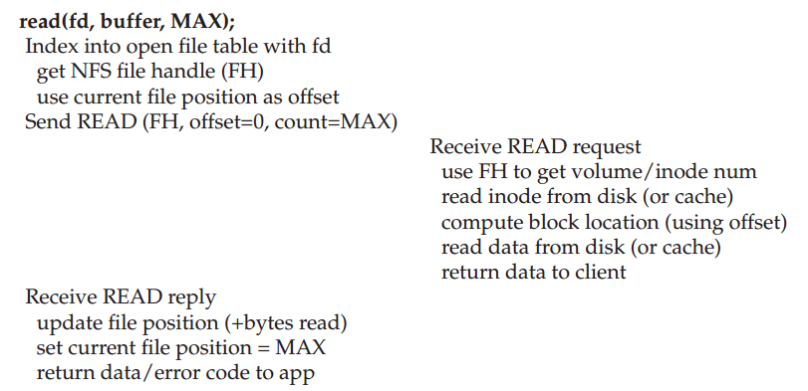
Reading A File: Client-side And File Server Actions

Slide 25
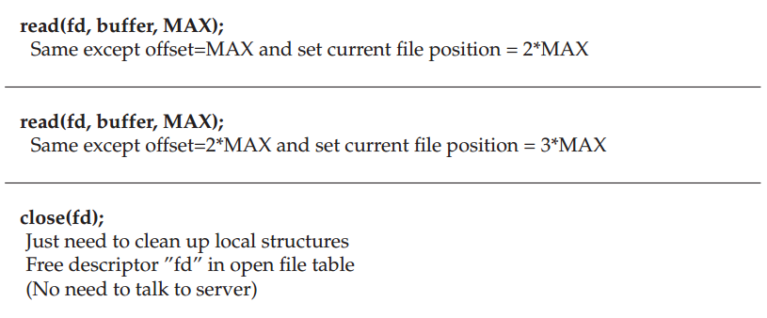
Reading A File: Client-side And File Server Actions

Slide 26
NFS Server Failure Handling
When a client does not receive a reply within a certain amount of time
Just retry

Slide 27
Append
fh = open(char *path);
pread(fh, buf, size, offset);
pwrite(fh, buf, size, offset);
append(fh, buf, size);
Would append() be a good idea?
Problem: if our client retries if no ACK or return, what happens when append is retried?

Slide 28
TCP Remembers Messages
Sender
[send message]
[timeout]
[send message]
[recv ack]
Receiver
[recv message]
[send ack]
[ignore message]
[send ack]

Slide 29
Replica Suppression is Stateful
If server crashes, it forgets what RPC’s have been executed
Solution: design API so that there is no harm is executing a call more than once.
An API call that has this is “idempotent”. If f() is idempotent, then: f() has the same effect as f(); f(); … f(); f()
pwrite is idempotent
append is NOT idempotent

Slide 30
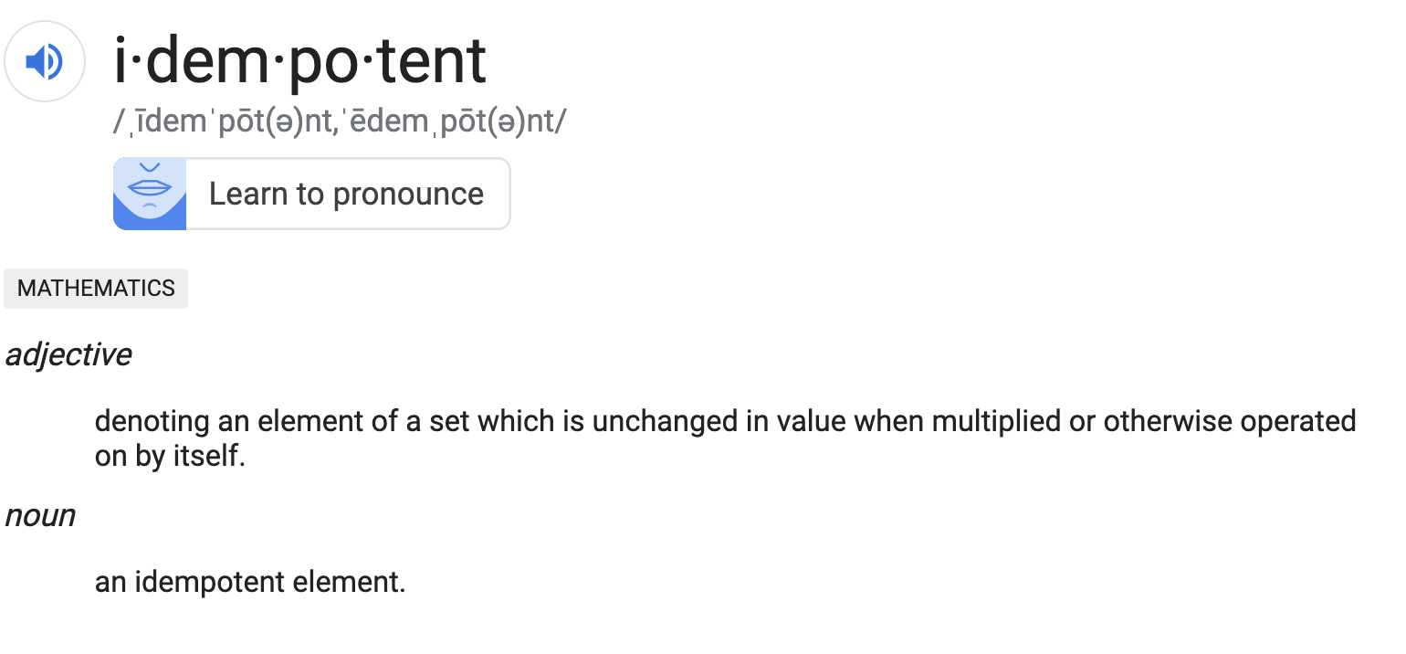

Slide 31
Idempotence
Idempotent
any sort of read
pwrite?
Not idempotent
append
What about these?
mkdir
creat

Slide 32
Subgoals
Fast+simple crash recovery
both clients and file server may crash
Transparent access
can’t tell it’s over the network
normal UNIX semantics
Reasonable performance

Slide 33
Write Buffers
Client
Server
write
NFS
write buffer
Local FS
write buffer
Local FS

Slide 34
What if server crashes?
Server Write Buffer Lost
client:
write A to 0
write B to 1 server mem
write C to 2
write X to 0 server disk
write Y to 1
write Z to 2
Can we get XBZ on the server?

Slide 35
Write Buffers on the Server Side
don’t use server write buffer
use persistent write buffer

Slide 36
Cache
We can cache data in different places, e.g.:
server memory
client disk
client memory
How to make sure all versions are in sync?

Slide 37
“Update Visibility” problem
server doesn’t have latest
Client
Server
Client
Local FS
Cache: A
NFS
Cache: A
Local FS
Cache: B
NFS
Cache: A
NFS
Cache: B
flush

Slide 38
Update Visibility Solution
A client may buffer a write.
How can server and other clients see it?
NFS solution: flush on fd close (not quite like UNIX)
Performance implication for short-lived files?

Slide 39
“Stale Cache” problem
client doesn’t have latest
Client
Server
Client
Local FS
Cache: B
NFS
Cache: A
NFS
Cache: B
NFS
Cache: B
read

Slide 40
Stale Cache Solution
A client may have a cached copy that is obsolete.
How can we get the latest?
If we weren’t trying to be stateless, server could push out update.
NFS solution: clients recheck if cache is current before using it.
Cache metadata records when data was fetched.
Before it is used, client does a GETATTR request to server: get’s last modified timestamp, compare to cache, and refetch if necessary

Slide 41
Measure then Build
NFS developers found stat accounted for 90% of server requests.
Why? Because clients frequently recheck cache.
Solution: cache results of GETATTR calls.
Why is this a terrible solution?
Also make the attribute cache entries expire after a given time (say 3 seconds).
Why is this better than putting expirations on the regular cache?

Slide 42
Misc
VFS interface is introduced
Defines the operations that can be done on a file within a file system

Slide 43
Summary
Robust APIs are often:
stateless: servers don’t remember clients states
idempotent: doing things twice never hurts
Supporting existing specs is a lot harder than building from scratch!
Caching and write buffering is harder in distributed systems, especially with crashes.

Slide 44
Andrew File System
Main goal: scale
GETATTR is problematic for NFS scalability
AFS cache consistency is simple and readily understood
AFS is not stateless
AFS requires local disk, and it does whole-file caching on the local disk

Slide 45
AFS V1
open:
The client-side code intercepts open-system-call; decide ‘is this local file or remote’;
contact a server (through the full path string in AFS-1) in case of remote files
On the server side: locate the file; send the whole file to client
Client side: take the whole file, put it in local disk, return a file-descriptor to user-level
read/write: on the client side copy
close: send the entire file and pathname to the server

Slide 46
Measure then re-build
Main problems for AFSv1
Path-traversal costs are too high
The client issues too many TestAuth protocol messages

