Slide 1
Lecture 24 The Andrew File System

Slide 2
NFS Architecture
client
client
RPC
RPC
File
Server
client
client
RPC
Local FS
RPC

Slide 3
NFS
Export local FS to network
many machines may export and mount
Fast+simple crash recovery
both clients and file server may crash
Transparent access
can’t tell it’s over the network
normal UNIX semantics
Reasonable performance

Slide 4
General Strategy: Export FS
Client
Server
read
Local FS
NFS
Local FS

Slide 5
NFS Protocol Examples
NFSPROC_GETATTR expects: file handle returns: attributes
NFSPROC_SETATTR expects: file handle, attributes returns: nothing
NFSPROC_LOOKUP expects: directory file handle, name of file/directory to look up returns: file handle
NFSPROC_READ expects: file handle, offset, count returns: data, attributes
NFSPROC_WRITE expects: file handle, offset, count, data returns: attributes

Slide 6
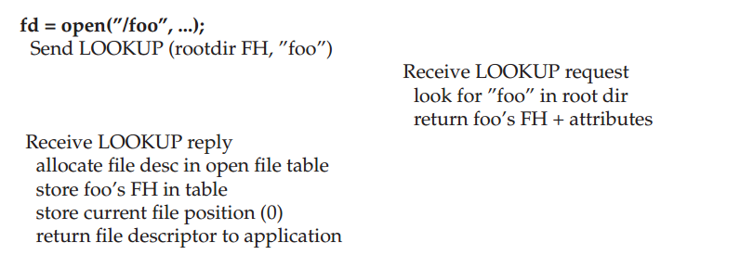
Reading A File: Client-side And File Server Actions

Slide 7
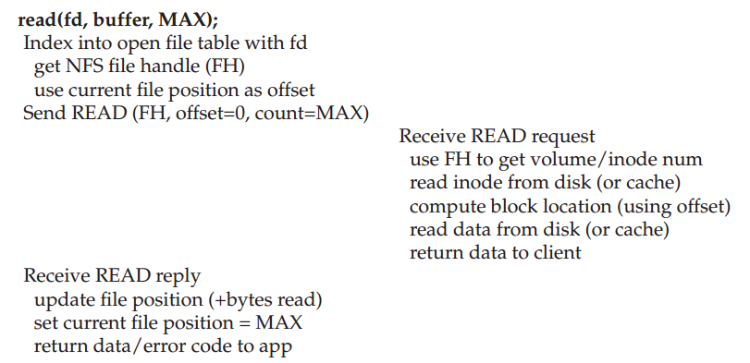
Reading A File: Client-side And File Server Actions

Slide 8
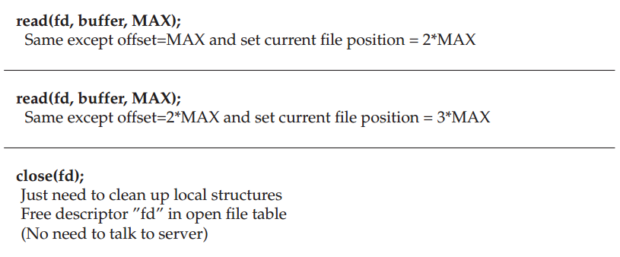
Reading A File: Client-side And File Server Actions

Slide 9
NFS Server Failure Handling
If at first you don’t succeed, and you’re stateless and idempotent, then try, try again.

Slide 10
Update Visibility Solution
Clients may buffer writes.
How(when) can server and other clients see it?
NFS solution: flush on fd close (not quite like UNIX)

Slide 11
Stale Cache Solution
A client may have a cached copy that is obsolete.
NFS solution: clients recheck if cache is current before using it.
Cache metadata records when data was fetched.
If cache has expired, client does a GETATTR request to server: get’s last modified timestamp, compare to cache, and refetch if necessary

Slide 12
Andrew File System
Main goal: scalability
Many clients per server
Large number of clients
Client performance not as important
Central store for shared data, not diskless workstations
Consistency
Understandable model you can program against
Reliability
Need to handle client & server failures
Naming
Global name space, not per-machine name space

Slide 13
AFS Design
NFS:
export local FS
Read/write by disk block
AFS:
present big file tree, store across many machines
Clear boundary between servers and clients (different from NFS)
Requires local disk! No kernel modification
Read/write by complete file

Slide 14
Prefetching
AFS paper notes: “the study by Ousterhout et al. has shown that most files in a 4.2BSD environment are read in their entirety.”
What are the implications for prefetching policy?
Aggressively prefetch whole files.

Slide 15
Whole-File Caching
Upon open, AFS fetches whole file (even if it’s huge), storing it in local memory or disk.
Upon close, whole file is flushed (if it was written).
Convenient:
AFS only needs to do work for open/close
reads/writes are local

Slide 16
AFS V1
open:
The client-side code intercepts open-system-call; decide it is local or remote’
contact a server (through the full path string in AFS-1) in case of remote files
Server side: locate the file; send the whole file to client
Client side: take the whole file, put it in local disk, return a file-descriptor to user-level
read/write: on the client side copy if the file has not been modified
close: send the entire file and pathname to the server if the file has been modified

Slide 17
Measure
Performance evaluation: Andrew Benchmark used by many others
Make dir – create directory tree: stresses metadata
Copy – copy in files – stresses file writes / creates
Scan Dir (like ls –R) – stresses metadata reads
ReadAll – find . | wc – stresses whole file reads
Make – may be CPU bound, does lots of reads + fewer writes

Slide 18
Measure then re-build
Low scalability: performance got a lot worse (on clients) when # of clients goes up
QUESTIONS: where were the bottlenecks?
Server disk? Seek time? disk BW?
Server CPU?
Network?
Client CPU/Disk?
Main problems for AFSv1
The client issues too many TestAuth protocol messages
Path-traversal costs are too high
Too many processes
Load was not balanced

Slide 19
Outline
Cache management
Name resolution
Process structure
Volume management

Slide 20
Cache Consistency
Update visibility
Stale cache

Slide 21
“Update Visibility” problem
server doesn’t have latest
Client
Server
Client
Local FS
Cache: A
NFS
Cache: A
Local FS
Cache: B
NFS
Cache: A
NFS
Cache: B
flush

Slide 22
Update Visibility Solution
Clients updates not seen on servers yet.
NFS solution is flush blocks:
on close()
when low on memory
Problems
flushes not atomic (one block at a time)
two clients flush at once: mixed data

Slide 23
Update Visibility Solution
Clients updates not seen on servers yet.
AFS solution:
flush on close
buffer whole files on local disk
Concurrent writes? Last writer (i.e., closer) wins.
Never get mixed data.

Slide 24
“Stale Cache” problem
client doesn’t have latest
Client
Server
Client
Local FS
Cache: B
NFS
Cache: A
NFS
Cache: B
NFS
Cache: B
read

Slide 25
Stale Cache Solution
Clients have old version
NFS rechecks cache entries before using them, assuming a check hasn’t been done “recently”.
“Recent” is too long:
you read old data
“Recent” is too short:
server overloaded with stats

Slide 26
Stale Cache Solution
AFS solution: tell clients when data is overwritten.
When clients cache data, ask for “callback” from server.
No longer stateless
Relaxed but well-defined consistency semantics
Get latest value on open
Changes visible on close
Read/write purely local – get local unix semantics

Slide 27
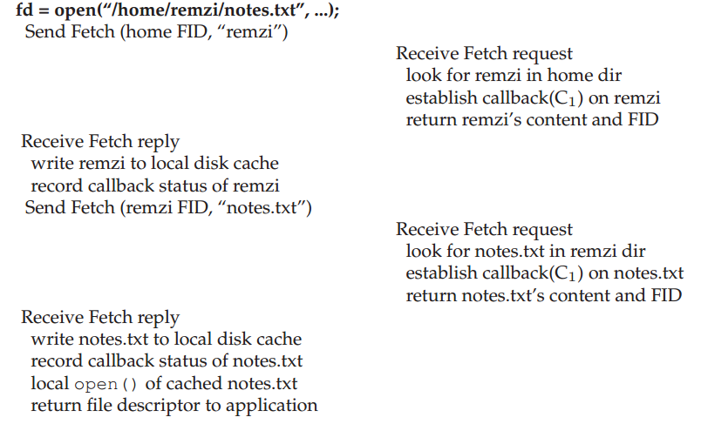
AFSv2 Reading a File

Slide 28
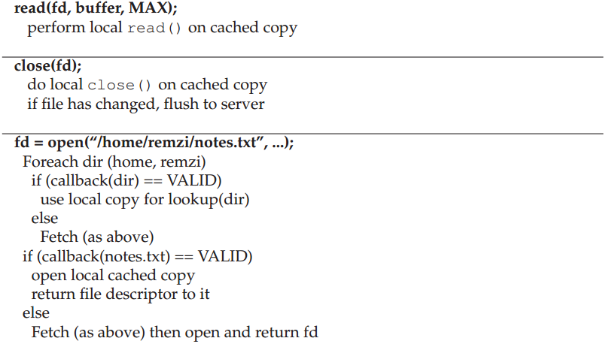
AFSv2 Reading a File

Slide 29
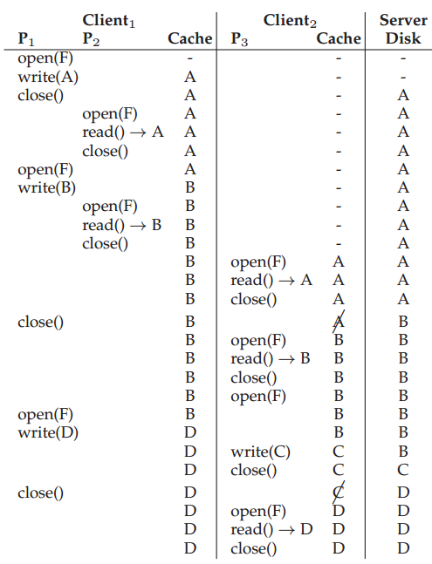

Slide 30
Callbacks
What if client crashes?
What if server runs out of memory?
What if server crashes?

Slide 31
Client Crash
What should client do after reboot?
Option 1:
evict everything from cache
Option 2:
recheck before using

Slide 32
Low Server Memory
Strategy: tell clients you are dropping their callback.
What should client do?
Mark entry for recheck.
How does server choose which entry to bump?
Sadly, it doesn’t know which is most useful.

Slide 33
Server Crashes
What if server crashes?
Option: tell everybody to recheck everything before next read.
Clients need to be aware of server crash
Option: persist callbacks.

Slide 34
Outline
Cache management
Name resolution
Process structure
Volume management

Slide 35
Why is this Inefficient?
Requests to server: fd1 = open(“/a/b/c/d/e/1.txt”) fd2 = open(“/a/b/c/d/e/2.txt”) fd3 = open(“/a/b/c/d/e/3.txt”)
Same inodes and dir entries repeatedly read.
Too much CPU, though.

Slide 36
Solution
Server returns dir entries to client.
Client caches entries, inodes.
Pro: partial traversal is the common case.
Con: first lookup requires many round trips.

Slide 37
Outline
Cache management
Name resolution
Process structure
Volume management

Slide 38
Process Structure
For each client, a different process ran on the server.
Context switching costs were high.
Solution:
use threads.

Slide 39
Outline
Cache management
Name resolution
Process structure
Volume management

Slide 40
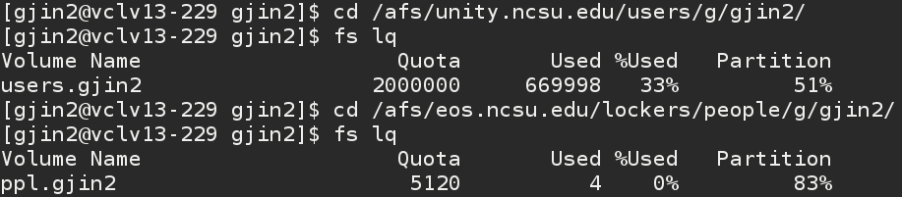
Volumes
AFS: presents big file tree, store across many machines
Break tree into “volumes.” i.e., partial sub trees.

Slide 41
Arch
A collection of servers store different volumes that together make up file tree.
Volumes may be moved by an administrator.
Client library gives seamless view of file tree by automatically finding write volumes.
Communication via RPC. Servers store data in local file systems.
Server
V1, V2
client
Server
V3, V4

Slide 42
Volume Glue
Volumes should be glued together into a seamless file tree.
Volume is a partial subtree.
Volume leaves may point to other volumes.

Slide 43
Volume Database
Given a volume name, how do we know what machine stores it?
Maintain volume database mapping volume name to locations.
Replicate to every server.
clients can ask any server they please

Slide 44
Volume Movement
What if we want to migrate a volume to another machine?
Steps:
copy data over
update volume database
AFS handles updates during movement

Slide 45
Other improvement
A global namespace
Security
Flexible user-managed access control
System management tools

Slide 46
Scale And Performance Of AFSv2
AFSv2 was measured and found to be much more scalable that the original version
Client-side performance often came quite close to local performance

Slide 47
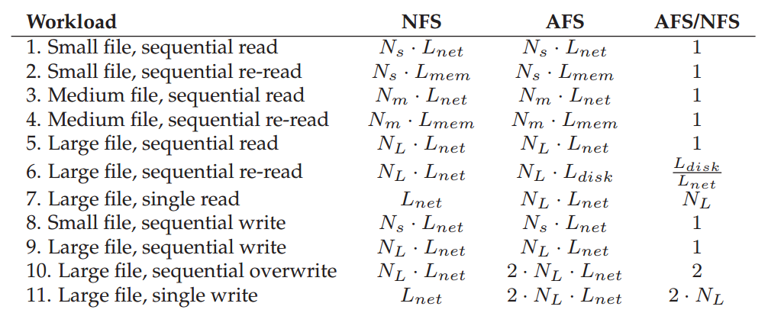
Comparison: AFS vs. NFS

Slide 48
Summary
Workload drives design: whole-file caching.
State is useful for scalability, but makes consistency hard.
Multi-step copy and forwarding make volume migration fast and consistent.

