Slide 1
Lecture 26 Virtual Machine Monitors

Slide 2
“Rather than attempting to modify existing operating systems to run on scalable shared-memory multiprocessors, we insert an additional layer of software between the hardware and the operating system.
This layer of software, called a virtual machine monitor, virtualizes all the resources of the machine, exporting a more conventional hardware interface to the operating system.
The virtual machine monitor schedules the virtual resources (processor and memory) of the virtual machines on the physical resources of the scalable multiprocessor.” – Bugnion, et al, “Disco”

Slide 3
Virtual Machines
Goal: run a guest OS over an host OS
Who has done this?
Why might it be useful?
Examples: Vmware, VirtualBox, Xen, KVM, Azure, Parallels Desktop, etc.

Slide 4
Motivation
Functionality: want Linux programs on Mac OS X
Consolidation: avoid light utilization
Cloud computing: fast scalability
Testing/Development: for example, Xinu

Slide 5
Needs
An OS expects to run on raw hardware.
Need to give illusion to OS of private ownership of H/W.
Didn’t we already virtualize H/W? How is this different?

Slide 6
Process Virtualization
We have done two things:
given illusion of private resources
provided more friendly interface
The interface (what processes see/use):
virtual memory
most instructions
most registers
syscalls, files, etc

Slide 7
Machine Virtualization
We have done two things:
given illusion of private resources
provided more friendly interface
The interface (what guest OS’s see/use):
“physical” memory
all instructions (including privileged)
all registers
“physical” devices, interrupts, disks, etc.

Slide 8
System Models
P1
P2
P3
P1
P2
P3
Linux
Linux
Hardware
VMM
Hardware

Slide 9
P1
P2
P3
P1
P2
P3
P1
P2
P3
Linux
OS X
Windows
VMM
Hardware

Slide 10
P1
P2
P3
P1
P2
P3
P1
P2
P3
Linux
OS X
Windows
Hypervisor
Hardware

Slide 11
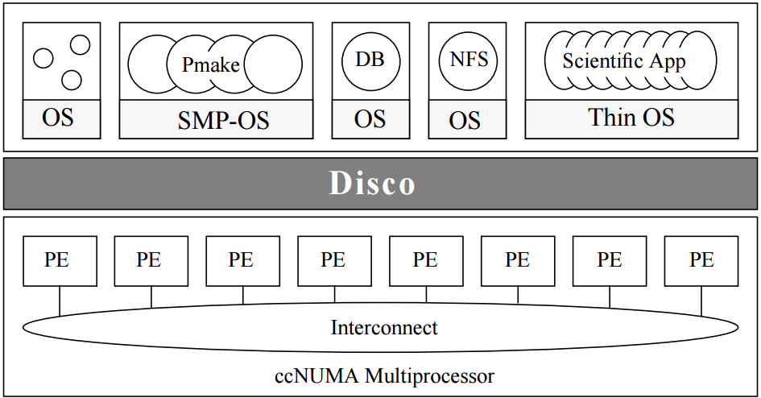
Architecture of Disco

Slide 12
Components to be Virtualized
CPU
Memory
I/O

Slide 13
Approach 1
Write a simulator.
For example:
big array for “physical” memory
run over OS instructions, call function for each
Problems?
Performance
Solution?
Limited Direct Execution!

Slide 14
Approach 2: Limited Direct Execution
Hypervisor runs in kernel mode and can do anything.
Processes and guest OS’s run in user mode when they don’t need to do anything privileged.
Machine switch
save the entire machine state (including registers, PC, and any privileged hardware state)
restore the machine state of the to-be-run VM
jump to the PC of the to-be-run VM

Slide 15
Process Privilege
Process: how do processes execute privileged ops?

Slide 16
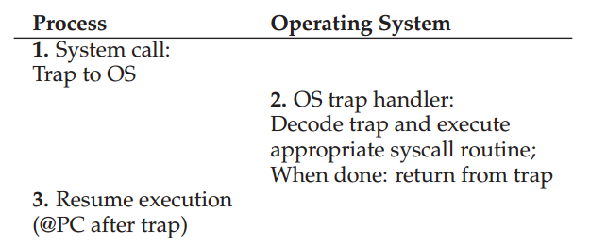
System Call Flow Without Virtualization

Slide 17
System Call Flow with Virtualization
Must also have the VMM in the middle…
Process Guest OS VMM
system call:
trap to OS
process trapped:
call os Trap handler
(at reduced privilege)
OS trap handler:
decode trap, exec syscall
return-from-trap
OS tried return-from-trap:
do real return-from-trap
resume execution:
(@PC after trap)

Slide 18
Where is the Guest OS Handler
Without virtualization
OS initialize trap table
With virtualization
When OS tries to initialize trap table, it traps into the VMM

Slide 19
Trap Table Initialization with Virtualization
Must also have the VMM in the middle…
VMM H/W Guest OS
Initialize trap table
Remember address
Of various handlers
Switch to guest
User mode
Initialize trap table
Kernel mode
Store guest trap
Table address

Slide 20
System Call Flow with Virtualization
Process Guest OS VMM
There is overhead
Disco takes advantage of supervisor mode on MIPS
system call:
trap to OS
process trapped:
call os Trap handler
(at reduced privilege)
OS trap handler:
decode trap, exec syscall
return-from-trap
OS tried return-from-trap:
do real return-from-trap
resume execution:
(@PC after trap)

Slide 21
Timer Interrupt Handlers
Guest OS Trap Handler
tick() {
maybe switch process;
return-from-trap;
}
VMM Trap Handler
tick() {
if (…) {
switch OS;
} else {
call OS tick;
}
}

Slide 22
Timer Interrupt Example
P1
P2
P3
P1
P2
P3
P1
P2
P3
Linux
OS X
Windows
VMM
Notes:
P1 on linux running
timer interrupt!
Hypervisor decides to keep running Linux
Linux tries to return-from-trap to P2, H/W intercepts and switches to Hypervisor.
Hypervisor switches to P2 for Linux.
timer interrupt!
P3
timer interrupt!
Hypervisor decides to switch to Windows.
Windows tries to return-from-trap to P2, H/W intercepts and switches to Hypervisor.

Slide 23
Another Example
P1
P2
P3
P1
P2
P3
P1
P2
P3
Linux
OS X
Windows
VMM
P1 calls lidt (P1 doesn’t have privileges for this)
Linux kills P1.
Linux tries return-from-trap to P2.

Slide 24
Components to be Virtualized
CPU
Memory
I/O

Slide 25
How to get more pages?
Process: asks politely
OS: just uses it!
VMM needs to intercept such usage. How? (assume software-managed TLB)

Slide 26
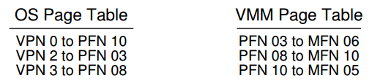
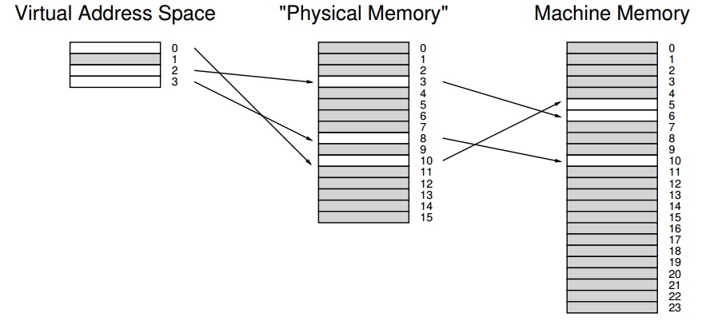

Slide 27
Strategy: store VPN => MFN mapping in TLB.
OS tries to insert VPN => PFN to TLB
VMM intercepts it, looks up in its PT, inserts VPN => MFN
Examples…
Timeline…

Slide 28
Process Guest OS VMM
Mem load
TLB miss: trap
Call OS TLB handler
(reducing privilege)
Extract VPN from VA.
Do page table lookup.
Get PFN, update TLB
Unprivileged code trying
to update TLB! Tried to
install VPN-to-PFN.
Insert VPN-to-MFN.
Jump back to OS.
Return from trap
Return from trap.
Resume execution:
(@PC of instruction)

Slide 29
A VMM-level “Software TLB”
TLB misses become more expensive on a virtualized system
Extra steps to handle TLB miss
TLB is shared
TLB is flushed on machine switch
A VMM-level “software TLB”
Records every virtual-to-physical mapping that it sees the OS try to install
Check whether it has the desired virtual-to-machine mapping

Slide 30
Information Gap
OS’s were not built to run on top of a VMM. (less true than it used to be)
H/W interface does not give VMM enough info about guest OS.
In particular, is the OS using all its resources?
How does the VMM know to give CPU to another OS?
How does the VMM know to give pages to another OS?
How does OS know page is already zeroed?
Para-virtualization

Slide 31
Summary
VM’s have overheads.
New opportunities for sharing often outweigh the disadvantages, as utilization is improved.

Slide 32
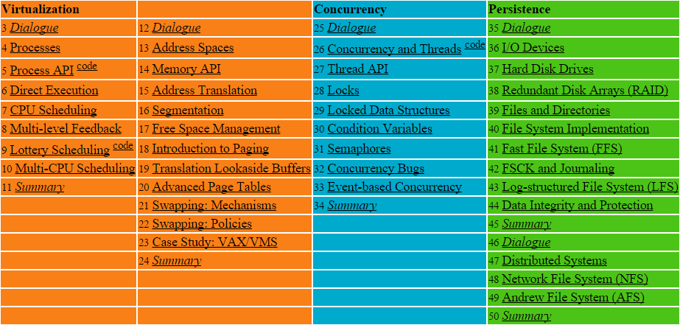

Slide 33
Next
Containers
Kubernetes – container orchestration

Slide 34
TLB and Virtual Machine Monitor TLB Flows: We have an application accessing memory running on an OS with a software managed TLB. Assume, for simplicity, a simple linear page table kept in physical memory. Here are some different hardware and software things that can happen during memory access (next slide).
At first, assume we are not running on a VMM, i.e., this is just an application running on top of the OS.
(a) Write down the flow that occurs when a user application encounters a TLB hit:
(b) Write down the flow that occurs when a user application encounters a TLB miss to a valid page that is present in memory:
(c) Write down the flow that occurs when a user application encounters a TLB miss to a valid page that is not present in memory:
Now assume that the OS is running on a virtual machine monitor.
(d) Write down the flow that occurs when a user application encounters a TLB hit:
(e) Write down the flow that occurs when a user application encounters a TLB miss to a valid page that is present in memory:
Notes:
0, 1
0, 2, 4, 5, 3, and then retry 0, 1
0, 2, 4, 7, 8, 6, 5, 3 and then retry 0, 1
0, 1
0, 9, 2, 4, 5, 11, 3, 10, retry 0, 1

Slide 35
0. the hardware checks the TLB to see if the VPN-to-PFN (or VPN-to-MFN if on a VMM) translation is present
1. the hardware issues a load to a physical address (or machine address if on a VMM)
2. the OS code at the start of the TLB miss handler runs
3. the OS code at the end of the TLB miss handler runs, which returns from trap
4. the OS code that accesses the page table to lookup a translation runs
5. the OS code that updates the TLB with a new mapping runs
6. the OS code that updates the page table with a new VPN-to-PPN mapping runs
7. a disk request is initiated
8. a disk request completes
9. the VMM code at the start of the VMM TLB miss handler runs
10. the VMM code at the end of the VMM TLB miss handler runs, which returns from trap)
11. the VMM code that updates the TLB with a new mapping runs
Notes:
0, 1
0, 2, 4, 5, 3, and then retry 0, 1
0, 2, 4, 7, 8, 6, 5, 3 and then retry 0, 1
0, 1
0, 9, 2, 4, 5, 11, 3, 10, retry 0, 1

