Slide 1
PA1 was out
Due very late September 23
(4AM September 24)

Slide 2
XINU Scheduling
Each process assigned a priority (in the pprio field)
Non-negative integer value
Initialized when process created
Can be changed
Scheduler chooses process with the highest priority
Processes with the same priority are scheduled in a round-robin fashion
Function resched makes the selection
Policy enforced as a system-wide invariant

Slide 3
The XINU Scheduling Invariant
At any time, the CPU must run the highest priority eligible process.
Among processes with equal priority, scheduling is round robin
Invariant enforced during
System call
Interrupt

Slide 4
Implementation
Process eligible if state is
ready or current
To avoid searching process table
Keep ready processes on a linked list called a ready list
Order ready list by priority
Selection in constant time
The current process does not appear on the ready list
Global integer currpid

Slide 5
int resched()
{
register struct pentry *optr; /* pointer to old process entry */
register struct pentry *nptr; /* pointer to new process entry */
/* no switch needed if current process priority higher than next*/
if ( ( (optr= &proctab[currpid])->pstate == PRCURR) &&
(lastkey(rdytail)<optr->pprio)) {
return(OK);
}
/* force context switch */
if (optr->pstate == PRCURR) {
optr->pstate = PRREADY;
insert(currpid,rdyhead,optr->pprio);
}
/* remove highest priority process at end of ready list */
nptr = &proctab[ (currpid = getlast(rdytail)) ];
nptr->pstate = PRCURR; /* mark it currently running */
#ifdef RTCLOCK
preempt = QUANTUM; /* reset preemption counter */
#endif
ctxsw((int)&optr->pesp, (int)optr->pirmask, (int)&nptr->pesp, (int)nptr->pirmask);
/* The OLD process returns here when resumed. */
return OK;
}

Slide 6
What if all processes are idle?
OS needs an extra process
Called NULL process with ID zero and priority zero
Never terminates
Cannot make a system call that takes it out of ready or current state
An infinite loop

Slide 7
Project 1 – Process Scheduling
Revisit Xinu scheduling invariant: At any time, the CPU must run the highest priority eligible process. Among processes with equal priority, scheduling is round robin
Problem with resched?

Slide 8
PA1: Process Scheduling
The process scheduling policy has a limitation, namely process starvation
You are asked to implement two different policies
Linux-like Scheduler (based loosely on the 2.2 Linux kernel)
Multi-queue Scheduler: a Real-Time queue and a Normal queue

Slide 9
XINU Code to Read
Read relevant source code in Xinu
Process queue management
h/q.h sys/queue.c sys/insert.c, …
Proc. creation/suspension/resumption/termination:
sys/create.c, sys/suspend.c sys/resume.c, sys/kill.c
Priority change
sys/chprio.c
Process scheduling
sys/resched.c
Other code
sys/initialize.c, sys/ready.c

Slide 10
Lecture 6 Memory Management

Slide 11
Virtual Memory Approaches
Time Sharing: one process uses RAM at a time
Static Relocation: statically rewrite code before run
Base: add a base to virtual address to get physical
Base+Bounds: also check physical addr is in range
Segmentation: many base+bounds pairs

Slide 12
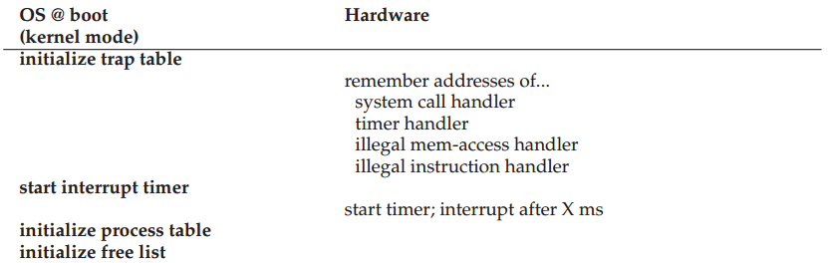

Slide 13
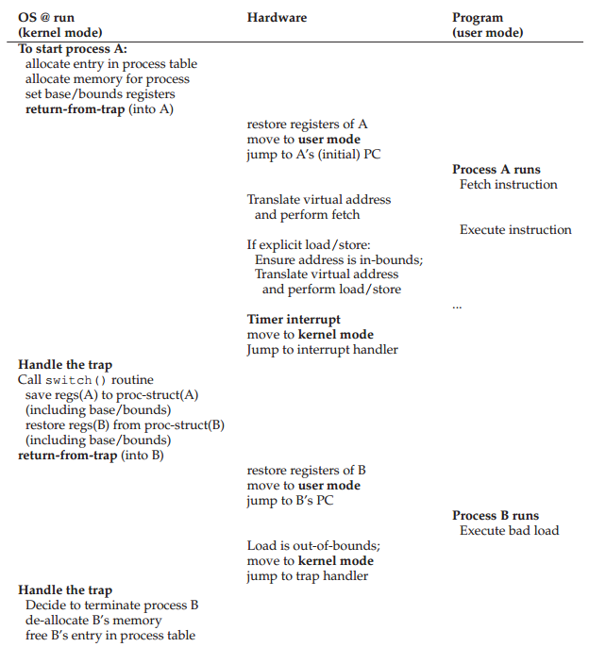

Slide 14
When is OS Involved
Set up exception handler
New process
Context switch
Exception handling
Growth of segmentation

Slide 15
When is HW Involved
Every virtual address translation
Check bounds and also protection bits
Raise exceptions
Remember OS handlers

Slide 16
Segmentation
Pros?
Supports sparse address space with no internal fragmentation
Code sharing
Fine grained protection
Cons?
External fragmentation
Waste address space

Slide 17
Fragmentation
Internal Fragmentation – allocated memory may be slightly larger than requested memory; this size difference is memory internal to a partition, but not being used

Slide 18
0KB
1KB
P1
2KB
4KB
P2
5KB
(free)
code, data
heap
(free)
stack
(free)
code, data
heap
(free)
stack

Slide 19
Fragmentation
Internal Fragmentation – allocated memory may be slightly larger than requested memory; this size difference is memory internal to a partition, but not being used
External Fragmentation – total memory space exists to satisfy a request, but it is not contiguous
Reduce external fragmentation by compaction
Shuffle memory contents to place all free memory together in one large block
Possible only if relocation is dynamic, and is done at execution time

Slide 20
Paging
Segmentation is too coarse-grained
Paging is a fine-grained alternative
Divide mem into small, fix-sized units (aka page frames)
Map each virtual page independently
Grow memory segments however we please

Slide 21
Addressing
For segmentation
High bits => segment
Low bits => offset
Segment number vs. number of high bits
Segment size vs. number of low bits
For paging
High bits => page
Low bits => offset
Page number vs. number of high bits
Page size vs. number of low bits

Slide 22
Address Examples
How many low bits do we need, for page size 16 bytes, 1KB, 1MB, 512 bytes, and 4KB?
4, 10, 20, 9, 12
How may page we can have for virtual address， with width 10, 20, 32, 16, and 32 bits correspondingly?
64, 1K, 4K, 128, 1MB

Slide 23
Virt => Phys Mapping
For segmentation, we used a formula, e.g., phys = virt_offset + base_reg
Now, we need a more general mapping mechanism.
What data structure is good?
Big array, called a page table

Slide 24
Page Mapping
P1
P2
P3
VirtMem
PhysMem
0 1 2 3 4 5 6 7 8 9 10 11
P1
P2
P3
3
0
8
Page Tables
1
4
5
7
2
9
10
6
11

Slide 25
Where are Page Tables Stored?
The size of a typical page table?
assume 32-bit address space
assume 4 KB pages
assume 4 byte entries (or this could be less)
2 ^ (32 - log(4KB)) * 4 = 4 MB
Store in memory, and CPU finds it via registers

Slide 26
offset = VirtualAddress & OFFSET_MASK
PhysAddr = (PFN << SHIFT) | offset
1 // Extract the VPN from the virtual address
2 VPN = (VirtualAddress & VPN_MASK) >> SHIFT
3
4 // Form the address of the page-table entry (PTE)
5 PTEAddr = PTBR + (VPN * sizeof(PTE))
6
7 // Fetch the PTE
8 PTE = AccessMemory(PTEAddr)
9
10 // Check if process can access the page
11 if (PTE.Valid == False)
12 RaiseException(SEGMENTATION_FAULT)
13 else if (CanAccess(PTE.ProtectBits) == False)
14 RaiseException(PROTECTION_FAULT)
15 else
16 // Access is OK: form physical address and fetch it
17 offset = VirtualAddress & OFFSET_MASK
18 PhysAddr = (PTE.PFN << PFN_SHIFT) | offset
19 Register = AccessMemory(PhysAddr)

Slide 27
Memory Accesses Again
PT, load from 0x5000
Fetch instruction at 0x2010
PT, load from 0x5004
Exec, load from 0x0100
…
0x0010 movl 0x1100, %r8d
0x0014 addl $0x3, %r8d
0x0017 movl %r8d, 0x1100
PT
2
Assume PT is at 0x5000
Assume PTE’s are 4 bytes
Assume 4KB pages
0
TOO SLOW
80
99

