Slide 1
Lecture 13 Semaphores /* & Concurrency Bugs */

Slide 2
Concurrency
Threads
Locks
Condition Variables
Fixing atomicity violations and order violations

Slide 3
Semaphores
Semaphores keep extra state, so users sometimes don’t.
Unlike CV, signal is not lost due to some race condition!
Generalized concurrency primitive: can be used as both locks and condition variables.

Slide 4
Definition (POSIX)
sem_init(sem_t *s, int initval) {
s->value = initval
}
sem_wait(sem_t *s) {
s->value -= 1
wait if s->value < 0
}
sem_post(sem_t *s) {
s->value += 1
wake one waiting thread (if there are any)
}
wait and post are atomic
value = 4: 4 waiting signals value = -3: 3 waiting threads

Slide 5
Building locks with semaphores…
typedef struct __lock_t {
sem_t m;
} lock_t;
void init(lock_t *lock) {
sem_init(&m, X);
}
void acquire(lock_t *lock) {
sem_wait(&m);
}
void release(lock_t *lock) {
sem_post(&m);
}

Slide 6
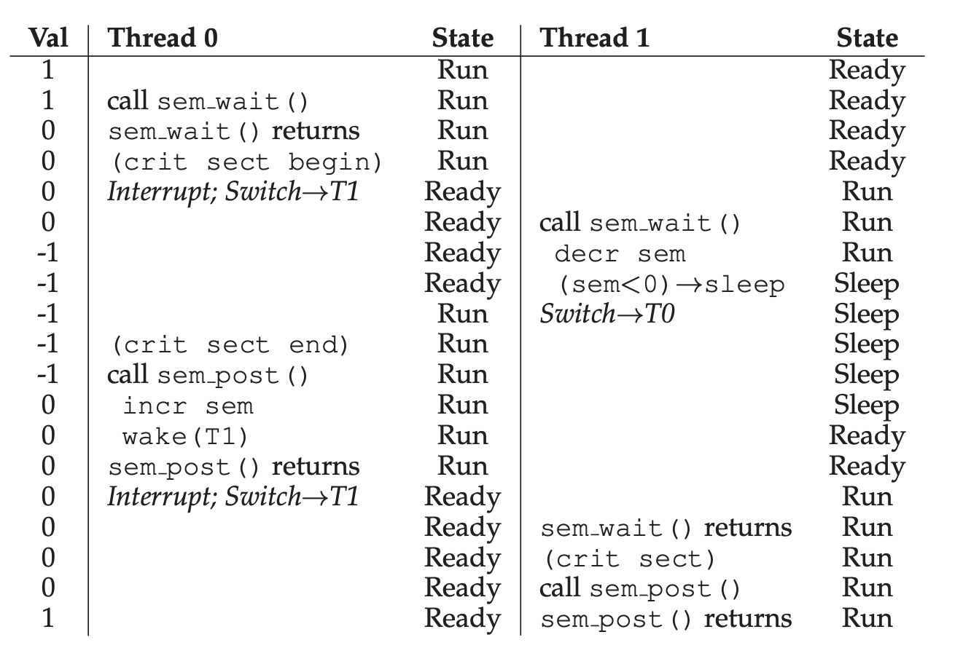

Slide 7
Join with CV
int done = 0;
mutex_t m = MUTEX_INIT; cond_t c = COND_INIT;
void *child(void *arg) {
Mutex_lock(&m);
done = 1;
cond_signal(&c);
Mutex_unlock(&m);
}
int main(int argc, char *argv[]) {
pthread_t c;
Pthread_create(c, NULL, child, NULL);
Mutex_lock(&m);
while(done == 0)
Cond_wait(&c, &m);
Mutex_unlock(&m);
return 0;
}

Slide 8
Join with Semaphore
sem_t s;
void *child(void *arg) {
sem_post(&s);
}
int main(int argc, char *argv[]) {
sem_init(&s, X);
pthread_t c;
Pthread_create(c, NULL, child, NULL);
sem_wait(&s);
}
Notes:
X = 0, so parent waits

Slide 9
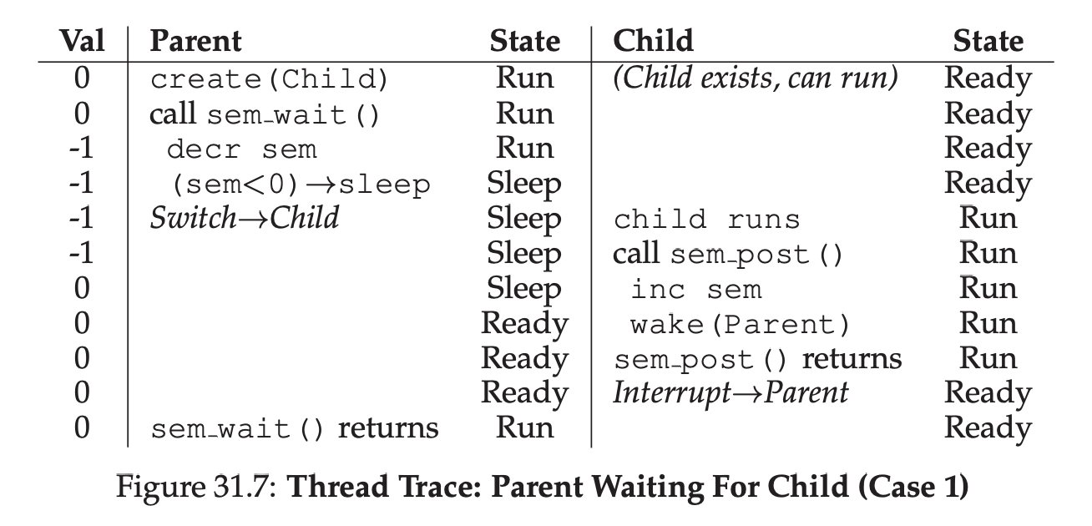

Slide 10
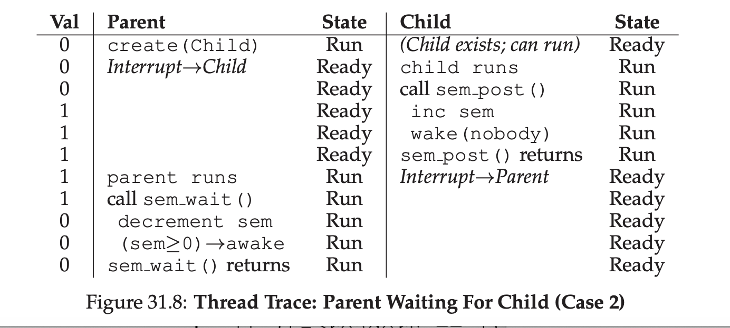

Slide 11
Producer Consumer problem
void put(int value) {
buffer[fill] = value;
fill = (fill + 1) % max;
count ++;
}
int get() {
int tmp = buffer[use];
use = (use + 1) % max;
count -;
return tmp;
}

Slide 12
Solution v4 (final)
void *producer(void *arg) {
for (int i=0; i < loops; i++){
Mutex_lock(&m); //p1
while (count == max) //p2
Cond_wait(&E, &m); //p3
put(i); //p4
Cond_signal(&F); //p5
Mutex_unlock(&m); //p6
}
}
void *consumer(void *arg) {
while (1) {
Mutex_lock(&m); //c1
while (count == 0) //c2
Cond_wait(&F, &m); //c3
int tmp = get(); //c4
Cond_signal(&E); //c5
Mutex_unlock(&m); //c6
printf("%d\n", tmp);
}
}

Slide 13
Queue get/put
void put(int value) {
buffer[fill] = value;
fill = (fill + 1) % max;
count++;
}
int get() {
int tmp = buffer[use];
use = (use + 1) % max;
count--;
return tmp;
}

Slide 14
P/C problem semaphore v1
int main(int argc, char *argv[]) {
// ...
sem_init(&empty, MAX);
sem_init(&full, 0);
// ...
}
sem_t empty, full;
void *consumer(void *arg) {
int i, tmp = 0;
while (tmp != -1) {
sem_wait(&full); // C1
tmp = get(); // C2
sem_post(&empty); // C3
printf("%d\n", tmp);
}
}
void *producer(void *arg) {
int i;
for (i = 0; i < loops; i++) {
sem_wait(&empty); // P1
put(i); // P2
sem_post(&full); // P3
}
}

Slide 15
P/C problem semaphore v2
int main(int argc, char *argv[]) {
// ...
sem_init(&empty, MAX);
sem_init(&full, 0);
sem_init(&mutex, 1);
// ...
}
sem_t empty, full, mutex;
void *consumer(void *arg) {
int i, tmp = 0;
while (tmp != -1) {
sem_wait(&mutex); // C0
sem_wait(&full); // C1
tmp = get(); // C2
sem_post(&empty); // C3
sem_post(&mutex); // C4
printf("%d\n", tmp);
}
}
void *producer(void *arg) {
int i;
for (i = 0; i < loops; i++) {
sem_wait(&mutex); // P0
sem_wait(&empty); // P1
put(i); // P2
sem_post(&full); // P3
sem_post(&mutex); // P4
}
}

Slide 16
P/C problem semaphore v3
int main(int argc, char *argv[]) {
// ...
sem_init(&empty, MAX);
sem_init(&full, 0);
sem_init(&mutex, 1);
// ...
}
sem_t empty, full, mutex;
void *consumer(void *arg) {
int i, tmp = 0;
while (tmp != -1) {
sem_wait(&full); // C1
sem_wait(&mutex); // C1.5
tmp = get(); // C2
sem_post(&mutex); // C2.5
sem_post(&empty); // C3
printf("%d\n", tmp);
}
}
void *producer(void *arg) {
int i;
for (i = 0; i < loops; i++) {
sem_wait(&empty); // P1
sem_wait(&mutex); // P1.5
put(i); // P2
sem_post(&mutex); // P2.5
sem_post(&full); // P3
}
}

Slide 17
Reader-Writer Locks
typedef struct _rwlock_t {
sem_t lock;
sem_t writelock;
int readers;
} rwlock_t;
void rwlock_init(rwlock_t *rw) {
rw->readers = 0;
sem_init(&rw->lock, 0, 1);
sem_init(&rw->writelock, 0, 1);
}
acquire_r (rwlock_t *rw) {
sem_wait(&rw->lock);
rw->readers++;
if (rw->readers == 1)
sem_wait(&rw->writelock);
sem_post(&rw->lock);
}
release_r (rwlock_t *rw) {
sem_wait(&rw->lock);
rw->readers--;
if (rw->readers == 0)
sem_post(&rw->writelock);
sem_post(&rw->lock);
}
acquire_w (rwlock_t *rw) {
sem_wait (&rw->writelock);
}
release_w (rwlock_t *rw) {
sem_post (&rw->writelock);
}

Slide 18
The Dining Philosophers
You might be asked about it on some interview.
However, its practical utility is low

Slide 19
Build semaphores with locks and CV’s
typedef struct __sem_t {
int value;
cond_t cond;
mutex_t lock;
} sem_t;
void sem_init(sem_t *s, int value) {
s->value = value;
Cond_init(&s->cond);
Lock_init(&s->lock);
}
void sem_wait(sem_t *s) {…}
void sem_post(sem_t *s) {…}
Notes:
14 void Zem_wait(Zem_t *s) {
15 Mutex_lock(&s->lock);
16 while (s->value <= 0)
17 Cond_wait(&s->cond, &s->lock);
18 s->value--;
19 Mutex_unlock(&s->lock);
20 }
21
22 void Zem_post(Zem_t *s) {
23 Mutex_lock(&s->lock);
24 s->value++;
25 Cond_signal(&s->cond);
26 Mutex_unlock(&s->lock);
27 }

Slide 20



Concurrency bugs in history

Slide 21
Concurrency Bugs are Common and Various
Application | Atomicity | Order | Deadlock | other
MySQL | 12 | 1 | 9 | 1
Apache | 7 | 6 | 4 | 0
Mozilla | 29 | 15 | 16 | 0
OpenOffice | 3 | 2 | 2 | 1

Slide 22
Atomicity: MySQL
Thread 1:
pthread_mutex_lock(&lock);
if (thd->proc_info) {
…
fputs(thd->proc_info, …);
…
}
pthread_mutex_unlock(&lock);
Thread 2:
pthread_mutex_lock(&lock);
thd->proc_info = NULL;
pthread_mutex_unlock(&lock);

Slide 23
Ordering: Mozilla
Thread 1:
void init() {
…
mThread
= PR_CreateThread(mMain, …);
pthread_mutex_lock(&mtLock);
mtInit = 1;
pthread_cond_signal(&mtCond);
pthread_mutex_unlock(&mtLock);
…
}
Thread 2:
void mMain(…) {
…
Mutex_lock(&mtLock);
while(mtInit == 0)
Cond_wait(&mtCond, &mtLock);
Mutex_unlock(&mtLock);
mState = mThread->State;
…
}
Notes:
The actual fix

Slide 24
Race
A data race occurs when 2 instructions from different threads access the same memory location, at least one of these accesses is a write and there is no synchronization that is mandating any particular order among these accesses.
A race condition is an undesirable situation that occurs when a device or system attempts to perform two or more operations at the same time, but because of the nature of the device or system, the operations must be done in the proper sequence in order to be done correctly.

Slide 25
Race: MySQL
Thread 1:
if (thd->proc_info) {
…
fputs(thd->proc_info, …);
…
}
Thread 2:
thd->proc_info = NULL;

Slide 26
Race: Mozilla
Thread 1:
void init() {
…
mThread
= PR_CreateThread(mMain, …);
…
}
Thread 2:
void mMain(…) {
…
mState = mThread->State;
…
}

Slide 27
Data Race Free DOES not mean Concurrency Bug Free

Slide 28
A Simple Deadlock Example
Thread 1 Thread 2
lock(&A); lock(&B);
lock(&B); lock(&A);

Slide 29
What’s Wrong?
set_t *set_union (set_t *s1, set_t *s2) {
set_t *rv = Malloc(sizeof(*rv));
Mutex_lock(&s1->lock);
Mutex_lock(&s2->lock);
for(int i=0; i<s1->len; i++) {
if(set_contains(s2, s1->items[i])
set_add(rv, s1->items[i]);
Mutex_unlock(&s2->lock);
Mutex_unlock(&s1->lock);
}

Slide 30
Encapsulation
Modularity can make it harder to see deadlocks.
Thread 1 Thread 2
rv = set_union(setA, setB); rv = set_union(setB, setA);

Slide 31
Deadlock Theory
Deadlocks can only happen with these four conditions:
mutual exclusion
hold-and-wait
no preemption
circular wait
Eliminate deadlock by eliminating one condition.

Slide 32
Mutual Exclusion
Def: Threads claim exclusive control of resources that they require (e.g., thread grabs a lock).

Slide 33
Wait-Free Algorithms
Strategy: eliminate lock use.
Assume we have:
int CompAndSwap(int *addr, int expected, int new)
0: fail, 1: success
void add_v1(int *val,
int amt) {
Mutex_lock(&m);
*val += amt;
Mutex_unlock(&m);
}
void add_v2(int *val,
int amt) {
do {
int old = *value;
}
while(!CompAndSwap(val,
old, old+amt);
}

Slide 34
Wait-Free Insert
void insert(int val) {
node_t *n = Malloc(sizeof(*n));
n->val = val;
lock(&m);
n->next = head;
head = n;
unlock(&m);
}
void insert(int val) {
node_t *n = Malloc(sizeof(*n));
n->val = val;
do {
n->next = head;
} while (!CompAndSwap(&head,
n->next, n));
}

Slide 35
Deadlock Theory
Deadlocks can only happen with these four conditions:
mutual exclusion
hold-and-wait
no preemption
circular wait
Eliminate deadlock by eliminating one condition.

Slide 36
Hold-and-Wait
Def: Threads hold resources allocated to them (e.g., locks they have already acquired) while waiting for additional resources (e.g., locks they wish to acquire).

Slide 37
Eliminate Hold-and-Wait
Strategy: acquire all locks atomically once (cannot acquire again until all have been released).
For this, use a meta lock, like this:
lock(&meta);
lock(&L1);
lock(&L2);
…
unlock(&meta);
disadvantages?

Slide 38
Deadlock Theory
Deadlocks can only happen with these four conditions:
mutual exclusion
hold-and-wait
no preemption
circular wait
Eliminate deadlock by eliminating one condition.

Slide 39
No preemption
Def: Resources (e.g., locks) cannot be forcibly removed from threads that are holding them

Slide 40
Support Preemption
Strategy: if we can’t get what we want, release what we have.
top:
lock(A);
if (trylock(B) == -1) {
unlock(A);
goto top;
}
…

Slide 41
Deadlock Theory
Deadlocks can only happen with these four conditions:
mutual exclusion
hold-and-wait
no preemption
circular wait
Eliminate deadlock by eliminating one condition.

Slide 42
Circular Wait
Def: There exists a circular chain of threads such that each thread holds a resource (e.g., lock) being requested by next thread in the chain.

Slide 43
Eliminating Circular Wait
Strategy:
decide which locks should be acquired before others
if A before B, never acquire A if B is already held!
document this, and write code accordingly

Slide 44
Other approaches
Deadlock avoidance vis scheduling
Detect and recover

