Slide 1
CSC 501 Lecture 3 Process & Scheduling

Slide 2
Process
Machine state
Process creation
Process APIs

Slide 3
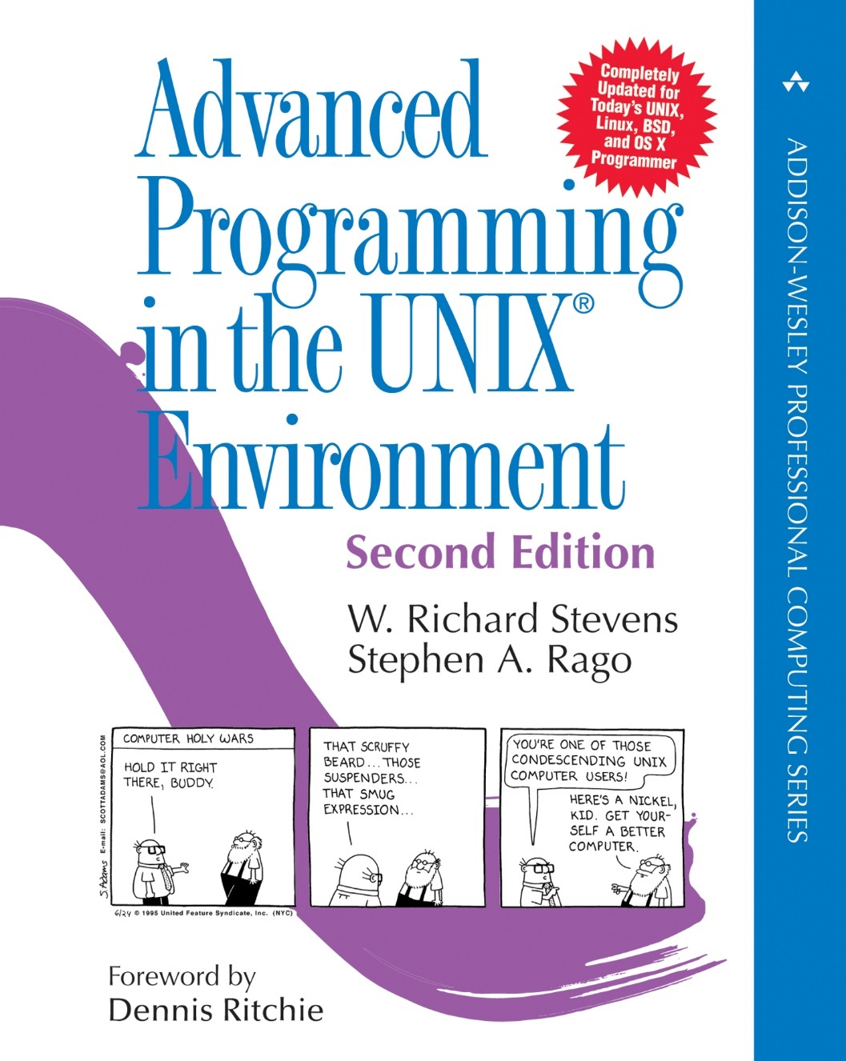
Process API
fork(), exec(), and wait()
Especially useful for implementing a shell

Slide 4
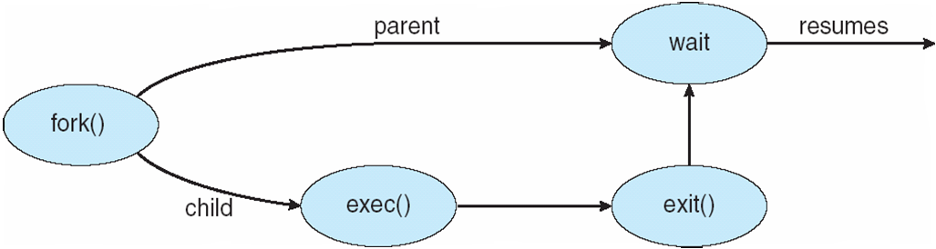
Process Creation
UNIX examples
fork system call creates new process
exec system call used after a fork to replace new process’ memory space with a new program

Slide 5
The fork() System Call
Output is not deterministic
#include <stdio.h>
#include <stdlib.h>
#include <unistd.h>
int main(int argc, char *argv[]){
printf("hello world (pid:%d)\n", (int) getpid());
int rc = fork();
if (rc < 0) { // fork failed; exit
fprintf(stderr, "fork failed\n");
exit(1);
} else if (rc == 0) { // child (new process)
printf("hello, I am child (pid:%d)\n", (int) getpid());
} else { // parent goes down this path (main)
printf("hello, I am parent of %d (pid:%d)\n",
rc, (int) getpid());
}
return 0;
}

Slide 6
The wait() System Call
Output is now deterministic
#include <stdio.h>
#include <stdlib.h>
#include <unistd.h>
#include <sys/wait.h>
int main(int argc, char *argv[]){
printf("hello world (pid:%d)\n", (int) getpid());
int rc = fork();
if (rc < 0) { // fork failed; exit
fprintf(stderr, "fork failed\n");
exit(1);
} else if (rc == 0) { // child (new process)
printf("hello, I am child (pid:%d)\n", (int) getpid());
} else { // parent goes down this path (main)
int wc = wait(NULL);
printf("hello, I am parent of %d (wc:%d) (pid:%d)\n",
rc, wc, (int) getpid());
}
return 0;
}

Slide 7
The exec() System Call

Slide 8
#include <stdio.h>
#include <stdlib.h>
#include <unistd.h>
#include <string.h>
#include <sys/wait.h>
int main(int argc, char *argv[]){
printf("hello world (pid:%d)\n", (int) getpid());
int rc = fork();
if (rc < 0) { // fork failed; exit
fprintf(stderr, "fork failed\n");
exit(1);
} else if (rc == 0) { // child (new process)
printf("hello, I am child (pid:%d)\n", (int) getpid());
char *myargs[3];
myargs[0] = strdup("wc"); // program: "wc" (word count)
myargs[1] = strdup("p3.c"); // argument: file to count
myargs[2] = NULL; // marks end of array
execvp(myargs[0], myargs); // runs word count
printf("this shouldn’t print out");
} else { // parent goes down this path (main)
int wc = wait(NULL);
printf("hello, I am parent of %d (wc:%d) (pid:%d)\n",
rc, wc, (int) getpid());
}
return 0;
}

Slide 9
All Of The Above With Redirection

Slide 10
#include <stdio.h>
#include <stdlib.h>
#include <unistd.h>
#include <string.h>
#include <fcntl.h>
#include <sys/wait.h>
Int main(int argc, char *argv[]){
int rc = fork();
if (rc < 0) { // fork failed; exit
fprintf(stderr, "fork failed\n");
exit(1);
} else if (rc == 0) { // child: redirect stdout to a file
close(STDOUT_FILENO);
open("./p4.output", O_CREAT|O_WRONLY|O_TRUNC, S_IRWXU);
// now exec "wc"...
char *myargs[3];
myargs[0] = strdup("wc"); // program: "wc" (word count)
myargs[1] = strdup("p4.c"); // argument: file to count
myargs[2] = NULL; // marks end of array
execvp(myargs[0], myargs); // runs word count
} else { // parent goes down this path (main)
int wc = wait(NULL);
}
return 0;
}

Slide 11
Process
Machine state
Process creation
Process APIs
Process state
Data structure:
process list and Process Control Block
Restricted operations and limited direct execution

Slide 12
Kernel stack per-process/thread or per-os?
Virtual address space is split for user and kernel
The kernel space can be mapped to the same physical memory range (per-os) or different ranges (per-process/thread)
Our XINU project is per-os
vx6 and real-world OSes are likely per-process/thread
See some discussion on https://forum.osdev.org/viewtopic.php?f=15&t=31127

Slide 13
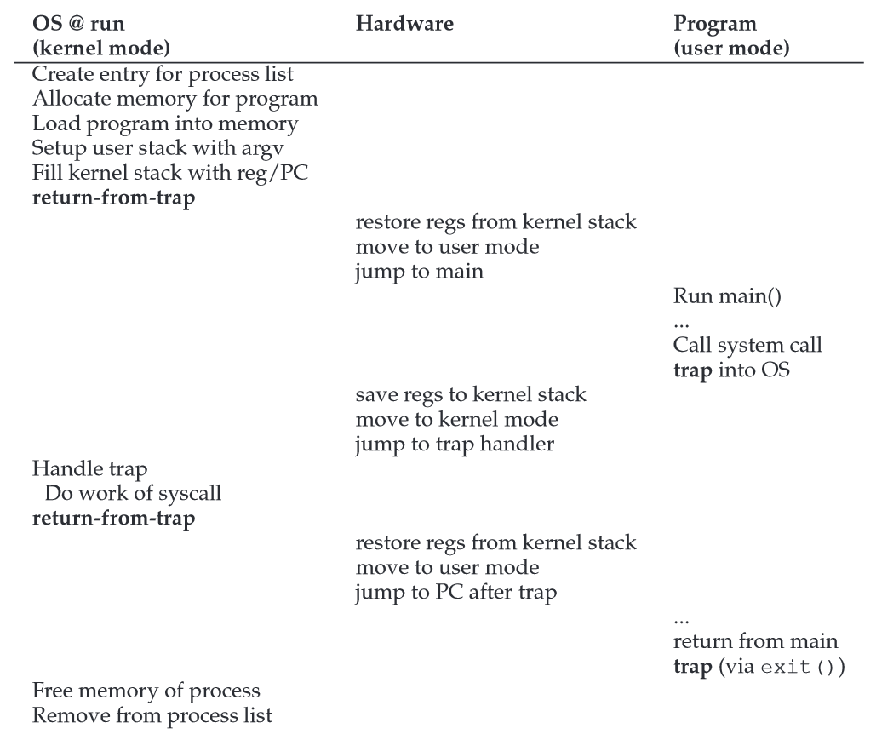

Slide 14
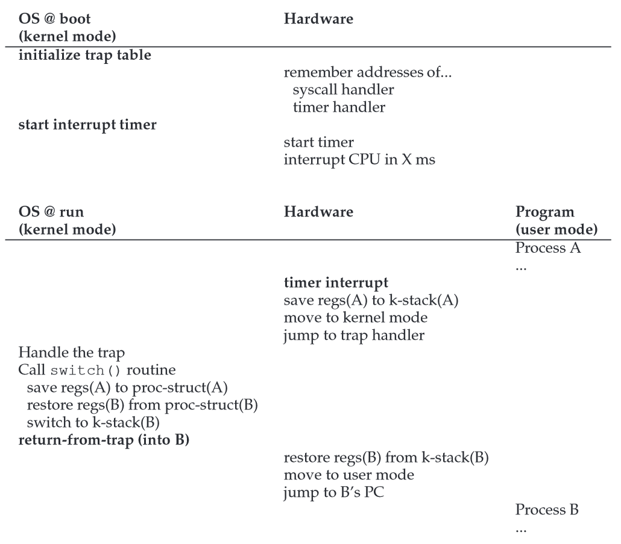

Slide 15
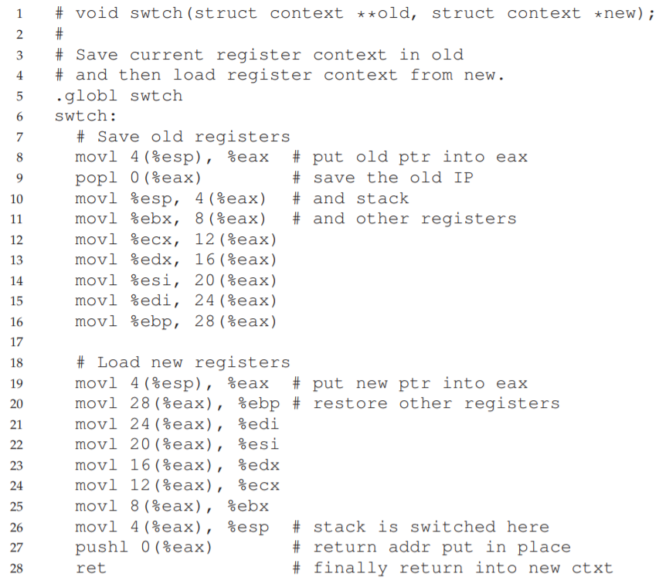
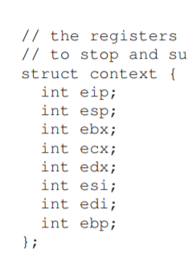
swtch

Slide 16
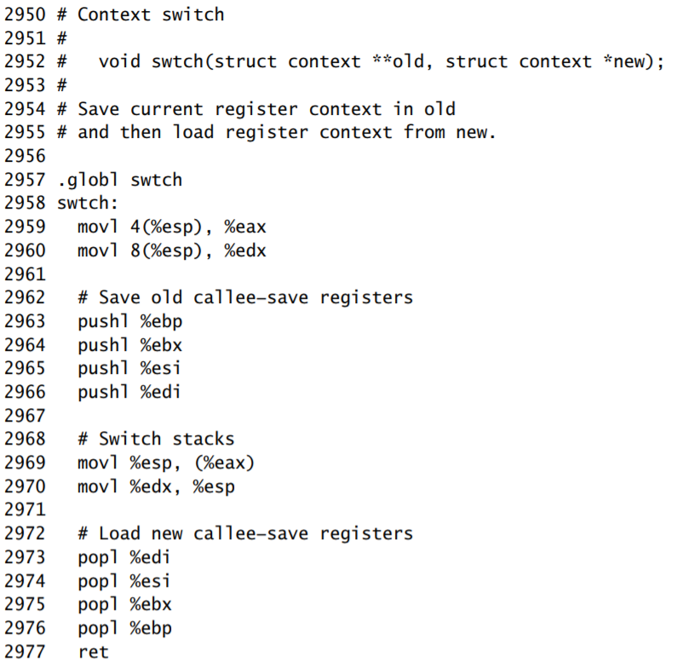
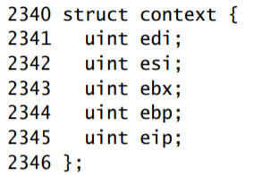
swtch 2

Slide 17
The problem:
https://github.com/mit-pdos/xv6-public/blob/c95bde8163eca7a19c95f3b05156e0ad33312589/swtch.S
The first line in Figure 6.4 is buggy

Slide 18
The “limited” part
Restricted Operations
System calls, which look like procedure calls and they are procedure calls
Underlying system calls, there are traps and return-from-traps
Someone has written the assembly for us
How to take over control
Timer interrupt
Context switch

Slide 19
PA0

Slide 20
PA0. 0-1
0. Step 2, wget -U firefox https://people.engr.ncsu.edu/gjin2/Classes/501/Fall2018/assignments/PA0/csc501-lab0.tgz
Step 4, typing "Ctrl-a" then "c"
.section .data .section .text .globl zfunction zfunction: pushl %ebp movl %esp, %ebp …. leave ret Read http://en.wikibooks.org/wiki/X86_Assembly/GAS_Syntax In C, we count from 0

Slide 21
PA0. 2,3, and 5
Try “man etext” and see what you can get. If you do not see anything on one machine, try another. Use “kprintf” for output
You can use in-line assembly Use ebp, esp
syscallsummary_start(): should clear all numbers syscallsummary_stop(): should keep all numbers

Slide 22
Others
https://vcl.ncsu.edu/get-help/documentation/where-to-save-my-files/
Local QUMU setup will be available for later projects.

Slide 23
Next: process scheduling
CPU scheduling
Multi-level feedback
Lottery scheduling

Slide 24
How to develop scheduling policy
What are the key assumptions?
What metrics are important?
What basic approaches have been used in the earliest of computer systems?

Slide 25
Workload Assumptions
1. Each job runs for the same amount of time.
2. All jobs arrive at the same time.
3. Once started, each job runs to completion.
4. All jobs only use the CPU (i.e., they perform no I/O).
5. The run-time of each job is known.

Slide 26
Scheduling Metrics
Performance: turnaround time
T_{turnaround} = T_{completion} − T_{arrival}
As T_{arrival} is now 0, T_{turnaround} = T_{completion}

Slide 27
First In, First Out
Work well under our assumption
Relax “Each job runs for the same amount of time”
Convoy effect
0
20
40
60
80
100
120
0
20
40
60
80
100
120
Notes:
20
110
Grocery, be nice

Slide 28
Shortest Job First
SJF would be optimal
Relax “All jobs arrive at the same time.”
0
20
40
60
80
100
120
B/C
arrive
A
B
C
0
20
40
60
80
100
120
Notes:
50
103.33

Slide 29
Shortest Time-to-Completion First
STCF is preemptive, aka PSJF
“Once started, each job runs to completion” relaxed
B/C
arrive
A
B
C
A
0
20
40
60
80
100
120
Notes:
50

Slide 30
Scheduling Metrics
Performance: turnaround time
T_{turnaround} = T_{completion} − T_{arrival}
As T_{arrival} is now 0, T_{turnaround} = T_{completion}
Performance: response time
T_{response} = T_{firstrun} − T_{arrival}

Slide 31
Turnaround time or response time
FIFO, SJF, or STCF
Round robin
0
20
40
60
80
100
120
0
20
40
60
80
100
120
Notes:
R 40
8

Slide 32
Conflicting criteria
Minimizing response time
requires more context switches for many processes
incur more scheduling overhead
decrease system throughput
Increase turnaround time
Scheduling algorithm depends on nature of system
Batch vs. interactive
Designing a generic AND efficient scheduler is difficult

Slide 33
Incorporating I/O
Poor use of resources
Overlap allows better use of resources
CPU
Disk
A
A
A
A
B
A
A
A
0
20
40
60
80
100
120
CPU
Disk
A
B
A
B
A
B
A
B
A
A
A
0
20
40
60
80
100
120

Slide 34
Next
Work on PA0
MLFQ
Lottery scheduling
Start memory virtualization

