Slide 1
Lecture 10 Virtual Memory Finale Concurrency Intro

Slide 2
Virtual Memory Approaches
Time Sharing, Static Relocation, Base, Base+Bounds
Segmentation
Paging
Too slow – TLB
Too big – smaller, multi-level, tables
Swapping

Slide 3
The Memory Hierarchy
Secondary Storage
Main Memory
Cache
Registers
Notes:
why do we want to support a single large address space for a process
Ease one program
Ease multi program

Slide 4
The Page Fault
Happens when the present bit is not set
OS handles the page fault
Regardless of hardware-managed or OS-managed TLB
Page faults to disk are slow, so no need to use hardware
Page faults are complicated to handler, so easier for OS
Where is the page on disk?
Store the disk address in the PTE

Slide 5
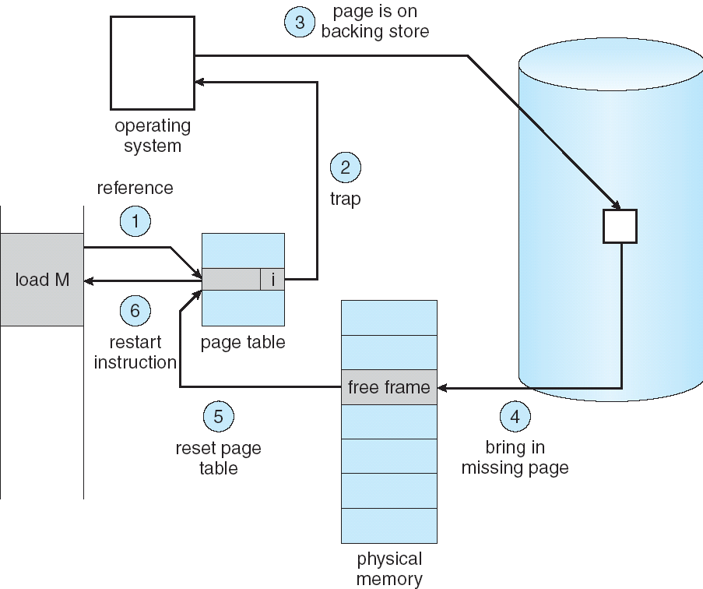

p
Notes:
Tlb?

Slide 6
Page-Fault Handler (OS)
PFN = FindFreePage()
if (PFN == -1)
PFN = EvictPage()
DiskRead(PTE.DiskAddr, PFN)
PTE.present = 1
PTE.PFN = PFN
retry instruction
<- policy
<- blocking

Slide 7
When Replacements Really Occur
High watermark (HW) and low watermark (LW)
A background thread (swap daemon/page daemon)
Frees pages when there are fewer than LW
Clusters or groups a number of pages
The page fault handler leverages this

Slide 8
Average Memory Access Time (AMAT)
Hit% = portion of accesses that go straight to RAM
Miss% = portion of accesses that go to disk first
Tm = time for memory access
Td = time for disk access
AMAT = (Hit% * Tm) + (Miss% * Td)
Mem-access time is 100 nanoseconds, disk-access time is 10 milliseconds, what is AMAT when hit rate is (a) 50% (b) 98% (c) 99% (d) 100%

Slide 9
The Optimal Replacement Policy
Replace the page that will be accessed furthest in the future
Given 0, 1, 2, 0, 1, 3, 0, 3, 1, 2, 1, hit rate?
Assume cache for three pages
Three C’s: types of cache misses
compulsory miss
capacity miss
conflict miss

Slide 10
FIFO
Given 0, 1, 2, 0, 1, 3, 0, 3, 1, 2, 1, hit rate?
Assume cache for three pages
Belady’s Anomaly
1, 2, 3, 4, 1, 2, 5, 1, 2, 3, 4, 5, hit rate if 3-page cache
1, 2, 3, 4, 1, 2, 5, 1, 2, 3, 4, 5, hit rate if 4-page cache
Random
Notes:
Good bad?

Slide 11
FIFO: Belady’s Anomaly Trace: 1, 2, 3, 4, 1, 2, 5, 1, 2, 3, 4, 5
Page | Three-page cache | Four-page cache
1 | 1 (miss) | 1 (miss)
2
3
4
1
2
5
1
2
3
4
5
Hit rate
Notes:
Good bad?

Slide 12
FIFO: Belady’s Anomaly Trace: 1, 2, 3, 4, 1, 2, 5, 1, 2, 3, 4, 5
Page | Three-page cache | Four-page cache
1 | 1 (miss) | 1 (miss)
2 | 1,2 (miss) | 1,2 (miss)
3 | 1,2,3 (miss) | 1,2,3 (miss)
4 | 4,2,3 (miss) | 1,2,3,4 (miss)
1
2
5
1
2
3
4
5
Hit rate
Notes:
Good bad?

Slide 13
FIFO: Belady’s Anomaly Trace: 1, 2, 3, 4, 1, 2, 5, 1, 2, 3, 4, 5
Page | Three-page cache | Four-page cache
1 | 1 (miss) | 1 (miss)
2 | 1,2 (miss) | 1,2 (miss)
3 | 1,2,3 (miss) | 1,2,3 (miss)
4 | 4,2,3 (miss) | 1,2,3,4 (miss)
1 | 4,1,3 (miss) | 1,2,3,4 (hit)
2
5
1
2
3
4
5
Hit rate
Notes:
Good bad?

Slide 14
FIFO: Belady’s Anomaly Trace: 1, 2, 3, 4, 1, 2, 5, 1, 2, 3, 4, 5
Page | Three-page cache | Four-page cache
1 | 1 (miss) | 1 (miss)
2 | 1,2 (miss) | 1,2 (miss)
3 | 1,2,3 (miss) | 1,2,3 (miss)
4 | 4,2,3 (miss) | 1,2,3,4 (miss)
1 | 4,1,3 (miss) | 1,2,3,4 (hit)
2 | 4,1,2 (miss) | 1,2,3,4 (hit)
Hit rate
Notes:
Good bad?

Slide 15
FIFO: Belady’s Anomaly Trace: 1, 2, 3, 4, 1, 2, 5, 1, 2, 3, 4, 5
Page | Three-page cache | Four-page cache
1 | 1 (miss) | 1 (miss)
2 | 1,2 (miss) | 1,2 (miss)
3 | 1,2,3 (miss) | 1,2,3 (miss)
4 | 4,2,3 (miss) | 1,2,3,4 (miss)
1 | 4,1,3 (miss) | 1,2,3,4 (hit)
2 | 4,1,2 (miss) | 1,2,3,4 (hit)
5 | 5,1,2 (miss) | 5,2,3,4 (miss)
1 | 5,1,2 (hit) | 5,1,3,4 (miss)
2 | 5,1,2 (hit) | 5,1,2,4 (miss)
3 | 5,3,2 (miss) | 5,1,2,3 (miss)
4 | 5,3,4 (miss) | 4,1,2,3 (miss)
5 | 5,3,4 (hit) | 4,5,2,3 (miss)
Hit rate
Notes:
Good bad?

Slide 16
FIFO: Belady’s Anomaly Trace: 1, 2, 3, 4, 1, 2, 5, 1, 2, 3, 4, 5
Page | Three-page cache | Four-page cache
1 | 1 (miss) | 1 (miss)
2 | 1,2 (miss) | 1,2 (miss)
3 | 1,2,3 (miss) | 1,2,3 (miss)
4 | 4,2,3 (miss) | 1,2,3,4 (miss)
1 | 4,1,3 (miss) | 1,2,3,4 (hit)
2 | 4,1,2 (miss) | 1,2,3,4 (hit)
5 | 5,1,2 (miss) | 5,2,3,4 (miss)
1 | 5,1,2 (hit) | 5,1,3,4 (miss)
2 | 5,1,2 (hit) | 5,1,2,4 (miss)
3 | 5,3,2 (miss) | 5,1,2,3 (miss)
4 | 5,3,4 (miss) | 4,1,2,3 (miss)
5 | 5,3,4 (hit) | 4,5,2,3 (miss)
Hit rate | .75 (9/12) | .67 (8/12)
Notes:
Good bad?

Slide 17
Let’s Consider History
Principle of locality: spatial and temporal
LRU evicts least-recently used
LFU evicts least-frequently used
Given 0, 1, 2, 0, 1, 3, 0, 3, 1, 2, 1, LRU hit rate?
Assume cache for three pages
MRU, MFU
Notes:
More workload example in the book

Slide 18
Implementing Historical Algorithms
Need to track every page access
Accurate implementation is expensive
Approximating LRU
Adding reference bit: set upon access, cleared by OS
Clock algorithm
Notes:
More workload example in the book

Slide 19
Dirty bit
Assume page is both in RAM and on disk
Do we have to write to disk for eviction?
not if page is clean
track with dirty bit

Slide 20
Other VM Policies
Demand paging
Don’t load pages into memory until they are first used
Less I/O needed, less memory needed
Faster response, more users
Demand zeroing
Zero one page only if it is accessed
Copy-on-write (COW)
For copying pages that are rarely changed
On process creation
Prefetching
Clustering/grouping

Slide 21
Thrashing
A machine is thrashing when there is not enough RAM, and we constantly swap in/out pages
Solutions?
admission control
buy more memory
Linux out-of-memory killer!

Slide 22
Working Set
Locality of Reference – a process references only a small fraction of its pages during any particular phase of its execution.
The set of pages that a process is currently using is called the working set.
Locality model
Process migrates from one locality to another
Localities may overlap

Slide 23
Working-Set Model
∆: working-set window, a fixed number of page references. E.g. 10,000 instructions
WSi (working set of Process Pi) = number of pages referenced in the most recent ∆
if ∆ too small will not encompass entire locality
if ∆ too large will encompass several localities
if ∆ = ∞ will encompass entire program
D = ∑ WSi : total demand frames
if D > m => Thrashing
Policy if D > m, then suspend one of the processes

Slide 24
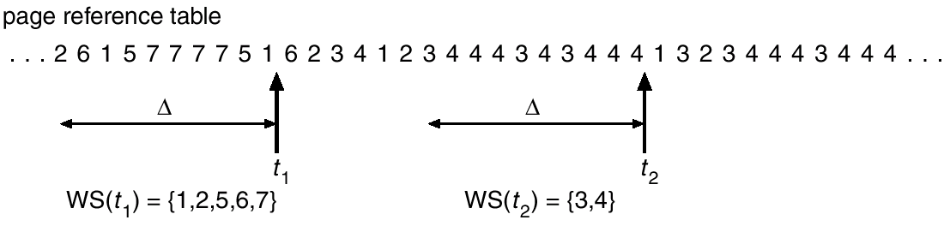
Working-Set Algorithm
The working set algorithm is based on determining a working set and evicting any page that is not in the current working set upon a page fault.

Slide 25
Prepaging
So, what happens in a multiprogramming environment as processes are switched in and out of memory?
Do we have to take a lot of page faults when the process is first started?
It would be nice to have a particular processes working set loaded into memory before it even begins execution. This is called prepaging.

Slide 26
Discuss
Can Belady’s anomaly happen with LRU?
Stack property: smaller cache always subset of bigger
The set of pages in memory when we have f frames is always a subset of The set of pages in memory when we have f+1 frames
Said a different way, having more frames will let the algorithm keep additional pages in memory, but, it will never choose to throw out a page that would have remained in memory with fewer frames
Does optimal have stack property?

Slide 27
Review through VAX/VMS
The VAX-11 architecture comes from DEC 1970’s
The OS is known as VAX/VMS (or VMS)
One primary architect later led Windows NT
VAX-11 has different implementations

Slide 28
Address Space
32-bit virtual address space, 512-byte pages
0-2^31: process space; remaining: system space
23-bit VPN, upper two for segment
User page table in kernel virtual memory
Page 0 is invalid
Kernel virtual address space is part of each user address space, and kernel appears as library
Kernel space is protected

Slide 29
Page Replacement
PTE: a valid bit, a protection field (4 bits), a modify (or dirty) bit, a field reserved for OS use (5 bits), and finally PFN, but no reference bit!
Segmented FIFO
Each process has a limit on page numbers
Second-chance FIFO with a global clean-page free list and dirty-page list
Page Clustering
Groups batches of pages from the global dirty list

Slide 30
Other Neat VM Tricks
Demand zeroing
Zero one page only if it is accessed
Copy-on-write (COW)
Copy one page only if it is written
For copying pages that are rarely changed
On process creation
Not everything discussed is implemented in VMS
Everything discussed could have alternatives

Slide 31
CPU Trends
The future:
same speed
more cores
Faster programs => concurrent execution
Write applications that fully utilize many CPUs …
Notes:
Thus far, we have seen the development of the basic abstractions that the OS performs. We have seen how to take a single physical CPU and turn it into multiple virtual CPUs, thus enabling the illusion of multiple programs running at the same time. We have also seen how to create the illusion of a large, private virtual memory for each process; this abstraction of the address space enables each program to behave as if it has its own memory when indeed the OS is secretly multiplexing address spaces across physical memory (and sometimes, disk).

Slide 32
Strategy 1
Build applications from many communicating processes
like Chrome (process per tab)
communicate via pipe() or similar
Pros/cons?
don’t need new abstractions
cumbersome programming
copying overheads
expensive context switching

Slide 33
Strategy 2
New abstraction: the thread.
Threads are just like processes, but they share the address space
Same page table
Same code segment, but different IP
Same heap
Thread control block
Different stacks, also used for thread-local storage
Different registers

Slide 34
Threads vs. Processes
Advantages of multi-threading over multi-processes
Far less time to create/terminate thread than process
Context switch is quicker between threads of the same process
Communication between threads of the same process is more efficient
Through shared memory

Slide 35
Shared and Not-Shared
All threads of a process share resources
Memory address space: global data, code, heap …
Open files, network sockets, other I/O resources
User-id
IPC facilities
Private state of each thread:
Execution state: running, ready, blocked, etc..
Execution context: Program Counter, Stack Pointer, other user-level registers
Per-thread stack

Slide 36
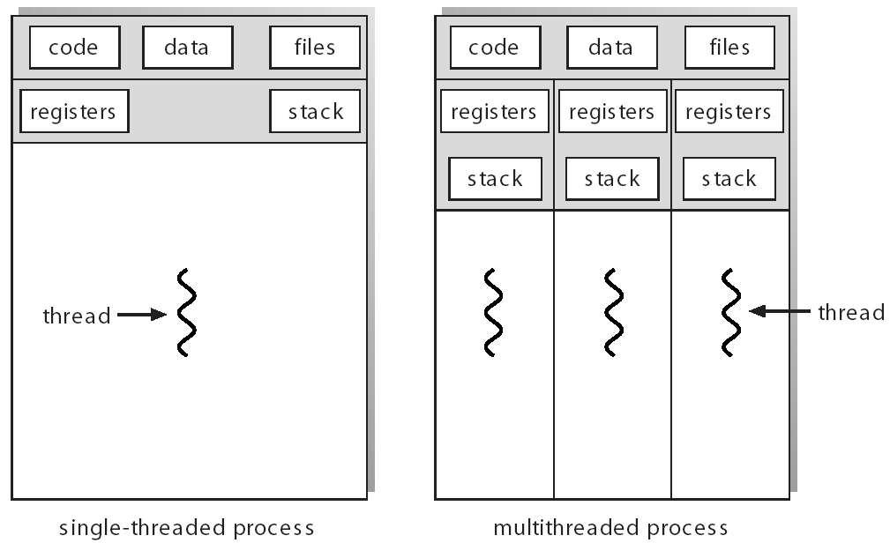

Slide 37
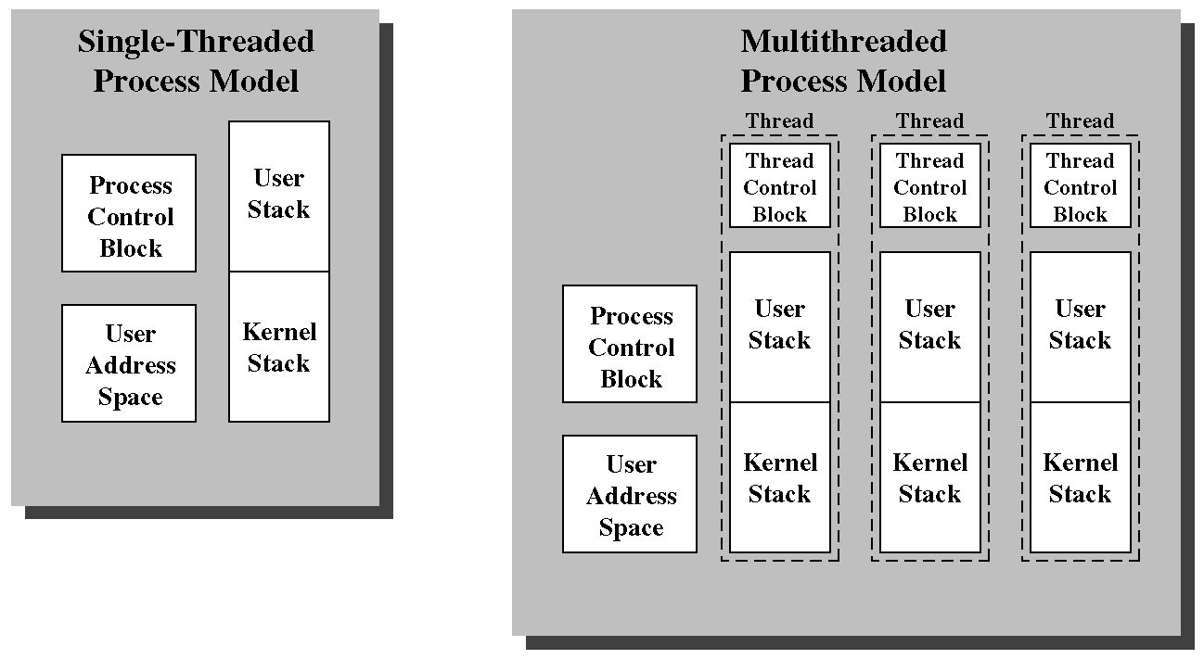

Slide 38
Process Address Space
kernel space
kernel space
stack
thread 1 stack
thread 2 stack
thread 3 stack
shared among threads
heap
heap
data
data
code
code
single threaded address space
multi-threaded address space

Slide 39
Thread
In single threaded systems, a process is:
Resource owner: memory address space, files, I/O resources
Scheduling/execution unit: execution state/context, dispatch unit
Multithreaded systems
Separation of resource ownership & execution unit
A thread is unit of execution, scheduling and dispatching
A process is a container of resources, and a collection of threads

Slide 40
When to, and not to use threads?
Applications
Multiprocessor machines
Handle slow devices
Background operations
Windowing systems
Server applications to handle multiple requests
No threads cases
When each unit of execution require different authentication/user-id
E.g., secure shell server

Slide 41
#include <stdio.h>
#include "mythreads.h"
#include <stdlib.h>
#include <pthread.h>
void *mythread(void *arg) {
printf("%s\n", (char *) arg);
return NULL;
}
Int main(int argc, char *argv[]){
if (argc != 1) {
fprintf(stderr, "usage: main\n");
exit(1);
}
pthread_t p1, p2;
printf("main: begin\n");
Pthread_create(&p1, NULL, mythread, "A");
Pthread_create(&p2, NULL, mythread, "B");
// join waits for the threads to finish
Pthread_join(p1, NULL);
Pthread_join(p2, NULL);
printf("main: end\n");
return 0;
}

Slide 42
#include <stdio.h>
#include "mythreads.h"
#include <stdlib.h>
#include <pthread.h>
int max;
// shared global variable
volatile int counter = 0;
void * mythread(void *arg)
{
char *letter = arg;
int i; // stack
printf("%s: begin\n", letter);
for (i = 0; i < max; i++) {
counter = counter + 1;
}
printf("%s: done\n", letter);
return NULL;
}
int main(int argc, char *argv[]) {
if (argc != 2) {
fprintf(stderr, "usage: ...\n");
exit(1);
}
max = atoi(argv[1]);
pthread_t p1, p2;
printf("main: begin [counter = %d] [%x]\n",
counter, (unsigned int) &counter);
Pthread_create(&p1, NULL, mythread, "A");
Pthread_create(&p2, NULL, mythread, "B");
// join waits for the threads to finish
Pthread_join(p1, NULL);
Pthread_join(p2, NULL);
printf("main: done\n [counter: %d]\n
[should: %d]\n", counter, max*2);
return 0;
}

Slide 43
Scheduling Control: Mutex
Basic
Others
pthread_mutex_t lock = PTHREAD_MUTEX_INITIALIZER;
pthread_mutex_lock(&lock);
x = x + 1; // or whatever your critical section is
pthread_mutex_unlock(&lock);
int pthread_mutex_trylock(pthread_mutex_t *mutex);
int pthread_mutex_timedlock(pthread_mutex_t *mutex,
struct timespec *abs_timeout);

Slide 44
Scheduling Control: Condition Variable
pthread_mutex_t lock = PTHREAD_MUTEX_INITIALIZER;
pthread_cond_t init = PTHREAD_COND_INITIALIZER;
Pthread_mutex_lock(&lock);
while (initialized == 0)
Pthread_cond_wait(&init, &lock);
Pthread_mutex_unlock(&lock);
Pthread_mutex_lock(&lock);
initialized = 1;
Pthread_cond_signal(&init);
Pthread_mutex_unlock(&lock);
Initilization
Wait side
Signal side

Slide 45
Debugging
Concurrency leads to non-deterministic bugs
Whether bug manifests depends on CPU schedule!
Passing tests means little
How to program: imagine scheduler is malicious

Slide 46
Thread API Guidelines
Keep it simple
Minimize thread interactions
Initialize locks and condition variables
Check your return codes
Be careful with how you pass arguments to, and return values from, threads
Each thread has its own stack
Always use condition variables to signal between threads. Avoid simple flags!
Use the manual pages

Slide 47
Next: lock

