Slide 1
Lecture 10 Concurrency: Locks

Slide 2
Problem: Multiple threads, shared data
Run t1.c…

Slide 3
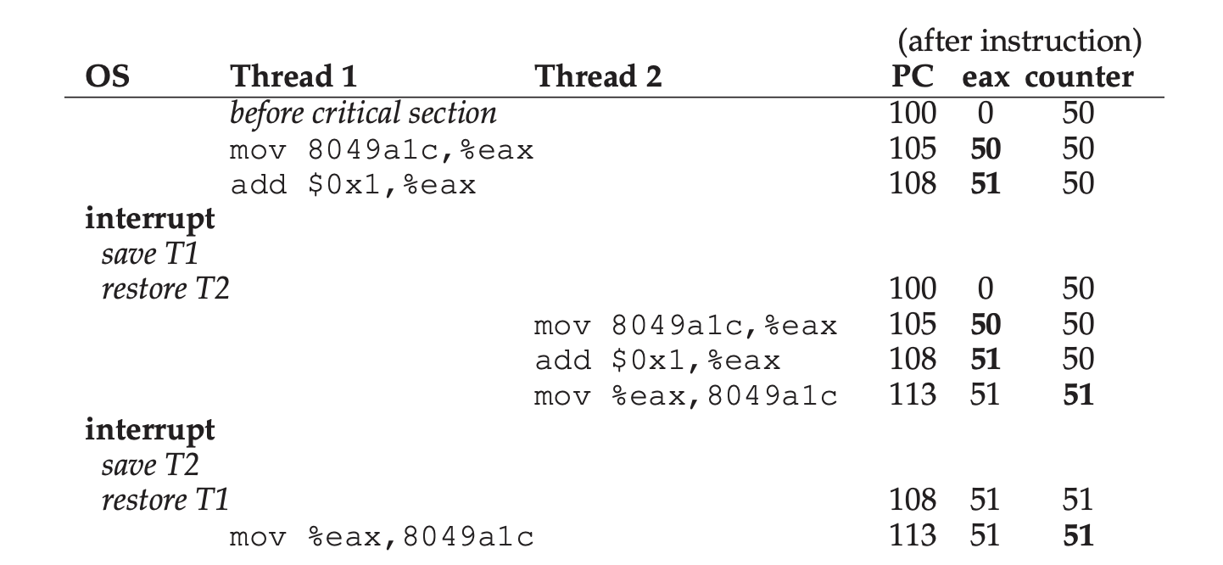
Problem: Multiple threads, shared data

Slide 4

Terminology: ‘Critical section’
“A critical section is a piece of code that accesses a shared variable (or more generally, a shared resource) and must not be concurrently executed by more than one thread.” – OSTEP

Slide 5
Terminology: ’Atomic’, ‘Atomicity’
‘Atomic’ – ‘as a unit’… executed without being interrupted

Slide 6
Synchronization primitive: Mutex/Lock
Basic
pthread_mutex_t lock = PTHREAD_MUTEX_INITIALIZER;
pthread_mutex_lock(&lock);
x = x + 1; // or whatever your critical section is
pthread_mutex_unlock(&lock);
Other variants
int pthread_mutex_trylock(pthread_mutex_t *mutex);
int pthread_mutex_timedlock(pthread_mutex_t *mutex,
struct timespec *abs_timeout);

Slide 7
#include <stdio.h>
#include "mythreads.h"
#include <stdlib.h>
#include <pthread.h>
int max;
// shared global variable
volatile int counter = 0;
void * mythread(void *arg)
{
char *letter = arg;
int i; // stack
printf("%s: begin\n", letter);
for (i = 0; i < max; i++) {
counter = counter + 1;
}
printf("%s: done\n", letter);
return NULL;
}
int main(int argc, char *argv[]) {
if (argc != 2) {
fprintf(stderr, "usage: ...\n");
exit(1);
}
max = atoi(argv[1]);
pthread_t p1, p2;
printf("main: begin [counter = %d] [%x]\n",
counter, (unsigned int) &counter);
Pthread_create(&p1, NULL, mythread, "A");
Pthread_create(&p2, NULL, mythread, "B");
// join waits for the threads to finish
Pthread_join(p1, NULL);
Pthread_join(p2, NULL);
printf("main: done\n [counter: %d]\n
[should: %d]\n", counter, max*2);
return 0;
}
Notes:
Always the same result on a uni-processor machine?
Need lock

Slide 8
Controlling Interrupts
void lock() {
DisableInterrupts();
}
void unlock() {
EnableInterrupts();
}
Would it work?
Problems:
We have to trust the application
Does not work on multiprocessors
Inefficient
Only used in limited contexts

Slide 9
Evaluating Locks
Mutual exclusion: "At any moment at most one of the processes is engaged in its critical section."
Fairness: "The decision which of the processes is the first to enter its critical section cannot be postponed to eternity."
Speed independence: "Stopping a process in its 'remainder of cycle' [that is, outside its critical region] has no effect upon the others."
- Dijkstra, “Communicating Sequential Processes”, 1968

Slide 10
typedef struct __lock_t { int flag; } lock_t;
void init(lock_t *mutex) {
// 0 -> lock is available, 1 -> held
mutex->flag = 0;
}
void lock(lock_t *mutex) {
while (mutex->flag == 1) // TEST the flag
; // spin-wait (do nothing)
mutex->flag = 1; // now SET it!
}
void unlock(lock_t *mutex) {
mutex->flag = 0;
}

Slide 11
Test And Set (Atomic Exchange)
int TestAndSet(int *ptr, int new) {
int old = *ptr; // fetch old value at ptr
*ptr = new; // store ’new’ into ptr
return old; // return the old value
}

Slide 12
typedef struct __lock_t { int flag; } lock_t;
void init(lock_t *mutex) {
// 0 -> lock is available, 1 -> held
mutex->flag = 0;
}
void lock(lock_t *mutex) {
while (TestAndSet(&lock->flag, 1) == 1)
; // spin-wait (do nothing)
}
void unlock(lock_t *mutex) {
mutex->flag = 0;
}

Slide 13
Evaluating Spin Locks
Correctness: yes
Fairness: no
Performance:
bad on single CPU
reasonable if the number of threads roughly equals the number of CPUs

Slide 14
Compare-And-Swap
int CompareAndSwap(int *ptr, int expected, int new) {
int actual = *ptr;
if (actual == expected)
*ptr = new;
return actual;
}

Slide 15
typedef struct __lock_t { int flag; } lock_t;
void init(lock_t *mutex) {
// 0 -> lock is available, 1 -> held
mutex->flag = 0;
}
void lock(lock_t *mutex) {
while (CompareAndSwap(&lock->flag, 0, 1) == 1)
; // spin-wait (do nothing)
}
void unlock(lock_t *mutex) {
mutex->flag = 0;
}

Slide 16
Load-Linked and Store-Conditional
int LoadLinked(int *ptr) {
return *ptr;
}
int StoreConditional(int *ptr, int value) {
if (no update to *ptr since the LoadLinked to it) {
*ptr = value;
return 1; // success!
} else {
return 0; // failed to update
}
}

Slide 17
void lock(lock_t *mutex) {
while (1) {
while (LoadLinked(& mutex->flag) == 1)
; // spin until it’s zero
if (StoreConditional(& mutex->flag, 1) == 1)
return; // if set-it-to-1 succeeded: all done
// otherwise: try it all over again
}
}
void unlock(lock_t *mutex) {
mutex->flag = 0;
}

Slide 18
Fetch-And-Add and Ticket Locks
int FetchAndAdd(int *ptr) {
int old = *ptr;
*ptr = old + 1;
return old;
}

Slide 19
typedef struct __lock_t {
int ticket;
int turn;
} lock_t;
void lock_init(lock_t *lock) {
lock->ticket = 0; lock->turn = 0;
}
void lock(lock_t *lock) {
int myturn = FetchAndAdd(&lock->ticket);
while (lock->turn != myturn) ; // spin
}
void unlock(lock_t *lock) {
FetchAndAdd(&lock->turn);
}

Slide 20
Spinning is Bad
Imagine two threads on a single processor
Imagine N threads on a single processor

Slide 21
void init() {
flag = 0;
}
void lock() {
while (TestAndSet(&flag, 1) == 1)
yield(); // give up the CPU
}
void unlock() {
flag = 0;
}

Slide 22
Sleeping Instead Of Spinning
On Solaris, OS provides two calls:
park() to put a calling thread to sleep
unpark(threadID) to wake a particular thread as designated by threadID

Slide 23
typedef struct __lock_t {
int flag;
int guard;
queue_t *q;
} lock_t;
void lock_init(lock_t *m) {
m->flag = 0;
m->guard = 0;
queue_init(m->q);
}

Slide 24
void lock(lock_t *m) {
while (TestAndSet(&m->guard, 1) == 1)
; //acquire guard lock by spinning
if (m->flag == 0) {
m->flag = 1; // lock is acquired
m->guard = 0;
} else {
queue_add(m->q, gettid());
m->guard = 0;
park();
}
}

Slide 25
void unlock(lock_t *m) {
while (TestAndSet(&m->guard, 1) == 1)
; //acquire guard lock by spinning
if (queue_empty(m->q))
m->flag = 0; // let go of lock; no one wants it
else
// hold lock (for next thread!)
unpark(queue_remove(m->q));
m->guard = 0;
}

Slide 26
void lock(lock_t *m) {
while (TestAndSet(&m->guard, 1) == 1)
; //acquire guard lock by spinning
if (m->flag == 0) {
m->flag = 1; // lock is acquired
m->guard = 0;
} else {
queue_add(m->q, gettid());
setpark(); // new code
m->guard = 0;
park();
}
}

Slide 27
Different Supports
On Linux, OS provides two calls:
futex_wait(address, expected) puts the calling thread to sleep, assuming the value at address is equal to expected. If it is not equal, the call returns immediately.
futex_wake(address) wakes one thread that is waiting on the queue.
Two-Phase Locks

Slide 28
void lock(lock_t *m) {
int v;
/* Bit 31 was clear, we got the mutex (fastpath) */
if (atomic_bit_test_set (m, 31) == 0) return;
atomic_increment (m);
while (1) {
if (atomic_bit_test_set (m, 31) == 0) {
atomic_decrement (m); return;
}
/* We have to wait now. First make sure the futex value
we are monitoring is truly negative (i.e. locked). */
v = *m;
if (v >= 0) continue;
futex_wait (m, v);
}
}

Slide 29
void unlock(lock_t *m) {
/* Adding 0x80000000 to the counter results in 0 if
& only if there are not other interested threads */
if (atomic_add_zero (mutex, 0x80000000))
return;
/* There are other threads waiting for this mutex,
wake one of them up. */
futex_wake (mutex);
}

Slide 30
Concurrent Counters
typedef struct __counter_t {
int value;
} counter_t;
void init(counter_t *c) {
c->value = 0;
}
void increment(counter_t *c) {
c->value++;
}
void decrement(counter_t *c) {
c->value--;
}
int get(counter_t *c) {
return c->value;
}

Slide 31
typedef struct __counter_t {
int global; // global count
pthread_mutex_t glock; // global lock
int local[NUMCPUS]; // local count (per cpu)
pthread_mutex_t llock[NUMCPUS]; // ... and locks
int threshold; // update frequency
} counter_t;
void init(counter_t *c, int threshold) {
c->threshold = threshold; c->global = 0;
pthread_mutex_init(&c->glock, NULL);
int i;
for (i = 0; i < NUMCPUS; i++) {
c->local[i] = 0;
pthread_mutex_init(&c->llock[i], NULL);
}
}

Slide 32
void update(counter_t *c, int threadID, int amt) {
pthread_mutex_lock(&c->llock[threadID]);
c->local[threadID] += amt; // assumes amt > 0
if (c->local[threadID] >= c->threshold) {
pthread_mutex_lock(&c->glock);
c->global += c->local[threadID];
pthread_mutex_unlock(&c->glock);
c->local[threadID] = 0;
}
pthread_mutex_unlock(&c->llock[threadID]);
}
int get(counter_t *c) {
pthread_mutex_lock(&c->glock);
int val = c->global;
pthread_mutex_unlock(&c->glock);
return val; // only approximate!
}

Slide 33
Concurrent Linked Lists
typedef struct __node_t {
int key;
struct __node_t *next;
} node_t;
typedef struct __list_t {
node_t *head;
pthread_mutex_t lock;
} list_t;
void List_Init(list_t *L) {
L->head = NULL;
pthread_mutex_init(&L->lock, NULL);
}

Slide 34
int List_Insert(list_t *L, int key) {
pthread_mutex_lock(&L->lock);
node_t *new = malloc(sizeof(node_t));
if (new == NULL) {
perror("malloc");
pthread_mutex_unlock(&L->lock);
return -1; // fail
}
new->key = key;
new->next = L->head;
L->head = new;
pthread_mutex_unlock(&L->lock);
return 0; // success
}

Slide 35
int List_Lookup(list_t *L, int key) {
pthread_mutex_lock(&L->lock);
node_t *curr = L->head;
while (curr) {
if (curr->key == key) {
pthread_mutex_unlock(&L->lock);
return 0; // success
}
curr = curr->next;
}
pthread_mutex_unlock(&L->lock);
return -1; // failure
}

Slide 36
int List_Insert(list_t *L, int key) {
// synchronization not needed
node_t *new = malloc(sizeof(node_t));
if (new == NULL) {
perror("malloc");
return;
}
new->key = key;
// just lock critical section
pthread_mutex_lock(&L->lock);
new->next = L->head;
L->head = new;
pthread_mutex_unlock(&L->lock);
}

Slide 37
int List_Lookup(list_t *L, int key) {
int rv = -1;
pthread_mutex_lock(&L->lock);
node_t *curr = L->head;
while (curr) {
if (curr->key == key) {
rv = 0;
break;
}
curr = curr->next;
}
pthread_mutex_unlock(&L->lock);
return rv; // now both success and failure
}

Slide 38
Others
Hand-over-hand locking for list
Concurrent queues
Concurrent hash table

Slide 39
Next: Condition Variables Semaphores
Reference: Reference: “The Origin of Concurrent Programming”, Per Brinch Hansen, https://link.springer.com/book/10.1007%2F978-1-4757-3472-0

