Slide 1
Lecture 8 Memory Management

Slide 2
Virtual Memory Approaches
Time Sharing
Static Relocation
Base
Base+Bounds
Segmentation
Paging
Too slow – TLB
Too big

Slide 3
PTE Size
Phys addr space contains 1024 pages. 7 bits needed for extras (prot, valid, etc.)
Phys addrs 16-bits, pages are 32 bytes, 8 bits needed for extras
Phys addr space is 4 GB, pages are 4 KB, 6 bits needed for extras

Slide 4
Page Table Size
(a) PTE’s are 3 bytes, and there are 32 possible virtual page numbers
(b) PTE’s are 3 bytes, virtual addrs are 24 bits, and pages are 16 bytes
(c) PTE’s are 4 bytes, virtual addrs are 32 bits, and pages are 4 KB
(d) PTE’s are 4 bytes, virtual addrs are 64 bits, and pages are 4 KB
(e) assume each PTE is 10 bits. We cut the size of pages in half, keeping everything else fixed, including size of virt/phys addresses. By what factor does the PT increase in size?

Slide 5
Page Size
(a) Goal PT size is 512 bytes. PTE’s are 4 bytes. Virtual addrs are 16 bits
(b) Goal PT size is 1 KB. PTE’s are 4 bytes. Virtual addrs are 16 bits
(c) Goal PT size is 4 KB. PTE’s are 4 bytes. Virtual addrs are 32 bits

Slide 6
Motivation
Why do we want a large virtual address space?
Programming is easier
Applications need not worry (as much) about fragmentation
Paging goals:
Space efficiency (don’t waste on invalid data)
Simplicity (no bookkeeping should require contiguous pages)

Slide 7
Approaches
Increase page size
Combine segmentation and paging
Page the page table: Multi-level page tables

Slide 8
Change Sizes
Make virtual address space smaller
Make pages bigger
PT size 512 bytes. PTE’s 4 bytes. Virtual addrs 16 bits
PT size 1 KB. PTE’s 4 bytes. Virtual addrs 16 bits
PT size 4 KB. PTE’s 4 bytes. Virtual addrs 32 bits
Why are 4 MB pages bad?
Internal fragmentation.
Some systems support multiple page sizes
Reduce TLB misses
Notes:
32 bits AS
With 512 byte pages 32MB
With 4KB pages 4MB
Why do we want large virtual AS? Easy to program
(a) Goal PT size is 512 bytes. PTE’s are 4 bytes. Virtual addrs are 16 bits
(b) Goal PT size is 1 KB. PTE’s are 4 bytes. Virtual addrs are 16 bits
(c) Goal PT size is 4 KB. PTE’s are 4 bytes. Virtual addrs are 32 bits
.

Slide 9
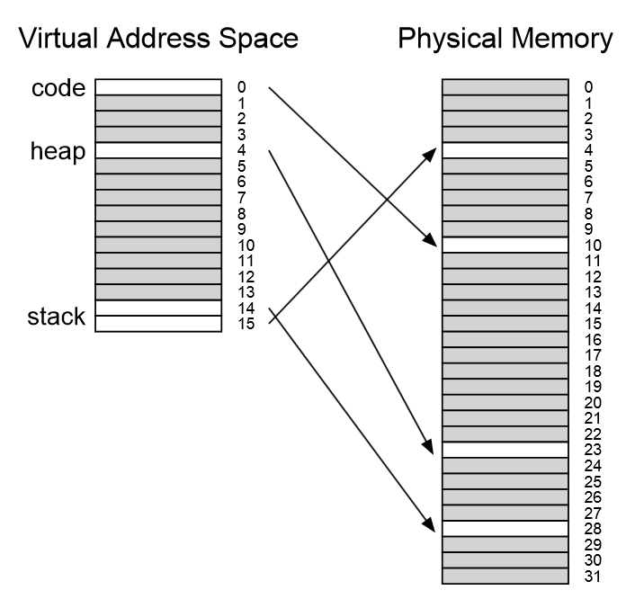
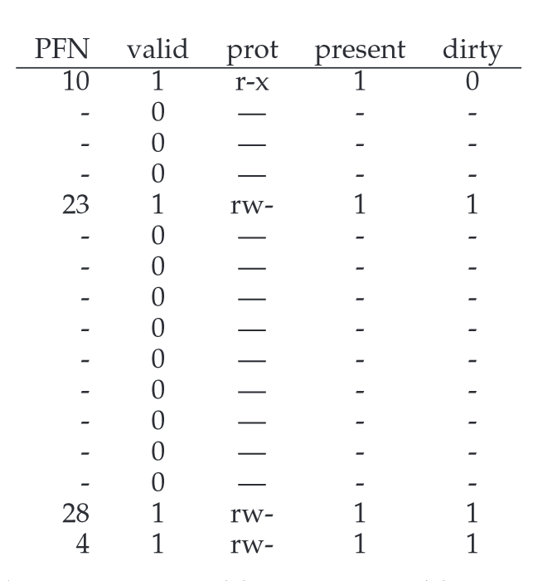

Slide 10
Many invalid PT entries
There is a big “hole” in our page table
Invalid entries are clustered.
How did we fix holes in physical memory before?
Segmentation
Paging

Slide 11
Segmentation/Paging Hybrid
Idea: use different page tables for heap, stack, etc
Each PT can have a different size
Each PT has a base/bounds (where?)
Virtual address
Before: PT_Index + OFFSET
Now: SEG + PT_Index + OFFSET, VPN is SEG + PT_Index
Notes:
SN = (VirtualAddress & SEG_MASK) >> SN_SHIFT
VPN = (VirtualAddress & VPN_MASK) >> VPN_SHIFT
AddressOfPTE = Base[SN] + (VPN * sizeof(PTE))

Slide 12
Segment 00: code Segment 01: heap
(a) 0x12FFF =>
(b) 0x10FFF =>
(c) 0x01ABC =>
(d) 0x11111 =>
PFN | valid | Prot
0x10 | 1 | r-x
0x15 | 1 | r-x
0x12 | 1 | r-x
 | …
PFN | valid | Prot
0x22 | 1 | rw-
0x02 | 1 | rw-
0x04 | 1 | rw-
 | …
18-bit addresses.
2-bit segment index
6-bit VPN

Slide 13
Multi-Level Page Tables
Idea: break PT itself into pages
A page directory refers to pieces
Only have pieces with >0 valid entries
Used by x86
Virtual address
Basic paging: PT_Index + OFFSET
Segmentation/Paging: SEG + PT_Index + OFFSET
Multi-level page tables: PD_Index + PT_Index + OFFSET
Notes:
SN = (VirtualAddress & SEG_MASK) >> SN_SHIFT
VPN = (VirtualAddress & VPN_MASK) >> VPN_SHIFT
AddressOfPTE = Base[SN] + (VPN * sizeof(PTE))
proportion to the amount of address space you are using
constructed, each portion of the page table fits neatly within a page,

Slide 14
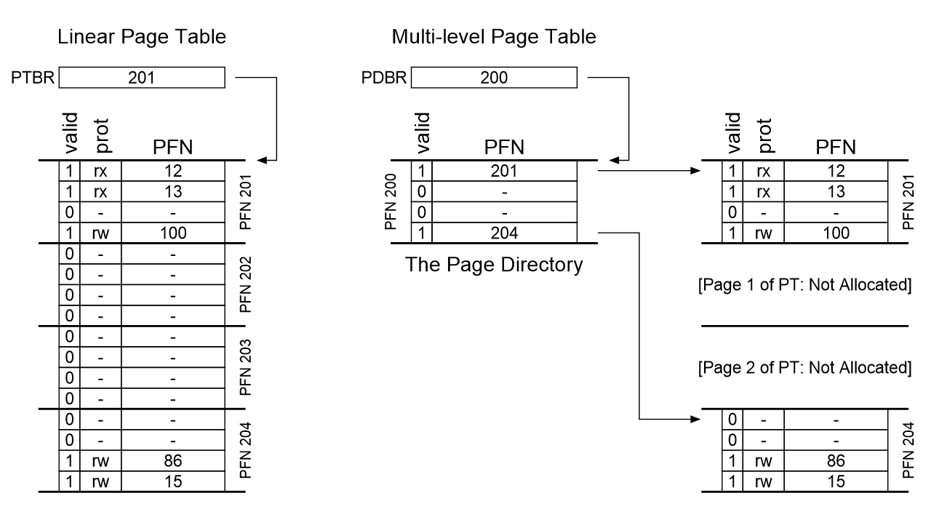
Notes:
proportion to the amount of address space you are using
constructed, each portion of the page table fits neatly within a page,

Slide 15
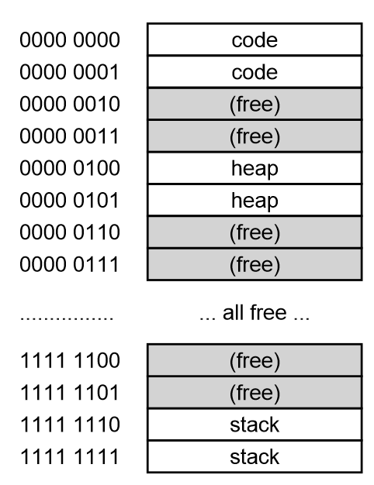
Assume
64-KB address space
256-byte pages
16-byte PTE

Slide 16
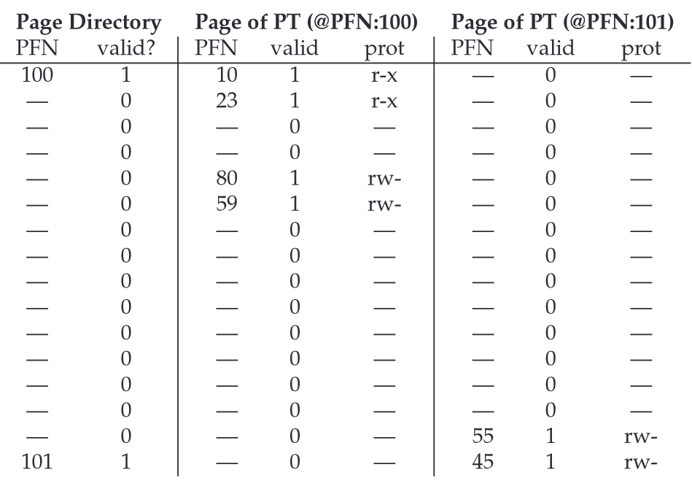
Notes:
(a) how many PT pages would have been needed if we instead had a simple, linear array?
(b) how many bits of a virt addr are used for the page-directory index?
(b) how many virtual pages are there?
(c) translate 0x01AB
(d) translate 0x0000
(e) translate 0xFEED
(f) translate 0x1000?

Slide 17
Questions
(a) how many PT pages would have been needed if we instead had a simple, linear array?
(b) how many bits of a virt addr are used for the page-directory index?
(b) how many virtual pages are there?
(c) translate 0x01AB
(d) translate 0x0000
(e) translate 0xFEED
(f) translate 0x1000?

Slide 18
>2 Levels
Problem: page directories may not fit In a page
Solution: split page directories into pieces.
Use another page dir to refer to the page dir pieces.
Virtual address
Basic paging: PT_Index + OFFSET
Segmentation/Paging: SEG + PT_Index + OFFSET
Multi-level page tables: PD_Index0 + …1 + PT_Index + OFFSET

Slide 19
How many levels do we need?
30-bit virtual address space, 512-byte pages, 4-byte PTE
How large is the virtual addr space, assuming 4-KB pages and 4-byte entries with N levels? (PT can now no longer require more than 1 contiguous page for bookkeeping)
(a) N = 1
(b) N = 2
(c) N = 3

Slide 20
What about TLBs?
Lookups in multiple levels more expensive.
How much does a miss cost?
Time/Space tradeoffs

Slide 21
10 else // TLB Miss
11 // first, get page directory entry
12 PDIndex = (VPN & PD_MASK) >> PD_SHIFT
13 PDEAddr = PDBR + (PDIndex* sizeof(PDE))
14 PDE = AccessMemory(PDEAddr)
15 if (PDE.Valid == False)
16 RaiseException(SEGMENTATION_FAULT)
else
// PDE is valid: now fetch PTE from page table
19 PTIndex = (VPN & PT_MASK) >> PT_SHIFT
20 PTEAddr = (PDE.PFN << SHIFT) + (PTIndex*sizeof(PTE))
21 PTE = AccessMemory(PTEAddr)
22 if (PTE.Valid == False)
23 RaiseException(SEGMENTATION_FAULT)
24 else if (CanAccess(PTE.ProtectBits) == False)
25 RaiseException(PROTECTION_FAULT)
26 else
27 TLB_Insert(VPN, PTE.PFN, PTE.ProtectBits)
28 RetryInstruction()

Slide 22
How Many Physical Accesses
Assume a 3-level page table
Assume 256-byte pages, 16-bit addresses.
Assume ASID of current process is 211
Thee independent instructions:
0xAA10: movl 0x1111, %edi
0xBB13: addl $0x3, %edi
0x0519: movl %edi, 0xFF10
valid | VPN | PFN | ASID | Prot
1 | 0xBB | 0x91 | 211 | ?
1 | 0xFF | 0x23 | 211 | ?
1 | 0x05 | 0x91 | 112 | ?
0 | 0x05 | 0x12 | 211 | ?
Notes:
(d) what do the “prot” bits probably contain for the first TLB entry?
(e) why do two entries map to the same physical page, 0x91?
(f) which fields in the TLB would also appear in a PT? Do any have a different meaning?
!
(g) would accessing 0x0500 cause a segfault?

