Slide 1
Lecture 9 Memory Management

Slide 2
Virtual Memory Approaches
Time Sharing
Static Relocation
Base
Base+Bounds
Segmentation
Paging
Too slow – TLB
Too big – smaller tables

Slide 3
How Many Physical Accesses
Assume a 3-level page table
Assume 256-byte pages, 16-bit addresses.
Assume ASID of current process is 211
Thee independent instructions:
0xAA10: movl 0x1111, %edi
0xBB13: addl $0x3, %edi
0x0519: movl %edi, 0xFF10
valid | VPN | PFN | ASID | Prot
1 | 0xBB | 0x91 | 211 | ?
1 | 0xFF | 0x23 | 211 | ?
1 | 0x05 | 0x91 | 112 | ?
0 | 0x05 | 0x12 | 211 | ?
Notes:
(d) what do the “prot” bits probably contain for the first TLB entry?
(e) why do two entries map to the same physical page, 0x91?
(f) which fields in the TLB would also appear in a PT? Do any have a different meaning?
!
(g) would accessing 0x0500 cause a segfault?

Slide 4
Swapping
What happens when you run out of physical memory?

Slide 5
The Memory Hierarchy
Secondary Storage
Main Memory
Cache
Registers
Notes:
why do we want to support a single large address space for a process
Ease one program
Ease multi program

Slide 6
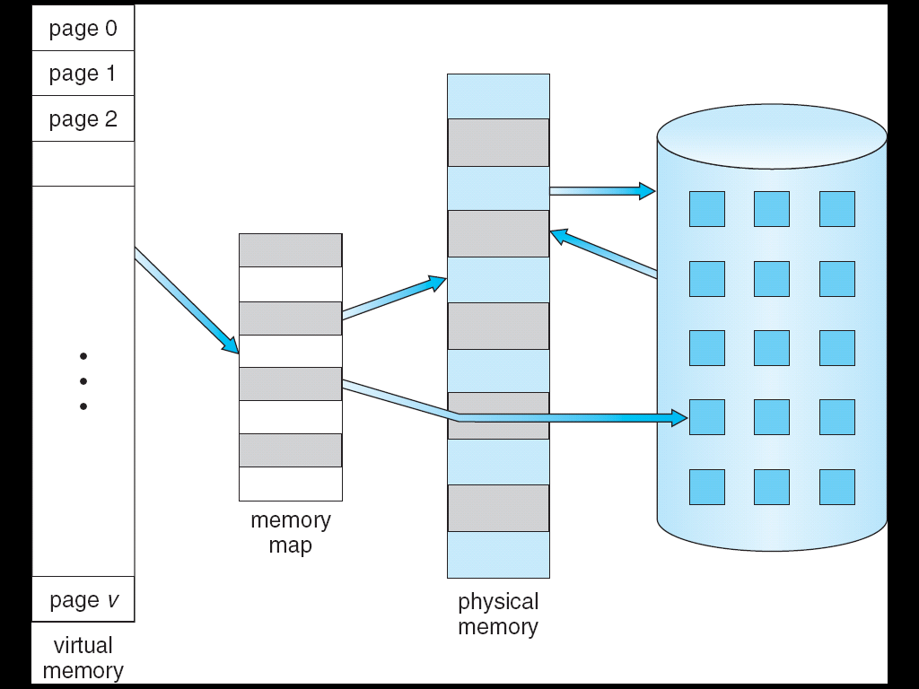

Slide 7
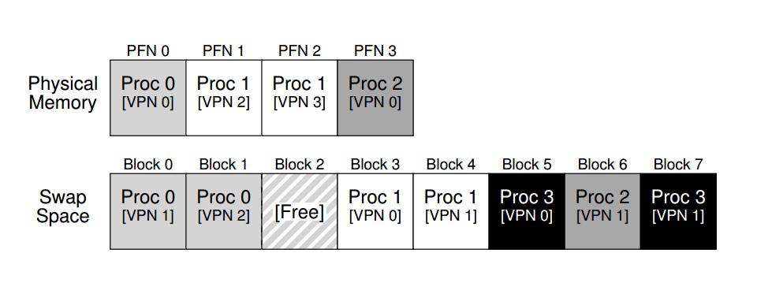
Swap Space
Reserved disk space for moving pages back and forth

Slide 8
How to know where a page lives? The Present Bit
Now Proc 1 accesses VPN 0, …
Notes:
We had PFN valid prot
Now present bit
What is the bit for proc 1?

Slide 9
Translation Steps
H/W: for each mem reference:
extract VPN from VA
check TLB for VPN
TLB hit:
build PA from PFN and offset
fetch PA from memory
TLB miss:
fetch PTE
if (!valid): exception [segfault]
else if (!present): exception [page fault, or page miss]
else: extract PFN, insert in TLB, retry

Slide 10
The Page Fault
OS handles the page fault
Regardless of hardware-managed or OS-managed TLB
Page faults to disk are slow, so no need to use hardware
Page faults are complicated to handler, so easier for OS
Where is the page on disk?
Store the disk address in the PTE

Slide 11
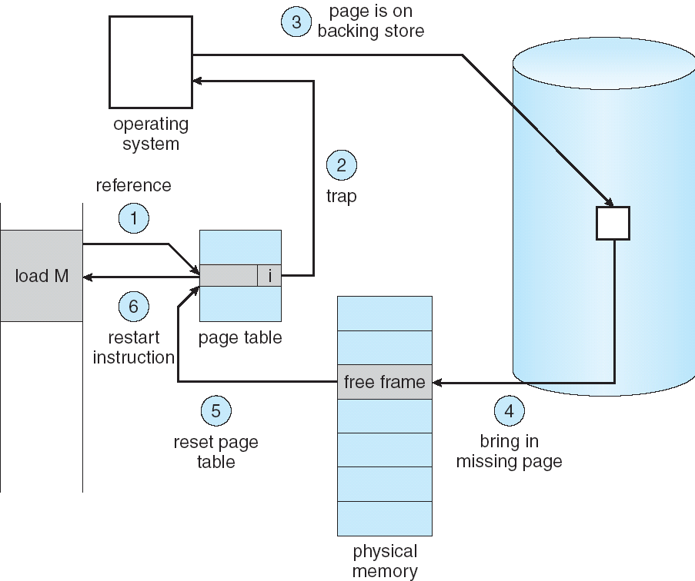

p
Notes:
Tlb?

Slide 12
Page-Fault Handler (OS)
PFN = FindFreePage()
if (PFN == -1)
PFN = EvictPage()
DiskRead(PTE.DiskAddr, PFN)
PTE.present = 1
PTE.PFN = PFN
retry instruction
<- policy
<- blocking

Slide 13
Policy
Page replacement policy
How would you measure replacement policy ‘goodness?’

Slide 14
Policy
Page replacement policy
How would you measure replacement policy ‘goodness?’
Hint: What if you see physical memory as a cache for virtual memory?

Slide 15
Policy
Page replacement policy
How would you measure replacement policy ‘goodness?’
Hint: What if you see physical memory as a cache for virtual memory?
Metrics:
Cache hits, cache misses
Average Memory Access Time (AMAT): Tm + (Pmiss · Td)

Slide 16
Metric: Average Memory Access Time
Assume:
the cost of accessing memory (TM) is around 100 nanoseconds
the cost of accessing disk (TD) is about 10 milliseconds Assuming a 90% hit rate, we have the following AMAT:
100ns + 0.1 · 10ms, which is 100ns + 1ms, or 1.0001 ms, or about 1 millisecond.
If our hit rate had instead been 99.9% (Pmiss = 0.001), the result is quite different:
AMAT is 10.1 microseconds, or roughly 100 times faster.

Slide 17
‘Optimal’ Policy
“replace the page that will be accessed furthest in the future” – Belady, 1965

Slide 18
Policy Alternatives
Practical alternatives?

Slide 19
Policy Alternatives
“replace the page that will be accessed furthest in the future” – Belady, 1965
Practical alternatives?
First In First Out (FIFO)
Random
Least Recently Used (LRU)

Slide 20
Next
Other VM-related material not in OSTEP
Concurrency

