Slide 1
CSC 501 Lecture 2: Processes

Slide 2
Last Time: Course Topics–Questions?
Virtualization
CPU: process, “time-sharing”
Memory: virtual memory, “space-sharing”
Concurrency
CPU: thread(s)
Memory: locks, semaphores, condition variables
Network: sockets, go channels
Persistence
Long-Term Memory: file

Slide 3
This Time:
Process mechanisms, OSTEP, pp 21-63
What’s a process?
Process internals
Process lifecycle
Process data structures
Limited Direct Execution
Process API
Process API Examples
Review "On building systems that will fail”
First Assignment: How’s it going with P0?

Slide 4
Problem: # Programs > # CPUs
Program: list of instructions (and maybe some static data)
We want to have multiple running programs
However, we only have a few (or, one) CPUs
So, limit the number of programs you are running
Process is
a running program
a program in execution
an “instantiation” of a program
Notes:
Peach? Do you like?
Survey again, first OS?

Slide 5
A Process
A process includes the following machine state:
Memory
Registers, e.g., PC, stack pointer (Xinu’s different here)
I/O, opened files
Process state
Generic API calls: create, destroy, wait, control, status
Unix: fork/exec, exit, wait, signal (e.g. kill, alarm, interrupt)
Xinu: create, die, kill, panic, sleep, suspend, resume, immortal, getpid, chprio

Slide 6
Process states
As a process executes, it changes state
new: The process is being created
running: Instructions are being executed
blocked: The process is waiting for some event to occur
ready: The process is waiting to be assigned to a processor
terminated: The process has finished execution

Slide 7
Process Lifecycle
New
Terminated
Admitted
Exit
Scheduled
Running
Ready
Descheduled
I/O: done
Blocked
I/O: initiate

Slide 8
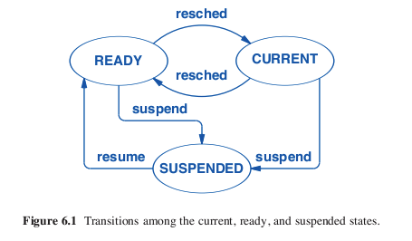
Xinu Process Lifecycle
Xinu, Comer, pg. 100

Slide 9
Tracing Process State: CPU and I/O Time Process0 Process1 Notes
1 Running Ready
2 Running Ready
3 Running Ready Process0 initiates I/O
4 Blocked Running Process0 is blocked,
5 Blocked Running so Process1 runs
6 Blocked Running
7 Ready Running I/O done
8 Ready Running Process1 now done
9 Running –
10 Running – Process0 now done

Slide 10
Data Structures
Process list
Common elements in process structure
Process state
Program counter
CPU registers
CPU scheduling information
Memory-management information
Accounting information
I/O status information

Slide 11
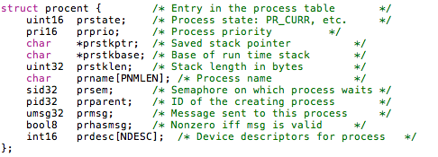
Example PCB in XINU
from process.h, x86 (Xinu-Code-Gallileo), show also create.c

Slide 12
Limited Direct Execution
Time sharing the CPU:
Run one process for a little while, then run another one, and so forth
How to efficiently virtualize the CPU with control
Performance and control
The “direct execution” part of the idea is simple:
Just run the program directly on the CPU.

Slide 13
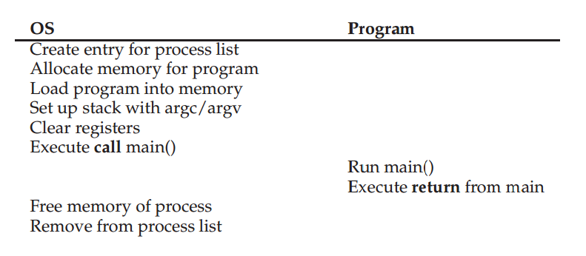
Protocol without limits
Restricted Operations
How to take over control
the “limited” part

Slide 14
Restricted Operations
The need to perform restricted operations
Two processor modes: user mode and kernel mode
Hardware support
How to perform restricted operations from a user process: System calls, pioneered on ancient machines such as the Atlas (1962)
expose certain pieces of functionality to user programs
most operating systems provide a few hundred calls
Notes:
system calls
allow the kernel to carefully expose certain key pieces of functionality to
user programs, such as accessing the file system, creating and destroying
processes, communicating with other processes, and allocating more
memory.

Slide 15
How to execute system call
Trap instruction
The program executes trap, simultaneously jump into kernel and raise privilege
Kernel does the work
Kernel calls return-from-trap, return into the calling user program and simultaneously reducing the privilege level
Hardware support
Save caller’s registers
On x86, PC, flags, and a few others saved to a per-process kernel stack

Slide 16
Protocol without limits
Restricted Operations
How to take over control
the “limited” part

Slide 17
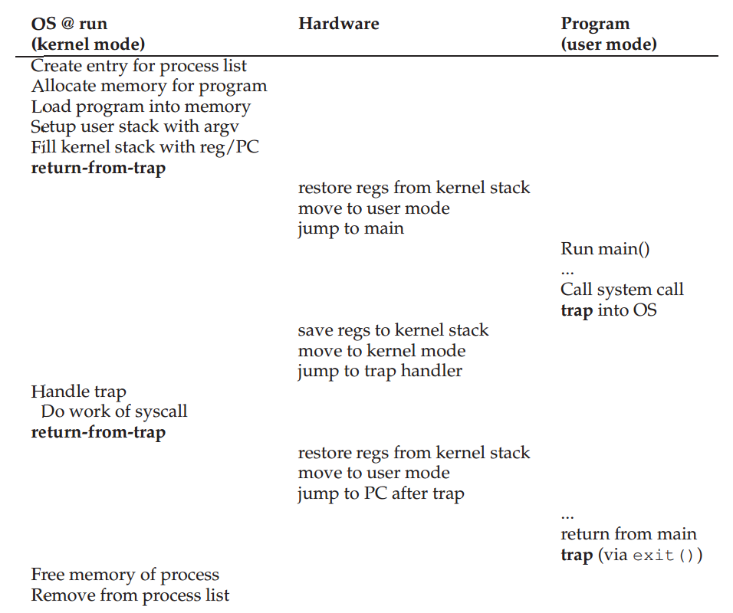

Slide 18
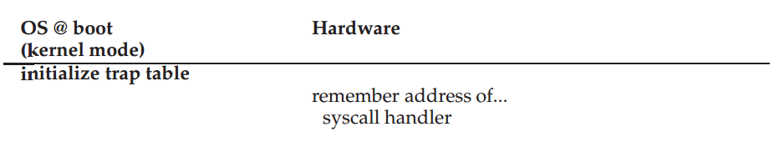
Which code to run
Let the calling process specify the address
Set up a trap table at boot time
The hardware remembers the locations of trap handlers
Notes:
two phases. first (at boot time), trap table, and the CPU remembers its … does so via a privileged instruction (in bold).
second (when running a process), the kernel sets up a few things
(e.g., allocating a node on the process list, allocating memory) before using
a return-from-trap instruction to start the execution of the process;
this switches the CPU to user mode and begins running the process.
When the process wishes to issue a system call, it traps back into the OS,
which handles it and once again returns control via a return-from-trap
to the process. The process then completes its work, and returns from
main(); this usually will return into some stub code which will properly
exit the program (say, by calling the exit() system call, which traps into
the OS). At this point, the OS cleans up and we are done.

Slide 19
The “limited” part
Restricted Operations
System calls, which look like procedure calls and they are procedure calls
Underlying system calls, there are traps and return-from-traps
Someone has written the assembly for us
How to take over control

Slide 20
Switching Between Processes
Since OS is not running, how can it do anything?
A cooperative approach
Used in early version of the Macintosh OS
Wait for systems calls
Illegal actions which generate trap
Processes are assumed to periodically give up the CPU
What if a process gets stuck in an infinite loop?

Slide 21
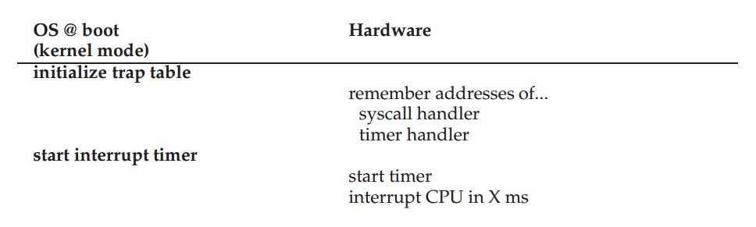
A Non-Cooperative Approach: The OS Takes Control
Timer interrupt - 1963
Boot time:
Set interrupt handler
Start timer
Notes:
hardware has some responsibility when an interrupt occurs
Need to save blabla
Like on system calls

Slide 22
Context Switch
When CPU switches to another process
System must
Save the state of the old process (suspend) and
Load the saved state for the new process (resume)
Context-switch time is overhead
System does no useful work while switching
Time dependent on hardware support
See, e.g, Xinu sys/ctxsw.S
Notes:
Now get the control, no matter how
And if we decide to switch, do something to switch to another process
1996, 4microseconds, now sub-micro

Slide 23
Saving and Restoring Context
Save state of currently executing process
Copy all “live” registers to process control block
Restore state of process to run next
Copy values of live registers from process control block to registers
How to get into and out of the context switching code?

Slide 24
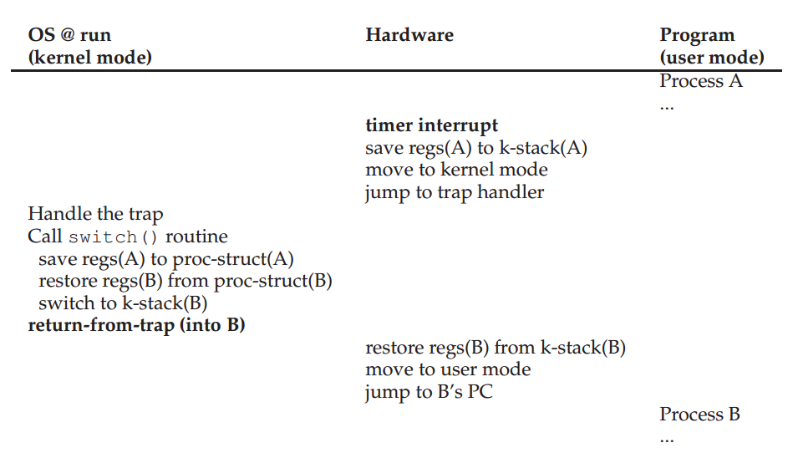
Notes:
Call context switching subroutine
The subroutine saves context of current process, restores context of the next process to be executed, and returns
The subroutine returns in the context of another (the next) process!
Eventually, will switch back to the current process
To process, it appears as if the context switching subroutine just took a long while to return

Slide 25
The “limited” part
Restricted Operations
System calls, which look like procedure calls and they are procedure calls
Underlying system calls, there are traps and return-from-traps
Someone has written the assembly for us
How to take over control
Timer interrupt
Context switch

Slide 26
Process API
On Unix:
fork, exec, wait, …
Why:
they are essential in building a Unix shell

Slide 27
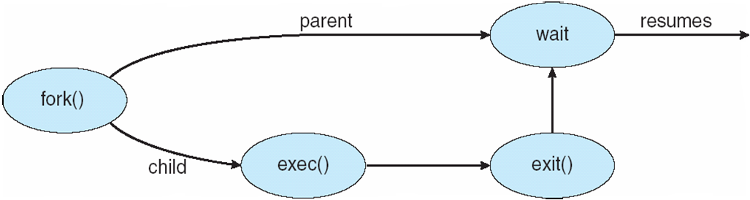
Process Creation
UNIX examples
fork system call creates new process
exec system call used after a fork to replace new process’ memory space with a new program

Slide 28
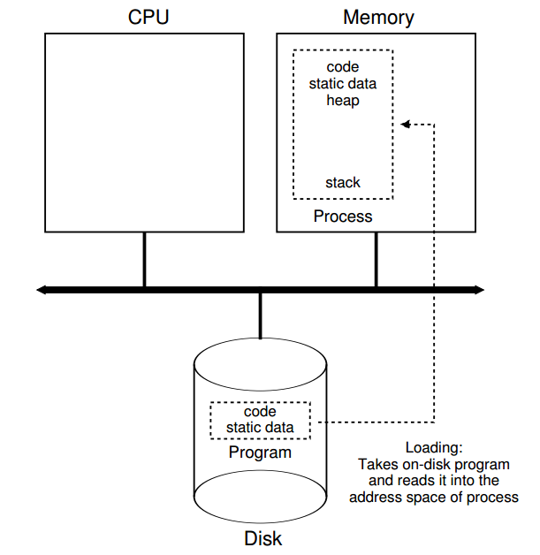
Process Creation
Loading: code and static data
Eagerly vs lazily
Allocate memory for stack, heap
Initialize file descriptors
Jump to the main and give the CPU to the process
Notes:
the OS transfers control of the CPU to the
newly-created process, and thus the program begins its execution.

Slide 29
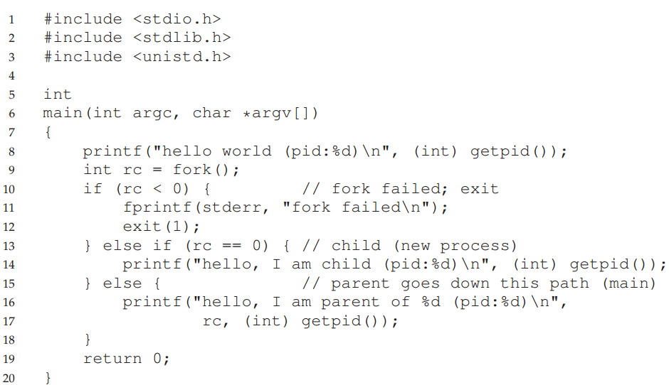
OSTEP, p. 38
Notes:
Basic fork example

Slide 30
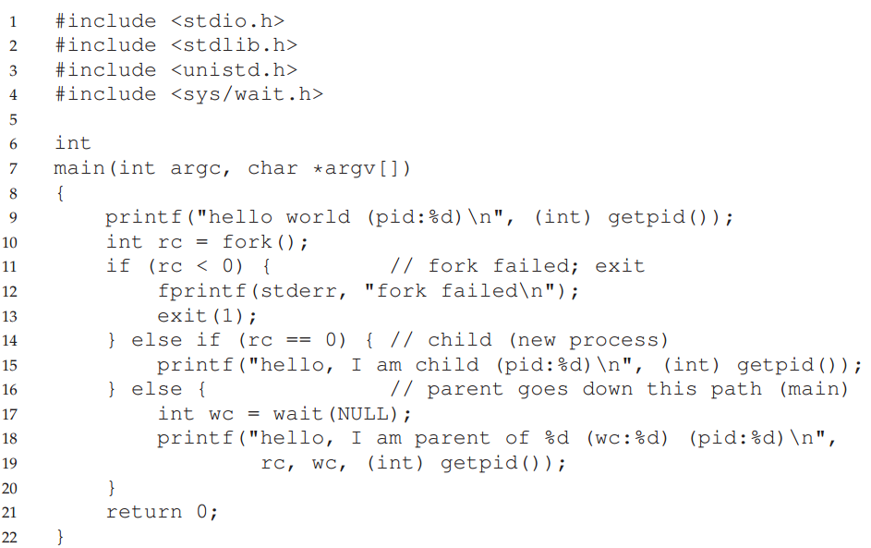
Notes:
Fork with wait

Slide 31
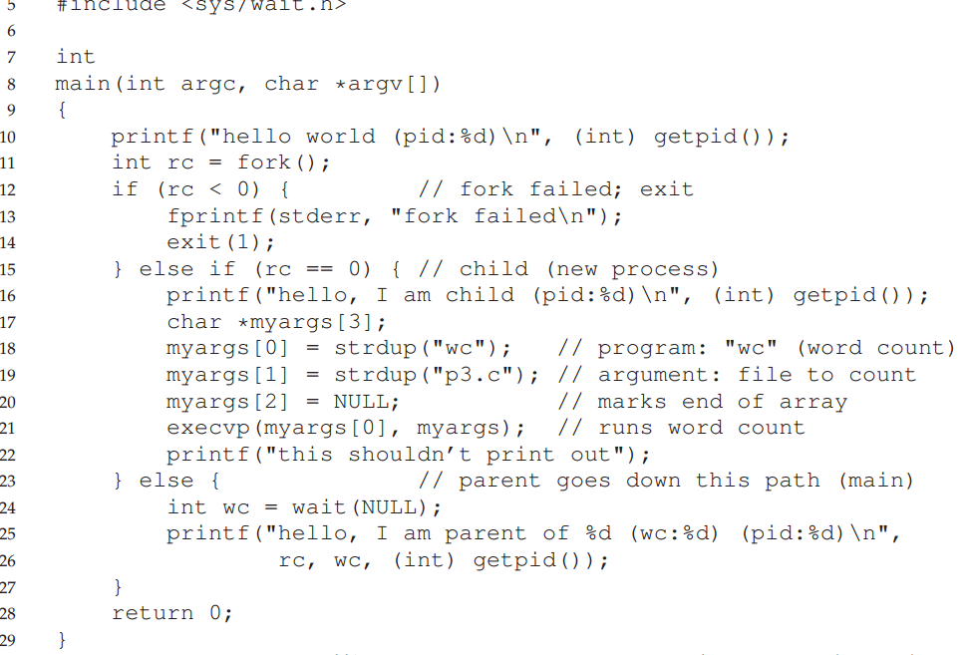
Notes:
Added execvp

Slide 32
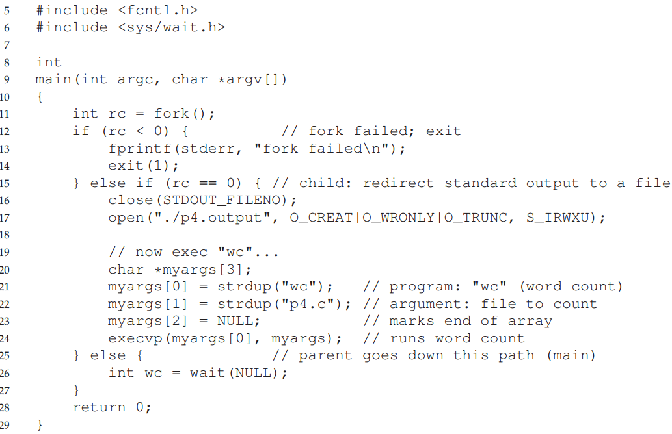

Slide 33
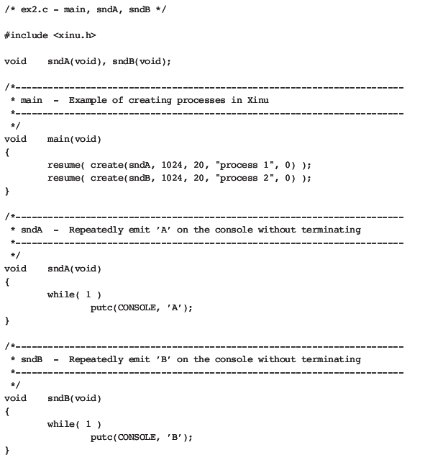
Xinu Process Creation E
Xinu, p. 20 … and have a look at sys/create.c

Slide 34
Process Termination
Possible scenarios for process termination
Exit (by itself)
Abort (by parent)
Kill (by sysadmin)

Slide 35
Process Termination
Exit (by itself)
Process executes last statement and asks operating system to delete
Abort (by parent)
Child has exceeded allocated resources
Task assigned to child is no longer required
If parent is exiting
Some operating system do not allow child to continue if its parent terminates
All children terminated - cascading termination
Kill (by sysadmin)
Administration purpose

Slide 36
Process Suspension
Temporarily ‘‘stop’’ a process
Prohibit from using the CPU
Why?
What should be done?
Change its state in PCB
Save its machine states for later resumption
Process table entry retained
Complete state saved

Slide 37
Paper Reviews
Review elements:
Paper citation
Keywords
First paragraph: Description of the paper’s contents
Second paragraph: Your view of the paper’s strengths, weaknesses, and possible future work.
We will sometimes give questions to be answered about papers.

Slide 38
Review of “On building systems that will fail”, Corbato
Paper citation: F. Corbato, "On Building Systems That Will Fail", ‘Communications of the ACM’, Vol 34, Issue 9, pp. 72-81, also - http://larch-www.lcs.mit.edu:8001/~corbato/turing91/
Keywords: CTSS, Multics, ambitious systems, design, mistakes

Slide 39
First paragraph:
This paper is a transcript of Fernado Corbato's 1991 Turing Award speech. In it, he describes his work on the Compatible Time Sharing System (CTSS) and Multics operating systems, and uses these projects to illustrate the need to consider failure when designing 'ambitious' systems. Corbato states his main thesis as the question to ask when designing such systems is not: "if something will go wrong, but when will it?", with examples from his work. He characterizes 'ambitious' systems as large, complicated, ambiguous, groundbreaking, and extensible. These attributes lead to both technical and human difficulties with building systems, for which Corbato offers several suggested solutions, notably simplicity, metaphors, constrained languages, anticipating errors, maintainability, and cross-training.

Slide 40
Second paragraph:
Strengths of the paper include many useful philosophical ideas, supported by examples. My favorite was the following passage "The UNIX system [12] was a reaction to Multics. Even the name was a joke. Ken Thompson was part of the Bell Laboratories' Multics effort, and, frustrated with the attempts to bring a large system development under control, decided to start over. His strategy was clear. Start small and build up the ideas one by one as he saw how to implement them well." Weaknesses of the paper primarily center around its age; computing has grown several magnitudes in size since the early 1990's. For future work, it would be worth examining how his proposed solutions worked, whether by surveying developemnt teams, reviwing the operating systems literature, or by conducting experiments to assess their value.

Slide 41
Lecture review
Process mechanisms
What’s a process?
Process internals
Process lifecycle
Process data structures
Limited Direct Execution
Process API
Process API Examples
Paper reviews

Slide 42
For the next lecture
OSTEP chapters on CPU Scheduling, pp 65-102
CPU scheduling
Multi-level feedback
Lottery scheduling
First assignment due 9/7 4am

