Slide 1
Risk
PJ Onusconich, Dale Hartman, and Adam Karl

Slide 2
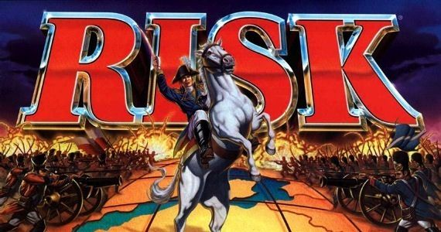
What is Risk?
Turn based 2-6 player game
Players initially claim and fortify territories
Each turn, players gain more armies, attack/conquer opposing territories, and move armies amongst their territories
Ultimate goal is to control all 42 territories on the board

Slide 3
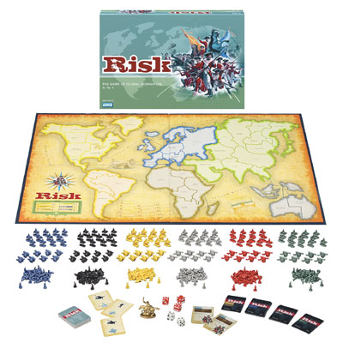
User Stories
As a player I can…
Claim territories
Place armies
Attack other territories
Win the game

Slide 4
SCRUM Experience
Strengths:
Planned approach
Provided a time schedule
Weaknesses/Challenges:
Creating a good plan
Maintaining good communication

Slide 5
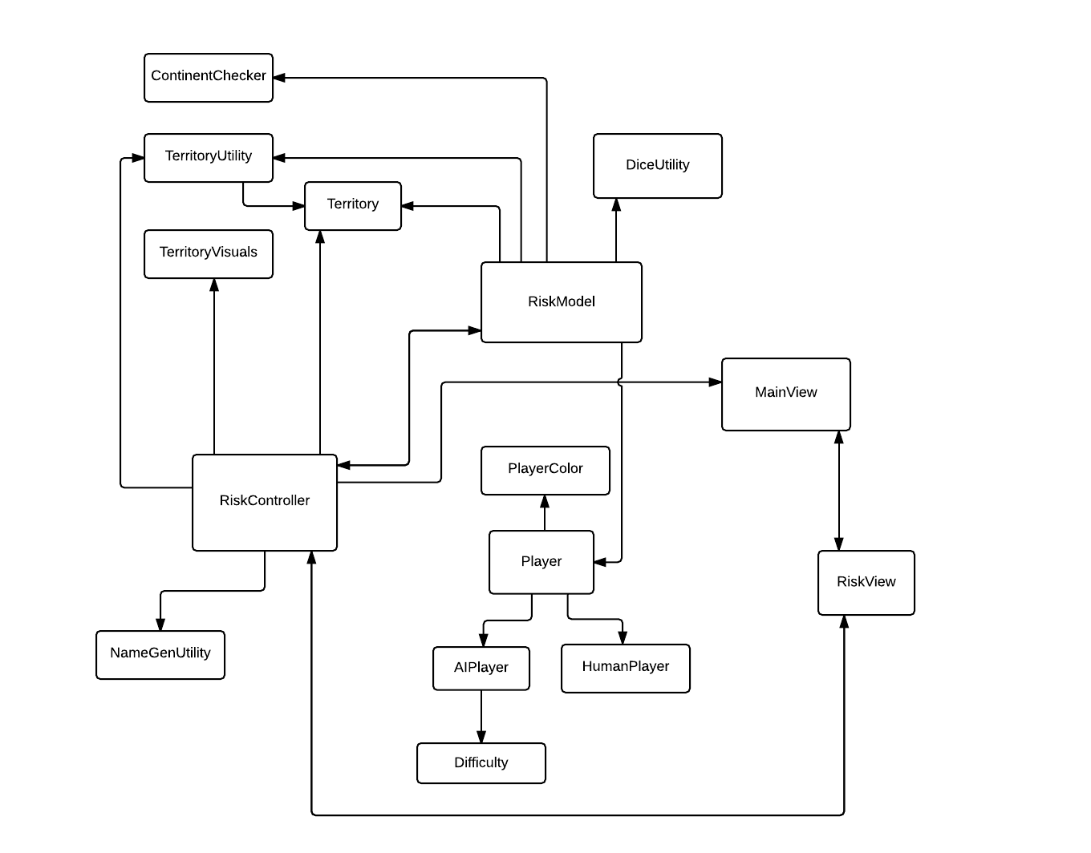
Design and Implementation - Major Classes

Slide 6
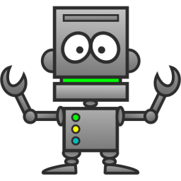
Design and Implementation - Data Structures/Algorithms
TerritoryVisuals Class
AI Functionality
Button sequences

Slide 7
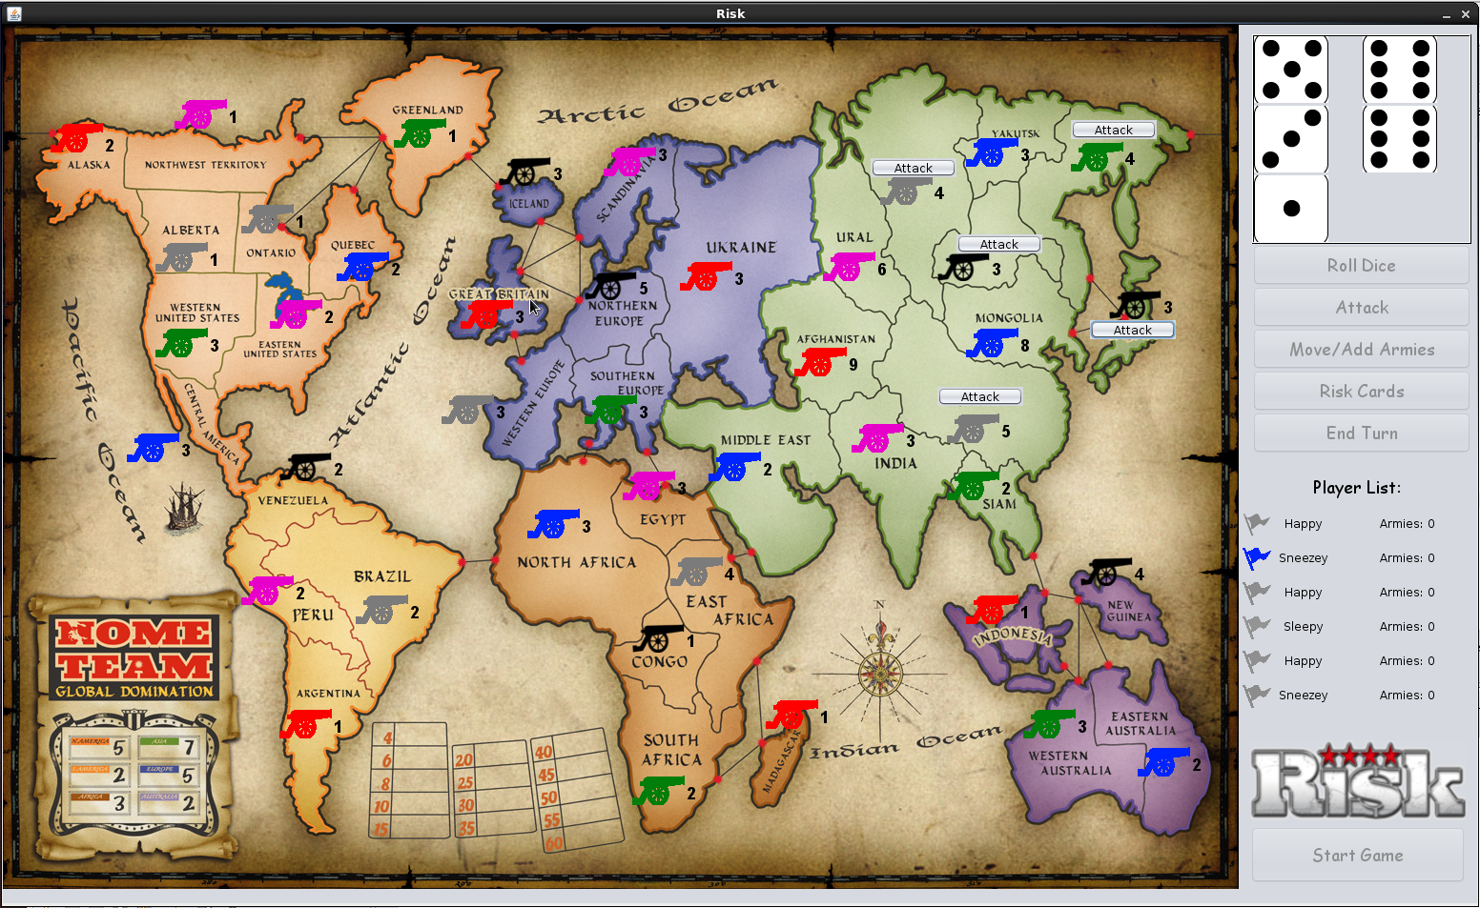
Our Interface

Slide 8
Demo
Basic setup and attacking

Slide 9
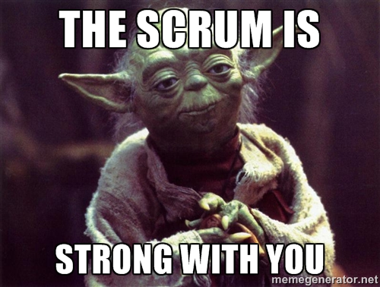
Conclusion
Challenges:
Yodiz
Communication
What you learned:
Better long-term planning
What would be in version 2.0:
Cancelling actions
Better TerritoryVisuals class design

