Slide 1

Final Project Classifying White-Blood-Cells
Jonak, Paul
CSCI E-89 Deep Learning
Harvard University Extension School
Prof. Zoran B. Djordjević
Notes:
Allo, my name is Paul Jonak and this video describes how I built a white blood cell classifier. This project was undertaken as the final project for the Deep Learning course at the Harvard Extension School.

Slide 2
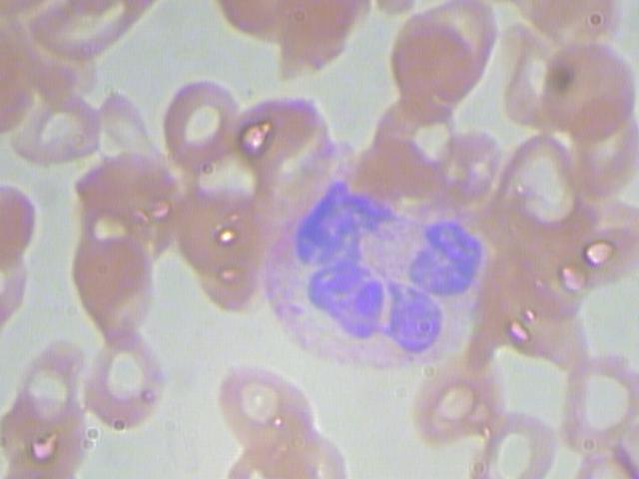
Problem Statement
Images were taken of a patient’s blood sample to identify, characterize and count the various components present.
Given an image containing a single white-blood-cell, classify what type of white-blood-cell is shown.
Neutrophil
Notes:
Our blood is comprised of red blood cells, white bloods cells, platelets, and more. Doctors take blood samples to get approximate counts of these components to monitor your health or diagnose conditions. As an example, a bacterial infection will result in a high white blood cell count and a low count may indicate a viral infection.
Another way we could approach this is by identifying the class of white blood cells present. Each class has specialized roles as part of your immune system, therefore understanding which cell types are over- or under- represented could provide crucial diagnostic information.
For the task at hand, we assume a blood sample has been taken and we now have images of the white blood cells within that sample. The goal is to identify which class of white blood cells is present for each image.

Slide 3
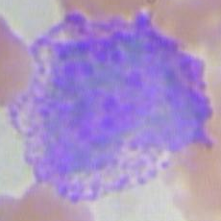
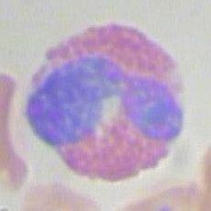
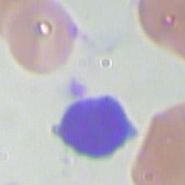
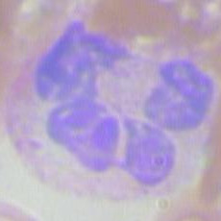
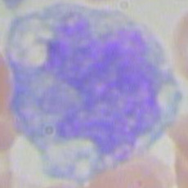
Why Is This Important?
Basophil
Knowing which white-blood-cells are over- or under- represented in your blood may identify your illness
Basophil
Warning system for allergic and antigen response
Eosinophil
Fight parasitic infections and allergic reactions
Lymphocyte
Make antibodies, fight viruses, fight cancer
Monocyte
Eat things and can activate certain lymphocytes
Neutrophil
Fight bacterial and fungal infections
Eosinophil
Lymphocyte
Monocyte
Neutrophil
Notes:
Going a bit deeper into the background, we’d like to briefly cover the role played by each white blood cell and show a corresponding sample image from the dataset. Starting at the top right, we have Basophils. These cells act as a warning system by releasing chemicals to increase blood flow to a target area, which in turn results in more white blood cells arriving. Next are Eosinophils, which fight parasitic infections and allergic reactions. They also happen to look awesome. Lymphocytes are not nearly as photogenic but they are incredibly important in that they fight viruses and cancer. Second from the bottom are Monocytes which collect dead cell debris and present these remains to Lymphocytes. This information exchange allows Lymphocytes to make antibodies to help fight future infections. Last are the Neutrophils which are the most abundant white blood cell. These cells are responsible for fighting bacterial and fungal infections.

Slide 4
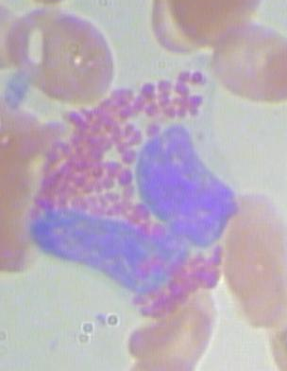
The Data
Found on Kaggle
kaggle.com/paultimothymooney/blood-cells
Approximately 400 source images covering 5 classes of white-blood-cells
480 x 640 x 3 images, dtype uint8
Augmentation expanded the dataset to 3,000 images per class
120 x 160 x 3 images, dtype uint8
4 classes -> 12,000 images
One class dropped due to lack of source images
Notes:
The data used for this project was found on Kaggle at the URL shown here. For the viewers not familiar with Kaggle, it is an online platform for data science competitions. These competitions involve prize money or the chance to interview at the company hosting the competition. Subsequently, it is a good place to find datasets to apply your machine learning skills.
The dataset used for this project consists of approximately 400 images covering 5 classes. Exploring the data revealed that one class, Basophils, had very few images. We dropped Basophils from analysis and then used augmentation on the remaining 4 classes to expand the dataset. We opted to generate a dataset with 3,000 images per class.
Additionally, the images were down-sampled by a factor of 4 and the pixel values were adjusted to be within the range of 0 to 1.

Slide 5
Configuration
Technology
Developed within Jupyter Notebook using Python 3.6
Modeling done with Keras
Tensorflow backend
ImageDataGenerator was used for data augmentation and for model training
Image handling performed with cv2 and PIL
Non-image data manipulation done with Numpy and Pandas
Visualization and plotting via Matplotlib
Tensorflow GPU requires Nvidia cuDNN
Hardware
OS: Windows 10
CPU: AMD Ryzen 1950x (16-core, 3.4GHz)
RAM: 64GB DDR4
GPU: dual Nvidia GTX 1080 Ti (3854 CUDA cores, 11GB GDDR5X)
Notes:
For this project, the code was developed with Python 3. The modeling was done with Keras using a Tensorflow backend. More specifically, the GPU variant of Tensorflow was used alongside Nvidia’s deep neural network libraries. The other python packages include cv2 and PIL for image handling, Numpy and Pandas for general data handling, and Matplotlib for visualization.
I’m very lucky to have had a fairly powerful work computer to train these models on. In particular, the heavy-lifting was done by two 1080 Tis.

Slide 6
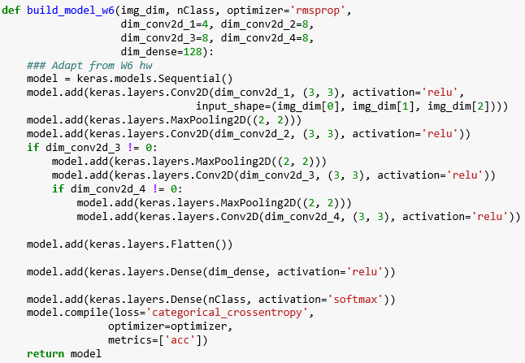
Building The Classifier
Began by adapting the dog-cat classification model from Week 6
“5.2 – Using Convnets With Small Datasets” by Francois Chollet
Performed grid search for optimal number of Conv2D layers and their size parameter
Notes:
Before building any models, the course material was scanned for problems of a similar nature. As dogs and cats are merely a collection of cells, the dog-cat classifier built in Week 6 seemed like an appropriate place to start. The model provided was built by Francois Chollet. We adapted his model by changing important parameters into variables, and then performing a grid search to see which values would provide the best model. This was first done on a small subset of the data, followed by a narrower search on a medium-sized dataset.

Slide 7
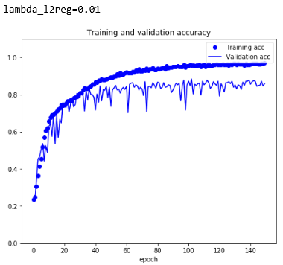
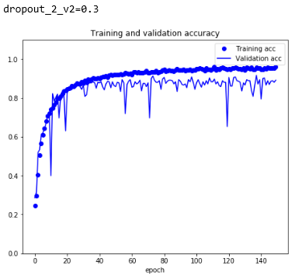
Building The Classifier
Tuning was also performed on
Optimizer ( RMSPropr vs Adam vs Nadam )
ImageDataGenerator properties ( i.e. batch size and steps per epoch )
L2 Regularization vs Dropout vs combination of Dropout & L2 Regularization
Tuning Dropout requires a lot of time investment!
Notes:
Once the optimal model structure was determined, we looked at other properties such as the optimizer, as well as options for dealing with over-fitting. We’d like to direct the viewers attention to the two plots showing accuracy across epochs when using L2 regularization on the left and dropout on the right. These charts were generated on the medium dataset. We see that dropout performs slightly better than L2 regularization, though neither appears to reach 90% validation accuracy.

Slide 8
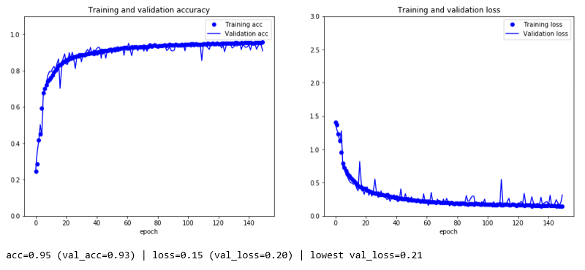
Results
With L2 Regularization, we were able to correct for over-fitting and achieve 93% acc
Dropout performed surprisingly poorly on the full dataset
Notes:
When we move from the medium dataset to the full dataset, three things happen. First, dropout performs very poorly in comparison to L2 regularization, though this isn’t shown. Second, with L2 regularization, our validation accuracy passes 93% even before full convergence. Lastly, the validation loss plot on the right indicates that over-fitting has been thoroughly addressed.
We are quite pleased with these results as a first pass.

Slide 9
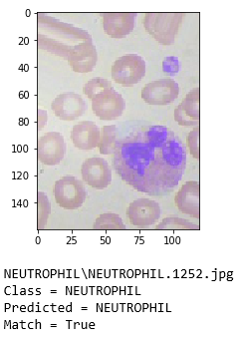
DEMO
Let’s try to make predictions with the model
Hopefully you’ll see this:
Notes:
And now let’s run a prediction with the model
SWITCH TO JUPYTER NOTEBOOKS
We’ll start by loading our python packages. You can see here that Tensorflow is using the CPU and not the GPU as when training.
Next we prepare file locations. Okay, now we’re ready to load our model. The summary output shows the model’s structure. We have an intermixing of 4 convolutional layers and 3 max pooling layers. This is followed by a flattening layer and then two dense layers. The last dense layer has output of 4, which corresponds to the 4 classes of white blood cells that we are targeting. This will be discussed further a littler later.
With the model loaded, we prepare the ImageDataGenerator object. This is from Keras’s preprocessing routines. We use the ImageDataGenerator object when augmenting the dataset and when we fed batches of input images into the model for training. With this approach, we don’t need to worry about having more training data than will fit in memory. This is an incredibly powerful tool. Here, we use ImageDataGenerator to prepare test images prior to making predictions, and to feed the images into the final model to generate those predictions.
Here we see a sample output from the model. For a given image, our model outputs a vector of 4 probabilities. The first position of the output vector refers to the probability the image is an Eosinophil, the second with Lymphocyte, and so forth. We can find the position of the largest probability to determine which class of white blood cell is shown. To do this, we’ve built a small function that will also tell us the true class for the image, and display the image itself.
Okay we’re ready to inspect the results. We’ll randomly sample 5 images. Let’s see what the model found

Slide 10
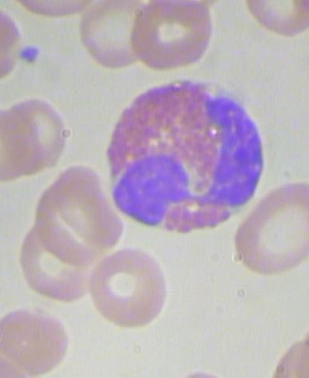
Lessons Learned
Adapt pre-existing models that are relevant to the case at hand
Model tuning is time consuming -> plan ahead!
Lowest point in a validation loss plot may be more informative than the final point
Acts as a proxy for expected validation loss after correcting for over-fitting
Approach taken to correct for over-fitting must be validated when moving from smaller test dataset to larger final dataset
Notes:
The lessons learned from this project center around time and planning. Model building and model tuning can be time consuming, therefore one should try to build off past work where possible. You should also have a clear plan for your tuning, with an understanding of which parameters you want to focus on first.
It was found that over-fitting should be dealt with last. This is evident by the drastic performance difference seen with L2 regularization and dropout when moving from the medium dataset to the full dataset. With the larger dataset, L2 regularization performed perfectly while Dropout was disappointing. With that said, perhaps changing the dropout rate would have led to even better results.
This sort of reasoning could lead to excessive tuning. Be mindful of your time and have a general idea of when the model is good enough. For this project, the final model met and exceeded our expectations. It could be better, but we’re really happy with it as a first pass.

Slide 11
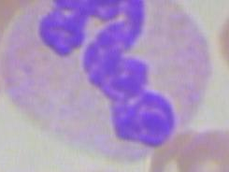
More Info
Acknowledgements
Prof. Zoran B. Djordjević
Francois Chollet & the TAs!
Lastly, an awesome white blood cell from the dataset
Notes:
I’d like to conclude by thanking our professor Zoran Djor-De-vch, Francois Chol-le, and all the other hard-working TAs. Thank you for a great course.

