Slide 1

Final Project Classifying White-Blood-Cells
Jonak, Paul
CSCI E-89 Deep Learning
Harvard University Extension School
Prof. Zoran B. Djordjević
Notes:
Allo, my name is Paul Jonak and this is a short video summarizing my attempt to build a white blood cell classifier.

Slide 2
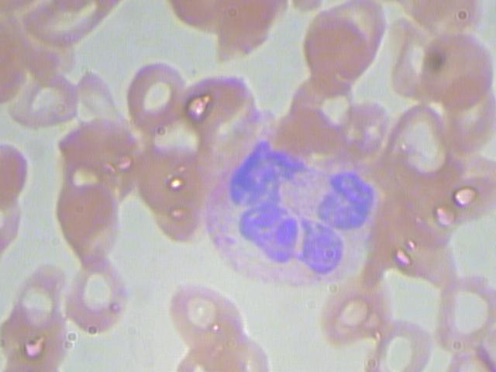
Problem Statement
Images were taken of a patient’s blood sample to identify, characterize and count the various components present.
Given an image containing a single white-blood-cell, classify what type of white-blood-cell is shown.
Neutrophil
Notes:
Our blood is comprised of several components. Doctors take blood samples to get approximate counts of these components to monitor your health or diagnose conditions. With white blood cells, there are 5 main classes, each playing a specific role. A more targeted approach would therefore identify and count the classes of white blood cells present. For instance, high levels of neutrophils might suggest a bacterial infection, and high levels of lymphocytes could indicate a viral infection.
To that end, our task is to take an image from a blood sample and identify what class of white blood cell is shown.

Slide 3
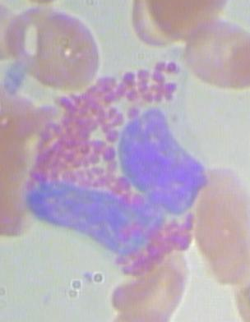
The Data
Found on Kaggle
kaggle.com/paultimothymooney/blood-cells
Approximately 400 source images covering 5 classes of white-blood-cells
480 x 640 x 3 images, dtype uint8
Augmentation expanded the dataset to 3,000 images per class
120 x 160 x 3 images, dtype uint8
4 classes -> 12,000 images
One class dropped due to lack of source images
Notes:
The data used for this project was found on Kaggle at the URL shown here. This dataset has approximately 400 images covering the 5 main classes. Due to lack of data, one class was dropped. For the remaining 4 classes, augmentation was performed to expand the dataset to hold 3,000 images per class.
Additionally, the images were down-sampled and the pixel values were adjusted to be within the range of 0 to 1.

Slide 4
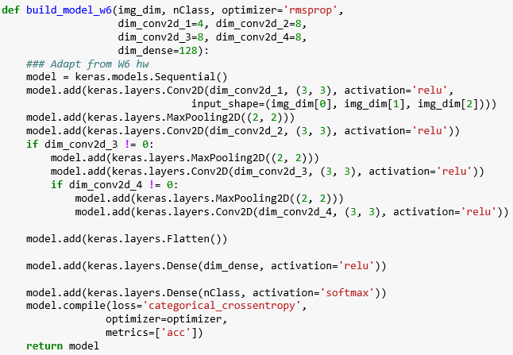
Building The Classifier
Began by adapting the dog-cat classification model from Week 6
“5.2 – Using Convnets With Small Datasets” by Francois Chollet
Performed grid search for optimal number of Conv2D layers and their size parameter
Notes:
To tackle this problem, a convolutional network was built by adapting Francois Chollet’s dog-cat classifier from Week 6 of this course. Rather than hard-coding layer properties, we made use of variables and grid searched for optimal values.

Slide 5
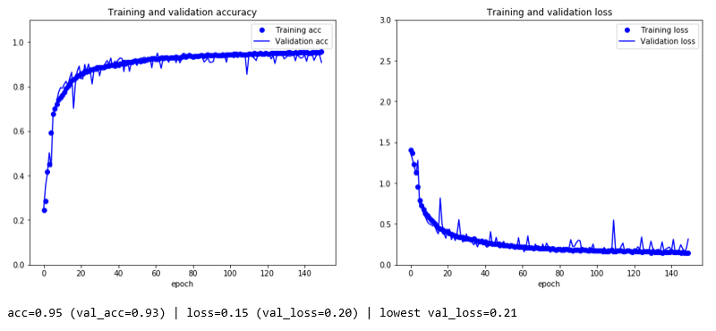
Results
With L2 Regularization, we were able to correct for over-fitting and achieve 93% acc
Dropout performed surprisingly poorly on the full dataset
Notes:
Once the optimal model structure was determined, we corrected for over-fitting with L2 regularization. The final model was able to achieve 93% validation accuracy even before full convergence.

Slide 6
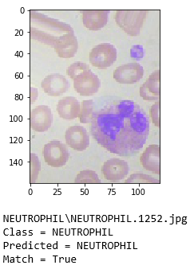
DEMO
Let’s try to make predictions with the model
Hopefully you’ll see this:
Notes:
And now let’s run a prediction with the model

Slide 7
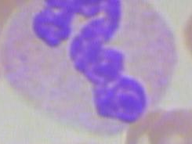
More Info
Acknowledgements
Prof. Zoran B. Djordjević
Francois Chollet & the TAs!
Lastly, an awesome white blood cell from the dataset
Notes:
Thank you for listening to this short summary.

