Slide 1
Writing software for parallel machines
Kees van Reeuwijk

Slide 2
This is a workshop
The goal is to learn by doing
I assume you work in pairs
I assume you have an account on the lisa
There is a processor reservation for this workshop: 10 nodes just for us
We are going to use the C programming language
I will teach you enough C to do the workshop, but not full C
The hands-on periods also serve as pauses, but for chatting please go outside
Short questions during the presentation are ok. If it’s complicated please ask in the pauses

Slide 3
Outline
Background: why, where & how (overlaps Adam Belloum’s teachings)
C programming survival guide
Introduction to OpenMP
Get your own OpenMP program running
Introduction to MPI
Get your own MPI program running
The graded assignment
The red sections have a hands-on part

Slide 4
Part 1: Background

Slide 5

Why do parallel programming at all?
Inherently distributed: web server, collecting data, IoT, communication application
Speed! One processor is not enough for me!
Private Eye/Tony Husband

Slide 6

Moore’s law won’t save you any more
Up until about 15 years ago (Pentium 4), for more computing power you could just wait for the next generation of processor
These processors often used parallelism for the speedup, but they still looked like a sequential processor
Now processors are multi-core and multi-threaded, and you have to use parallelism

Slide 7
Parallel hardware: in a compute node
In one compute node:
Possibly multiple processors
Multiple cores
Multithreading
(GPUs)
(Storage nodes)
Core
Core
Core
Core
Cache
Cache
Cache
Cache
Cache
Cache
CPU
CPU
Memory & disk
Compute node

Slide 8
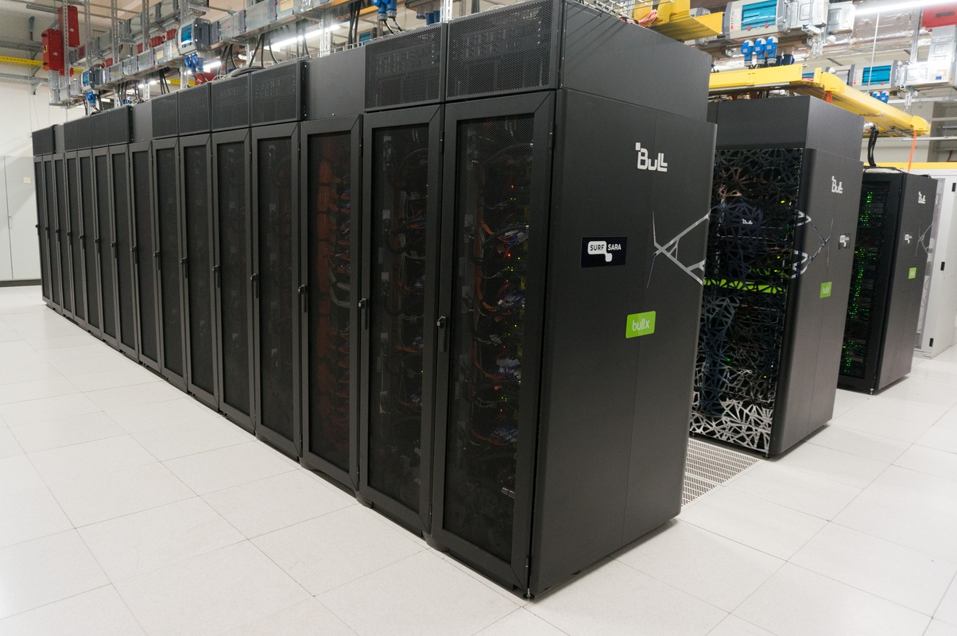
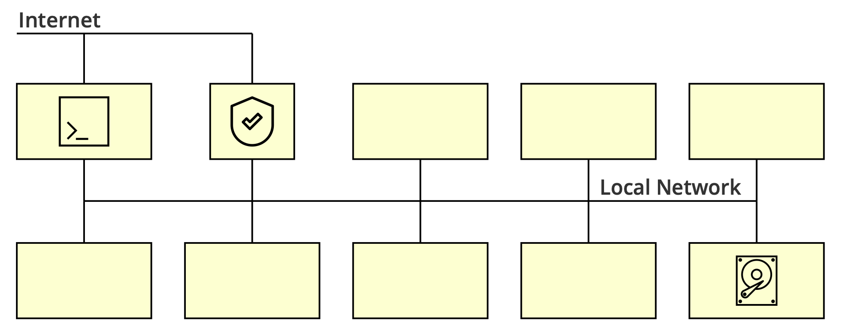
Parallel hardware: clusters
Fast local network
10GB Ethernet
InfiniBand
Head Nodes
Storage node(s)
SurfSara Cartesius (March 2016)

Slide 9
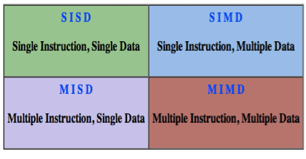
Assumptions
A node has one address space, even with more than one processor in the node
An address space does not span multiple nodes
Between nodes, message passing is used

Slide 10
Complications
Within an address space, access times are messy
But try to keep accesses local
Not all nodes may be equally powerful
Not all communication may have the same speed
In general: don’t rely on exact timing, things can and will be unpredictable

Slide 11
Programming

Slide 12
Threads
A thread is a single execution sequence
The order of execution is deterministic (only determined by state and input)
The processor is free to change the order of execution, as long as the final observable result is the same
A program with a single thread is a sequential program, the traditional approach
Sequential programs are far easier to understand
A sequential program can only use one core
A program with multiple threads is a parallel program

Slide 13
Creating more threads is easy
thrd_t thread;
thrd_create(&thread, fn, NULL);
Thread t = new Thread(runable);
t.run();
C
Java
… but then what?

Slide 14
Parallel programming is hard!
You have to understand each individual thread
You have to understand the interaction between threads
You have to worry about efficiency
You have to worry about failures
… and what did we just say about exact timing?

Slide 15

Parallel programming is hard!
Finding the parallelism
Race conditions & deadlocks
Efficiency
Portability
Scalability
FOKKE & SUKKE work at the helpdesk
So you only
switched it on…
And then
THIS happened?

Slide 16
Dependencies
“This step can only be done after that step is finished”
The dependency can be:
A previous step in a sequence
A previous iteration
A computation of control flow (if, loop, etc.)
The absence of dependencies allows parallelisation
Not everything can be parallelised
Rewriting may be necessary
a = 12;
b = a + 2;
c = a + 3;
d = b + c;
for(i=1..10)
a[i] = a[i-1]*2;
if (v<0)
d = -2;
else
d = 2;

Slide 17
Race conditions
int primes = 0;
par {
primes += is_prime(5);
primes += is_prime(7);
}
int primes = 0;
par {
primes += 1;
primes += 1;
}
int primes = 0;
par {
primes += 1;
primes += 1;
}
load R0, primes
add R0, 1
store R0, primes
load R0, primes
add R0, 1
store R0, primes
Watch out when you modify any shared resource
load R0, primes
load R0, primes
add R0, 1
store R0, primes
add R0, 1
store R0, primes
This can result in primes = 1 if you’re not careful.
The only correct executions are those where the red and green sequences are executed without interleaving with the other sequence. It is said they should be executed atomically, because they are critical sections.

Slide 18
Atomic operations
We need to protect sections that should be atomic. One solution: mutual exclusion locks
#include <stdatomics.h>
mtx_t lock;
void atomic_add_primes(int n){
mtx_lock(&lock);
primes += n;
mtx_unlock(&lock);
}
par {
atomic_add_primes(is_prime(5));
atomic_add_primes(is_prime(7));
}
#include <omp.h>
par {
#pragma omp atomic
primes += is_prime(5);
#pragma omp atomic
primes += is_prime(7);
}

Slide 19
Deadlock

Slide 20
Efficiency
Keep all your important resources busy:
Processors
Memory banks
Disks
Communication networks

Slide 21
Scalability & Portability
Does your parallel program also work on twice as many processors?
Does your parallel program also work on the next generation of processors?
Does your parallel program also work on that other shiny high-performance platform?
At some point you unavoidably have to say ‘no’, but try to be flexible
Using higher-level frameworks helps!

Slide 22
Communication
Communication is relatively slow: even with fast networks and perfect circumstances it takes at least 1μs (InfiniBand) to 7μs (10GB Ethernet) within a cluster
Thus you have time to execute thousands of instructions in the time to send a message
Long-distance communication is inherently slow: speed of light in glass fiber is about 2e8 m/s, so the Netherlands measures about 1ms x 1.5 ms, Amsterdam->Paris is 2.5 ms, Amsterdam->New York is 28 ms, and Amsterdam->Tokyo is 46ms
Try to overlap communication and computation

Slide 23
Parallel programming patterns
To avoid all these headaches of parallel programming, we need simpler programming models, or at least recommended programming patterns
Ideally, a magic language/compiler would take care of it all, but that is impossible
None of these models or patterns is suitable for every problem
None of these models/patterns avoids all problems

Slide 24

Fork/join parallelism
Random thread creation can be messy, structuring helps
Rules:
A thread can be split in a number of threads (fork)
At some point the threads wait for each other to complete (barrier) and a single thread continues (join)
Nesting is allowed
OpenMP supports fork/join parallelism, and we’re going to use it

Slide 25
Master/worker
Work is handed out by a master, work is done by workers
Master or workers can be idle if you’re not careful
Too few workers -> master is idle
Too many workers -> master overworked -> workers idle
It may make sense to have more than one master
Also works if some workers are slower: they just do a smaller share of the work
Communication latency
Local work queue
Larger chunks of work
We’ll do an MPI implementation of master/worker, OpenMP also has some support

Slide 26
Data parallel
Each processor is given responsibility for a part of the data, including computations on it (owner computes rule)
If the computation requires data from other processors, they send that data to the processors that need it
Works best if all processors have roughly the same amount of work, not too much communication
Can be tweaked with well-chosen data distribution
Good fit with message passing: supported by MPI, we’ll do an example

Slide 27

Data distribution - 1D
Which processor owns which element of an array? Many distributions are possible
We only show symmetric distributions, but this can be generalised
block
cyclic
Assign a single block of consecutive elements to each processor. As much as possible, divide equally over the processors
Assign elements one by one to the processors. Repeat as necessary to place all elements.

Slide 28






Data distribution - 2D
For 2D arrays we can apply a distribution to each dimension, or ignore a dimension
block, block
block, *
*, block
cyclic, cyclic
cyclic, *
*, cyclic

Slide 29
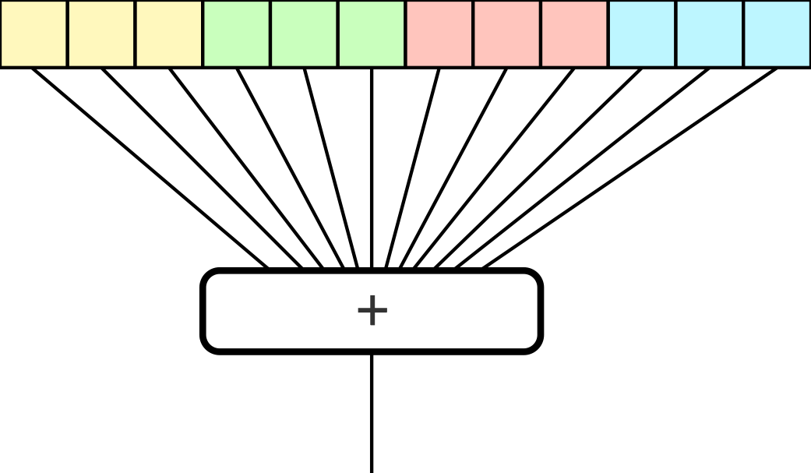
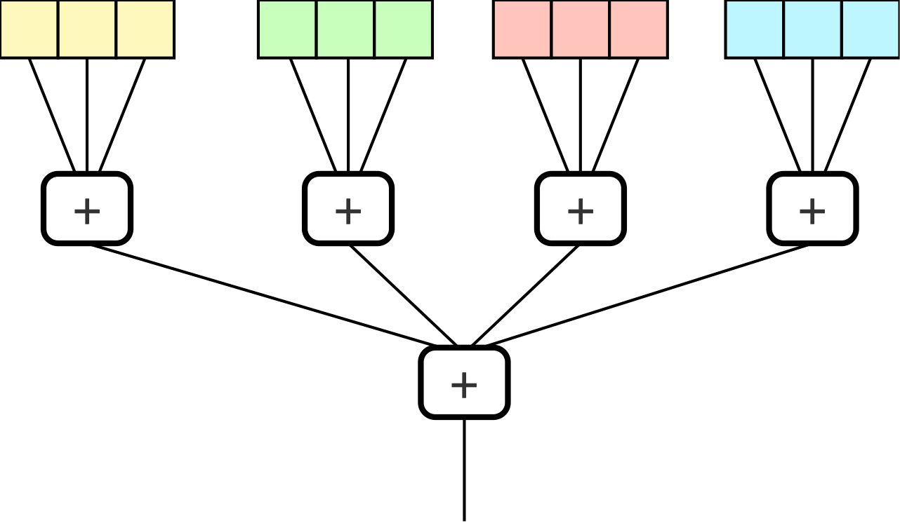
Reductions
Problem: compute sum of the elements of a distributed array
Solution: compute local sum, then add all the subtotals
Similar for product, minimum, maximum, and/or/xor
This is called a reduction
Supported by both OpenMP and MPI

Slide 30
Part 2: Reading C

Slide 31
Goal
Let you learn to use OpenMP and MPI through hands-on experience
Both OpenMP and MPI support Fortran and C, OpenMP also supports C++
For the hands-on sessions we use C
Minimal overview of C to get you through the sessions
Mostly for reading: you will have to write some C, but all the difficult stuff will be given
There are ‘cheat sheets’ available

Slide 32
Hello world
A preprocessor replaces #include directives with the contents of
the specified file. The preprocessor also does variable substitution
and conditional substitution
#include <stdio.h>
int main() {
printf("Hello, World!\n");
return 0;
}
A C program starts in a function called main
printf formats a string and prints it to the standard output
Returning from main ends the program with the given exit code
Even better: use make
> make hello
gcc -W -Wall hello.c -o hello
> ./hello
Hello, World!
> gcc hello.c -o hello
> ./hello
Hello, World!

Slide 33
Functions
/* Given an integer ’n’, return ‘true’ iff ’n’ is prime. */
bool is_prime(long int n) {
if (n < 2) {
return false; // By definition
}
if ((n % 2) == 0) {
return n == 2; // There is only one even prime: 2
}
const long int top = (long int) ceil(sqrt(n));
for (long int k = 3; k <= top; k += 2) {
if ((n % k) == 0) {
return false;
}
}
return true;
}
The calculation
Function signature
long int
const
for loop
Comment

Slide 34
The #define
The preprocessor also handles token substitution:
#define ITERATIONS (25)
All subsequent instances of the token ITERATIONS will be replaced by (25)
Tokens, so something like ITERATIONS_ENABLED will not be affected
By convention, these names are in CAPITAL LETTERS, but nothing stops you from breaking that convention (except modern compilers may warn you)

Slide 35
Types
type | printf format | bits | description
int | %d | 32 | integer
long int | %ld | 64 | long integer
char | %c | 8 | character
double | %f | 64 | floating-point number (IEEE 754-1985)
char * | %s | 64 | pointer to char (strings are char arrays that end with a ‘\0’ character)
void |  | n.a. | the ‘nothing’ type
void * | %p | 64 | pointer to anything
bool | %d | 8 | Boolean
Disclaimer: the C standard does not dictate the exact number of bits in a type, this is just for `normal’ systems.
It is allowed to have a 9-bit char, a 48-bit int, or a double with a different floating-point representation, although this is mostly historic or for exotic processors.

Slide 36
Constants
int constants: 12, 0, -3
double constants: 1.0, 1e4, 1.3e-10
char constants: ‘a’, ‘B’, ‘1’, ‘@‘, ‘\t’(tab), ‘\n’(new line), ‘\r’ (carriage return), ‘\0’ (null), normally 8-bit ASCII or Unicode.

Slide 37
Arrays
Array types are written as <type> <var>[<size>], where <size> is a constant. Examples: int t[9], char *w[6]
Accessing elements also uses [ ]:
int a[10];
a[0] = 1;
for (int i=1; i<10; i++)
a[i] = 2 * a[i-1];

Slide 38
Pointers
Pointers are typed addresses, type is written as <base-type>*
Examples: int *, char **
The & unary operator takes the address of an assignable expression
Array variables are almost pointers, but they have a fixed value
Accessing elements uses * or [ ]:
#define COL_SZ 5
#define ROW_SZ 8
double a[COL_SZ*ROW_SZ];
double *col = &a[2*COL_SZ];
for (int i=0; i<COL_SZ; i++ )
col[i] = -1.0;
int v = 3;
int *p = &v;
*p += 2; // v is now 5

Slide 39
Strings
Strings don’t have a special type, they are char *
Strings should end with a null character (‘\0’)
char *greeting = “Hello”;
greeting
H
e
l
l
o
‘\0’

Slide 40
Printf
The function printf prints a string to the standard output, with format strings replaced by the value of extra parameters
Example: printf(“The square root of %d is %f\n”, 3, sqrt(3));
Output: The square root of 3 is 1.7321
Example: printf(“Error at line %d: %s\n”, 3, “value is negative”);
Output: Error at line 3: value is negative
Use %% to get a single %

Slide 41
Pragmas
C has a pragma annotation construct in the preprocessor: #pragma
Gives hints to the compiler. The compiler may, or may not use them
Most annotations are compiler-dependent, but there are a few in the standard (C99):
Used in OpenMP
#pragma STDC FP_CONTRACT ON
double v = (0x1p512*0x1p512)-0x1p1023;
Allow fused multiply-add, possibly avoiding inf here.

Slide 42
Now let’s run something
As a warmup, let’s compile and run that “hello world” C program
I assume you will do these things on your Lisa account
If you don’t have one, any other slurm cluster will work, but things might be a bit different
You may even be able to do some of this stuff on a Mac OS or Linux laptop
… or perhaps even a Windows laptop with Linux subsystem
At this point you’re on your own, though

Slide 43
Compiling and running C programs
> cd ~
> mkdir lab
> cd lab
> git clone https://github.com/CvR42/parallel-demo.git
> cd parallel-demo
> make hello
gcc -W -Wall hello.c -o hello
> ./hello
Hello, World!

Slide 44
Using a slurm queue
> sbatch hello-sbatch.sh
Submitted batch job 14696
> squeue -u $LOGNAME
…
> cat slurm-14696.out
Hello, World!

Slide 45

Now write some code
Modify hello.c to print the square of 5
Hints:
printf(<string-with-formats>, <parm>…<parm>);
The printf() format string you need is %d
See https://github.com/CvR42/parallel-demo/tree/master/reference for some help
printf(“The square of 5 is %d\n”, 5*5);

Slide 46
Part 3: OpenMP

Slide 47
OpenMP Properties
Assumes shared memory, so only within a single node
fork/join parallelism: split execution into multiple threads, and wait for these threads to terminate
Can be nested
Consists of #pragma annotations and library calls

Slide 48
OpenMP Annotations
The core of OpenMP is a set of parallelisation pragma’s:
Works on the for immediately after it
Divides the iterations over the threads, how is up to the implementation
Sequential execution is still correct
Only recognises for loops with one loop variable, constant bound and increment, and no modification of loop variable in loop
No jumping out of the loop (return, break, goto)
#pragma omp parallel for
for(int i=0; i<1000; i++){
squares[i] = i*i;
}

Slide 49
Parallel sections
The threads can also do completely different things:
#pragma omp parallel sections
{
#pragma section
{ primes += is_primes(5); }
#pragma section
{ primes += is_primes(7); }
}

Slide 50
Shared and private
Variables can be public between threads or private to an iteration
Obvious default: everything within parallel section is private, everything outside is public
Can be changed in the pragma declaration:
#pragma omp parallel for public(b) private(v)
int a[100];
int b = 33;
#pragma omp parallel for
for (int i=0; i<100; i++){
int v = 2*i + b;
a[i] = v;
}

Slide 51
Reduction variables
Reduction variables get special treatment: local and public
int sum = 0;
#pragma omp parallel for reduction(+:sum)
for (int i=0; i<100; i++)
sum += a[i];

Slide 52
Availability OpenMP
Shared-memory parallelism for Fortran, C, and C++
See openmp.org
Now at version 5.0 of Nov 2018. Version 4.5: Nov 2015, version 4.0: July 2013
At least some version supported by many standard compilers, in particular GCC family (5.0, partially), Intel C/Fortran (5.0, partially), LLVM (Clang, 4.5)
Can even deal with nested and other complicated parallelism structures, but that’s advanced
Bindings for other languages are problematic: requires compiler support

Slide 53
Part 4: Running OpenMP

Slide 54
Your mission…
Count the number of primes in a range of integers.
I already gave the function is_prime(), now I give you the main() function.
int main(void) {
const long int base = 10000000000001L;
const long int r = 400000;
int primes = 0;
for (long int n = base; n < base + r; n += 2) {
bool prime = is_prime(n);
if (prime) {
primes++;
}
}
printf("There are %d primes between %ld and %ld.\n", primes, base, base + r);
return 0;
}

Slide 55
Compiling and running an OpenMP program
Edit primes-omp.c to parallelise it
Compile it to a runnable program with: make primes-omp
Submit job with: sbatch primes-omp-sbatch.sh
Check the work queue with: squeue -u <login-name>
Look at slurm-xxxx.out for the result of the run (There should be 67001 primes)
Write down the number of threads used, and the computation time
Edit the line OMP_NUM_THREADS=X in primes-omp-sbatch.sh to run with a different number of threads and go to step 3

Slide 56
Timing
Don’t bother with 1 or 2 cores!
Cores | Time (s) | Speedup | Efficiency
1 | 861.0 | 1.00 | 1.0
2 | 436.8 | 1.97 | 0.99
4 | 229.9 | 3.75 | 0.94
6 | 156.5 | 5.50 | 0.92
8 | 119.5 | 7.21 | 0.90
12 | 88.7 | 9.71 | 0.81
16 | 73.3 | 11.75 | 0.73

Slide 57
Part 5: MPI

Slide 58
Message Passing Interface
MPI (Message Passing Interface) is a library for communication with explicit messages
Intended for computations with multiple nodes
May even make sense within a node, may be implemented with shared memory
Or: it may be combined with OpenMP
Usually requires cooperation between the two parties: send operation must have a matching receive operation
Supported on many machines, different implementations
Optimised for large amounts of data across reliable networks (preferably symmetric)

Slide 59
Communicators, rank
Every MPI process belongs to one or more communication groups
The default communication group MPI_COMM_WORLD contains all processes
The group is passed to almost all MPI functions
Each group has a size, all processes in a group have a unique rank in the range [0,size>
size
int rank, size;
MPI_Comm_rank(MPI_COMM_WORLD, &rank);
MPI_Comm_size(MPI_COMM_WORLD, &size);

Slide 60
Send and receive
double vector[SZ];
MPI_Status status;
MPI_Send(vector, SZ, MPI_Double, 2, 0, MPI_COMM_WORLD);
MPI_Recv(vector, SZ, MPI_Double, MPI_ANY_SOURCE, 0, MPI_COMM_WORLD, &status);
Send an array of data to a receiving process
Receive an array of data from a sending process
Receiver may specify MPI_ANY_SOURCE, sender is put in a field in status
Similarly, receiver may specify MPI_ANY_TAG, tag is put in a field in status
For small messages MPI_Send() will return immediately, for large messages an MPI_Recv() is needed to accept the data before MPI_Send() returns
Functions return an error code. We ignore those which is BAD, BAD, no good at all

Slide 61
Send/receive
double vector1[SZ], vector2[SZ];
MPI_Status status;
MPI_Sendrecv(vector1, SZ, MPI_Double, 2, 0,
vector2, SZ, MPI_Double, 2, 0, MPI_COMM_WORLD, &status);
Send and receive in one call
There ordering of the operations is left to the implementation, may avoid deadlock
Send and receive buffers cannot overlap
Source and destination may be different, also size and even data type

Slide 62
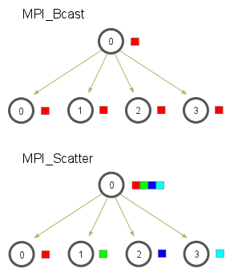
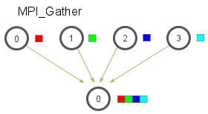
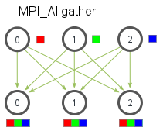
Collective communication patterns
Reduction
Broadcast
Scatter
Gather
All gather
Pictures: mpitutorial.com

Slide 63
Availability MPI
Message-passing library for Fortran, C, and C++
Two main implementations:
Open MPI, open-mpi.org (Current: v4.0 of Nov. 2018, v3.1 of May 2018)
MPICH mpich.org (Current: v3.3 of Nov. 2018)
Bindings libraries for Python, Java, Rust, Haskell, Perl, Mathematica, …

Slide 64
Part 6: Running MPI

Slide 65
Your mission…
Count the number of primes in a range of integers. See primes-mpi.c
Use master/worker pattern:
Workers wait for a number, compute is_prime(), send back result, repeat
A worker stops if it is sent 0 as the number
Master distributes work over workers
The node with rank 0 is master, others are workers
We give you initialisation, communication helpers, all worker code, and other bureaucracy
You have to add communication code to the function run_as_master()

Slide 66
Solution: worker
Accept work messages, send back results, until told to stop.
void run_as_worker(void){
while(true){
int val;
await_command(&val);
if (val == 0 ) {
break;
}
int result = is_prime(val);
send_result(result);
}
}

Slide 67
Solution: master
Send numbers to test to all workers until work is exhausted, then shut down workers
int run_as_master(int worker_count, long int startval, long int nval){
int active_workers = 0, primes = 0;
long int val = startval, endval = startval + nval;
for (int worker = 1; worker <= worker_count && val <= endval; worker++){
send_work_command(worker, val);
val += 2;
active_workers++;
}
while (active_workers > 0) {
int worker, result;
/* insert communication */
primes += result;
if (val <= endval) {
/* insert communication */; val += 2;
} else {
/* insert communication */; active_workers—;
}
}
return primes;
}

Slide 68
Compiling and running an MPI program
Edit primes-mpi.c to parallelise it: search for /* insert communication */
Compile it to a runnable program with: make primes-mpi
Submit job with: sbatch primes-mpi-sbatch.sh
Look at slurm-xxxx.out for the result of the run (there should be 67001 primes)
Write down the number of workers used, and the computation time
Edit the specification -N 1 in primes-mpi-sbatch.sh to run with a different number of processors, and go to step 3

Slide 69
Solution: master
Send numbers to test to all workers until work is exhausted, then shut down workers
int run_as_master(int worker_count, long int startval, long int nval){
int active_workers = 0, primes = 0;
long int val = startval, endval = startval + nval;
for (int worker = 1; worker <= worker_count && val <= endval; worker++){
send_work_command(worker, val);
val += 2;
active_workers++;
}
while (active_workers > 0) {
int worker, result;
await_result(&worker, &result);
primes += result;
if (val <= endval) {
send_work_command(worker, val); val += 2;
} else {
send_work_command(worker, 0); active_workers—;
}
}
return primes;
}

Slide 70
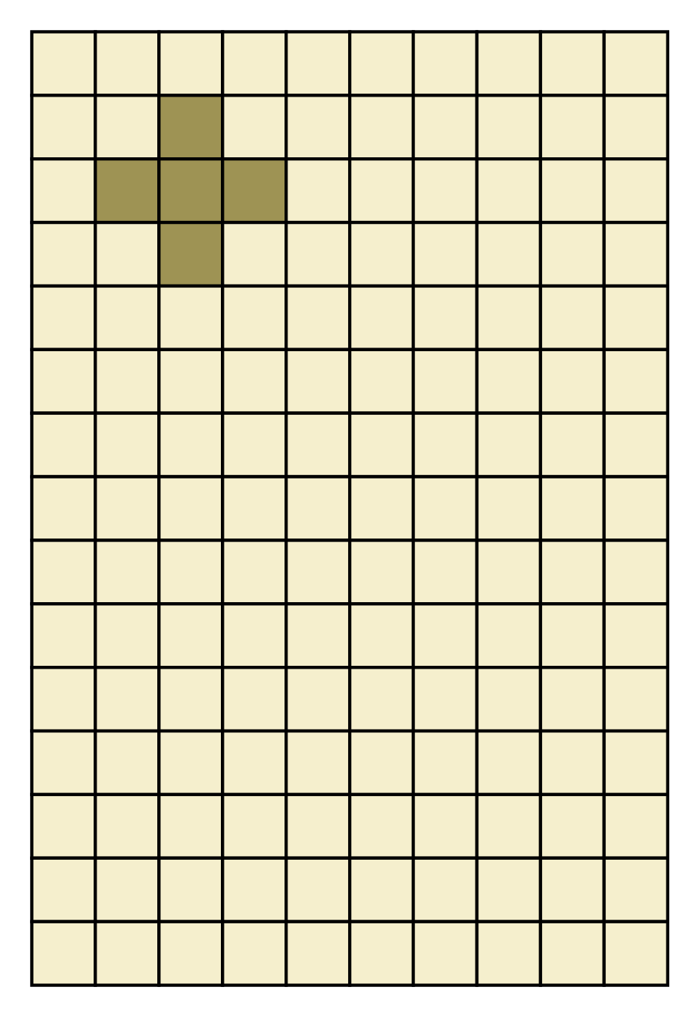
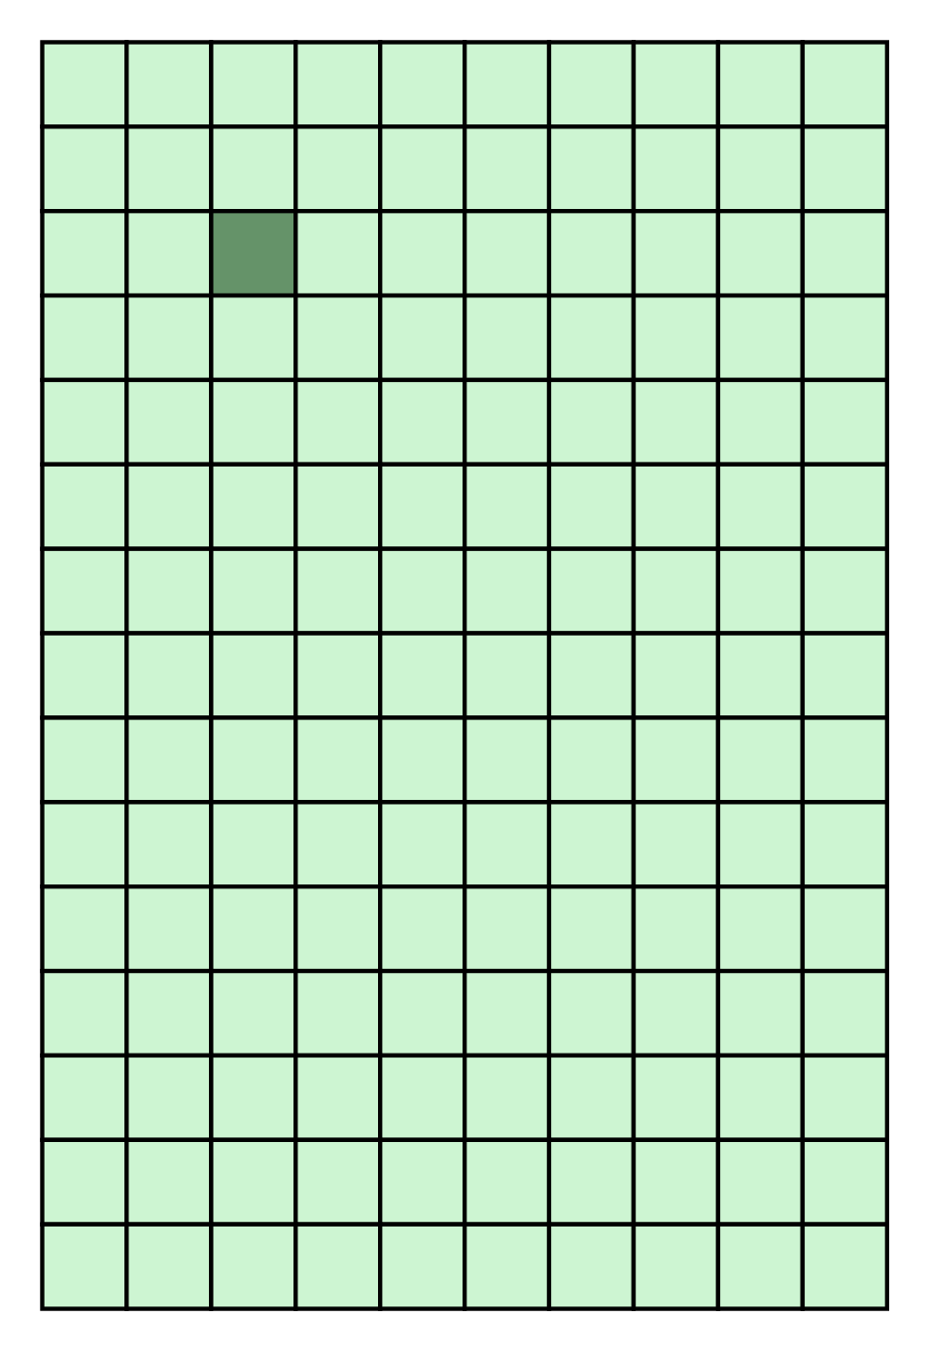
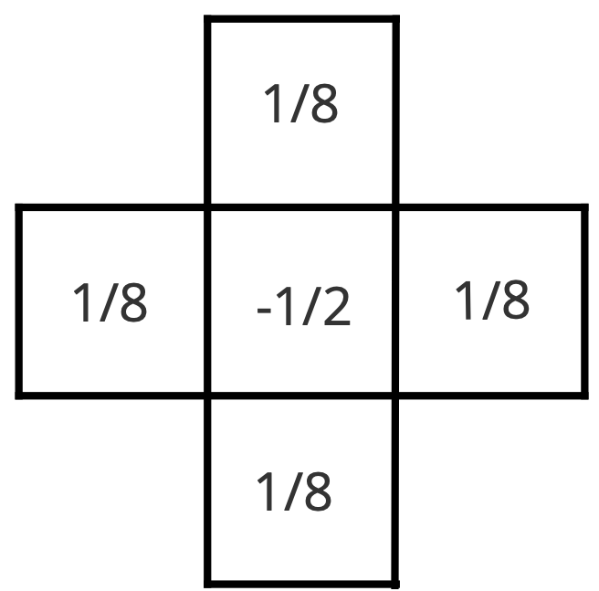
Stencil operations
Role of the arrays is swapped after each iteration
Typical for diffusion computations (including weather prediction)

Slide 71



Parallel stencil
Block distribution over processors
Requires border cells

Slide 72
The communication
void exchange_columns(const int proc, double *cells, const int send_col, const int recv_col)
{
double *send_buffer = &cells[compute_index(0, send_col)];
double *recv_buffer = &cells[compute_index(0, recv_col)];
// Add code to send and receive columns here
// Hints: use a tag value of 0, use MPI_COMM_WORLD
}
Use the official documentation (I’ll give a pointer)
Mind the hints

Slide 73
Compiling and running an OpenMP program
Edit the function exchange_columns() in stencil-mpi.c. Add code to send and receive columns
Use https://www.open-mpi.org/doc/current as reference
Compile it to a runnable program with: make stencil-mpi
Submit job with: sbatch stencil-mpi-sbatch.sh
Look at slurm-xxxx.out for the result of the run (25 iterations in less than a second)

Slide 74
Now let’s scale up…
Edit stencil-mpi.c to go from 100 rows to 1000 rows
Compile it to a runnable program with: make stencil-mpi
Submit job with: sbatch stencil-mpi-sbatch.sh
Look at slurm-xxxx.out for the result of the run

Slide 75
DEADLOCK?!?
MPI_Send() may block until data is received!
Who is going to do the receiving?!?
What is going on here?
Everyone sends to left neighbour (if any)
Everyone receives from left neighbour (if any)
Everyone sends to right neighbour (if any)
Everyone receives from right neighbour (if any)

Slide 76
Solution
Arrange that even-numbered processors first send, then receive, odd-numbered processors first receive, then send
Use MPI_Sendrecv() and let the implementation determine who sends first
Use special MPI_Isend() that never blocks
You’ll have to wait explicitly later on to ensure communication is finished

Slide 77
Using MPI_Sendrecv()
void exchange_columns(const int proc, double *cells, const int send_col, const int recv_col)
{
MPI_Sendrecv(&cells[compute_index(0, send_col)], ROWS, MPI_DOUBLE, proc, 0,
&cells[compute_index(0, recv_col)], ROWS, MPI_DOUBLE, proc, MPI_ANY_TAG,
MPI_COMM_WORLD, MPI_STATUS_IGNORE);
}
Avoids deadlock
Inefficient, because everyone looks left first, so communication between processors is not parallel.
Can be solved by an odd/even pattern

Slide 78

Milestone!
You may have compiled your first C program
You may have written your first C program
You may have written your first parallel program
You have written and run your first OpenMP program
You have written and run your first MPI program
You may have created your first race condition
You may have created your first deadlock
Debagarh (in Odia language), also known as Deogarh, is a city in Odisha state of eastern India. Located in the North-Western region of the state, it is the headquarters of Debagarh District that was created on 1 January 1994, after being bifurcated from Sambalpur District.
(Source: wikipedia)

Slide 79
Part 7: Assignment

Slide 80
Matrix-vector multiplication
Given a matrix M of size N x N and a vector V of size N, implement V = M x V
Choose a memory layout and distribution of M and V for maximal efficiency of this computation
Add code to repeat the computation R times, and to measure the overall execution time
Hint: the MPI collective communication function
Hint: it may (or may not) be a good idea to replicate V over multiple processors
Show speedup curves for 16 processors/threads and less, for different choices of R and N, so that execution time on 16 processors/threads is roughly 60 seconds. Under that constraint, explore different combinations of N and R, and discuss the results
Write a report containing the full, commented, code of the implementation, a motivation of your chosen distribution and communication method, and a discussion of the performance
A passing grade requires at least a speedup of 8 on 16 processors/threads. 1 bonus point for (also?) using OpenMP, 1 bonus point for the largest N

Slide 81

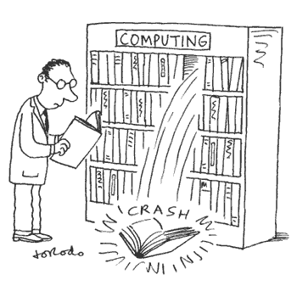

Programming hazards

