Slide 1
Introduction
Background on Foreign House Sales in Turkey

Slide 2
In recent years, Turkey has seen a slightly increase in foreign house sales. Although the perception in the society says the opposite, we can see this when we examine the TUIK data.

Slide 3
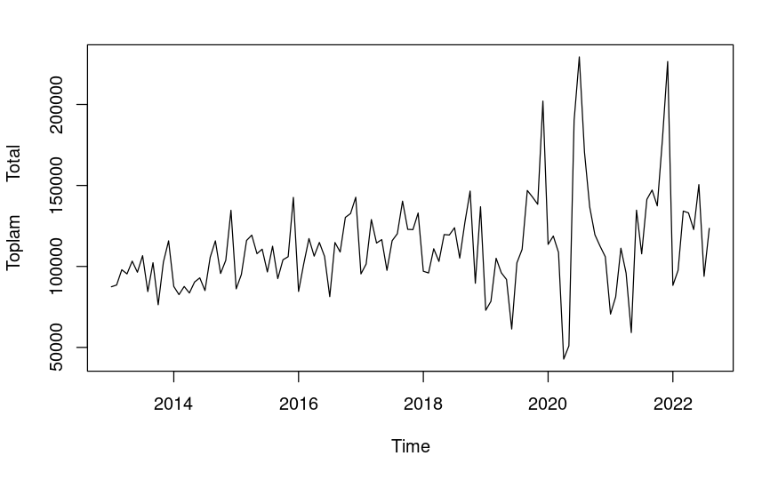
House Sales by Time

Slide 4
Purpose of the Presentation
The purpose of this presentation is to provide a detailed analysis of foreign house sales in Turkey, including an examination of construction costs and their relationship to the exchange rate. By understanding these factors, we can gain a better understanding of the current state of the housing market in Turkey and make more informed predictions about its future growth.

Slide 5
Foreign house sales in Turkey have increased slightly in recent years, with the number of sales to foreign buyers reaching a record high in 2020. This trend has been driven by a number of factors, including Turkey's growing economy, its attractive climate and natural beauty, and its status as a popular tourist destination.

Slide 6
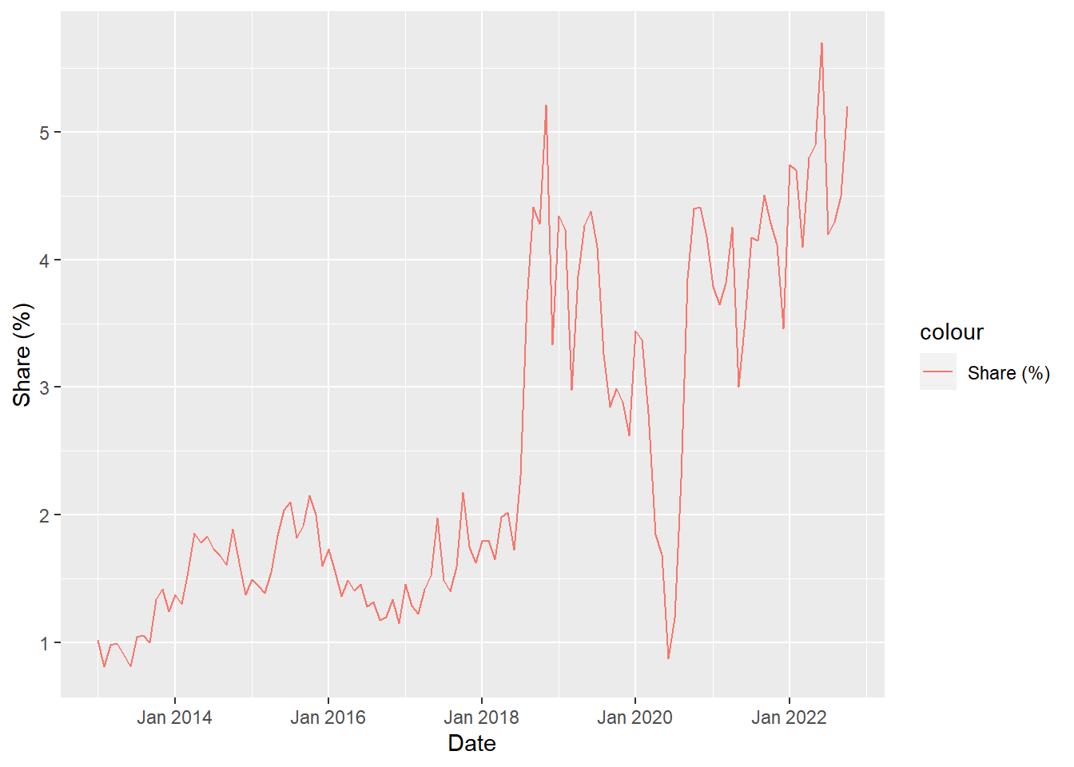
Statistics on Foreign House Sales in Turkey
To provide a more detailed picture of the current state of foreign house sales in Turkey, here are some key statistics:
In 2021, the number of foreign house sales in Turkey reached a record high of 58,576 representing an increase of 43,35% compared to the previous year.
The majority of foreign house buyers in Turkey are from Middle Eastern countries, including Iraq, Iran, and Kuwait.
In the last two years, Russia's housing purchases have increased. We think it's because of the Ukraine war.
The most popular cities for foreign house buyers in Turkey are Istanbul, Antalya, and Bursa.

Slide 7
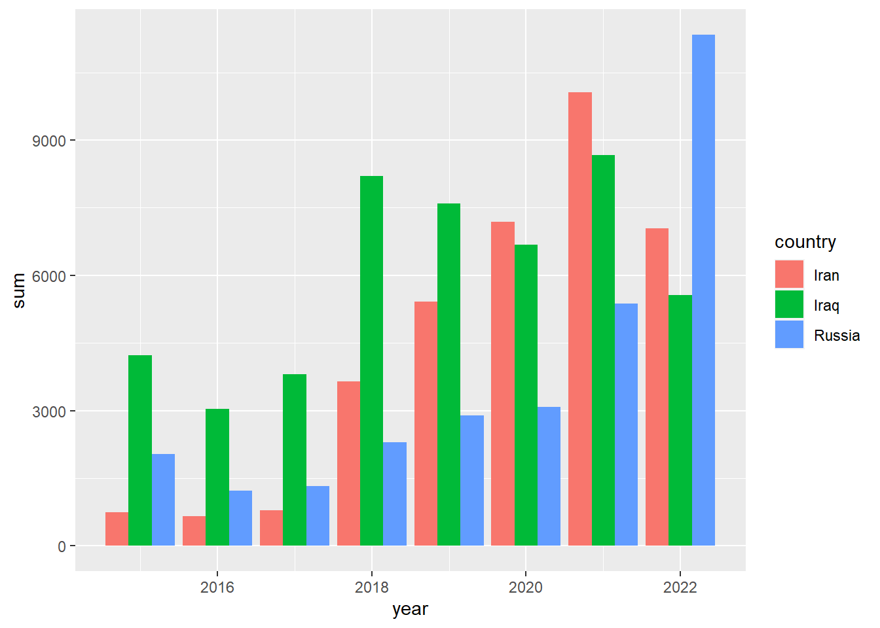
Yearly Sales by Nations
After 2017, Iran overtakes Iraq. There is a high increase in Russia as we move from 2021 to 2022. We assume the reason is Ukraine - Russian war.

Slide 8
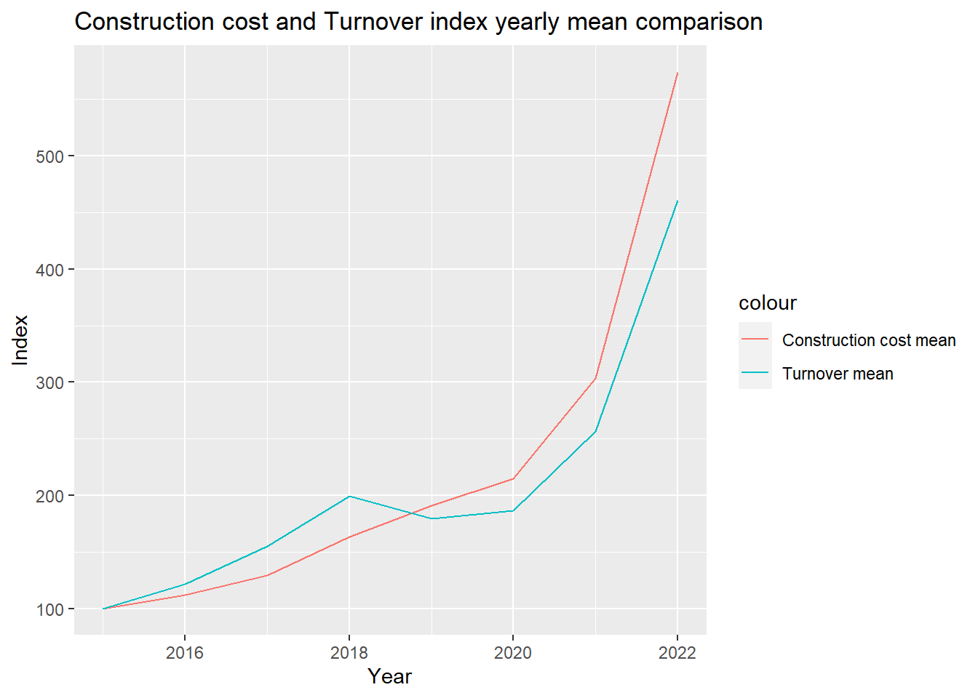
Construction Costs in Turkey
Construction costs in Turkey can vary depending on a number of factors, including the location, type of property, and materials used. Let’s look the construction cost index increase.

Slide 9
In conclusion, the house sales market in Turkey has shown strong growth in recent years, with increasing demand from both domestic and international buyers. Factors such as a favorable exchange rate, a growing economy, and a wide variety of property options have contributed to this trend.
However, it is important to carefully consider all factors when purchasing a property in Turkey, including location, amenities, and potential for appreciation. Overall, the house sales market in Turkey presents a promising opportunity for investors and homeowners.

