Slide 1
Introduction
Background on Foreign House Sales in Turkey

Slide 2
In recent years, Turkey has seen a slightly increase in foreign house sales. Although the perception in the society says the opposite, we can see this when we examine the TUIK data.

Slide 3
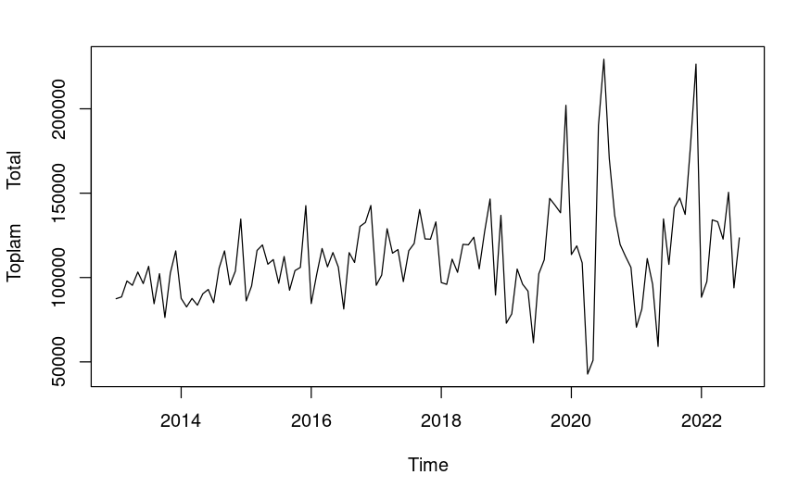
House Sales by Time

Slide 4
Purpose of the Presentation
The purpose of this presentation is to provide a detailed analysis of foreign house sales in Turkey, including an examination of construction costs and their relationship to the exchange rate. By understanding these factors, we can gain a better understanding of the current state of the housing market in Turkey and make more informed predictions about its future growth.

Slide 5
Foreign house sales in Turkey have increased slightly in recent years, with the number of sales to foreign buyers reaching a record high in 2020. This trend has been driven by a number of factors, including Turkey's growing economy, its attractive climate and natural beauty, and its status as a popular tourist destination.

Slide 6
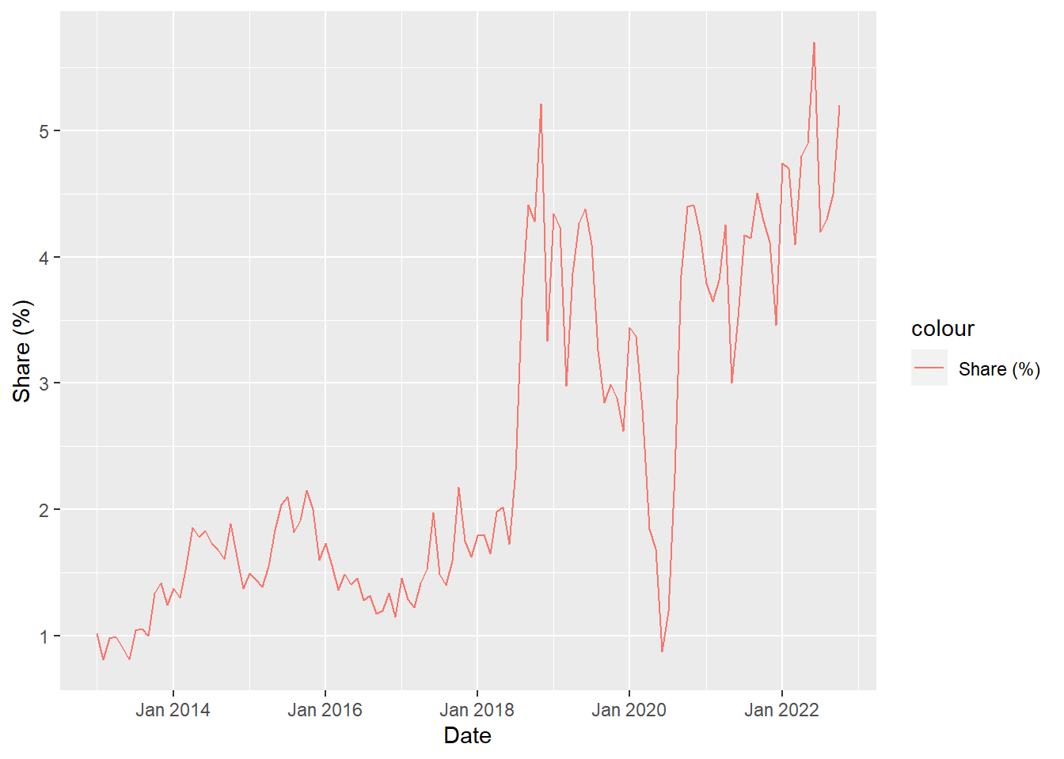
Statistics on Foreign House Sales in Turkey
To provide a more detailed picture of the current state of foreign house sales in Turkey, here are some key statistics:
In 2021, the number of foreign house sales in Turkey reached a record high of 58,576 representing an increase of 43,35% compared to the previous year.
The majority of foreign house buyers in Turkey are from Middle Eastern countries, including Iraq, Iran, and Kuwait.
In the last two years, Russia's housing purchases have increased. We think it's because of the Ukraine war.
The most popular cities for foreign house buyers in Turkey are Istanbul, Antalya, and Bursa.

Slide 7
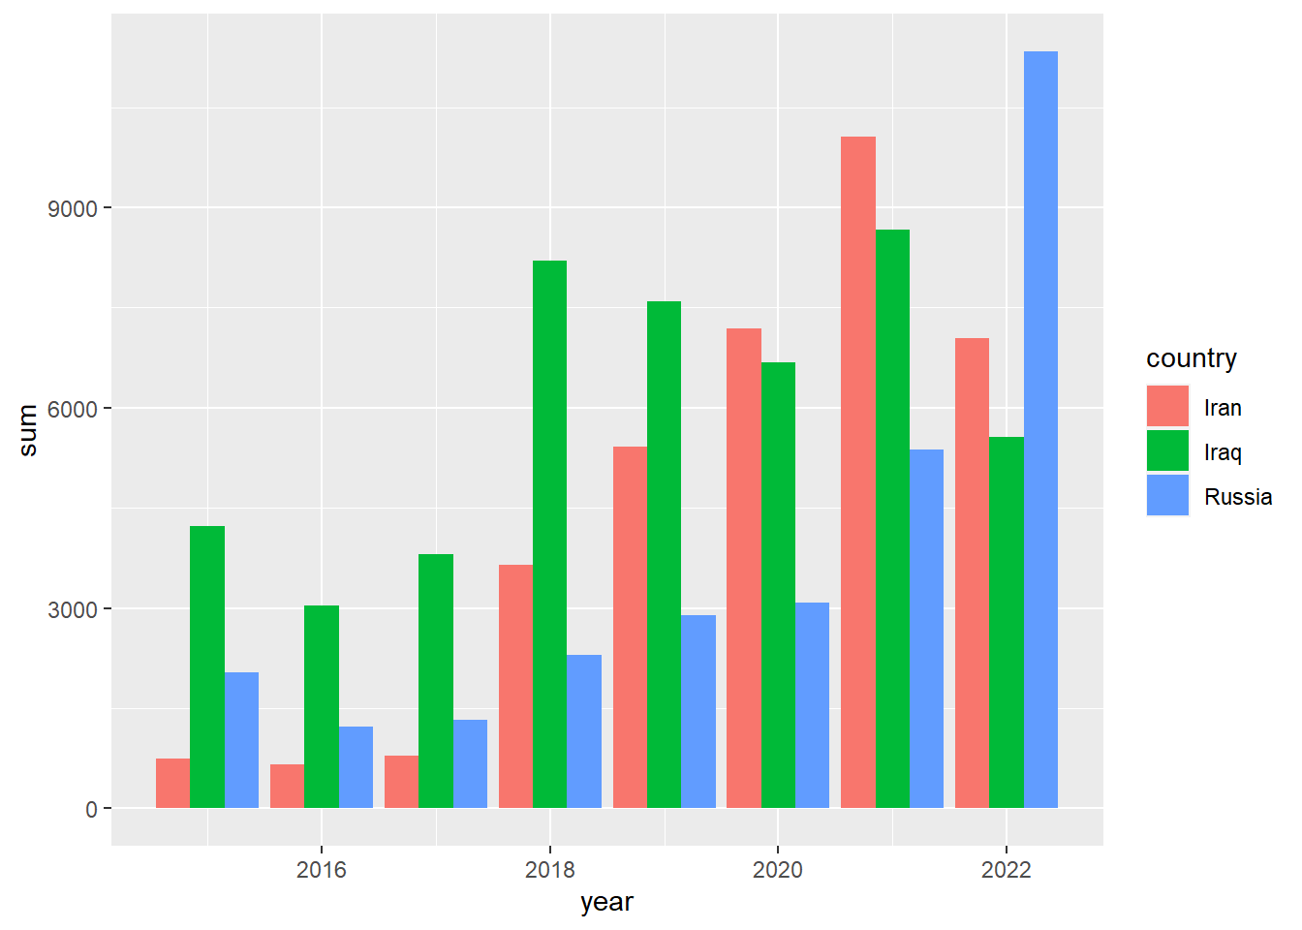
Yearly Sales by Nations
After 2017, Iran overtakes Iraq. There is a high increase in Russia as we move from 2021 to 2022. We assume the reason is Ukraine - Russian war.

Slide 8
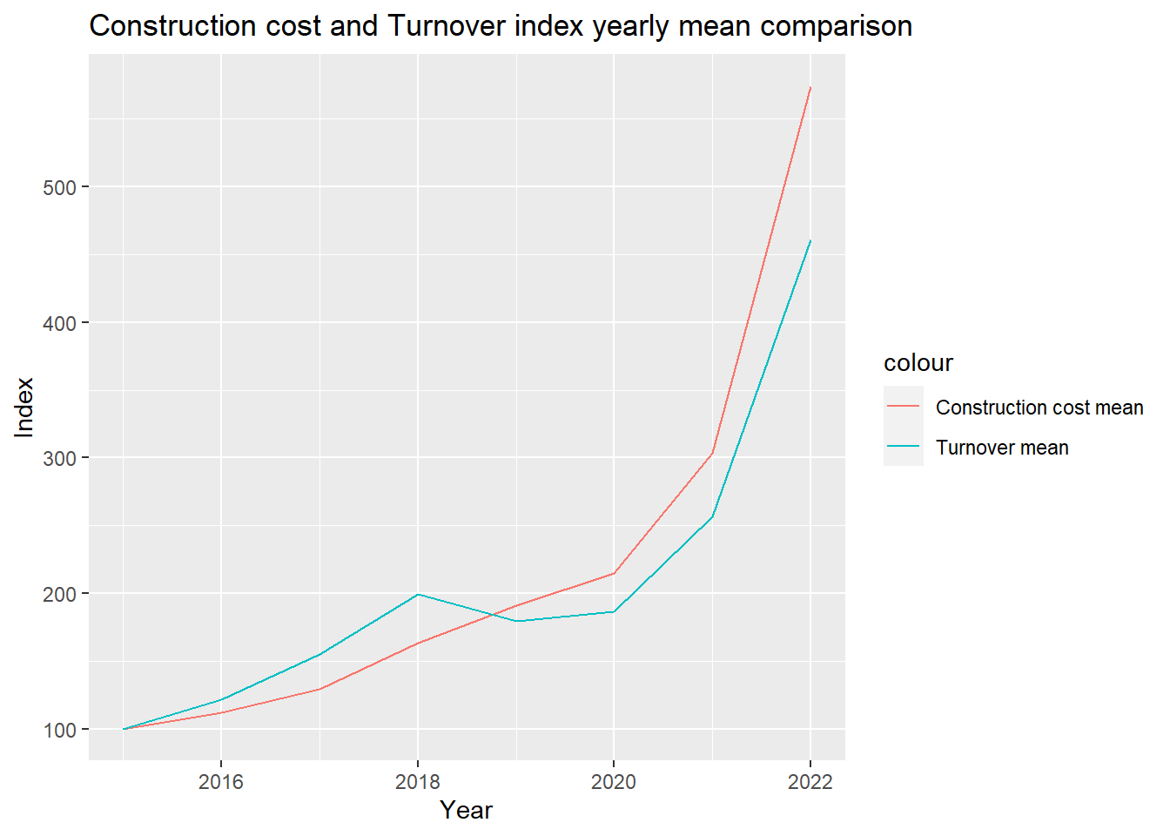
Construction Costs in Turkey
Construction costs in Turkey can vary depending on a number of factors, including the location, type of property, and materials used. Let’s look the construction cost index increase.

Slide 9
Analysis of First-Hand & Second-Hand Sales and Total Sales & Mortgaged Sales
The exchange rate crisis in Turkey are contributing to an increase in construction costs. When the value of a Turkey’s currency decreases, it make imports more expensive, which can impact the cost of materials and other inputs that are used in the construction industry.
When construction costs increase, it can make it more expensive to build new houses, which could lead developers to build fewer homes or to pass on the higher costs to buyers in the form of higher prices.
The increase in construction costs were contributing to a decrease in the number of new houses being built, which in turn led to a decrease in first-hand house sales and an increase in second-hand sales since 2018.
In Turkey, high demand for housing and limited supply has caused housing prices to rise. The government attempted to address this issue by implementing policy measures that restricted mortgage credit, but these measures had limited impact on overall house sales and resulted in a decrease in the number of houses purchased with mortgages. There may be other factors contributing to this trend.

Slide 10
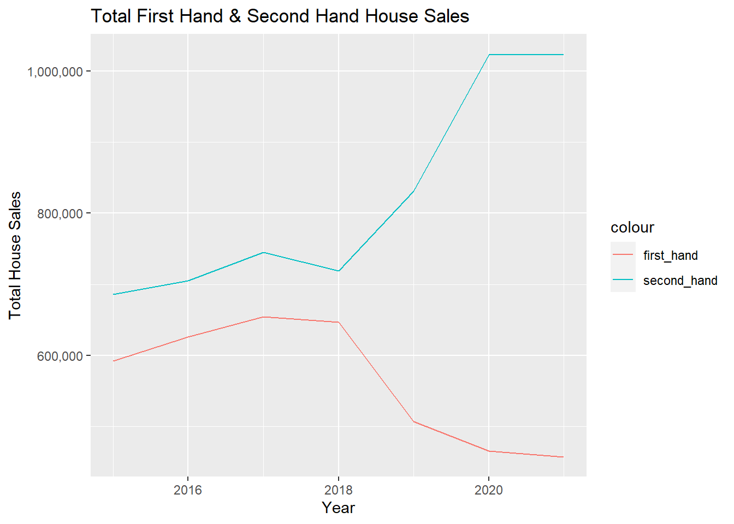

Slide 11
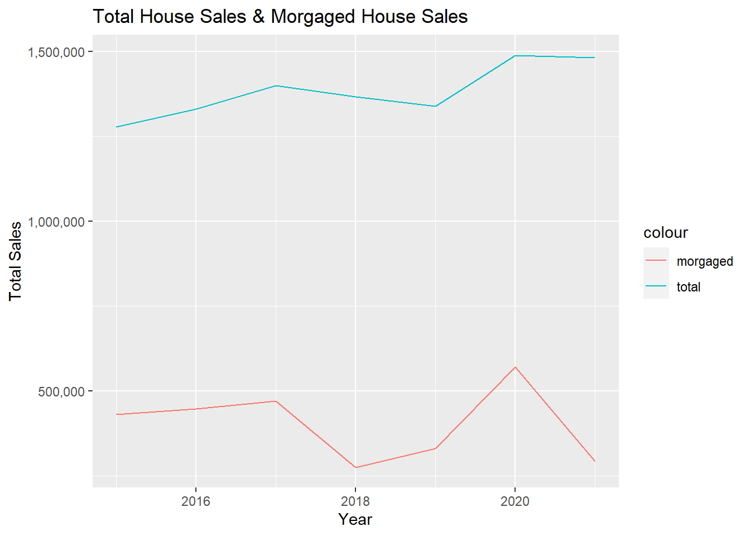

Slide 12
Conclusion
The housing market in Turkey has been facing challenges, including rising construction costs and the impact of exchange rates.
Foreign house sales in Turkey have increased slightly, but make up only about 5% of total sales.
The construction cost index in Turkey has been increasing faster than in Europe, making construction less profitable.
The exchange rate of the Turkish lira has a significant impact on construction costs in Turkey.

Slide 13
The government's limit on mortgages in 2021 decreased sales of houses with credit, but total sales have not decreased as people are buying houses with cash from other sources.
The most popular cities for foreign house buyers in Turkey are Istanbul, Antalya, and Bursa.
It will be important to analyze market trends and factors that can affect them in order to identify challenges and opportunities.
By doing so, informed decisions can be made and plans can be made for the future growth of the housing market in Turkey.

