Slide 1
Verilog

Slide 2
Introduction
Verilog HDL originated in 1983 at Gateway Design Automation.
HDL are popular for logic verification
Designers manually translate the HDL-based design into a schematic circuit with interconnections between gates
Digital circuits could be described at a register transfer level (RTL) by use of an HDL.
The details of gates and their interconnections to implement the circuit were automatically extracted by logic synthesis tools from the RTL description.
Verilog standardized as IEEE 1364
HDLs also began to be used for system-level design -→ ASIC / FPGA

Slide 3
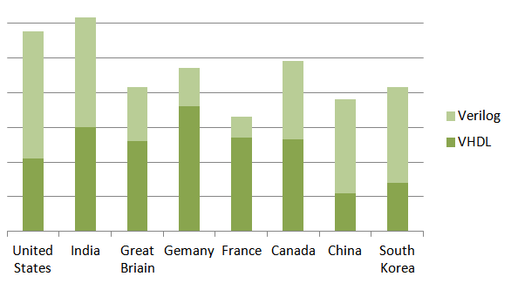
VHDL vs Verilog
VHDL | Verilog
Library and Package requires | No library and Package
Case in-sensitive | Case Sensitive
Similar to ADA | Similar to C
IEEE 1164 | IEEE 1364

Slide 4
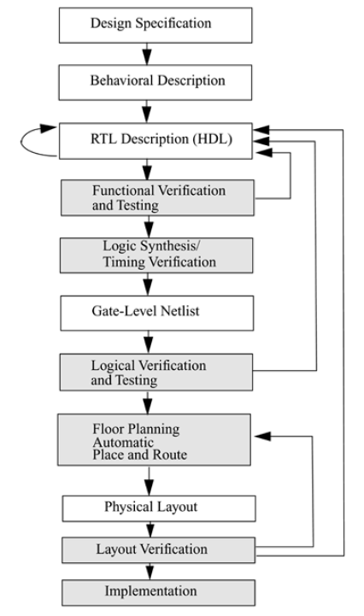
VLSI Design Flow
Specifications➔ functionality, interface, and overall architecture of the digital circuit
behavioral description➔ analyze the design in terms of functionality performance, compliance to standards and other high-level issues
behavioral description is manually converted to an RTL description in an HDL

Slide 5
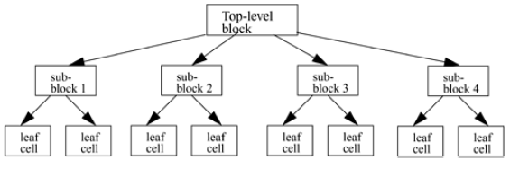
Design Methodologies
Top-down Design Methodology
define the top-level block and identify the sub-blocks necessary to build the top-level block.
We further subdivide the sub-blocks until we come to leaf cells
which are the cells that cannot further be divided

Slide 6
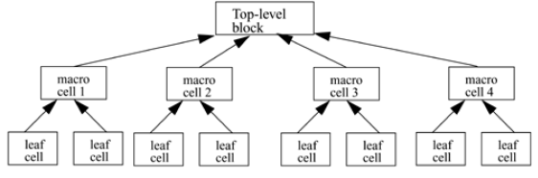
Bottom-up Design Methodology
first identify the building blocks that are available to us.
We build bigger cells, using these building blocks.
These cells are then used for higher-level blocks until we build the top-level block in the design
Typically, a combination of top-down and bottom-up flows is used

Slide 7
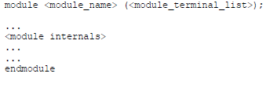
Modules
A module is the basic building block in Verilog.
A module can be an element or a collection of lower-level design blocks.
Typically, elements are grouped into modules to provide common functionality that is used at many places in the design.
A module provides the necessary functionality to the higher-level block through its port interface (inputs and outputs)

Slide 8
module can be defined at four levels of abstraction
1. Behavioral or algorithmic level
This is the highest level of abstraction provided by Verilog HDL.
A module can be implemented in terms of the desired design algorithm without concern for the hardware implementation details
2. Dataflow level
module is designed by specifying the data flow.
The designer is aware of how data flows between hardware registers
3. Gate level
module is implemented in terms of logic gates and interconnections between these gates
4. Switch level
This is the lowest level of abstraction provided by Verilog.
A module can be implemented in terms of switches, storage nodes, and the interconnections between them.

Slide 9

Lexical Conventions
Whitespace Blank spaces (\b)
tabs (\t)
newlines (\n)
Comments one-line comment starts with "//“
multiple-line comment starts with "/*" and ends with "*/“
Operators
Number Specification
Sized numbers <size> '<base format> <number>
<size> in decimal and specifies the number of bits in the number.
<base format> are decimal ('d or 'D), hexadecimal ('h or 'H), binary ('b or 'B) and octal ('o or 'O).
<number> specified as consecutive digits from 0, 1, 2, 3, 4, 5, 6, 7, 8, 9, a, b, c, d, e, f

Slide 10



Unsized numbers
without a <base format> specification are decimal numbers by default.
Numbers that are written without a <size> specification have a default number of bits that is simulator- and machine-specific (must be at least 32).
Negative numbers
minus sign before the size for a constant number.
-25 ➔ -5’b11001

Slide 11


Strings
sequence of characters that are enclosed by double quotes.
string is that it must be contained on a single line
It cannot be on multiple lines.
Nets
Nets represent connections between hardware elements.
Nets are declared primarily with the keyword wire.
Nets are one-bit values by default
The default value of a net is z
Nets get the output value of their drivers. If a net has no driver, it gets the value z.

Slide 12
Verilog Logic Value
Verilog is 4 valued logic
0 – False
1 – True
X –Unknown
Z- High impedance

Slide 13

Registers
Registers represent data storage elements.
Registers retain value until another value is placed onto them.
reg ➔ variable that can hold a value.
default value for a reg data type is x
Reg | Wire
Variable data type | Net data type
Can store value | Connection between part of a design
Default value X | Default value Z
Used in Procedural block | Used in concurrent assignment

Slide 14


Vectors
Nets or reg data types can be declared as vectors (multiple bit widths).
If bit width is not specified, the default is scalar (1-bit).
[high# : low#] or [low# : high#]
left number in the squared brackets is always the MSB of the vector
Vector Part Select

Slide 15
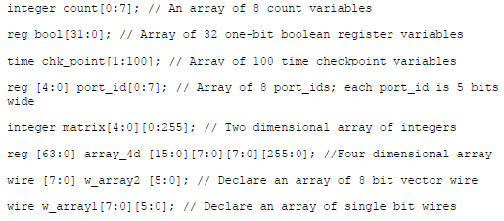
Arrays array is a collection of variables
Arrays are accessed by <array_name>[<subscript>]

Slide 16
QUIZ
The default value for reg data type is ______.
0
z
1
x

Slide 17
QUIZ
To introduce delays in a circuit, we can use a _________
Buffer
EXOR gate
Inverter
Flip-flops

Slide 18
Integer
integer is a general purpose register data type used for manipulating quantities.
The default width for an integer is the host-machine word size 32 bits
integer counter; // general purpose variable used as a counter.
initial
counter = -1;
Time
time register data type is used in Verilog to store simulation time.
system function $time is invoked to get the current simulation time.
time save_sim_time; // Define a time variable save_sim_time
initial
save_sim_time = $time; // Save the current simulation time
Parameters
constants to be defined in a module by the keyword parameter
parameter port_id = 5;

Slide 19
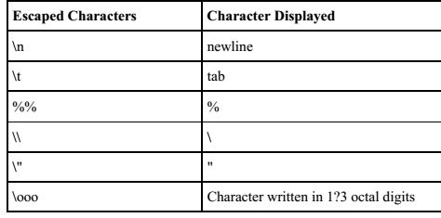
Memories RAM/ROM are modelled as 1D array
Each element of the array is element or word and is addressed by a single array index.
Each word can be one or more bits
reg mem1bit[0:1023]; // Memory mem1bit with 1K 1-bit words reg [7:0] membyte[0:1023]; // Memory membyte with 1K 8-bit words membyte[511] // Fetches 1 byte word whose address is 511.

Slide 20
Practice
Which of the following statements is true for Verilog modules?
a. A module can contain definitions of other modules.
b. When a module X is called multiple numbers of times from some other module, only one copy of module X is included in the hardware after synthesis.
c. More than one module can be instantiated within another module.
d. If a module X is instantiated 4 times within another module, 4 copies of X are created.
Correct answers are (c) and (d).

Slide 21
Practice
What does the statement assign f = (a & b) | (a ^ b) signify?
A gate level netlist consisting of one AND gate, one OR gate, and one XOR gate.
A behavioral description of the function f.
A structural description of the function f.
A continuous assignment of the function realized by the right hand side to the net type variable on the left hand side.
Correct answers are (b) and (d).

Slide 22
Practice
For the following Verilog code segment, if the initial value of IR is ABCD3456 (in hexadecimal), the value of “data” in decimal will be ………….. (Note that “data” is a 4-bit variable)
wire [31:0] IR;
wire [3:0] data;
wire [15:0] d1;
wire [31:16] d2;
assign d1 = IR[31:16];
assign d2 = IR[15:0];
assign data = d1[11:8] + d2[19:16] + d2[31:28];

Slide 23
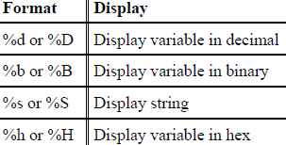
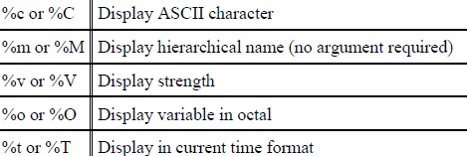
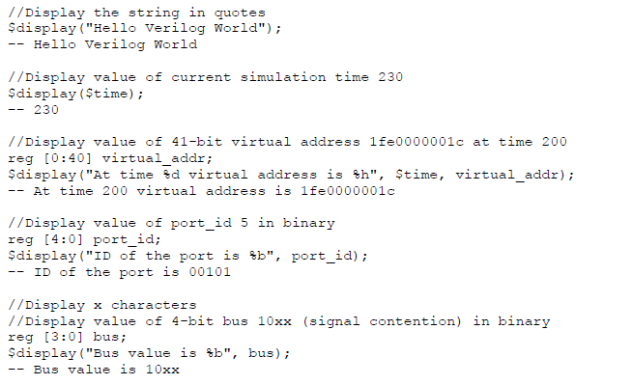
System Tasks➔ $<keyword>
system tasks for certain routine operations
$display is system task for displaying values of variables or strings or expressions.

Slide 24
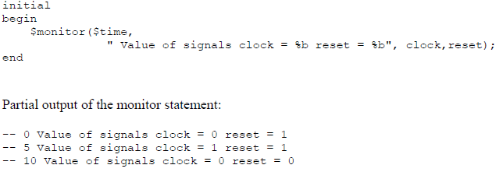
$monitor task monitor a signal when its value changes
continuously monitors the values of the variables or signals specified in the parameter list
displays all parameters in the list whenever the value of any one variable or signal changes
$display s-- prints the value (once) whenever it is executed.
$monitor -- prints the values whenever at least one of the variables in the list is modified

Slide 25
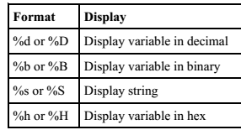
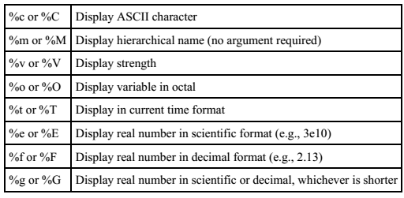
String Format Specifications

Slide 26
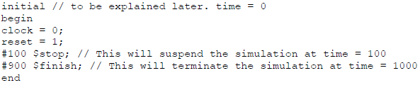
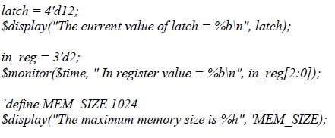
$stop designer wants to suspend the simulation and examine the values of signals in the design.
$finish task terminates the simulation

Slide 27
QUIZ
To suspend a simulation, you can use this system task command.
$finish
$stop
$end
$close

Slide 28
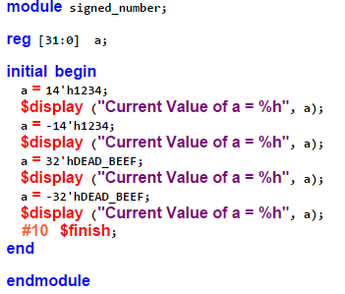
Example

Slide 29
QUIZ
When does the $monitor statement in a Verilog test bench print the specified values?
At the beginning of the simulation.
When the $monitor statement is first encountered.
Whenever the value of any of the specified variables change.
None of the above

Slide 30
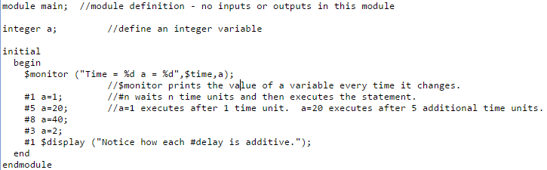
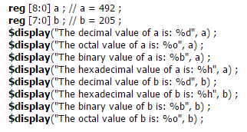
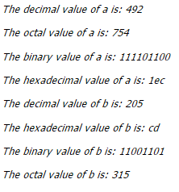
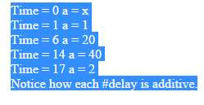

Slide 31
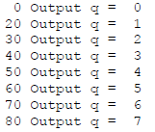
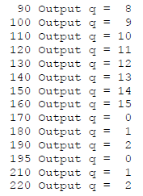
module stimulus;
reg clk;
reg reset;
wire[3:0] q;
ripple_carry_counter r1(q, clk, reset);
initial
clk = 1'b0;
always
#5 clk = ~clk;
initial
begin
reset = 1'b1;
#15 reset = 1'b0;
#180 reset = 1'b1;
#10 reset = 1'b0;
#20 $finish;
End
initial
$monitor($time, " Output q = %d", q);
endmodule

Slide 32
QUIZ
When does the $monitor statement in a Verilog test bench print the specified values?
At the beginning of the simulation.
When the $monitor statement is first encountered.
Whenever the value of any of the specified variables change.
None of the above

Slide 33
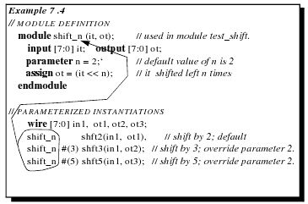
Instantation
A module provides a template from which you can create actual objects.
When a module is invoked, Verilog creates a unique object from the template.
Each object has its own name, variables, parameters, and I/O interface.
The process of creating objects from a module template is called instantiation, and the objects are called instances

Slide 34
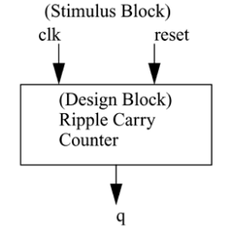
Components of a Simulation
Once a design block is completed, it must be tested.
The functionality of the design block can be tested by applying stimulus and checking results
Stimulus or Test bench
Simulation – Process of functionality verification
stimulus and design blocks separate
stimulus block instantiates the design block and drives the signals in the design block

Slide 35
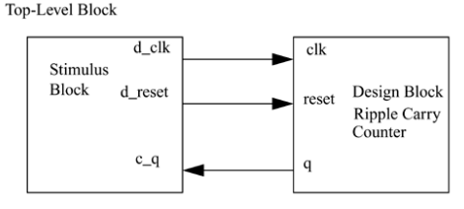
d_clk and d_reset, connected to clk and reset
c_q connected to q
In stimulus block Top module
Input declared as reg
Output declared as wired
Top module instantioned in stimulus block

Slide 36
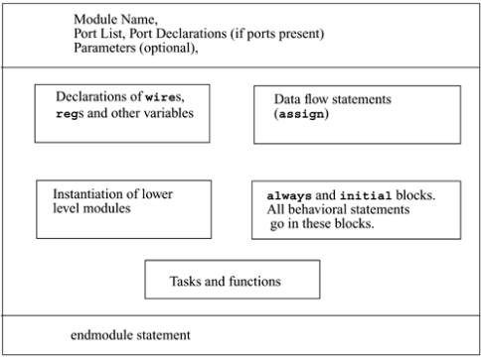
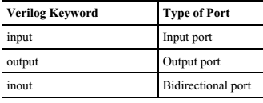
Components of a Verilog Module
Module in Verilog consists of distinct parts,
Ports provide the interface by which a module can communicate
list of ports module contains list of input / output ports

Slide 37
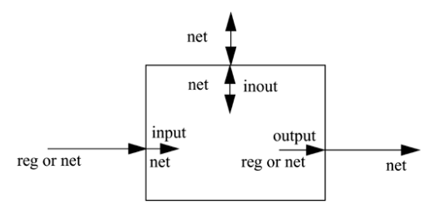
Port connection rule
port are (a) internal to the module (b) external to the module
when modules are instantiated within other follow rules
Connecting by ordered list module instantiation in the same order as the ports in the port list in the module definition
Connecting ports by name capability to connect external signals to ports by the port names, rather than by position.

Slide 38
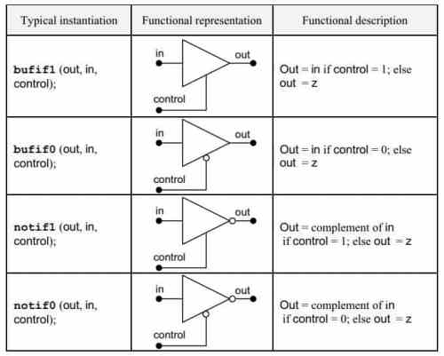
Gate Level Modeling
Logic gate and, or, not, nand, nor, xor, xnor are reserved word
Gate instanced by name
Gate port follow output than inputs

Slide 39
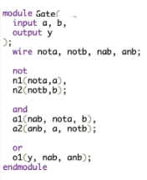
Following program presents

Slide 40
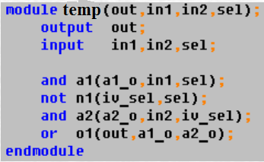
Following program presents

Slide 41
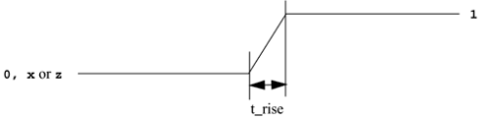
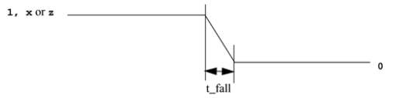
Gate Delays
In real circuits, logic gates have delays associated with them.
Gate delays allow the Verilog user to specify delays through the logic circuits
Rise delay is gate output transition to a 1 from another value
Fall delay is gate output transition to a 0 from another value
Turn-off delay is gate output transition to the high impedance value (z) from another value If the value changes to x, the minimum of the three delays is considered

Slide 42
Rise, Fall, and Turn-off Delay Specification and #(rise_val, fall_val, turnoff_val) b1 (out, in, control);
Rise and Fall Delay Specification and #(rise_val, fall_val) a2(out, i1, i2);
Delay of delay_time for all transitions and #(delay_time) a1(out, i1, i2);
no delays are specified →zero delay
one delay is specified → same for all transition
two delays are specified→ rise and fall delay, turn-off delay is the minimum of the two delays.
three delays are specified → rise, fall, and turn-off delay values.
and #(5) a1(out, i1, i2); //Delay of 5 for all transitions and #(4,6) a2(out, i1, i2); // Rise = 4, Fall = 6 bufif0 #(3,4,5) b1 (out, in, control); // Rise = 3, Fall = 4, Turn-off = 5

Slide 43
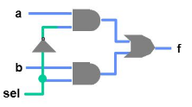
not # 2 n0(not_cnt, cnt);
and #(2,3) a0(a0_out, a, not_cnt);
or #(3,2) o0(out, a0_out, a1_out);
Delay of NOT 1
AND 2
OR 1

Slide 44
Practice
module buf_gate ();
reg in;
wire out;
buf #(5) (out,in);
initial begin
$monitor ("Time = %d in = %b out=%b", $time, in, out);
in = 0;
#10 in = 1;
#10 in = 0;
#10 $finish;
end
endmodule

Slide 45
Example

Slide 46
Min/Typ/Max Values of Delay
For each type of delay three values, min, typ, and max, can be specified
Min → minimum delay value that the designer expects the gate to have
Typ→ typical delay value that the designer expects the gate to have.
Max → maximum delay value that the designer expects the gate to have
and #(4:5:6) a1(out, i1, i2);
and #(3:4:5, 5:6:7) a2(out, i1, i2);
and #(2:3:4, 3:4:5, 4:5:6) a3(out, i1,i2);

Slide 47
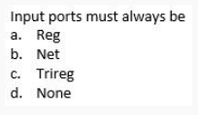
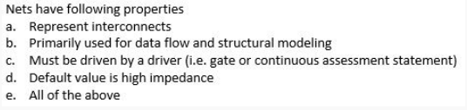
QUIZ

Slide 48
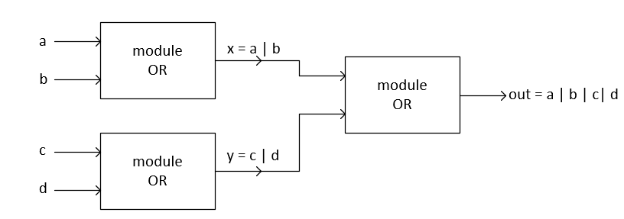
Verilog Program
four input OR gate
module orgate(out, a, b, c, d); input a, b, c, d;
wire x, y; output out;
or or1(x, a, b);
or or2(y, c, d);
or or3(out, x, y);
endmodule

Slide 49
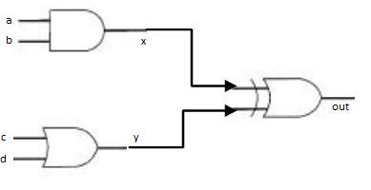
module example_2_bl(out, a, b, c, d);
input a, b, c, d;
output out;
wire x, y;
and gate_1(x, a, b);
or gate_2(y, c, d);
xor gate_3(out, x, y);
endmodule

Slide 50
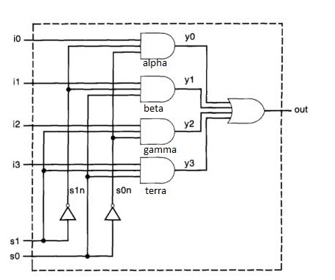
4×2 Multiplexer using gate level Modeling as shown below:
Verilog Code:
4×1 Multiplexer using gate level Modeling
module example_3_bl(out, i0, i1, i2, i3, s1, s0); input i0, i1, i2, i3, s1, s0;
output out;
wire y0, y1, y2, y3, s1n, s0n;
not n1(s1n, s1);
not n2(s0n, s0);
and alpha(y0, i0, s1n, s0n);
and beta(y1, i1, s1n, s0);
and gamma(y2, i2, s1, s0n);
and terra(y3, i3, s1, s0);
or out2(out, y0, y1, y2, y3);
endmodule

Slide 51

Full Adder in Gate Level
module fa(s,co,a,b,ci);
output s,co;
input a,b,ci;
Wire n1,n2,n2;
xor1 u1(s,a,b,ci);
and1 u2(n1,a,b);
and1 u3(n2,b,ci);
and1 u4(n3,a,ci);
or1 u5(co,n1,n2,n3);
endmodule
module full_adder(x,y,cin,s,cout);
input x,y,cin;
output s,cout;
wire s1,c1,c2;
half_adder ha1(x,y,s1,c1);
half_adder ha2(cin,s1,s,c2);
or(cout,c1,c2); endmodule
module half_adder(x,y,s,c);
input x,y;
output s,c;
Xor x1(s,x,y);
And a1(c,x,y);
endmodule

Slide 52
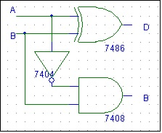
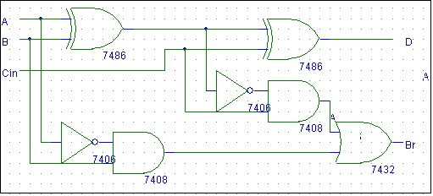
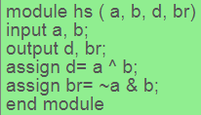
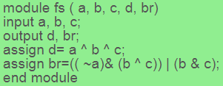
Subtractor

Slide 53
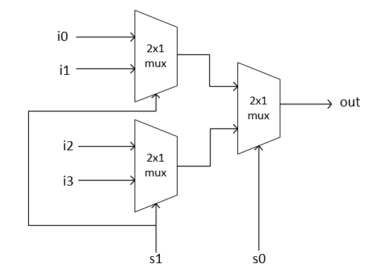
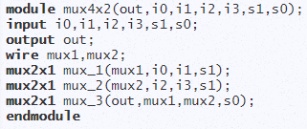
4:1 mux using 2:1 mux

Slide 54
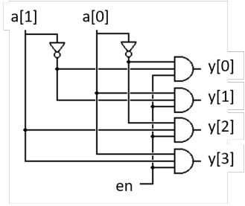
2:4 Decoder
module dec2_4 (a,b,en,y0,y1,y2,y3) input a, b, en; output y0,y1,y2,y3; assign y0= (~a) & (~b) & en; assign y1= (~a) & b & en; assign y2= a & (~ b) & en; assign y3= a & b & en; end module
module dec24_str( output [3:0] y, input [1:0] a, input en); and (y[0], ~a[1], ~a[0], en); and (y[1], ~a[1], a[0], en); and (y[2], a[1], ~a[0], en); and (y[3], a[1], a[0], en); endmodule

Slide 55
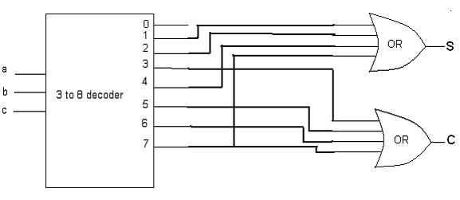
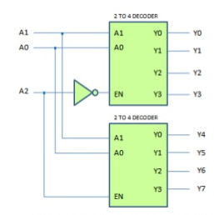
3:8 Decoder using 2:4 Decoder
Full Adder using 3:8 Decoder

Slide 56
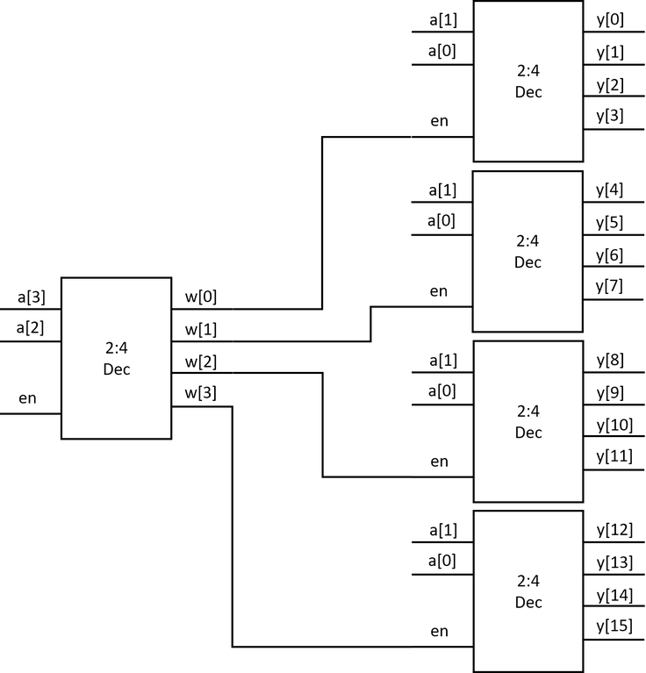
4:16 Decoder using 2:4 Decoder
module dec4x16_str(a,en,y); output [15:0] y, input [3:0] a, input en; wire [3:0] w; dec2x4_str u0(w, a[3:2], en); dec2x4_str u1(y[3:0], a[1:0], w[0]); dec2x4_str u2(y[7:4], a[1:0], w[1]); dec2x4_str u3(y[11:8], a[1:0], w[2]); dec2x4_str u4(y[15:12], a[1:0], w[3]); endmodule

Slide 57
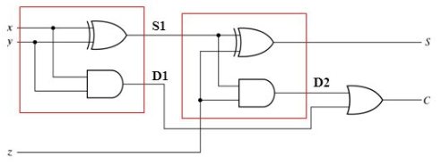




4 bit Ripple Carry Adder
module four_bit_adder(x,y,cin,sum,cout); input [3:0] x,y;
input cin;
output[3:0] sum;
output cout;
wire c1,c2,c3;
full_adder fa1(x[0],y[0],cin,sum[0],c1); full_adder fa2(x[1],y[1],c1,sum[1],c2); full_adder fa3(x[2],y[2],c2,sum[2],c3); full_adder fa4(x[3],y[3],c3,sum[3],cout);
endmodule

Slide 58

Carry Look ahead Adder
Pi = Ai xor Bi
Gi = Ai.Bi
Si = Pi xor Ci Ci+1 = Ci.Pi + Gi
C1 = C0P0 + G0
C2 = C1P1 + G1 = (C0P0+G0)P1 + G1 = C0P0P1 + P1G0 + G1
C3 = C2P2 +G2 = (C0P0P1 + P1G0 + G1)P2+G2 = C0P0P1P2 + P2P1G0 + P2G1 + G2
C4 = C3P3 +G3 = (C0P0P1P2 + P2P1G0 + P2G1 + G2)P3 + G3 = C0P0P1P2P3 + P3P2P1G0 +
P3P2G1 + G2P3 + G3
Similar to Ripple carry Adder It is used to add together two binary numbers; carry look ahead adders are able to calculate the Carry bit before the Full Adder is done with its operation.
This gives it an advantage over the Ripple Carry Adder because it is able to add two numbers together faster. The drawback is that it takes more logic

Slide 59


CLA

Slide 60

Carry Save Adder
module fulladder( a,b,cin,sum,carry); input a,b,cin;
output sum,carry; assign sum = a ^ b ^ cin; assign carry = (a & b) | (cin & b) | (a & cin); endmodule module CSA ( x,y,z,s,cout);
input [3:0] x,y,z; output [4:0] s; output cout; wire [3:0] c1,s1,c2; fulladder fa_inst10(x[0],y[0],z[0],s1[0],c1[0]); fulladder fa_inst11(x[1],y[1],z[1],s1[1],c1[1]); fulladder fa_inst12(x[2],y[2],z[2],s1[2],c1[2]); fulladder fa_inst13(x[3],y[3],z[3],s1[3],c1[3]); fulladder fa_inst20(s1[1],c1[0],1'b0,s[1],c2[1]); fulladder fa_inst21(s1[2],c1[1],c2[1],s[2],c2[2]); fulladder fa_inst22(s1[3],c1[2],c2[2],s[3],c2[3]); fulladder fa_inst23(1'b0,c1[3],c2[3],s[4],cout); assign s[0] = s1[0]; endmodule

Slide 61
Dataflow Modeling
Preferred for small circuit
circuit design in terms of the data flow between rather than instantiation of individual gates
Continuous Assignments
LHS must scalar or vector net assign out = i1 & i2; wire out; assign out = in1 & in2;
Implicit Continuous Assignment
Assignment during declaration wire out = in1 & in2;
Implicit Net Declaration
inferred for that signal name wire i1, i2; assign out = i1 & i2;

Slide 62
Delay (# value) ns
Control time between change in a RHS operand and new value is assigned to LHS
Regular Assignment Delay (inertial delay ) (INTRA Delay)
assign #10 out = in1 & in2;
change in values of in1 or in2 will result in a delay of 10 time units before computation and the result will be assigned to out
INTER Delay
#10 assign out = in1 & in2;
Statement out delay by 10 time units

Slide 63


Operator -- Operand Operands can be any one of the data types Operators act on the operands to produce desired results

Slide 64



Arithmetic Operators multiply (*), divide (/), add (+), subtract (-), power (**),and modulus (%)
If any operand bit has a value x, then the result of the entire expression is x
Logical Operators logical-and (&&), logical-or (||) and logical-not (!)
always evaluate to a 1-bit value, 0 (false), 1 (true), or x (ambiguous).
If any operand bit is x or z, it is equivalent to x

Slide 65


Relational Operators greater-than (>), less-than (<), greater-than-or-equal-to (>=), and less-than-or-equal-to (<=)
Evaluate to logical value of 1 if expression is true and 0 if expression is false
If any unknown or z bits in the operands evaluates to x
Equality Operators logical equality (==), logical inequality (!=), case equality (===), and case inequality (!==)
Evaluates to 1 if true, 0 if false.
Compare two operands bit by bit, zero filling if operands are unequal length
case equality compare both operands bit by bit including x and z

Slide 66

Bitwise Operators Bitwise operators are negation (~), and(&), or (|), xor (^), xnor (^~, ~^).
Perform a bit-by-bit operation on two operands. T
X = 4'b1010, Y = 4'b0000
X | Y // bitwise operation. Result is 4'b1010 X || Y // logical operation. Equivalent to 1 || 0. Result is 1.

Slide 67
Reduction Operators
Reduction operators are and (&), nand (~&), or (|), nor (~|), xor (^), and xnor (~^, ^~). Take only one operand
Perform a bitwise operation on a single vector operand and yield a 1-bit result.
X = 4'b1010
&X //Equivalent to 1 & 0 & 1 & 0. Results in 1'b0 |X //Equivalent to 1 | 0 | 1 | 0. Results in 1'b1 ^X //Equivalent to 1 ^ 0 ^ 1 ^ 0. Results in 1'b0
A reduction xor or xnor can be used for even or odd parity generation respectively.
Shift Operators right shift ( >>), left shift (<<), arithmetic right shift (>>>), arithmetic left shift (<<<). Shift a vector operand to the right or the left by a specified number of bits.
X = 4'b1100 Y = X >> 1; //Y is 4'b0110. Shift right 1 bit. 0 filled in MSB position. Y = X << 1; //Y is 4'b1000. Shift left 1 bit. 0 filled in LSB position. Y = X << 2; //Y is 4'b0000. Shift left 2 bits.

Slide 68
Concatenation Operator {, } provides a mechanism to append multiple operands.
A = 1'b1, B = 2'b00, C = 2'b10, D = 3'b110
Y = {B , C} // Result Y is 4'b0010 Y = {A , B , C , D , 3'b001} // Result Y is 11'b10010110001 Y = {A , B[0], C[1]} // Result Y is 3'b101
Replication Operator concatenation of same number by using a replication constant
reg A; reg [1:0] B, C; reg [2:0] D; A = 1'b1; B = 2'b00; C = 2'b10; D = 3'b110;
Y = { 4{A} } // Result Y is 4'b1111 Y = { 4{A} , 2{B} } // Result Y is 8'b11110000 Y = { 4{A} , 2{B} , C } // Result Y is 8'b1111000010

Slide 69
Conditional Operator
takes three operands. condition_expr ? true_expr : false_expr ;
(condition_expr) is true true_expr is evaluated.
(Condition_expr) false false_expr is evaluated.
If the (Condition_expr) is x (ambiguous), both true_expr and false_expr are evaluated and their results are compared, bit by bit, return for each bit position an x if the bits are different and the value of the bits if they are the same
model functionality of a tristate buffer assign addr_bus = drive_enable ? addr_out : 36'bz;
model functionality of a 2-to-1 mux assign out = control ? in1 : in0;

Slide 70
Practice
For the following Verilog code segment:
wire [7:0] A;
wire B;
assign B = ^A;
if the value of A is 16’b10110011, what will be the value of {A[4:3], 3{B}}
5’b10111 *
5’b10000
5’b01000
None of the above
Correct answer is (a).

Slide 71


FSM (Finite State Machine)
A system models with number of state
Finite number of state
High outputs corresponding to each transition
There are two types of finite state machines that generate output −
Mealy Machine
Moore machine
Mealy Machine
output depends on the present state as well as the present input.
Moore Machine
outputs depend on only the present state.

Slide 72
Sequence Detector
Generate high output when particular sequence detects
It can Mealy (Overlap or non-overlap) Moore (Overlap or non-overlap) type
Overlap FSM – Last bit of one sequence and first bit of next sequence same

Slide 73
QUIZ
An overlapping sequence detector (ab) will produces output for sequence length (aabbaababa)
0010001010
1010001010
0010101010
0010111010

Slide 74
101 sequence detector (Mealy)
101 sequence detector (Moore)

Slide 75
Mealy sequence Detector 1010
Moore sequence Detector 1010

Slide 76

QUIZ
Following machine detects
101 mealy
101 moore
010 mealy
010 moore

Slide 77


Following machine detects

Slide 78
QUIZ
Number of state requires to implement moore machine ’101010’
6
7
8
5

Slide 79

Following sequence detector presents a
Mealy 101
Moore 101
Mealy 1101
Moore 1101

Slide 80

Sequence Detector
Overlap FSM – Last bit of one sequence and first bit of next sequence same
In sequence first and last bit same by n-bit→ n-bit overlap
Next state of main sequence intermediate state
Non-overlap FSM – Next state of main sequence initial state

Slide 81
Mealy Machine | Moore Machine
Output depends both upon the present state and the present input | Output depends only upon the present state.
Fewer states | more states
Output presented on transition | Output presented on state
React faster to inputs, in the same clock cycle. | More logic is required, more circuit delays. React one clock cycle later.

Slide 82
Revision
If X=8'b10010100 than assign Y=X[6:3] evaluate to
X= 'd1234; the size of X is
The width of wire addr ?
assign [3:0]addr = addrr1[20:17] + addr2[10:7]
The possible output value of operator == are
The possible output value of operator === are
If B = 2'b00, C = 2'b10 than Y = {B , C} result into

Slide 83
QUIZ
In continuous assignment left hand side must be
net
reg
scalar or vector net
scalar or vector reg

Slide 84
Behavioral Modeling

Slide 85
Behavioral Modeling
Highest level of modelling
describe design functionality in an algorithmic manner.
resembles C programming
Verilog constructs are similar to C
great amount of flexibility
Describe sequential digital circuit
Output port are reg data type
Structured Procedures always and initial
Initial block starts at time 0
executes exactly once during a simulation
does not execute again
Each block finishes execution independently
Always block statement starts at time 0
Executes the statements in the always block continuously in a looping fashion
Model a block of activity that is repeated continuously in a digital circuit

Slide 86
Initial Block Example
module stimulus; reg x,y, a,b, m; initial m = 1'b0; //single statement; does not need to be grouped initial begin #5 a = 1'b1; //multiple statements; need to be grouped #25 b = 1'b0; end initial begin #10 x = 1'b0; #25 y = 1'b1; end initial
#50 $finish; endmodule
initialization, monitoring, waveforms and processes that must be executed only once

Slide 87

QUIZ
The simulation time is
A. 20ns
B. 50ns
C. 60 ns
D. 80 ns
E. 110 ns

Slide 88
Clock Generator with Always Block
module clock_gen (output reg clock); initial clock = 1'b0; //Initialize clock at time zero always #10 clock = ~clock; // //Toggle clock every half-cycle (time period = 20) initial #1000 $finish; endmodule

Slide 89
Clock Generator with Duty Cycle
lock generators with 50% duty cycles.
initial
reg clk = 0;
always begin #10 clk = 0; #10 clk = 1; end
20% duty cycle clock in verilog
initial
reg clk = 0;
always begin clk = 1; #1 clk = 0; #4 end

Slide 90
Procedural Assignment
Procedural assignments update values of reg, integer, real, or time variables.
Value placed on a variable will remain unchanged until another procedural assignment updates the variable with a different value.
2 types of procedural assignment statements: blocking and nonblocking
Blocking assignment
Executed in order specified.
The = operator specify blocking assignments.
Update the value instantly
reg x, y, z; reg [15:0] reg_a, reg_b; integer count;
initial begin x = 0; y = 1; z = 1; count = 0; reg_a = 16'b0; reg_b = reg_a; #15 reg_a[2] = 1'b1; #10 reg_b[15:13] = {x, y, z} ; count = count + 1;
end

Slide 91
Nonblocking assignments
Execute assignments without blocking execution
A <= operator is used to specify nonblocking assignments
Not update value instantly end of simulation
initial begin x = 0; y = 1; z = 1; count = 0; reg_a = 16'b0; reg_b = reg_a; reg_a[2] <= #15 1'b1; reg_b[15:13] <= #10 {x, y, z}; count <= count + 1; end

Slide 92


Example

Slide 93
QUIZ
Symbol meaning
a) = (i) blocking
b) <= (ii) non-blocking

Slide 94


Slide 95


Slide 96



assume a=1, b=0 initial begin #50 c = a|b; d = c; c = #50 a&b; #20 d = c; end
assume a=1, b=0 initial begin #50 c = a&b; d = a; c <= #60 a|b; d <= #80 b|c; end
assume a=1, b=0 initial begin c <= 0; #50 c <= a|b; d <= c; c <= #50 a&b; end

Slide 97




Slide 98
Swapping Example
always @(posedge clock) a = b; always @(posedge clock) b = a;
always @(posedge clock) a <= b; always @(posedge clock) b <= a;
No Swapping
Racing Error
Swapping possible

Slide 99


I1=2
I2=2
I1=2
I2=1
No Swapping
Swapping

Slide 100
QUIZ
Identify true statement
Evaluate the RHS of nonblocking statements at the beginning of the time step.
Update the LHS of nonblocking statements at the end of the time step.
Both are true

Slide 101
comment on execution
module ao4 (y, a, b, c, d);
output y;
input a, b, c, d;
reg y, tmp1, tmp2;
always @(a or b or c or d)
begin
tmp1 <= a & b;
tmp2 <= c & d;
y <= tmp1 | tmp2;
end
endmodule
module ao2 (y, a, b, c, d);
output y;
input a, b, c, d;
reg y, tmp1, tmp2;
always @(a or b or c or d)
begin
tmp1 = a & b;
tmp2 = c & d;
y = tmp1 | tmp2;
end
endmodule

Slide 102


sequential logic use a clocked always block with Nonblocking assignments.
combinational logic use an always block with Blocking assignments.
Try not to mix the two in the same always block
always @ (posedge clk ) begin
b = a;
c = b;
end
always @ (posedge clk ) begin
b <= a;
c <= b;
end

Slide 103
Event-Based Timing Control
Provide a way to specify the simulation time at which procedural statements will execute
change in the value on a register or a net
Trigger execution of block
Delay-based (ii) Event based (iii) level-sensitive
Event based control – trigger execution of a statement
(a) Regular event control @ symbol specify an event control
@(clock) q = d; @(posedge clock) q = d; positive transition ( 0 to 1,x or z, x to 1, z to 1 ) @(negedge clock) q = d; negative transition ( 1 to 0,x or z,x to 0, z to 0) q = @(posedge clock) d;
(b) Named event control Event trigger by symbol -> always @(posedge clock) begin if(last_data_packet) ->received_data;
end
always @(received_data) data_buf = {data_pkt[0], data_pkt[1]};

Slide 104
(c) Event OR Control multiple signals or events can trigger the execution
list of events as a sensitivity list
either ‘or’ of ‘ , ’
always @( reset or clock or d) begin if (reset) q = 1'b0; else if(clock) q = d; end
@* and @(*) sensitive to a change on any signal
(d) Level-Sensitive Timing Control @ provided edge-sensitive control
wait for triggering of an event
‘wait’ is used for level sensitive constructs.
always wait (count_enable) #20 count = count + 1;
Count_enable 0, statement is not entered.
Count_enable 1, statement count = count + 1 is executed after 20 time units

Slide 105
Conditional Statements
if (<expression>)
true_statement ;
if (<expression>)
true_statement ;
else
false_statement ;
if (<expression1>)
true_statement1 ;
else if (<expression2>)
true_statement2 ;
else if (<expression3>)
true_statement3 ;
else
default_statement ;
Execute statements based on ALU control signal
if (alu_control == 0) y = x + z; else if(alu_control == 1) y = x - z; else if(alu_control == 2) y = x * z; else $display("Invalid ALU control signal")

Slide 106
Multiway Branching
One Switch Multiple Branch
Branch number entered in Binary/Octal/Decimal/HexaDecimal Format
case (expression) alternative1: statement1; alternative2: statement2; alternative3: statement3; ... ... default: default_statement; endcase
case (alu_control) 2'd0 : y = x + z; 2'd1 : y = x - z; 2'd2 : y = x * z; default : $display("Invalid ALU control signal"); endcase

Slide 107
Example
4:1 Multiplexer using case statement

Slide 108
Design a module has 2-bit select signal to route one of three 3-bit signal to output

Slide 109

casez and casex statement
casez allows “Z” and “?” to be treated as don’t care in condition
casex allows “Z”, “?”, and “X” to be treated as don’t care in condition
reg [3:0] encoding; integer state; casex (encoding) 4'b1xxx : next_state = 3; 4'bx1xx : next_state = 2; 4'bxx1x : next_state = 1; 4'bxxx1 : next_state = 0; default : next_state = 0; endcase
input encoding = 4'b10xz would cause next_state = 3

Slide 110
TFF DFF

Slide 111
UP Down Counter

Slide 112
Shift Register

Slide 113
LFSR

Slide 114
Which is a Random Number Generator
Counter
Shifter
LFSR
Gray Counter

Slide 115


Slide 116
FSM Programming

Slide 117
State transition happens _______ in every clock cycle
a) Once b) Twice c) Thrice d) Four times

Slide 118
LOOP
4 loop statements in Verilog while, for, repeat, and forever
Syntax are similar to C-language
A loop statement occur inside initial or always
While Loop- executes until the while expression is not true
Increment count from 0 to 127; Exit at count 128

Slide 119
For Loop • An initial condition • A check to see if the terminating condition is true • A procedural assignment to change
Increment count from 0 to 127; Exit at count 128

Slide 120

What does following code do
reg [3:0] x;
initial clk =0;
always #10 clk = ~clk;
initial
integer i;
begin
#5 for (i=0; i <16; i=i+1)
#20 x=i;
end

Slide 121
Repeat Loop - executes the loop a fixed number of times
Increment count from 0 to 127; Exit at count 128

Slide 122
Forever loop does not contain any expression
executes forever until the $finish task is encountered

Slide 123
Which is unconditional loop
While
For
Repeat
Forever

Slide 124

Loop Example
Write Program and Testbench /Stimulus Program

Slide 125
4-bit Comparator in verilog

Slide 126


Slide 127
What does the following code segment indicate?
initial clk = 1’b1;
always #10 clk = ~clk;
Falling edges of the clock will appear at times 10, 30, 50, 70,
Falling edges of the clock will appear at times 20, 40, 60, 80,
Falling edges of the clock will appear at times 10, 20, 30, 40,
None of the above

Slide 128
Memories in Verilog
reg bit; // a single register
reg [31:0] word; // a 32-bit register
reg [31:0] array[15:0]; // 16 32-bit regs
reg [31:0] array_2d[31:0][15:0]; // 2 dimensional 32-bit array
assign read_data = array[index]; // combinational (asynch) read
always @(posedge clock)
array[index] <= write_data; // clocked (synchronous) write

Slide 129

Create RAM of 256 bytes and fill with number 0-255
0
1
2
255
module RAM_code(out, in, addr, RW, CS); output [7:0] out; input [7:0] in; input [3:0] addr; input RW, CS; reg [7:0] out; reg [7:0] DATA[15:0]; always @(negedge CS) begin if(RW==1'b0) //READ out=DATA[addr]; else if(RW==1'b1) //WRITE DATA[addr]=in; else out=8'bz; end endmodule
8 bit

Slide 130

Verilog ROM Program
module ROM_code(out, addr, CS); output[15:0] out; input[3:0] addr; input CS; reg [15:0] out; reg [15:0] ROM[15:0]; always @(negedge CS) begin ROM[0]=16'h5601; ROM[1]=16'h3401; ROM[2]=16'h1801; ROM[3]=16'h0ac1; ROM[4]=16'h0521; ROM[5]=16'h0221; ROM[6]=16'h5601; ROM[7]=16'h5401; ROM[8]=16'h4801; ROM[9]=16'h3801; ROM[10]=16'h3001; ROM[11]=16'h2401; ROM[12]=16'h1c01; ROM[13]=16'h1601; ROM[14]=16'h5601; ROM[15]=16'h5401; out=ROM[addr]; end endmodule

Slide 131
reg [31:0] regfile[30:0];
31 32-bit words
32 31-bit words

Slide 132
What are the final values of a, b, c, d?
initial begin a = 1'b0; #0 c = b;
end
initial begin b = 1'b1; #0 d = a;
end

Slide 133
Using the repeat loop, delay the statement a = a + 1 by 20 positive edges of clock.

Slide 134

Switch Level Modelling
Verilog provides the ability to design at a MOS-transistor level. Lowest level of modeling
MOS Switch
nmos n1(out, data, ncontrol)
pmos n1(out, data, pcontrol)
Power and Ground → power (Vdd, logic 1) = supply1
ground (Vss, logic 0) == supply 0
supply1 vdd; supply0 gnd;

Slide 135

CMOS NOT GATE
module my_not(out, in); output out; input in; supply1 pwr; supply0 gnd;
pmos (out, pwr, in); nmos (out, gnd, in); endmodule

Slide 136
In switch level modeling, a MOS switch have
A. 1 terminal
B. 2 terminal
C. 3 terminal
D. 4 terminal

Slide 137

CMOS NOR GATE
module my_nor(out, a, b); output out; input a, b; wire c;
supply1 pwr; supply0 gnd ;
pmos (c, pwr, b); pmos (out, c, a); nmos (out, gnd, a); nmos (out, gnd, b); endmodule
module stimulus; reg A, B; wire OUT; my_nor n1(OUT, A, B); initial begin A = 1'b0; B = 1'b0; #5 A = 1'b0; B = 1'b1; #5 A = 1'b1; B = 1'b0; #5 A = 1'b1; B = 1'b1; end initial $monitor($time, " OUT = %b, A = %b, B = %b", OUT, A, B); endmodule

Slide 138

CMOS Switch

Slide 139
2-to-1 Multiplexer using CMOS switch

Slide 140


Bidirectional Switches
tran t1(inout1, inout2); tranif0 (inout1, inout2, control); tranif1 (inout1, inout2, control);

Slide 141

Design a 4-bit bidirectional bus switch that has two buses, BusA and BusB, on one side and a single bus, BUS, on the other side, 1-bit control signal is used for switching. BusA and BUS are connected if control = 1. BusB and BUS are connected if control = 0.

Slide 142
Switch Level Modeling supports module instantion
True
False

Slide 143

Switch with Delay

Slide 144

Tasks and Functions
When require same functionality multiple time
Frequently use part abstracted in routine and can be invoked
Similar to subroutine into other programs
functions can have input arguments.
Tasks can have input, output, and inout arguments

Slide 145
A task begins with keyword task and ends with keyword endtask
Inputs and outputs are declared after the keyword task.
Local variables are declared after input and output declaration
Example—Temperature Celsius to Fahrenheit conversion
module task_calling (temp_a, temp_b, temp_c, temp_d);
input [7:0] temp_a, temp_c;
output [7:0] temp_b, temp_d;
reg [7:0] temp_b, temp_d;
always @ (temp_a)
begin
convert (temp_a, temp_b);
end
always @ (temp_c)
begin
convert (temp_c, temp_d);
task convert;
input [7:0] temp_in; 5
output [7:0] temp_out; 6
begin
temp_out = (9/5) *( temp_in + 32)
end
endtask
endmodule

Slide 146
QUIZ
Which of the following is a difference between a Function and a Task?
A Function can call another function; a Task cannot
A Function cannot call a task; a Task can call another task
A Function has one or more inputs; a Task has no inputs
A Function argument may be an output; a Task’s argument may only be an input

Slide 147
Tasks- keywords task and endtask
Consider a task called bitwise_oper, which computes the bitwise and, bitwise or, and bitwise ex-or of two 16-bit numbers. The two 16-bit numbers a and b are inputs and the three outputs are 16-bit numbers ab_and, ab_or, ab_xor.
module operation; parameter delay = 10; reg [15:0] A, B; reg [15:0] AB_AND, AB_OR, AB_XOR; always @(A or B) begin bitwise_oper(AB_AND, AB_OR, AB_XOR, A, B); end
task bitwise_oper; output [15:0] ab_and, ab_or, ab_xor; input [15:0] a, b; begin #delay ab_and = a & b; ab_or = a | b; ab_xor = a ^ b; end endtask endmodule

Slide 148
Automatic (Re-entrant) Task
Tasks are static in nature.
Task is called concurrently from two places in code, operate on same task variables.
Highly likely that the results of such an operation will be incorrect
To avoid this problem, a keyword automatic is added in front of the task

Slide 149
Functions
Declared with the keywords function and endfunction
No delay, timing, or event control constructs in the procedure.
Returns a single value.
At least one input argument.
No output or inout arguments
No nonblocking assignments
Parity calculation with Function

Slide 150
Bidirectional Shifter using Function
module shifter;
Input [31:0] addr; output reg [31:0] left_addr, right_addr; reg control; always @(addr) begin left_addr = shift(addr, `LEFT_SHIFT); right_addr = shift(addr, `RIGHT_SHIFT); end function [31:0] shift; input [31:0] address; input control; begin shift = (control ) ?(address << 1) : (address >> 1); end endfunction endmodule

Slide 151
Automatic (Recursive) Functions
Functions are normally used non-recursively .
If a function is called concurrently from two locations, the results are non-deterministic because both calls operate on the same variable space.
keyword automatic can be used to declare a recursive (automatic) function where all function declarations are allocated dynamically for each recursive calls

Slide 152
How to avoid error due to recursive call of task or function
A. Automatic
B. Re-entrant

Slide 153
User-Defined Primitives
All the logic gate are in-built primitive
UDP allow own custom built primitive
Combinational UDP- Output defined by logical combination of input
Sequential UDP- Output defined by present input and present state
primitive <udp_name> (output_terminal_name,input_terminal_names> ); output <output_terminal_name>; input <input_terminal_names>;
reg <output_terminal_name>; only for sequential UDP
initial <output_terminal_name> = <value>;
table input _terminal_name : output_terminal_name;
<table entries> endtable endprimitive

Slide 154
Combinational UDP
Primitive udp_and

Slide 155
UDP Rules
Only scalar input terminals (1 bit).
Multiple input terminals are permitted.
Only one scalar output terminal (1 bit).
The output terminal must always appear first in the terminal list.
Multiple output not permitted
UDPs do not support inout ports
The state table entries can contain values 0, 1, or x.
UDPs do not handle z values.
z values passed to a UDP are treated as x values
UDP defined with primitive -- endprimitive
UDPs can instantiated
Sequential UDP present state declared as reg
state in a sequential UDP can be initialized with an initial statement

Slide 156
In verilog UDP program first signal in the port list
Input
Output
Reg
wire

Slide 157
UDP does not handle
0
1
Z
x

Slide 158



UDP_OR
UDP_OR
Shortned Table
? symbol is used for a don't care condition. ? symbol is automatically expanded to 0, 1, x

Slide 159

UDP_MUX4:1

Slide 160
Identify correct
state table becomes large very quickly as the number of inputs increases.
Memory requirements to simulate UDPs increase exponentially .
Both are true

Slide 161

Sequential UDP
Level-Sensitive Latch with clear
"-" symbol is used to denote no chang
<input1> <input2> ..... <inputN> : <current_state> : <next_state>;
primitive latch(q, d, clock, clear); output q; reg q;
input d, clock, clear;
initial q = 0; table d clock clear : q : q+ ; ? ? 1 : ? : 0 ; 1 1 0 : ? : 1 ; 0 1 0 : ? : 0 ;
? 0 0 : ? : - ; endtable endprimitive

Slide 162

Edge-Sensitive Sequential UDPs
(10) denotes a negative edge transition from logic 1 to logic 0. (1x) denotes a transition from logic 1 to unknown x state. (0?) denotes a transition from 0 to 0, 1, or x. Potential positive-edge transition. (??) denotes any transition in signal value 0,1, or x to 0, 1, or x.

Slide 163

Define a negative edge-triggered JK flipflop, jk_ff with asynchronous preset and clear as a UDP. q = 1 when preset = 1 and q = 0 when clear = 1.

Slide 164

UDPs model functionality only
limit on the maximum number of inputs specific to simulator being → minimum of 9 inputs for sequential UDPs and 10 for combinational UDPs
UDP is typically implemented as a lookup table in memory
Memory requirement for a UDP grows exponentially in relation to the number of inputs
state table should be specified as completely as possible If a certain combination of inputs is not specified, the default output value x

Slide 165
In verilog UDP state table symbol '-' stands for
No change
Set
Reset
toggle

Slide 166


Synthesis
logic synthesis is the process of converting a high-level description of the design into an optimized gate-level representation, given a standard cell library and certain design constraints.
A standard cell library can have simple cells, such as basic logic gates like and, or, and nor, or macro cells, such as adders, muxes, and special flipflops.
Designer's Mind as Logic Synthesis Tool
Computer-Aided Logic Synthesis Process

Slide 167
CAD Synthesis Tool
Computer-aided logic synthesis tools has automated the process of converting the high-level description to logic gates.
Designers can now concentrate on the architectural trade-offs High-level description of the design
Accurate design constraints
Impact of synthesis / Limitation of Manual Conversion
Manual conversion was prone to human error
Designer could never be sure that the design constraints were going to be met
Time taken to convert a high-level design into gates.
If the gate-level design did not meet requirements, the turnaround time for redesign
Re-design was needed to verify what-if scenarios.
Each designer would implement design blocks differently
If a bug was found require redesign
Timing, area, and power dissipation in library cells are fabrication-technology specific
Design reuse was not possible

Slide 168
Automated logic synthesis tools Impacts
less prone to human error
without significant concern about design constraints
Conversion from high-level design to gates is fast.
Turnaround time for redesign of blocks is shorter
What-if scenarios are easy to verify
optimize the design as a whole
If a bug is found need to change few code of program
technology-independent design
Design reuse is possible

Slide 169



Slide 170




Slide 171

Delay of the circuit shown below is
8
11
12
15

Slide 172
Introduction to FPGA & CPLD Devices

Slide 173
Hierarchy of Logic Implementations
Logic
ASIC
STANDERD LOGIC
FULL CUSTOM
Programmable
Logic Devices
(FPLDs)
Gate
Arrays
SPLDs
(e.g., PALs)
CPLDs
FPGAs
Acronyms
SPLD = Simple Prog. Logic Device
PAL = Prog. Array of Logic
CPLD = Complex PLD
FPGA = Field Prog. Gate Array
ASIC = Application Specific IC
Common Resources
Configurable Logic Blocks (CLB)
Memory Look-Up Table (LUT)
AND-OR planes
Simple gates
Input / Output Blocks (IOB)
Bidirectional, latches, inverters, pullup/pulldowns
Interconnect or Routing
Local, internal feedback, and global

Slide 174
Two competing implementation approaches
ASIC
Application Specific
Integrated Circuit
FPGA
Field Programmable
Gate Array
designs must be sent for expensive and time consuming fabrication
in semiconductor foundry
bought off the shelf (ready to use)
and reconfigured by designers themselves
no physical layout design; design ends with a bitstream used to configure a device
Low development cost
Short time of market
Reconfigurability
designed all the way from behavioral description to physical layout
High performance
Low power
Low cost in high volume

Slide 175
What is an FPGA?
Configurable
Logic
Blocks
Block RAMs
Block RAMs
I/O
Blocks
Block
RAMs

Slide 176
Other FPGA Advantages
Manufacturing cycle for ASIC is very costly, lengthy and engages lots of manpower
Mistakes not detected at design time have large impact on development time and cost
FPGAs are perfect for rapid prototyping of digital circuits
Easy upgrades like in case of software
Unique applications
reconfigurable computing

Slide 177
Major FPGA Vendors
SRAM-based FPGAs
Xilinx, Inc.
Altera Corp.
Atmel
Lattice Semiconductor
Flash & antifuse FPGAs
Actel Corp.
Quick Logic Corp.
Share over 60% of the market

Slide 178




Xilinx FPGA Families
Old families
XC3000, XC4000, XC5200
Old 0.5µm, 0.35µm and 0.25µm technology. Not recommended for modern designs.
High-performance families
Virtex (0.22µm)
Virtex-E, Virtex-EM (0.18µm)
Virtex-II, Virtex-II PRO (0.13µm)
Virtex-4 (0.09µm)
Low Cost Family
Spartan/XL – derived from XC4000
Spartan-II – derived from Virtex
Spartan-IIE – derived from Virtex-E
Spartan-3

Slide 179
FPGA
SPLDs and CPLDs are relatively small and useful for simple logic devices
Up to about 20000 gates
Field Programmable Gate Arrays (FPGA) can handle larger circuits
No AND/OR planes
Provide logic blocks, I/O blocks, and interconnection wires and switches
Logic blocks provide functionality
Interconnection switches allow logic blocks to be connected to each other and to the I/O pins

Slide 180
Structure of an FPGA
I/O block
interconnection switch
I/O block
I/O block
logic block
I/O block

Slide 181
LUTs
Logic blocks are implemented using a lookup table (LUT)
Small number of inputs, one output
Contains storage cells that can be loaded with the desired values
A 2 input LUT uses 3 MUXes to implement any desired function of 2 variables
Shannon's expansion at work!
x
1
0/1
0/1
f
0/1
0/1
x
2

Slide 182
Example 2 Input LUT
x₁ | x₂ | f
0 | 0 | 1
0 | 1 | 0
1 | 0 | 0
1 | 1 | 1
f = x₁'x₂' + x₁x₂, or using Shannon's expansion:
f = x₁'(x₂') + x₁(x₂) = x₁'(x₂'(1) + x₂(0)) + x₁(x₂'(0) + x₂(1))
x
1
1
0
f
0
1
x
2

Slide 183
3 Input LUT
7 2x1 MUXes and 8 storage cells are required
Commercial LUTs have 4-5 inputs, and 16-32 storage cells
x
1
x
2
0/1
0/1
0/1
0/1
f
0/1
0/1
0/1
0/1
x
3

Slide 184
Example FPGA
Use an FPGA with 2 input LUTS to implement the function f = x₁x₂ + x₂'x₃
f₁ = x₁x₂
f₂ = x₂'x₃
f = f₁ + f₂

Slide 185
FPGA Implementation
f = (x₁x₆' + x₂x₇)(x₃ + x₄x₅)

Slide 186
_______________ based designs must be sent for expensive and time consuming fabrication in semiconductor foundry
ASIC
FPGA
Both
None

Slide 187
_______________ based designs bought off the shelf (ready to use) and reconfigured by designers themselves
ASIC
FPGA
Both
None

Slide 188
Internal component of FPGA are
CLB
IOB
BRAM
All of the above

Slide 189
Look-up-table (LUT) are composed of
multiplexer
decoder
demultiplexer
encoder

