Slide 1
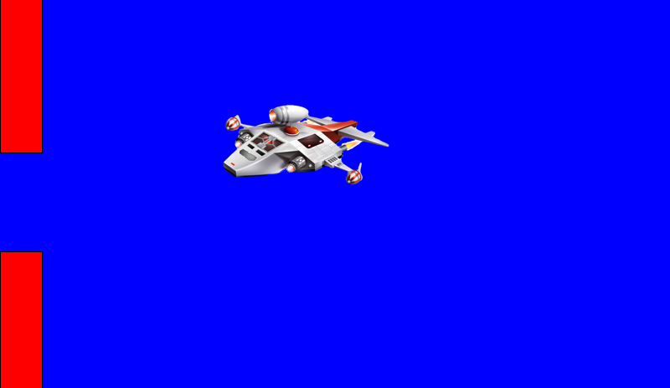

Game Programming with "Processing"
SpaceDoors
Lesson #11 – The End!

Slide 2

50
(x, y)
height/2 - ship.height/2 - 10
height/2 + ship.height/2 + 10
(x, y+ship.height)

Slide 3
-ship.width
0
ship.width

Slide 4
0
height – ship.height
width - ship.width

Slide 5
size(800, 600)
height
width

Slide 6
PImage ship;
ship = loadImage("spacecraft.png")
ship.height
ship.width

Slide 7
50
height/2 – ship.height/2 - 10

Slide 8
(0, 0)
(0, height/2 + ship.height/2 + 10)

Slide 9
(0, 0)
100
XX
size(800, 600)
600
400
(100, 400)
YY
(799, 599)
800

Slide 10
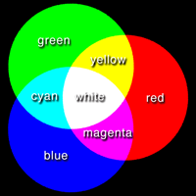
Colors
All colors are made by mixing 3 primary colors.
In computers the primary colors are RED, GREEN and BLUE.
Each color is a number that goes from 0 (min) to 255 (max)
(255,0,0)
(255,255,255)
(0,255,0)
(0,0,0)
(0,0,255)
(255,255,0)
(0,255,255)
(255,0,255)

