Slide 1
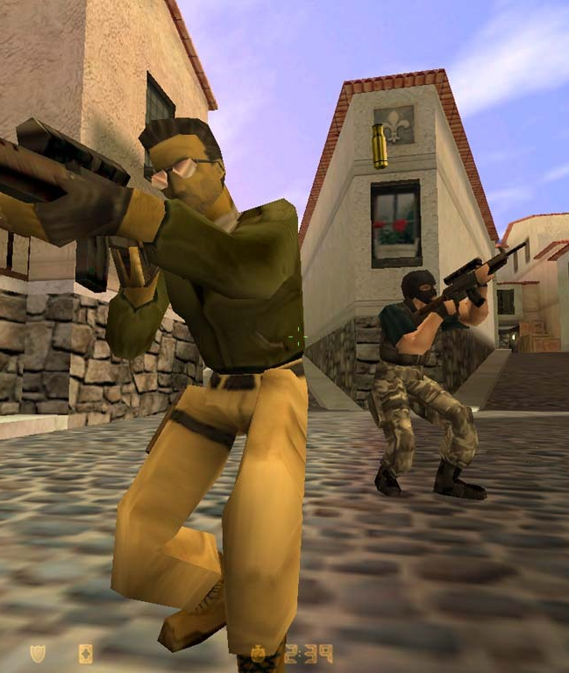
> SYSTEM BOOT.......... OK
> LOADING ASSETS....... OK
> ESTABLISHING LINK.... OK
Operation MissFits
Evaluating Haptic Guidance for Aiming Optimization
> R2oD OPERATOR....... THIJMEN STAATSEN
> 5CRN CLEARANCE...... PO-YU HSIEH
> H4PL1 COORDINATOR….. PACO PRONK
> TRG3T SELECTOR...... DAMON DE GROOT
> DATE OF BRIEFING.... 26-03-2026
> READY _
PROGRESS: 0%

Slide 2
INDEX
00 / 07
TABLE OF CONTENTS
> LOADING MISSION INDEX........... OK
> 01 // INTRODUCTION
> 05 // INTRODUCTION
> 02 // INTRODUCTION
> 06 // INTRODUCTION
> 03 // DATA TABLE
> 07 // INTRODUCTION
> 04 // INTRODUCTION
> AWAITING INPUT _
PROGRESS: 0%
PROGRESS: 0%

Slide 3
INTRODUCTION
01 / 07
INTRODUCTION
> SOME SUBTITLE......
> Use this slide for your title and mission statement
> Subtitle acts as a secondary context line
> Corner brackets define the slide boundary
PHASE 1: INTRODUCTION

Slide 4
DATA
05 / 07
DATA TABLE LAYOUT
EDIT ROWS AND COLUMNS AS NEEDED
CATEGORY | VALUE A | VALUE B | STATUS
Item 01 | — | — | ACTIVE
Item 02 | — | — | STANDBY
Item 03 | — | — | OFFLINE
PROGRESS: 62%

