Slide 1
Gentoo Linux-Play for Fun
An Introduction
Jianqing Peng
June 2022
Richard Freeman <rich0@gentoo.org>

Slide 2
Agenda
Whoami
About Gentoo Linux
Using Gentoo
Diving Deeper
Noteworthy Examples
How to Build Linux Kernel
Demo
VMWare(LiveCD)
Vagrant
Q&A

Slide 3
whoami
2005 Red Hat Linux
2006 Ubuntu 6.04
2007 Gentoo Linux
PC from my older brother
Celeron /CDROM/(拳屏)CRT 14 inch/Floppy Disk
120M/30G
Windows 98/me/2000/xp/Ubuntu
2007 bought one new PC
500G/2-4G/AMD64
Ubuntu/Gentoo/Fedora/Debian/SUSE/Kali/FreeBSD/CentOS/OpenWRT/Deepin/LFS/SliTaz/Raspbian
GNOME/KDE/Xfce/LXDE/FVWM/Enlightenment/Unity/FluxBox

Slide 4
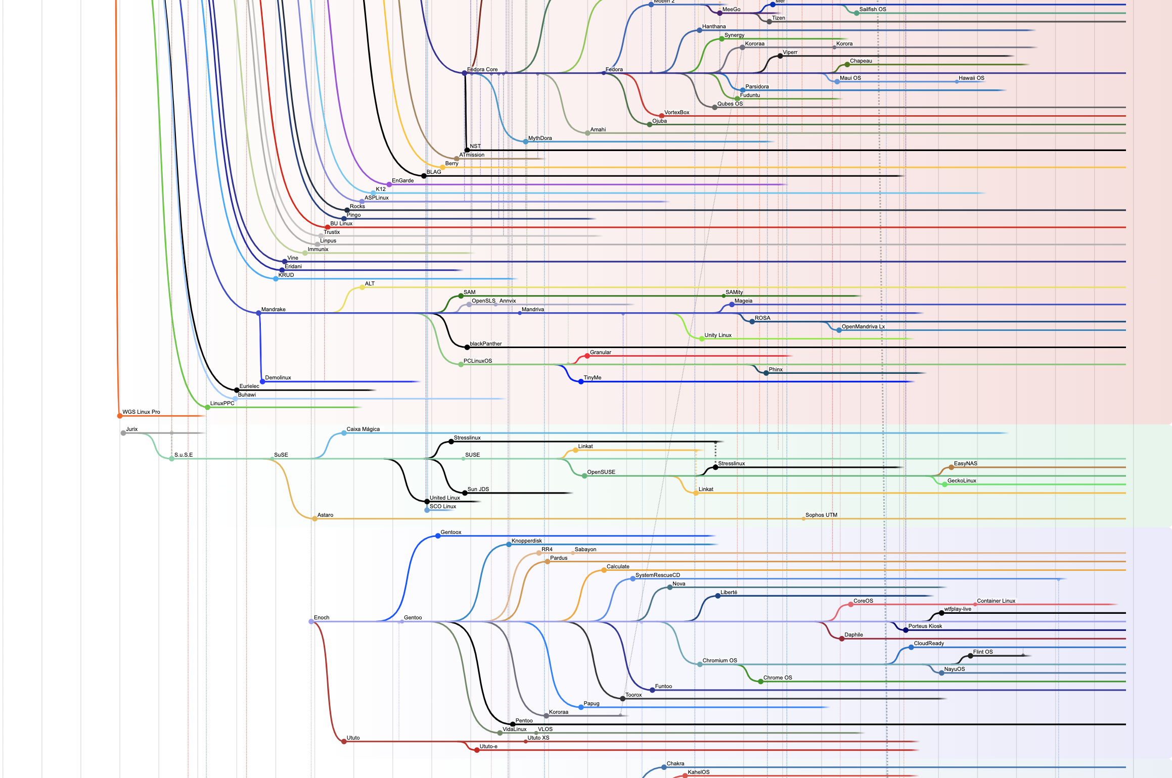
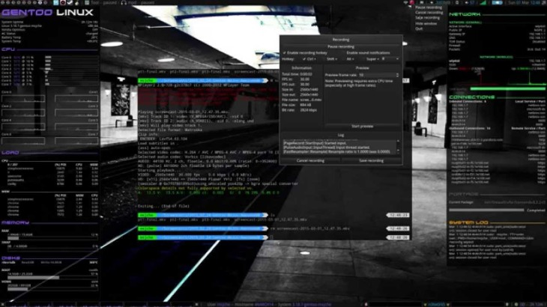
About Gentoo

Slide 5
What Is Gentoo?
Gentoo is a free operating system based on either Linux or FreeBSD that can be automatically optimized and customized for just about any application or need.
Extreme configurability, performance and a top-notch user and developer community are all hallmarks of the Gentoo experience.

Slide 6
Gentoo Social Contract
Gentoo is and will remain Free Software
We will give back to the Free Software Community
We will not hide problems
https://gentoo.org/get-started/philosophy/social-contract.html

Slide 7
Governance
The Gentoo Distribution
Developers
Projects
Council - elected by developers
The Gentoo Foundation
Manages property and finances
Members - current/former devs and selected contributors
Trustees - elected by members

Slide 8
Source-based Distro
Almost all packages are built from source on your PC
Builds are scripted
Support for user patching
Configuration is easy to configure globally and locally
Full dependency management
Gentoo’s default source-based package manager is called Portage. Alternatives exist.

Slide 9
Close to Upstream
By default almost all packages behave as upstream intends
Avoidance of over-wrapping
eg systemd units vs init.d scripts
Config files are generally user-editable
Package manager and utility support for merging changes

Slide 10
Benefits of Gentoo
Greater flexibility
Control over package build-time configuration
Control over optional dependencies
Ability to tailor C/LDFLAGS
Can mix dependencies (stable library + unstable application, etc)
No Releases
Faster package availability
Minimal base footprint
(well, if you don’t count the toolchain)
Avoids less-free upstream licensing issues
Can patch without redistribution

Slide 11
Diversity: Good and Bad
Gentoo is a very heterogeneous community
Build processes are robust, but testing is diffuse
Not all configurations equally supported by all packages
Gentoo has survived recent turmoils by embracing choice
Support for OpenRC, SystemD, Runit, Epoch, and Busybox
No preferred desktop environment, sound system, etc.
This does result in even more heterogeneity

Slide 12
What to Expect
Less hand-holding overall
You WILL be exposed to the details
You will end up interacting with the FOSS community...

Slide 13
Using Gentoo

Slide 14
Day-to-day Maintenance
Update repository: emerge --sync
Update packages: emerge -u @world
Install package: emerge apache
Merge config files: dispatch-conf (or cfg-update)

Slide 15
Installing Gentoo
Go to:
https://gentoo.org/get-started/
https://wiki.gentoo.org/wiki/Handbook:AMD64/Full/Installation
Follow the handbook (manual but scripted)
Plan an hour or two if you’re new
You don’t necessarily have to use the official Gentoo boot CD. You just need a shell, tools for partitioning/mounting, wget/etc.

Slide 16
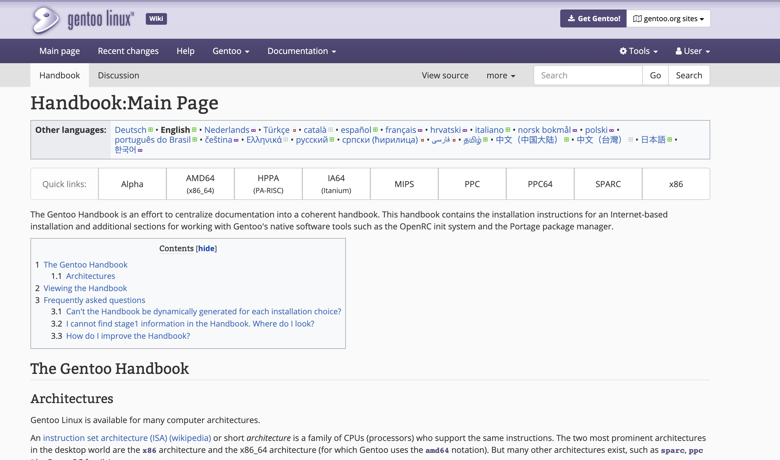
The Gentoo Handbook

Slide 17
The Gentoo Repository
Inspired by BSD Ports
Default location: /usr/portage
Packages are defined by ebuilds
An ebuild is essentially a build script

Slide 18
USE Flags
Most of Gentoo’s configurability comes from USE flags.
May be set globally or per-package
Control build-time configuration of packages
ffmpeg can be built without X11 support
many packages include optional debugging features (beyond gcc -g)
choose your openssl, libjpeg, etc implementation
Also used to control 32/64-bit builds, etc.

Slide 19
Diving Deeper

Slide 20
net-irc/irssi-0.8.17
# Copyright 1999-2015 Gentoo Foundation
# Distributed under the terms of the GNU General Public License v2
EAPI=5
AUTOTOOLS_AUTORECONF=1
inherit autotools-utils eutils flag-o-matic perl-module toolchain-funcs
# Keep for _rc compability
MY_P="${P/_/-}"
DESCRIPTION="A modular textUI IRC client with IPv6 support"
HOMEPAGE="http://irssi.org/"
SRC_URI="http://irssi.org/files/${MY_P}.tar.bz2"
LICENSE="GPL-2" ; SLOT="0"
KEYWORDS="alpha amd64 arm ~arm64 hppa ia64 ~mips ppc ppc64 ~s390 ~sh sparc x86 ~x86-fbsd ~x86-interix ~amd64-linux ~x86-linux ~ppc-macos ~x64-macos ~x86-macos ~sparc-solaris ~sparc64-solaris ~x64-solaris ~x86-solaris"
IUSE="ipv6 +perl selinux ssl socks5 +proxy"
CDEPEND="sys-libs/ncurses
>=dev-libs/glib-2.6.0
ssl? ( dev-libs/openssl:= )
perl? ( dev-lang/perl )
socks5? ( >=net-proxy/dante-1.1.18 )"
DEPEND="${CDEPEND}
virtual/pkgconfig"
RDEPEND="${CDEPEND}
selinux? ( sec-policy/selinux-irc )
perl? ( !net-im/silc-client )"
S=${WORKDIR}/${MY_P}
src_prepare() {
cd m4
epatch "${FILESDIR}/${PN}-0.8.15-tinfo.patch"
cd ..
autotools-utils_src_prepare
}
src_configure() {
econf \
--with-ncurses="${EPREFIX}"/usr \
--with-perl-lib=vendor \
--enable-static \
$(use_with proxy) $(use_with perl) $(use_with socks5 socks) \
$(use_enable ssl) $(use_enable ipv6)
}
src_install() {
emake \
DESTDIR="${D}" \
docdir="${EPREFIX}"/usr/share/doc/${PF} \
install
use perl && perl_delete_localpod
prune_libtool_files --modules
dodoc AUTHORS ChangeLog README.md TODO NEWS
}

Slide 21
kde-apps/kompare-4.14.3.ebuild
# Copyright 1999-2015 Gentoo Foundation
# Distributed under the terms of the GNU General Public License v2
# $Id$
EAPI=5
KDE_HANDBOOK="optional"
inherit kde4-base
DESCRIPTION="Kompare is a program to view the differences between files"
HOMEPAGE="https://www.kde.org/applications/development/kompare
http://www.caffeinated.me.uk/kompare"
KEYWORDS="amd64 ~arm ppc ppc64 x86 ~amd64-linux ~x86-linux"
IUSE="debug"
DEPEND="$(add_kdeapps_dep libkomparediff2)"
RDEPEND="${DEPEND}"

Slide 22
Noteworthy Examples

Slide 23
ChromeOS, CoreOS
Both ChromeOS and CoreOS are Gentoo derivatives.

Slide 24
Wall Street
Gentoo has been used on wall street.
In 2011, Chronos developed two software platforms, affectionately named Zardoz after the Sean Connery movie of the same name. One was intended to run on commodity x86 hardware and capable of 15 microsecond tick to trade latencies, and the other was optimized for Tilera hardware and capable of sub 5 microsecond tick to trade latencies. Both infrastructures were intended for co-location...
We compiled and provided our clients with a lightweight custom build of Linux (Gentoo), which we maintained in-house.
http://www.forbes.com/sites/quora/2014/01/07/what-is-the-technology-stack-like-behind-a-high-frequency-trading-platform/
Linux also offered financial firms the ability to modify the source code to further speed performance, Lameter said. "It depends on how daring the exchange is," Lameter said, noting that NASDAQ uses a modified version of the Gentoo Linux distribution.
http://www.computerworld.com/article/2510334/financial-it/how-linux-mastered-wall-street.html

Slide 25
System Rescue CD
You’ve probably used it… If not, you probably should.
SystemRescueCd is a Linux system rescue disk available as a bootable CD-ROM or USB stick for administrating or repairing your system and data after a crash.
http://www.sysresccd.org/

Slide 26
And More...
Most of Gentoo’s sponsors run Gentoo in some way:
https://www.gentoo.org/inside-gentoo/sponsors/
Daniel Robbins maintains a useful graphic of Gentoo derivatives:
http://www.funtoo.org/Gentoo_Ecosystem

Slide 27
How to Build Linux Kernels

Slide 28
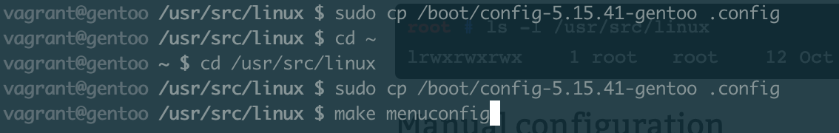
How to Build Linux Kernels
https://wiki.gentoo.org/wiki/Kernel/Configuration

Slide 29
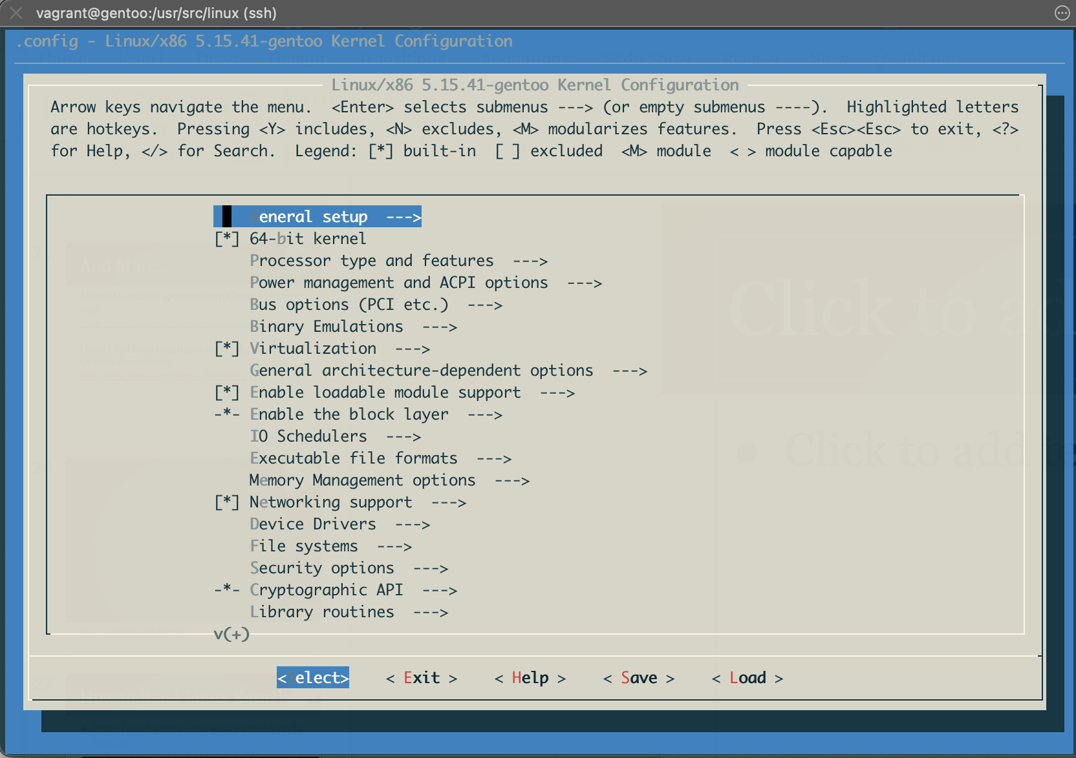
make menuconfig

Slide 30
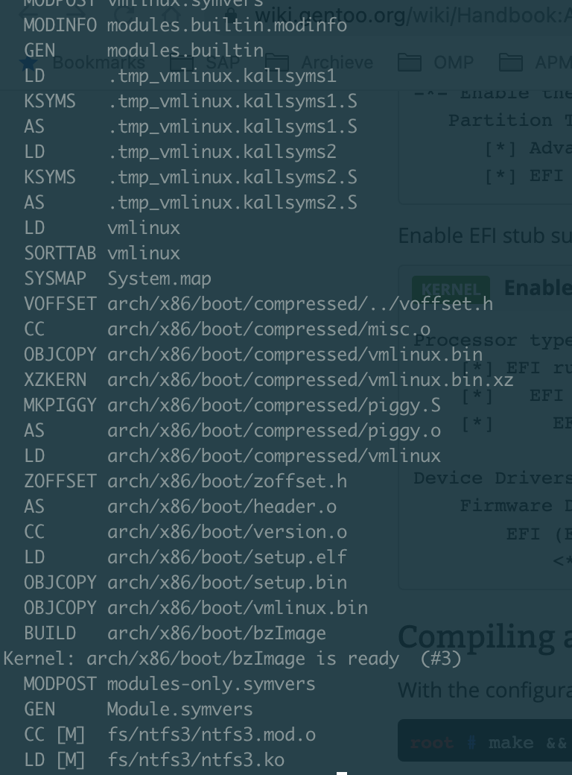
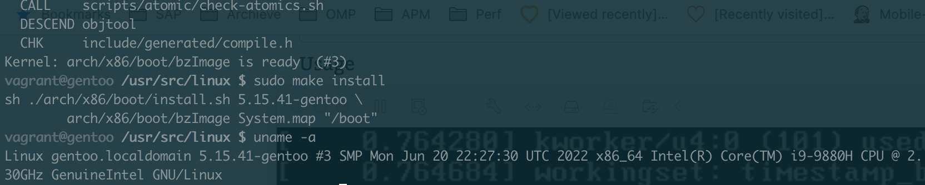
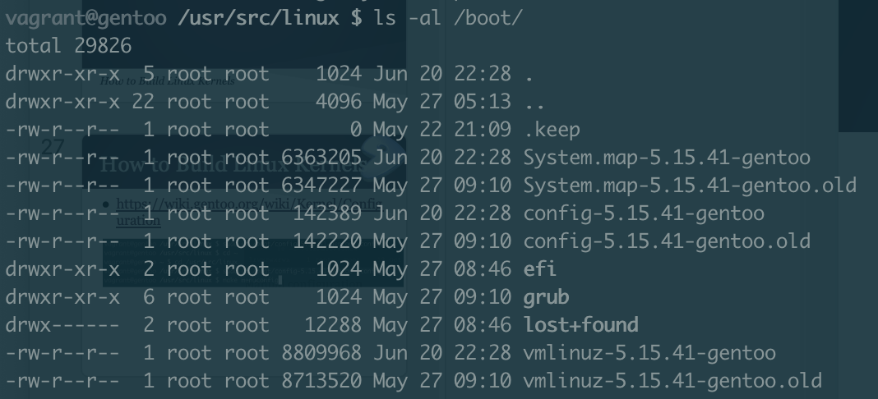
make && make install

Slide 31
Q&A

Slide 32
Misc Questions from Email
How can you avoid conflicts during upgrades?
This is a common issue with Gentoo. Avoid adding dependencies to @world. Usually the problem is with opaque error messages.
Can you do an automated install?
I’m not aware of any tools for this, though there have been various efforts to create one.
Ansible is an obvious approach.

Slide 33
Copyright Notice
Content Copyright 2016 Richard Freeman. Some rights reserved.
This work is licensed under the Creative Commons Attribution-NonCommercial-ShareAlike License.
To view a copy of this license, visit http://creativecommons.org/licenses/by-nc-sa/2.0 or send a letter to:
Creative Commons, 559 Nathan Abbott Way, Stanford, California 94305, USA.
The Gentoo Linux logo is a trademark of the Gentoo Foundation, Inc.

Slide 34
Reference
https://www.gentoo.org/get-started/screenshots/
https://forums.gentoo.org/
https://www.gentoo.org/downloads/
https://wiki.gentoo.org/wiki/Distributions_based_on_Gentoo
https://distrowatch.com/
https://gitweb.gentoo.org/proj/gentoo-ecosystem.git/plain/gentoo-17.01.pdf
https://upload.wikimedia.org/wikipedia/commons/1/1b/Linux_Distribution_Timeline.svg

