Slide 1
Big Mountain Resort
Ticket Prices Model prediction

Slide 2
Problem Identification
Business problem Big Mountain installed an additional chairlift that increases their operating costs by $1,540,000 this season. What strategies can be applied to low the tickets prices, improve quality services and start capitalizing for the next season?
Context Big Mountain Resort offers spectacular views of Glacier National Park and Flathead National Forest, with access to 105 trails. Every year about 350,000 people ski or snowboard at Big Mountain. | Constraints within solution space Basing their pricing on just the market average does not provide the business with a good sense of how important some facilities are compared to others.
Criteria for success Have a guidance on how select the correct value of the ticket’s prices. | Stakeholders to provide key insight Director of Operations: Jimmy Blackburn Database Manager: Alesha Eisen
Scope of solution space Create guidance on how to select the correct value of the tickets prices by making cuts without undermining the ticket prices. | Key data sources SQL database or S3 bucket CSV file of Company detail data

Slide 3
Key Findings
Montana was in 23rd place of ticket prices meaning that is not the most expensive tickets.
Montana have 12 resort making the top 15 of the most resort per region and state.
Montana is in the top list in the following areas:
Vertical drops
Area covered by snow makers
Number of share distribution
Number of run
Skiable terrain

Slide 4
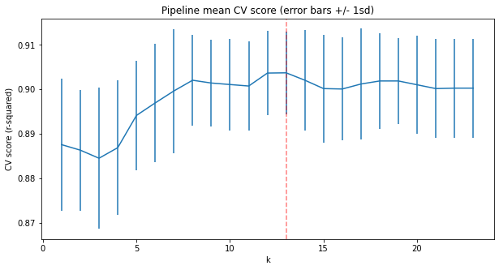

Analysis and Modeling
Train
70%
Test
30%
Study the variation with coefficient of determination
Split data
Determine the pipeline

Slide 5
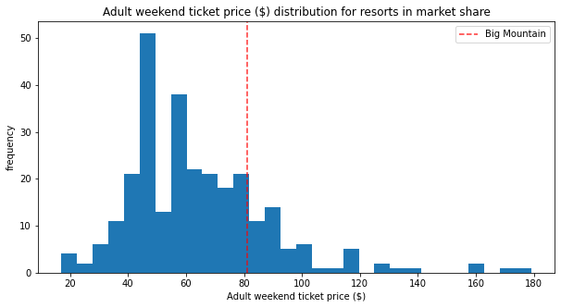
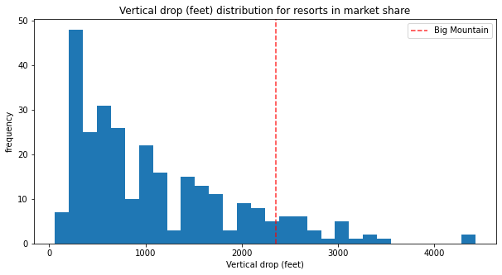
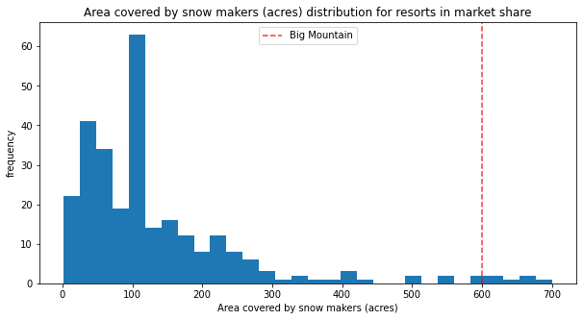
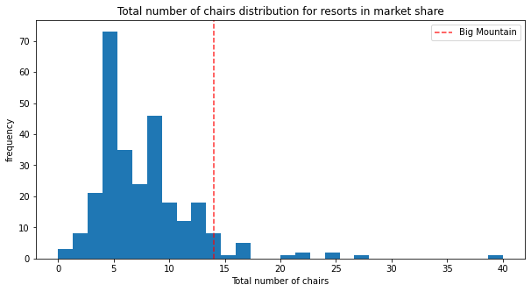
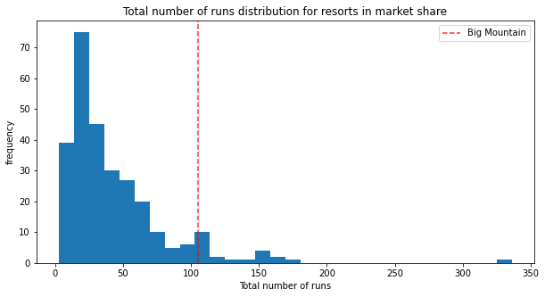
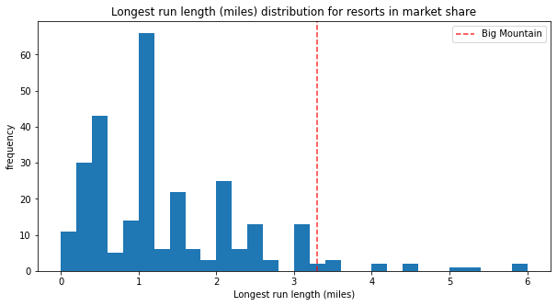
Analysis and Modeling

Slide 6
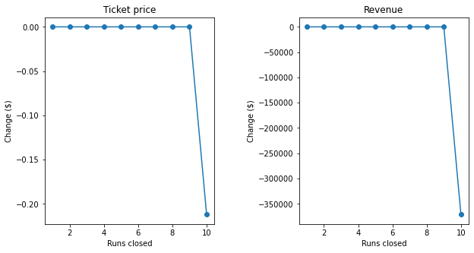
Modeling
First Scenario
The model says closing one 9 makes no difference. Increasing the closures down to 10 leads to a large drop.

Slide 7
Modeling
Scenario 2
In this scenario, Big Mountain is adding a run, increasing the vertical drop by 150 feet, and installing an additional chair lift. This scenario increases support for ticket price by $1.33
Scenario 3
In this scenario, you are repeating the previous one but adding 2 acres of snow making. This scenario increases support for ticket price by $1.33
Scenario 4
This scenario calls for increasing the longest run by .2 miles and guaranteeing its snow coverage by adding 4 acres of snow making capability.
No difference whatsoever.

Slide 8
Summary and conclusion
The best prediction model indicates the Big Mountain Resort displayed the best price at $87.48, and the actual cost is $81.00. Even with the expected mean absolute error of $6.76, this suggests there is room for an increase. The model suggested an incrementation because Big Mountain Resort is very competitive in some areas that justified the increasing price.

