Slide 1
HEAPS
Patil, Shantanu Deepak
Patole, Atharv
Pereira, Dylan
Pol, Yash Jitendra
Polireddy, Pavan

Slide 2
Introduction to Heaps
Definition: A heap is a binary tree-based data structure that satisfies the heap property.
Overview of heap properties:
Complete binary tree structure
Heap order property: Every node is greater than or equal to (max-heap) or less than or equal to (min-heap) its children

Slide 3
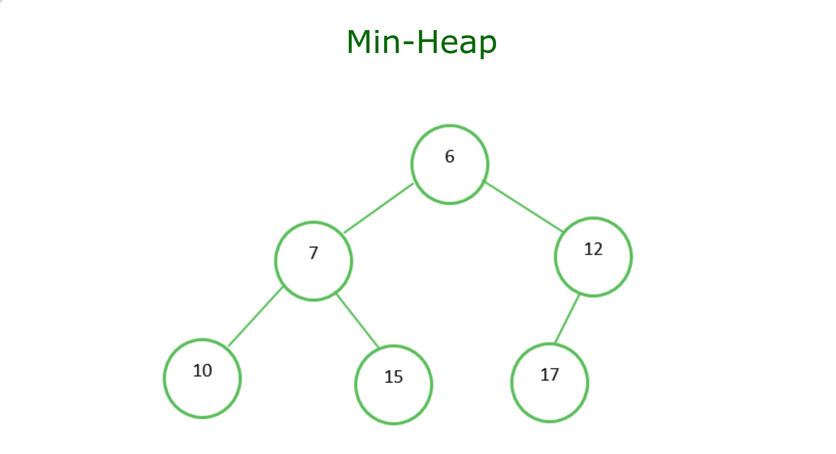
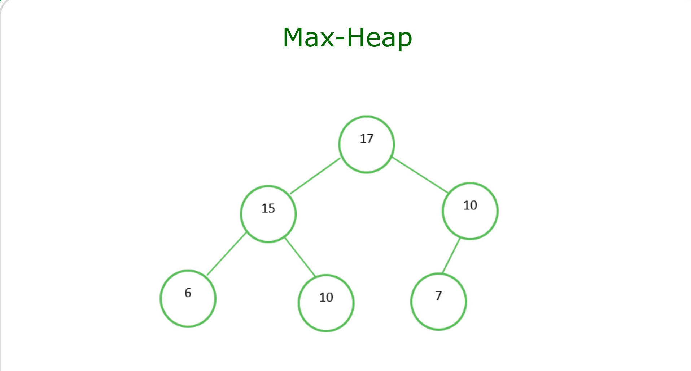
Types of Heaps
Max-Heap vs. Min-Heap:
Max-Heap: Parent nodes are greater than or equal to their child nodes.
Min-Heap: Parent nodes are less than or equal to their child nodes.

Slide 4
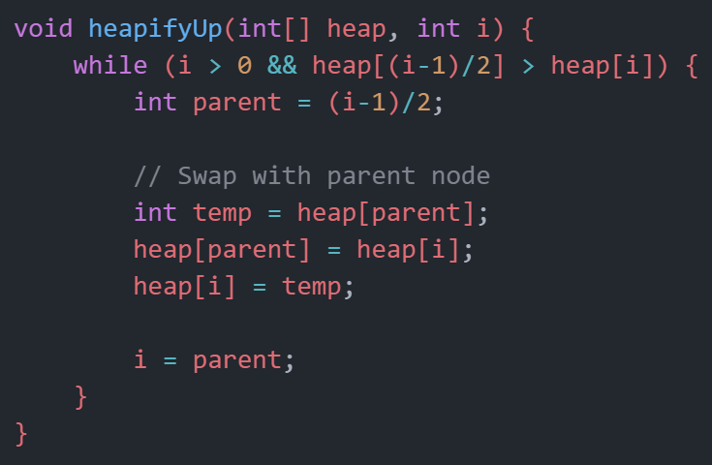
Heap Operations: Insertion
To insert an element into a heap, it is added to the bottom level of the heap and then heapified up.

Slide 5
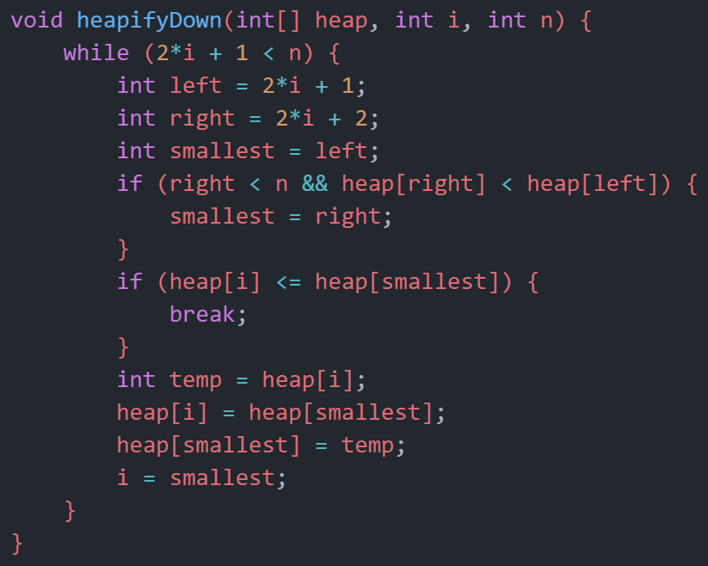
Heap Operations: Deletion
To delete an element from a heap, the element is removed from the top of the heap, and then the heap is heapified down.

Slide 6
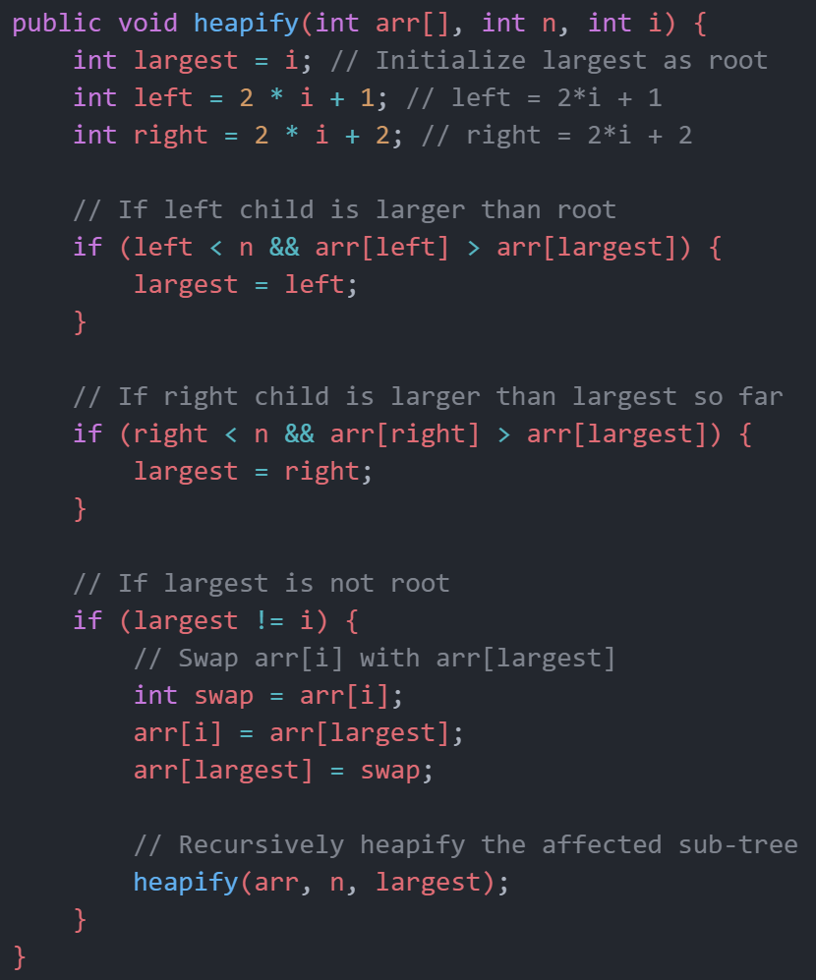
Heap Operation: Heapify
The process of converting an array into a heap data structure.
The purpose of the heapify operation is to maintain the heap property.
For a Min Heap, the heap property is that the value of each node is greater than or equal to the value of its parent.
The heapify function is typically used during the heap creation process and after the removal of the root element.
It works by comparing the parent node to its children and ensuring the smallest element among them becomes the parent.
This process is applied recursively, from the bottom up, to rebuild the heap if it's disturbed.

Slide 7
Heap Sort Algorithm
Heap Sort:
A sorting algorithm that utilizes the heap data structure to sort elements.
Steps:
Build a min-heap from the input array.
Remove the root (minimum element) from the heap and place it at the end of the array.
Heapify down the root element.
Repeat steps 2-3 until the heap is empty.
Time Complexity: O(n log n)

Slide 8
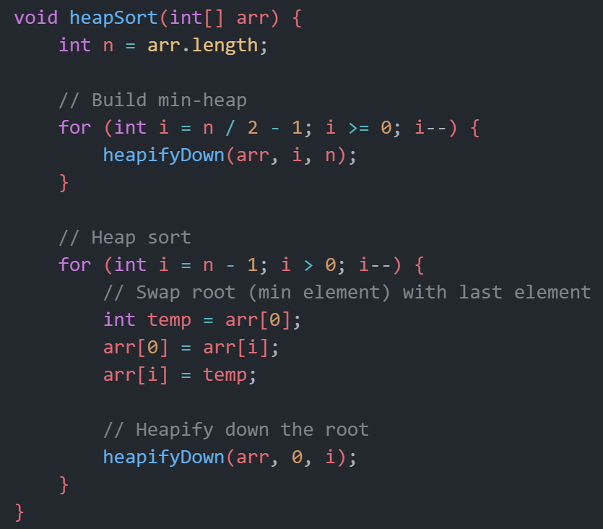
Heap Sort Algorithm

Slide 9
Heap Applications
Dijkstra's Algorithm: Finding the shortest path in a graph.
Priority Scheduling: Process scheduling in operating systems.
Huffman Coding: Data compression algorithm.
Selection Algorithms: Finding kth largest/smallest element in an array.

Slide 10
Conclusion
Heap data structure provides efficient solutions for various problems.
Understanding heaps is crucial for algorithm design and optimization.

