Slide 1
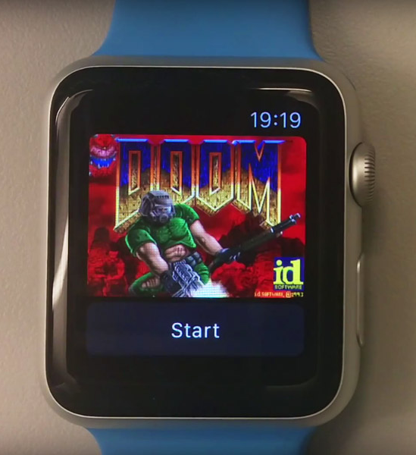
x-platform .net
@PeteSamuel

Slide 2
Agenda
Background
Workshop
The promise
.NET Core and Standard
What does this enable
Use cases
Cross platform
Android
iOS
Linux
Windows
Write a .NET Standard Class Library
Implement this in
Android
iOS
Deploy a version of the same code to Azure

Slide 3

Disclaimer
Noob alert
https://flic.kr/p/JjZkxW

Slide 4
The Promise

Slide 5
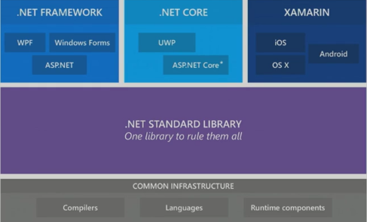
How does this work?

Slide 6
Use Cases
Not suitable for
Proof of Concepts
Wireframing
MVP
Fast time to market
High code re-use across platforms
High Performance Applications

Slide 7
FAQs
What is required to produce an Android App?
Deploy to iOS?

Slide 8
Tooling
PC
Mac
Visual Studio
Android Studio
SDK Manager
Emulators
Visual Studio for Mac
Xcode
Android Studio

Slide 9
References
https://blog.xamarin.com/building-xamarin-forms-apps-net-standard/
https://www.xamarin.com/prebuilt
https://docs.microsoft.com/en-us/dotnet/standard/net-standard#comparison-to-portable-class-libraries
https://github.com/jeremylindsayni/RaspberryPi.Template

