Slide 1
Mindfulness & Mood:
An Investigation of the Impact of Mindfulness Training
on Mood among U.S. Military Active Duty & Veteran Personnel
Valerie Riceª & Baoxia Liu^{b}
ªArmy Research Laboratory, Ft. Sam Houston, San Antonio, TX
^{b}DCS Corporation, Alexandria, VA

Slide 2
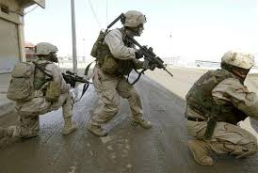
Mood & Performance
Mood states are associated with performance and can contribute to improving or degrading task execution
Studies have shown that negative mood states are associated with poor performance on cognitive tasks (e.g., Lane, 2015; Rice, Tree, & Liu, 2015)
Notes:
Prior research has shown that mood states have an effect on cognitive and physical performance:
Rice, Tree, & Liu (2015) measured attention and concentration in active duty and veteran volunteers. They found faster response times for younger participants that reported higher levels of happiness and slower response times for older participants that reported high levels of depression and fatigue.
Lane, et al. (2015) investigated the relationship between mood and running performance. Better performance was positively associated with happy, calm, energetic and moderately anxious mood states and poor performance was associated with sad, sluggish and highly anxious mood states.

Slide 3
Trait Mindfulness
Emotion regulation, differentiation, and liability are negatively associated with self-reported trait mindfulness (Mill & Updegraff, 2012), which suggests that mindful individuals are more aware of (and able to control) their emotions.
Trait mindfulness = attending to and being emotionally open to present moment events (Bishop, 2004).
Experienced meditators report higher levels of mindfulness as compared with non-meditators (Baer, et al., 2008).
Emotion
Regulation
Mill & Updegraff)
Mediation Model (2012
Emotion
Differentiation
Mindfulness
Notes:
Hill and Updegraff (2012) showed that the ability to differentiate, regulate, and control emotional responses is associated with trait mindfulness. Trait mindfulness has to do with attending to and being emotionally open to present moment events (Bishop, 2004).
Outcomes from other studies indicated that stress reduction activities (such as meditation) enhance mindfulness. For example, research by Baer and colleagues (2008) found that, relative to non-meditators, experienced meditators reported higher levels of mindfulness, particularly in regards to observing inner experiences, describing inner experiences, non-judging of inner experiences, and non-reactivity to inner experiences).
In light of the available evidence, it is highly plausible that instruction in mindfulness-based stress reduction techniques will enhance awareness and control of emotional states.

Slide 4

Mindfulness
Increasing one’s awareness of his or her own physical, cognitive, and emotional state, as well as the environment and events they are experiencing in the present moment.
With practice, individuals learn to recognize their response patterns and respond deliberately to events and persons, rather than “mindlessly reacting”.
Paying attention, in a particular way, to the present moment, non-judgmentally
Assists with self-reported:
Stress
Anxiety
Depression
Pain
Notes:
Mindfulness refers to the conscious awareness of one’s present experience without judgment. As described by Jon Kabat-Zinn [1], it is “paying attention in a particular way: on purpose, in the present moment, and nonjudgmentally”. When learning mindful meditation, participants are taught to focus on present experiences, including thoughts, feelings, or sensations as they change from moment-to-moment [2, 3]. When a person is being mindful, their attention will be intentionally administered and purposefully managed.
Importantly, mindfulness training teaches participants to focus on the present, acknowledging and accepting one’s feelings, thoughts, and physical sensations. Studies have shown that mindfulness training:
Studies with civilians
Speca and colleagues (2000): 7-week mindfulness training program with cancer patients. After training, subjects reported lower total mood disturbance and lower levels of depression, anxiety, anger, confusion and increased vigor as compared with control subjects.
Zeidan and colleagues (2010): 3-day mindfulness program reduced negative mood and depression.
Studies with veterans
Ramel, Goldin, Carmona, and McQuiad (2004) conducted an 8-week MBSR training course with veterans. Subjects reported significantly lower levels depression, anxiety,
Other evidence that MBSR reduced anxiety and depression in veterans: Serpa, Taylor, & Tillisch, 2014; Kearney, et al., 2016).
Studies with active duty
Decreases stress, anxiety, & fatigue for active duty service members & veterans (Rice, Liu, & Boykin, 2016a; Rice, Liu, & Boykin, 2016b).

Slide 5



Purpose
To investigate the impact of Mindfulness Training (MT)
on mood states of U.S. military active duty and veteran personnel
Notes:
In the present study, we investigated the relationship between self-reported state mood and trait mindfulness and in active duty military and veterans prior to and following mindfulness training. We hypothesized:
Positive association between positive mood state and trait mindfulness
Negative association between negative mood state and trait mindfulness
Increased positive mood state (happiness and vigor) and diminished negative mood (anger, anxiety, depression, restlessness, and fatigue following Mindfulness Training (MT).

Slide 6

Methods
Participants
U.S. military service members and veterans (N = 131)
Surveys
Demographics
Mindful Attention Awareness Scale (MAAS)
15-items, overall score
Five Facets Mindfulness Questionnaire (FFMQ)
39-items, 5 subscale scores:
Observe, Describe, Action, Non-discriminate, & Non-reaction
Automated Neuropsychological Assessment Metric (ANAM) Mood Scale Revised II
7 items, on:
Anger, Anxiety, Depression, Fatigue, Happiness, Restlessness, Vigor
Notes:
The study included 131 active duty and veteran U.S. Military service members.
Measures
Demographic Survey: The demographic survey included questions about participants’ age, race/ethnicity, gender, education, marital status, military status, military branch, deployment (i.e. whether they had deployed), and time-in-service (the amount of time the respondent was in the military). Participants answered the questions using a computerized questionnaire created with Microsoft Access.
Mindful Attention Awareness Scale (MAAS) is a 15-item scale designed to measure respondent’s attention to present moment experiences in everyday activities. Items are rated on a scale where 0 = almost always and 6 = almost never. An example item is “I find myself listening to someone with one ear, doing something else at the same time”. Responses are summed and divided by the total (15).
Five Facet Mindfulness Questionnaire (FFMQ): a 39-item measure of respondent’s tendency to be mindful in daily life. Items are rated on a scale where 1 = never or very rarely true and 5 = very often true or always true. Responses are scored on five subscales: observing (attending to internal experiences), describing (labelling internal experiences), acting with awareness, nonreactivity to inner experience, and non-judging inner experience. An example item is “When I have distressing thoughts or images, I “step back” and am aware of the thought or image without getting taken over by it”.
ANAM Mood Scale II: Part of the Automated Neuropsychological Assessment Metrics (ANAM) suite. Respondents see a series of adjectives (e.g., “Shaky”) and rate the correspondence of the word to their current state on a 6-point scale where 0 = “not at all” and 6 = “very much”. The seven mood states are: anger, anxiety, depression, fatigue, happiness, restlessness, and vigor. Scores on the ANAM mood scale were calculated as: Percent Adjusted Categories, which is the sum of the ratings for the adjectives divided by the maximum possible score (6).
Analyses: frequencies, chi-square, ANOVA, and Pearson correlation. A significance level of .05 was used.

Slide 7
Demographics
 | MT |  | Control
 | # | % | # | % | χ² (1) | sig
Gender
Male** | 48 | 52.7 | 19 | 47.5 | 12.55 | .0001
Female** | 43 | 47.3 | 21 | 52.5 | 7.56 | .006
Race
African-American | 18 | 19.8 | 12 | 30.0 | 1.20 | .273
Native American | 2 | 2.2 | 0 | 0.0 | NA | NA
Caucasian** | 53 | 58.2 | 22 | 55.0 | 12.81 | .0001
Hispanic* | 15 | 16.5 | 5 | 12.5 | 5.00 | .025
Asian | 2 | 2.2 | 1 | 2.5 | 0.33 | .564
Other | 1 | 1.1 | 0 | 0.0 | NA | NA
Education
High school/GED | 7 | 7.7 | 2 | 5.0 | 2.78 | .096
Some college/AA* | 25 | 27.5 | 12 | 30.0 | 4.57 | .033
Bachellors* | 23 | 25.3 | 9 | 22.5 | 6.13 | .013
Masters/Ph.D. | 31 | 34.1 | 15 | 37.5 | 5.57 | .018
Other professional degree | 5 | 5.5 | 2 | 5.0 | 1.29 | .257
Notes:
# of volunteers in the MT group: 91 (combination of in-person and virtual world groups)
# of volunteers in the control group: 40
Average reported age of MT volunteers = 51.19 years (SD = 11.11).
Average reported age of control volunteers = 49.35 years (SD =11.16).
Average ages between the two groups were not significantly different, p = .335.
The majority of the participants in the MT group were male, Caucasian, and highly educated.
The majority of the participants in the control group were: female, Caucasian, and highly educated.

Slide 8
Demographics
 | MT |  | Control
 | # | % | # | % | χ² (1) | sig
Marital status
Married** | 56 | 61.5 | 19 | 47.5 | 18.25 | .0001
Divorced | 15 | 16.5 | 11 | 27.5 | 0.62 | .433
Widowed | 1 | 1.1 | 0 | 0.0 | NA | NA
Single/seperated | 17 | 18.7 | 8 | 20.0 | 3.24 | .072
Partnered with sig. other | 2 | 2.2 | 2 | 5.0 | NA | NA
Military status
Active duty* | 25 | 27.5 | 12 | 30.0 | 4.57 | .033
Veteran** | 66 | 72.5 | 28 | 70.0 | 15.36 | .0001
Notes:
The majority of the participants in both groups were married and veterans.
Average reported time in service for the MT group = 16.21 years (SD = 9.29)
Average reported time in service for the control group = 16.09 years (SD = 8.01)
Average reported time in service for the two groups did not differ significantly, p = .580

Slide 9
Results
Pearson-Product Moment Correlations between scores on the ANAM mood and mindfulness measures before MT training
 | ANAM Mood State
Measure | Ang | Anx | Dep | Fat | Hap | Rest | Vigor
MAAS
Total | -.14 | -.35** | -.27** | -.27** | .35** | -.34** | .33**
FFMQ
Observe | .04 | -.08 | -.11 | -.09 | .28** | -.13 | .30**
Describe | -.11 | -.31** | -.31** | -.23** | .47** | -.28** | .39**
Acting w/ A | -.14 | -.33** | -.29** | -.33** | .33** | -.36** | .33**
Non-judge | -.17 | -.43** | -.37** | -.30** | .37** | -.43** | .26**
Non-react | -.23** | -.40** | -.42** | -.26** | .54** | -.42** | .43**
**= p < .01. Ang = anger, Anx = anxiety, Dep = depression, Fat = fatigue, Hap = happiness,
Rest = restlessness.
Notes:
This slide shows that mindfulness
MAAS: negatively correlated with negative ANAM moods (anger, anxiety, depression, fatigue and restlessness) and positively correlated with positive moods (happiness and vigor).
FFMQ: - only sub category correlated with all mood states = non-reactivity to inner experience.
- describing, acting with awareness, and non-judging of inner experience were correlated with all except anger
- observing was correlated ONLY with happiness and vigor, not correlated with any negative mood!
Of the moods themselves: only happiness and vigor were significantly correlated with ALL mindfulness measures, negative moods were NOT correlated with observe, and again…anger was ONLY correlated with non-reactivity to inner experience
Supports Hypotheses 1 and 2:
Positive association between positive mood state and trait mindfulness
Negative association between negative mood state and trait mindfulness

Slide 10
Results
Pearson-Product Moment Correlations between scores on the ANAM mood & mindfulness measures after MT training
 | ANAM Mood State
Measure | Ang | Anx | Dep | Fat | Hap | Rest | Vigor
MAAS
Total | -.37** | -.39** | -.41** | -.43** | .46** | -.47** | .32**
FFMQ
Observe | .00 | -.13 | -.15 | -.21* | .28** | -.09 | .28**
Describe | -.14 | -.37** | -.32** | -.41** | .50** | -.30** | .50**
Acting with A | -.23** | -.31** | -.31** | -.38** | .31** | -.43** | .25**
Non-judge | -.28** | -.46** | -.36** | -.41** | .36** | -.42** | .32**
Non-react | -.15 | -.37** | -.30** | -.26** | .46** | -.28** | .37**
*= p < .05, **= p < .01. Ang = anger, Anx = anxiety, Dep = depression, Fat = fatigue,
Hap = happiness, Rest = restlessness.
Notes:
This slide BASICALLY parallels the previous slide.
MAAS (same as previous slide):
- negatively correlated with negative ANAM moods (anger, anxiety, depression, fatigue and restlessness) and
- positively correlated with positive moods (happiness and vigor).
FFMQ: - DIFFERENT: sub categories correlated with all mood states = acting with awareness and non-judging of inner experience
- SAME: describing was correlated with all except anger and DIFFERENT: non-reacting to inner experience were correlated with all except anger
- SAME: observing was correlated with happiness and vigor, DIFFERENT: observing was negatively correlated with fatigue
Of the moods themselves:
- SAME: happiness and vigor were significantly correlated with ALL mindfulness measures,
- DIFFERENT: fatigue was also correlated with all mindfulness measures
- DIFFERENT: observe was correlated with fatigue (only negative measure correlated with observe)
- DIFFERENT: Anger was correlated with acting with awareness and non-reactivity to inner experience
Supports Hypotheses 1 and 2:
Positive association between positive mood state and trait mindfulness
Negative association between negative mood state and trait mindfulness
h mindfulness. High correlations were observed for ANAM mood, MAAS, FFMQ-non-judge and non-react.

Slide 11
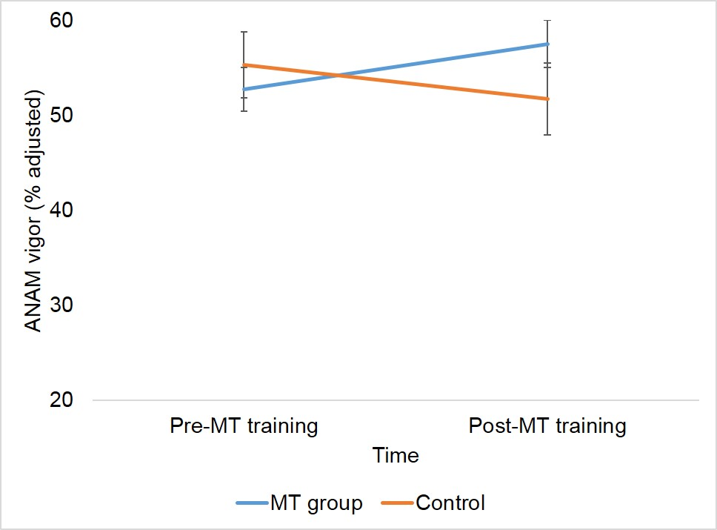
Results
Self-reported vigor before and after MT training
Range =
Notes:
A 2 (time) x 2 (group) repeated measures ANOVA was used to analyze the mood state data.
There was a significant main effect of time on self-reported anxiety and restlessness scores, with lower mean scores following MT training.
self-reported anxiety and restlessness scores were significantly lower following MT training, p’s < .05
None of the other comparisons were significantly different, p’s > .05
The main effect of group (MT/Control) was not significant for self-reported mood state, p’s > .05
The MT and control groups reported similar levels of mood states.
The two-way interaction between time (pre/post MT training) and group (MT/control) was significant only for self-reported vigor, F(1,129) = 4.529, p < .035, ηp² = .034.
Although pre- and post- training vigor scores did not differ significantly for the control group, p = .248, the MT group reported significantly higher post-training vigor (M = 57.57, ±23.67) as compared with reported pre-training vigor (M = 52.81, ±21.98), p < .035.
The interaction is displayed here. Note that, using the percent adjusted scoring criteria, the maximum score was 100 and the minimum was 2.78.

Slide 12
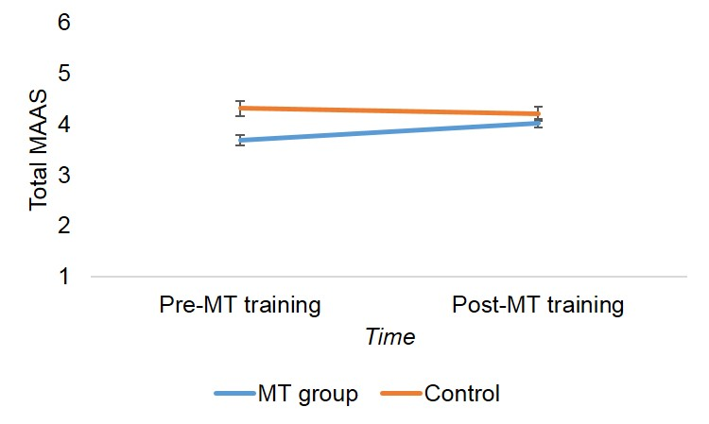
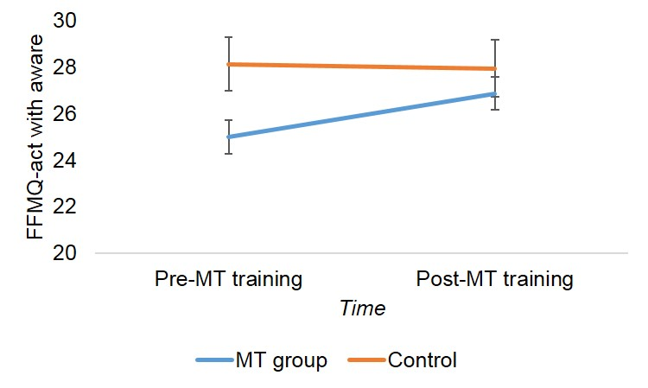
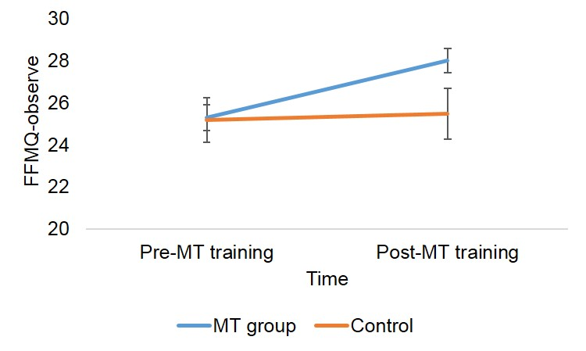
Results
Self-reported mindfulness before and after MT training
Notes:
There was a significant main effect of time.
Post- MT training scores on the FFMQ observe, describe, and non-judge subscales were significantly higher than pre- MT training scores. None of the other comparisons were statistically significant, p’s > .05
None of the other comparisons were significantly different, p’s > .05
There was a significant main effect of group.
The control group had significantly higher scores on the MAAS (M = 4.25, ±.92) than the MT group (M = 3.71, ±.93), F (1, 78) = 12.436, p < .001, ηp² = .138.
The control group had significantly higher FFMQ action scores (M = 28.04, ±7.42) than the MT group (M = 24.81, ±7.07), F (1, 78) = 7.371, p < .008, ηp² = .086.
None of the other comparisons were significantly different, p’s > .05
There was a significant time x group interaction (shown on this slide):
MAAS: F(1,128) = 9.1295, p < .003, ηp² = .067. The control group had significantly higher pre-training MAAS scores (M = 4.31, ± .96) as compared with the MT group (M = 3.68, ±.93), p < .001. Post-training MAAS scores did not differ significantly between the two groups, p = .228.
Pre-MT training minimum score: 1.40, maximum: 5.80
Post-MT training minimum score: 2.33, maximum: 5.93
FFMQ-observe: F(1,128) = 5.316, p < .023, ηp² = .040. The MT group had marginally significantly higher post-training FFMQ-observe scores (M = 28.00, ± 5.50) as compared with the control group (M = 25.48, ± 7.58), p < .06. Pre-training scores were not significantly different, p = .928
Pre-MT training minimum score: 3, maximum: 39
Post-MT training minimum score: 10, maximum: 40.
FFMQ-action: F(1,128) = 4.200, p < .042, ηp² = .032. The control group had significantly higher pre- training FFMQ-action scores (M = 28.13, ± 7.25) as compared with the MT group (M = 24.99, ± 6.94), p < .021. Post-training scores were not significantly different, p = .414.
Pre-MT training minimum score: 4, maximum: 40
Post-MT training minimum score: 8, maximum: 40
None of the other comparisons were significantly different, p’s > .05

Slide 13
Results
Calculating clinical significance
(post MT score – pre MT score)
Standard error _{(post MT score – pre MT score)}
Difference score =
Difference scores ≥ 1.96 = clinically significant
Difference scores < 1.96 = not clinically significant
Notes:
The clinical significance of the outcomes was evaluated with this formula. Clinically significant scores met or exceed the 95% confidence interval (1.96).

Slide 14
Results
Frequency of clinically significant scores for the two groups’ ANAM mood scores
 | MT group (n = 90) |  | Control (n = 40)
ANAM mood | # | % | # | %
Anger | 25 | 27.5 | 10 | 25.0
Anxiety | 22 | 24.2 | 7 | 17.5
Depression | 23 | 25.3 | 9 | 22.5
Fatigue | 27 | 29.7 | 16 | 40.0
Happiness | 68 | 74.7 | 28 | 70.0
Restlessness | 24 | 26.4 | 8 | 20.0
Vigor* | 47 | 51.6 | 11 | 27.5
* Significant at .05, Chi²

Slide 15
Conclusions
Main Findings:
Mood and Mindfulness are correlated, with higher mindfulness being associated with more positive moods and less negative moods
Higher levels of vigor for the MT group following training, but not the control group
Improvements in mindfulness (observing and acting with awareness) following training for the MT group, not for the control group
Clinically significant shifts in self-reported mood following mindfulness training, statistically significant for vigor
Notes:
The main findings of the study were as follows:
Mood was associated with mindfulness both prior to and following MT training. Anger, Anxiety, Depression, Fatigue, and Restlessness were negatively associated with mindfulness. Happiness and Vigor were positively associated with mindfulness. These findings are consistent with those reported by Hill & Updegraff (2012).
Significant improvements in self-reported vigor were found for the MT group following mindfulness training. Also, for both groups anxiety and restlessness significantly diminished at post-training assessment. This finding supports that mindfulness training enhances positive emotional states.
Although both groups showed significant improvements in self-reported mindfulness at post-training assessment, the MT group showed marginally significant improvement in FFMQ-observe, as compared with the control group. This suggests that mindfulness training may improve one’s ability to attend to their inner experiences. This finding is in agreement with outcomes from the Baer, et al. (2008) study, which found that meditators reported higher levels of FFMQ- observe as compared with non-meditators.
For the MT group, an average of 34 volunteers (37.06%) showed clinically significant scores on the ANAM mood scales. Changes in happiness and vigor following MT were prominent. This also supports that mindfulness enhances emotional regulation (Hill & Updegraff, 2012).
Limitations
Unequal group sizes in MT and control
Accept Hypotheses 1 & 2, reject hypothesis 3.
Positive association between positive mood state and trait mindfulness
Negative association between negative mood state and trait mindfulness
Increased positive mood state (happiness and vigor) and diminished negative mood (anger, anxiety, depression, restlessness, and fatigue following Mindfulness Training (MT).

Slide 16
References
Baer, R.A., et al. (2008). Construct validity of the five facet mindfulness questionnaire in meditating and nonmeditating samples. Assessment, 15, 329-342.
Bishop, S.R., et al. (2004). Mindfulness: A proposed operational definition. Clinical psychology: science and practice, 11, 230- 241.
Hill, C.L.M. & Updegraff, J.A. (2012). Mindfulness and its relationship to emotional regulation. Emotion, 12, 81-90.
Kabat-Zinn, J. (2009). Wherever you go, there you are: Mindfulness Meditation in Everyday Life. UK: Hachette.
Kearney, D.J., et al. (2016). Mindfulness-based stress reduction in addition to usual care is associated with improvements in pain, fatigue, and cognitive failures among veterans with gulf war illness. The American Journal of Medicine, 129, 204-214.
Lane, A.M., Devonport, T.J., Friesen, A.P., Beedie, C.J., Fullerton, C.L., & Stanley, D.M. (2015). How should I regulate my emotions if I want to run faster? European Journal of Sport Science, 1-8.
Ramel, W., Goldin, P.R., Carmona, P.E., & Mcquaid, J.R. (2004). The effects of mindfulness meditation on cognitive process and affect in patients with past depression. Cognitive Therapy and Research, 28, 433-455.
Rice, V.J., Liu, B., & Boykin, G. (2016). Investigating group wellness training in-person and via telehealth in a 3D virtual world. Military Health System Research Symposium, Orlando, FL.
Rice, V.J., Tree, R., & Liu, B. (2015). The effect of age and mood state on sustained attention. Proceedings of the Human Factors and Ergonomics Society 59th Annual Meeting, 1177-1181.
Serpa, J.G., Taylor, S.L., & Tillisch, K. (2014). Mindfulness-based stress reduction (MBSR) reduces anxiety, depression, and suicidal ideation in veterans. Medical Care, 52, 19-24.
Speca, M., Carlson, L.E., Goodey, E., & Angen, M. (2000). A randomized, wait-list controlled clinical trial: the effect of a mindfulness meditation-based stress reduction program on mood and symptoms of stress in cancer patients. Psychosomatic Medicine, 62, 613-622.
Zeidan, F. Johnson, S.K., Gordon, N.S., & Goolkasian, P. (2010). Effects of brief and sham mindfulness meditation on mood and cardiovascular variables. The Journal of Alternative and Complementary Medicine, 16, 867-873.

Slide 17

Questions?

Slide 18
Extras

Slide 19
Results
Comparison of ANAM mood states before & after MT training
 | Pre-MT training |  | Post-MT training
 | M | SD | M | SD | F | sig | ηp²
Anger | 8.31 | 15.87 | 9.01 | 15.36 | .446 | .506 | .003
Anxiety* | 17.64 | 19.30 | 13.11 | 16.21 | 6.091 | .015 | .045
Depression | 17.15 | 20.86 | 13.32 | 18.44 | 2.130 | .147 | .016
Fatigue | 31.28 | 20.44 | 28.67 | 20.40 | .684 | .410 | .005
Happiness | 62.00 | 23.25 | 63.63 | 24.12 | .043 | .836 | .000
Restlessness* | 19.36 | 18.50 | 15.78 | 16.66 | 5.515 | .020 | .041
Vigor | 53.58 | 21.88 | 55.79 | 23.82 | .086 | .770 | .001
*p < .05
Notes:
A 2 (time) x 2 (group) repeated measures ANOVA was used to analyze the mood state data.
There was a significant main effect of time on self-reported anxiety and restlessness scores, with lower mean scores following MT training.
As shown in this slide, overall self-reported anxiety and restlessness scores were significantly lower following MT training, p’s < .05
None of the other comparisons were significantly different, p’s > .05
The main effect of group (MT/Control) was not significant for self-reported mood state, p’s > .05
The MT and control groups reported similar levels of mood states.
The two-way interaction between time (pre/post MT training) and group (MT/control) was significant only for self-reported vigor, F(1,129) = 4.529, p < .035, ηp² = .034.
Although pre- and post- training vigor scores did not differ significantly for the control group, p = .248, the MT group reported significantly higher post-training vigor (M = 57.57, ±23.67) as compared with reported pre-training vigor (M = 52.81, ±21.98), p < .035.

Slide 20
Results
Comparison of self-reported mindfulness before and after MT training
 | Pre-MT training |  | Post-MT training
Measure | M | SD | M | SD | F | sig | ηp²
MAAS
Total | 3.86 | .98 | 4.06 | .82 | 2.075 | .152 | .016
FFMQ
Observe** | 25.25 | 6.07 | 27.28 | 6.28 | 10.163 | .002 | .074
Describe* | 26.40 | 7.24 | 27.72 | 7.16 | 5.880 | .017 | .044
Acting w/ A | 25.93 | 7.15 | 27.15 | 6.95 | 2.050 | .155 | .016
Non-judge** | 27.41 | 7.10 | 29.11 | 6.30 | 10.451 | .002 | .075
Non-react | 21.12 | 5.27 | 21.66 | 5.43 | .209 | .649 | .002
**p < .01, *p < .05
Notes:
There was a significant main effect of time.
As shown in this slide, post- MT training scores on the FFMQ observe, describe, and non-judge subscales were significantly higher than pre- MT training scores. None of the other comparisons were statistically significant, p’s > .05
None of the other comparisons were significantly different, p’s > .05
There was a significant main effect of group.
The control group had significantly higher scores on the MAAS (M = 4.25, ±.92) than the MT group (M = 3.71, ±.93), F (1, 78) = 12.436, p < .001, ηp² = .138.
The control group had significantly higher FFMQ action scores (M = 28.04, ±7.42) than the MT group (M = 24.81, ±7.07), F (1, 78) = 7.371, p < .008, ηp² = .086.
None of the other comparisons were significantly different, p’s > .05
There was a significant time x group interaction.
MAAS: F(1,128) = 9.1295, p < .003, ηp² = .067. The control group had significantly higher pre-training MAAS scores (M = 4.31, ± .96) as compared with the MT group (M = 3.68, ±.93), p < .001. Post-training MAAS scores did not differ significantly between the two groups, p = .228.
FFMQ-observe: F(1,128) = 5.316, p < .023, ηp² = .040. The MT group had marginally significantly higher post-training FFMQ-observe scores (M = 28.00, ± 5.50) as compared with the control group (M = 25.48, ± 7.58), p < .06. Pre-training scores were not significantly different, p = .928
FFMQ-action: F(1,128) = 4.200, p < .042, ηp² = .032. The control group had significantly higher pre- training FFMQ-action scores (M = 28.13, ± 7.25) as compared with the MT group (M = 24.99, ± 6.94), p < .021. Post-training scores were not significantly different, p = .414.
None of the other comparisons were significantly different, p’s > .05

