Slide 1
RISC PIPELINE PROCESSOR DESIGN

Slide 2
01
Introduction

Slide 3
Introduction
Datapath for different instruction formats
A Format
B Format
L Format
Controller and its execution for different datapath

Slide 4
Design Parameters
4-1 byte Registers in addition with a Link register
Instruction memory and Data memory of 256 bytes
Length of Instructions is 2 bytes
Arithmetic format has implicit function
Additional Z and N flags for the ALU
20 bits counter for adjusting the clock frequency to 50Hz

Slide 5
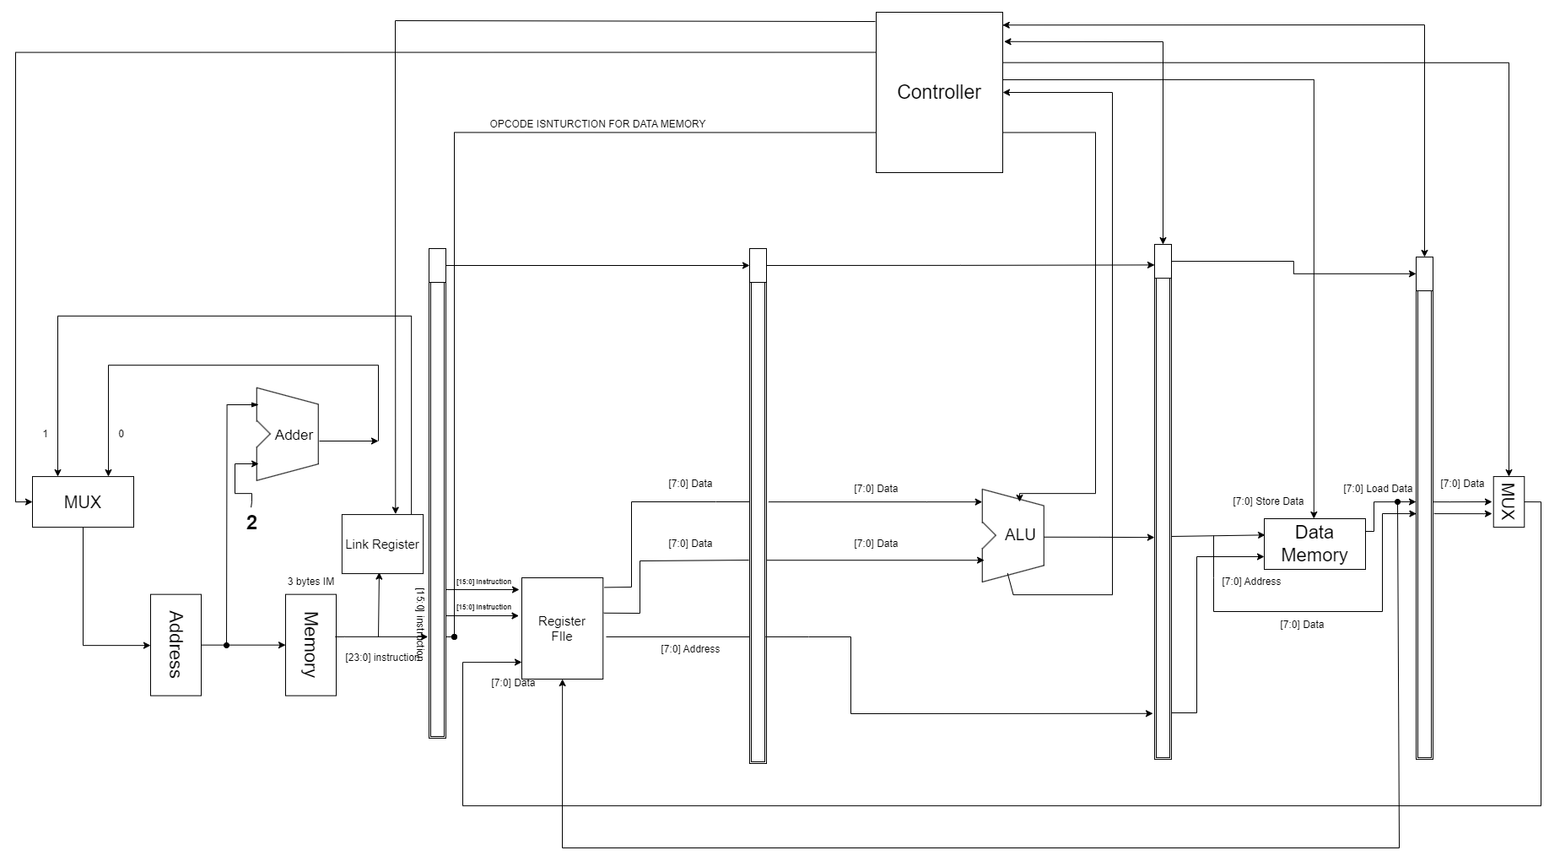
Final Design

Slide 6
02
Datapaths

Slide 7
A Format Instructions
Mnemonic | Op-code | Function
NOP | 0 | Nothing
ADD | 1 | R[ra] - R[ra] + R[rb]; (R[a] + R[rb]) = 0) => Z - 1; else Z - 0; (R[a] + R[rb]) <0) => N - 1; else => N - 0;
SUB | 2 | R[ra] - R[ra]-R[rb]; ((R[ra] - R[rb]) = 0) Z - 1; else Z - 0; (R[a] - R[rb]) <0) => N - 1; else =N - 0;
NAND | 3 | R[ra] - R[ra] NAND R[rb]; (R[a] NAND R[rb]) =0)=> - 1; else=>z-0: (R[a] NAND R[rb]) <0)=N-1;else=>N- 0;
SHL | 4 | Z - R[ra]<7>; R[ra] - (R[ra]<6:0>&0):
SHR | 5 | Z - R[ra]<0>; R[ra] - (0&R[ra]<7:1>):
OUT | 6 | OUT PORT - R[ra]:
IN | 7 | R[ra] - IN.PORT:
MOV | 8 | R[ra] - R[rb]:

Slide 8
A Format Datapath

Slide 9
A Format Issues
Output Z and N flags from ALU came later. After the next instruction is executed (i.e it is in decode stage), Z or N flag is reflected.
SHR command works in 2 ways. One of the shift right instructions in the assembly code has the number 1’s shifting to right until they are 0. Another SHR commands requires to add 1 in the MSB after all the bits are 0.
IN and OUT took longer to execute.
Data hazards.

Slide 10
B Format Instructions
Mnemonic | Op-code | Function
BR | 9 | PC - ea;
BR.Z | 10 | (brx=0 n Z=1) PC - ea ; (brx=0 n Z=0) PC - PC + 2;
BR.N | 10 | (brx=1 n N=1) => PC + ea; (brx=1 n N=0) => PC + PC+2
BR.SUB | 11 | LR - PC+2; PC - ea
RETURN | 12 | PC LR;

Slide 11
B Format Datapath

Slide 12
B Format Issues
Executing branch format in any other stage than fetch stage caused multiple problems.
Getting Z and N values from ALU.
Stalling issues.
Link Register storing address (causing to add interpath address)

Slide 13
L Format Instructions
Mnemonic | Op-code | Function
LOAD | 13 | R[ra] - M[ea];
STORE | 14 | M[ea] - R[ra];
LOADIMM | 15 | R[ra] - imm;

Slide 14
L Format Datapath

Slide 15
L Format Issues
Load immediate takes longer time to execute for loading data into register.
Load and Store instructions takes too many clock cycles to execute as these instructions are performed till write back stage.

Slide 16
Resolving Issues
A-Format
For, Z or N Flag, we storing the values of Z and N in the register and is sent directly to fetch stage through controller to have proper execution for B - Format instructions.
For SHR problem we have implemented that by comparing the value of R0 with zero, if it zero then we will send 1 bit for shift right and if it is not zero then we will send 0 bit for shift right.
To remove data hazard hazards, we have implemented stall between the instructions by inserting NOP.
We have solved the IN and OUT execution problem by resolving it DE stage.

Slide 17
Resolving Issues
B-Format
Branch was not able to jump in execute stage, so we have implemented it in the fetch stage where we were storing the current address into the link register and jump address is directly loaded into the current address.
During branch we were not getting the values of Z and N flag due to which we were not getting the desired output. So, we have extended the wire of Z and N flag to fetch stage,
To reduce the collision of instructions in branch, we have install the stall between the instructions by adding NOP between the two instructions.

Slide 18
Resolving Issues
L-Format
We have resolved load immediate instruction in decode stage as it can save 1 clock cycle and also requirement of stall can be resolved.
Load and Store takes longer time to resolve, in order to reduce the collision between the data and instructions, we have implemented stall between the instructions by inserting NOP.

Slide 19
03
Final Simulation Result

Slide 20
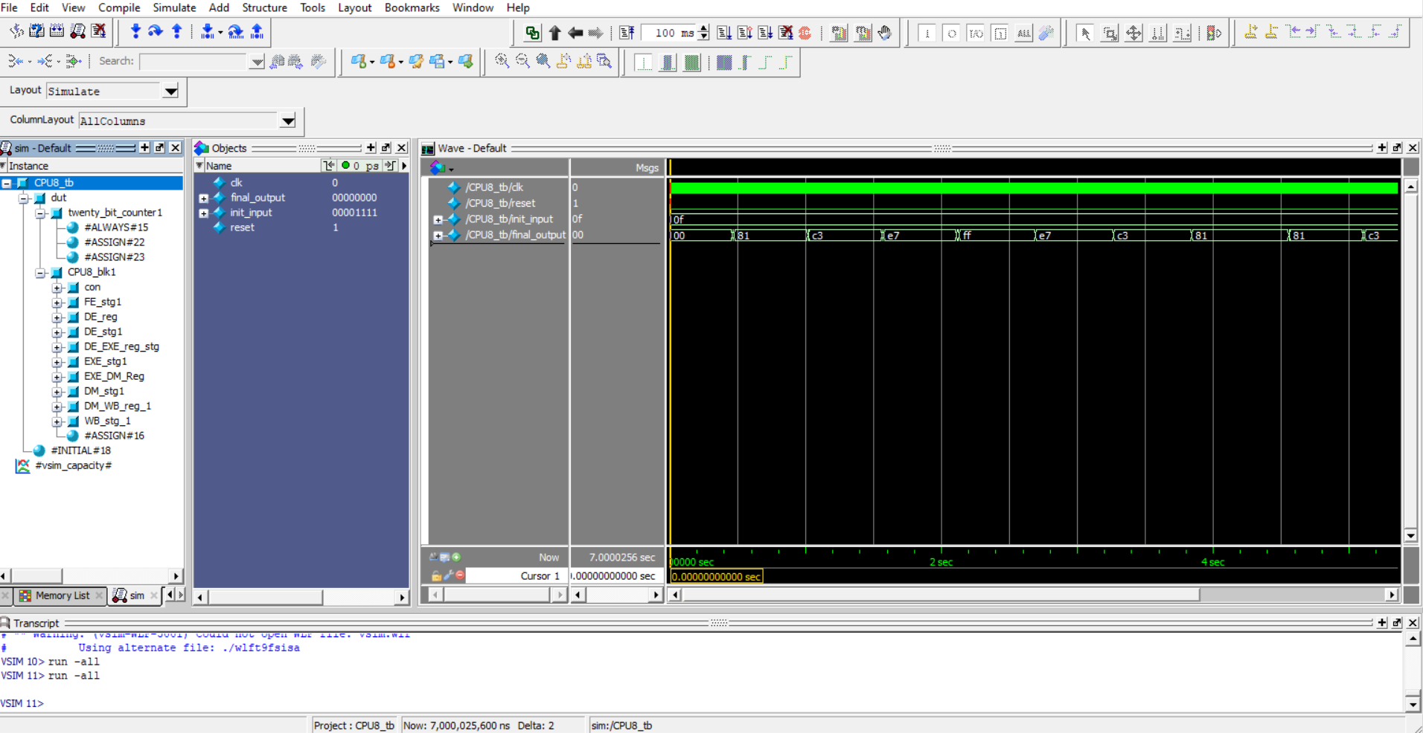
Final Simulation Result

Slide 21
Thank You!!
Do you have any questions ?
Submitted by
Milin Modi (1190172)
Priyam Sheth (1233198)

