Slide 1


TrackingAsia Machine Learning Program: Code Overview
Patrick Jaime Simba and Sharyl Rose Sy

Slide 2
What is the TrackingAsia Program and PySimpleGUI
TrackingAsia Program
A desktop application developed using Python that allows users to generate economic activity index (EAI) predictions using their own data and on their own, local devices.
A non-coding program that runs machine learning process in the back-end.
PysimpleGUI
A package used to create a graphical user interface (GUI) using Python.
The interface was created to allow users with no programming experience to utilize our machine learning code.
Why PySimpleGUI?
Easy to use and powerful.
Avoid having to learn a separate coding language to create GUI.
Seamlessly connect front-end interface with back-end processing and machine learning code.
Utilizes known GUI packages like tkinter as a framework while providing easy to understand, pythonic functions.
Free to use for non-commercial developers.
Notes:
Sri Lanka’s overall economic performance has been relatively strong but economic growth has been episodic, reflecting the impact of an array of domestic factors and international conditions. The period following the economic liberalization reforms initiated in 1977 saw moderately high but volatile economic growth. Economic growth dipped in the early years of the civil conflict before recovering in the early 1990s. Sri Lanka was little affected by the 1997–1998 Asian financial crisis, but was adversely affected by the surge in world oil and food prices during 2007–2008 and the global financial crisis that followed. Despite these external shocks and the intensification of the civil war in its final stages, the economy expanded by an annual average rate of 6.1% during the second half of that decade. During the 3 years immediately following the end of the civil conflict, the country’s economy experienced one of its strongest periods of growth during the entire post-independence period. In the last 3 years, however, the growth has weakened significantly due to the global economic slowdown.

Slide 3
Variable Processing and Information Extraction
Target Variable (GDP Level)
The target variable will generally be the quarterly GDP level of a chosen economy over time.
Any missing values in the middle of the data set will be filled in using linear interpolation.
GDP level is converted to GDP growth gap.
Additional processing steps:
Normalization
Year-on-year percent change
Using the processed data, filters such as the Hodrick-Prescott (HP), Hamilton and Christiano Fitzgerald (CF) filters are applied.
The Composite Indicators Framework (CIF) package for business cycle analysis is also used to calculate cycle information.
Peaks and troughs.
Expansion and slowdown speed, duration and amplitude.
Total number of complete cycles.
The processed, quarterly target variable is expanded using linear interpolation to be of monthly frequency for the modelling process.
The rest of the information acquired in this step is used in the dashboard creation.
Indicator Variables
Processing steps:
Monthly differential
YoY percent change
Normalization
Data is merged and any missing tail values are forecasted using ARIMA until the most recent date with available data.
Monthly indicator data is merged with the target variable to be used in modelling.
Notes:
Sri Lanka’s overall economic performance has been relatively strong but economic growth has been episodic, reflecting the impact of an array of domestic factors and international conditions. The period following the economic liberalization reforms initiated in 1977 saw moderately high but volatile economic growth. Economic growth dipped in the early years of the civil conflict before recovering in the early 1990s. Sri Lanka was little affected by the 1997–1998 Asian financial crisis, but was adversely affected by the surge in world oil and food prices during 2007–2008 and the global financial crisis that followed. Despite these external shocks and the intensification of the civil war in its final stages, the economy expanded by an annual average rate of 6.1% during the second half of that decade. During the 3 years immediately following the end of the civil conflict, the country’s economy experienced one of its strongest periods of growth during the entire post-independence period. In the last 3 years, however, the growth has weakened significantly due to the global economic slowdown.

Slide 4
Machine Learning Modelling: Iterative Prediction Process
Traditionally, the training set is used for training and the entire testing set is used for model evaluation.
For nowcasting models, the training step needs to be repeated every time new data is released.
Model selection process for each country:
After train-test split, the model is trained with the full training set.
The model is used to predict the first month succeeding the last month in the training set.
The predicted value, together with its corresponding indicators are added into the training set.
The steps are repeated until there are predictions for the entire testing set.
This method ensures that the model is always aware of the latest available data, improving its overall performance.
Indicator and target data from dates t0 to t1 are used to train the ML model.
Indicator data for date t1+1 is input into the trained model and outputs a prediction.
New prediction is recorded as the target feature for date t1+1.
Date t1+1 becomes the new date t1.
Notes:
Sri Lanka’s overall economic performance has been relatively strong but economic growth has been episodic, reflecting the impact of an array of domestic factors and international conditions. The period following the economic liberalization reforms initiated in 1977 saw moderately high but volatile economic growth. Economic growth dipped in the early years of the civil conflict before recovering in the early 1990s. Sri Lanka was little affected by the 1997–1998 Asian financial crisis, but was adversely affected by the surge in world oil and food prices during 2007–2008 and the global financial crisis that followed. Despite these external shocks and the intensification of the civil war in its final stages, the economy expanded by an annual average rate of 6.1% during the second half of that decade. During the 3 years immediately following the end of the civil conflict, the country’s economy experienced one of its strongest periods of growth during the entire post-independence period. In the last 3 years, however, the growth has weakened significantly due to the global economic slowdown.

Slide 5
Machine Learning Modelling: Model Selection
Data is split into a training set and a testing set. By default, the testing set is obtained by taking the latest 50% of datapoints from the full dataset; the remaining 50% of historical data becomes the initial training set.
Multiple supervised ML models are available for modelling in order to determine the best model for your data set.
Linear regression: Plots a line of best fit for each type of linear regression using the least squares method.
Random Forest: Uses ensemble learning with multiple decision trees to find more accurate predictions.
Gradient Boosting: An ensemble of weak learners/models are used to create a single, more accurate model.
XGBoost: Extreme gradient boosting. Uses advanced regularization to reduce overfitting. Usually performs better with larger datasets.
LGBM: Light gradient boosting method. More efficient and lightweight gradient boosting method.
Stochastic Gradient Descent (SGDR): Iterative method that optimizes an objective function and reduces the computational burden of bigger datasets.
Kernel Ridge: Uses a kernel function to calculate weights. This model is used when there is too much data for a traditional linear model.
Elastic Net: Uses lasso and ridge techniques to improve the regularization of models.
Bayesian Ridge: Uses linear regression with probability distributors instead of point estimates.
Support Vector Machine (SVM): Finds the hyperplane that passes through as many data points as possible within a certain distance to minimize prediction error.
Notes:
Sri Lanka’s overall economic performance has been relatively strong but economic growth has been episodic, reflecting the impact of an array of domestic factors and international conditions. The period following the economic liberalization reforms initiated in 1977 saw moderately high but volatile economic growth. Economic growth dipped in the early years of the civil conflict before recovering in the early 1990s. Sri Lanka was little affected by the 1997–1998 Asian financial crisis, but was adversely affected by the surge in world oil and food prices during 2007–2008 and the global financial crisis that followed. Despite these external shocks and the intensification of the civil war in its final stages, the economy expanded by an annual average rate of 6.1% during the second half of that decade. During the 3 years immediately following the end of the civil conflict, the country’s economy experienced one of its strongest periods of growth during the entire post-independence period. In the last 3 years, however, the growth has weakened significantly due to the global economic slowdown.

Slide 6
Component Calculation (Shapley Values)
Shapley values are generated and used in our process to determine the marginal contribution of each indicator, and by extension, each economic sector to each EAI prediction.
Conceptualized from cooperative game theory literature.
Used to measure the marginal contribution of each player/indicator to the overall prediction/result of a model.
Calculated by iteratively changing input features and seeing how the model prediction is affected.
Once computed, there will be a single Shapley value for each indicator and for each prediction; these values will add up to the difference between the prediction and the average of all the predictions.
For our iterative modelling process, Shapley values are computed for each iteration.
The values are generated per indicator.
The values for each indicator are summed up into their respective economic buckets.
Notes:
Sri Lanka’s overall economic performance has been relatively strong but economic growth has been episodic, reflecting the impact of an array of domestic factors and international conditions. The period following the economic liberalization reforms initiated in 1977 saw moderately high but volatile economic growth. Economic growth dipped in the early years of the civil conflict before recovering in the early 1990s. Sri Lanka was little affected by the 1997–1998 Asian financial crisis, but was adversely affected by the surge in world oil and food prices during 2007–2008 and the global financial crisis that followed. Despite these external shocks and the intensification of the civil war in its final stages, the economy expanded by an annual average rate of 6.1% during the second half of that decade. During the 3 years immediately following the end of the civil conflict, the country’s economy experienced one of its strongest periods of growth during the entire post-independence period. In the last 3 years, however, the growth has weakened significantly due to the global economic slowdown.

Slide 7
Additional Calculations and Output Generation
Outputs per chosen model
Excel file (data.xlsx)
GDP growth gap cycle fluctuations averages.
Components for GDP growth gap, EAI and various filters.
EAI forecast for the next three months including 95% and 99% confidence intervals.
Coordinates for business cycle dials.
Conversion of predictions from monthly to quarterly.
EAI dashboard
EAI dial charts
EAI prediction comparison
Error metric CSV file
Notes:
Sri Lanka’s overall economic performance has been relatively strong but economic growth has been episodic, reflecting the impact of an array of domestic factors and international conditions. The period following the economic liberalization reforms initiated in 1977 saw moderately high but volatile economic growth. Economic growth dipped in the early years of the civil conflict before recovering in the early 1990s. Sri Lanka was little affected by the 1997–1998 Asian financial crisis, but was adversely affected by the surge in world oil and food prices during 2007–2008 and the global financial crisis that followed. Despite these external shocks and the intensification of the civil war in its final stages, the economy expanded by an annual average rate of 6.1% during the second half of that decade. During the 3 years immediately following the end of the civil conflict, the country’s economy experienced one of its strongest periods of growth during the entire post-independence period. In the last 3 years, however, the growth has weakened significantly due to the global economic slowdown.

Slide 8
Outputs (Final Data Excel File)
For each of your chosen models, the program will generate an excel file called data.xlsx and store it in a folder named after the model.
Sheets in data.xlsx
Average Cycles: GDP growth gap cycle fluctuation statistics.
EAI_Components: Monthly EAI, GDP Gap and HP filtered EAI with contributing economic components. Also includes mean and standard deviation for each.
EAI_prediction: Monthly EAI predictions with latest 3-month forecast, including 95% and 99% confidence intervals.
EAI_quarterly: EAI predictions in quarterly frequency.
GDP_gap_quarterly: Real GDP growth gap and HP Based Cycle values per quarter.
Dial_Coordinates: Coordinates for dial charts per month for EAI and its components.
pred_vals: Monthly EAI values with 3-month forecasts and quarterly GDP growth gap.
Quarterly_computations: Monthly and quarterly EAI, with quarterly GDP growth gap and HP based cycle values.
Quarterly_data: Quarterly EAI with dial coordinates.
curved_data + curved_gdp_data: Data for average business cycle visualization of GDP growth gap. (No longer used in dashboards)
cycle_bands: Values used to set the band colors in the business cycle charts in the dashboards. (No longer used)
Notes:
Sri Lanka’s overall economic performance has been relatively strong but economic growth has been episodic, reflecting the impact of an array of domestic factors and international conditions. The period following the economic liberalization reforms initiated in 1977 saw moderately high but volatile economic growth. Economic growth dipped in the early years of the civil conflict before recovering in the early 1990s. Sri Lanka was little affected by the 1997–1998 Asian financial crisis, but was adversely affected by the surge in world oil and food prices during 2007–2008 and the global financial crisis that followed. Despite these external shocks and the intensification of the civil war in its final stages, the economy expanded by an annual average rate of 6.1% during the second half of that decade. During the 3 years immediately following the end of the civil conflict, the country’s economy experienced one of its strongest periods of growth during the entire post-independence period. In the last 3 years, however, the growth has weakened significantly due to the global economic slowdown.

Slide 9
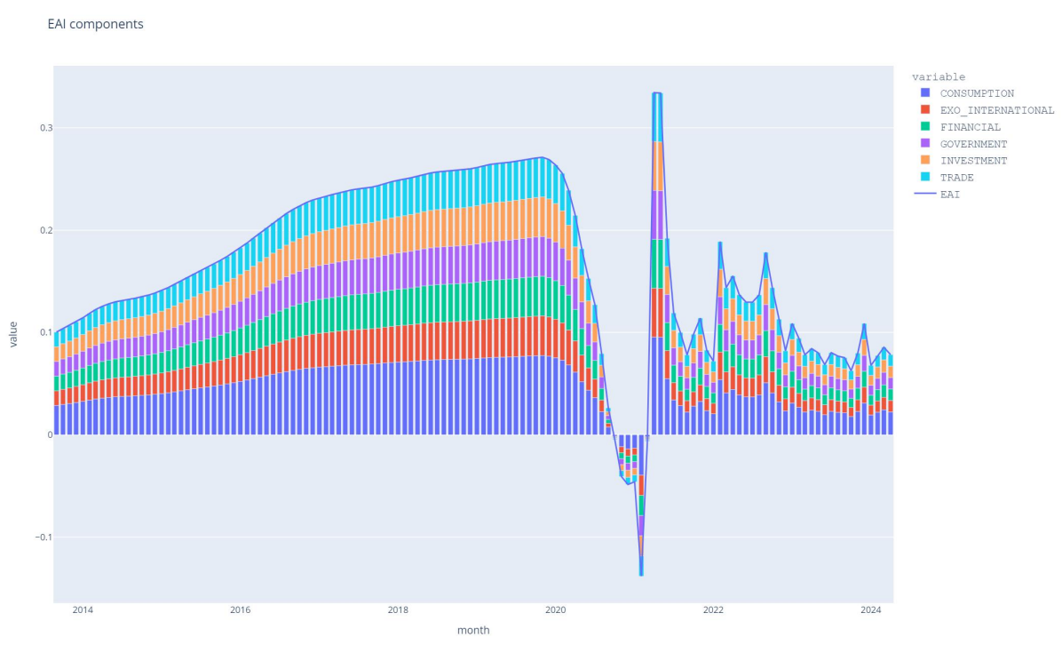
Outputs (EAI Dashboard)
The EAI components chart shows EAI predictions over time, together with the economic component breakdown using Shapley values.
Notes:
Sri Lanka’s overall economic performance has been relatively strong but economic growth has been episodic, reflecting the impact of an array of domestic factors and international conditions. The period following the economic liberalization reforms initiated in 1977 saw moderately high but volatile economic growth. Economic growth dipped in the early years of the civil conflict before recovering in the early 1990s. Sri Lanka was little affected by the 1997–1998 Asian financial crisis, but was adversely affected by the surge in world oil and food prices during 2007–2008 and the global financial crisis that followed. Despite these external shocks and the intensification of the civil war in its final stages, the economy expanded by an annual average rate of 6.1% during the second half of that decade. During the 3 years immediately following the end of the civil conflict, the country’s economy experienced one of its strongest periods of growth during the entire post-independence period. In the last 3 years, however, the growth has weakened significantly due to the global economic slowdown.

Slide 10
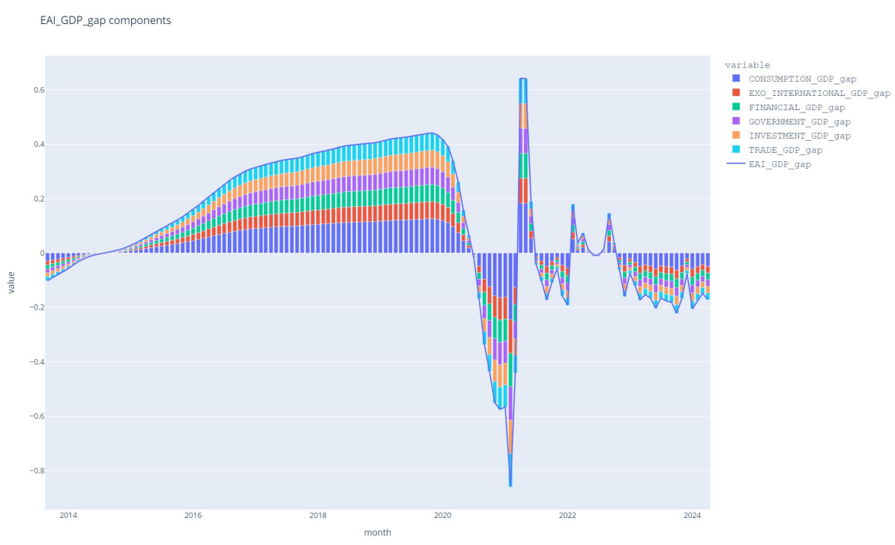
Outputs (EAI Dashboard)
The GDP Gap components chart shows actual GDP growth gap over time, together with the economic component breakdown using Shapley values.
Notes:
Sri Lanka’s overall economic performance has been relatively strong but economic growth has been episodic, reflecting the impact of an array of domestic factors and international conditions. The period following the economic liberalization reforms initiated in 1977 saw moderately high but volatile economic growth. Economic growth dipped in the early years of the civil conflict before recovering in the early 1990s. Sri Lanka was little affected by the 1997–1998 Asian financial crisis, but was adversely affected by the surge in world oil and food prices during 2007–2008 and the global financial crisis that followed. Despite these external shocks and the intensification of the civil war in its final stages, the economy expanded by an annual average rate of 6.1% during the second half of that decade. During the 3 years immediately following the end of the civil conflict, the country’s economy experienced one of its strongest periods of growth during the entire post-independence period. In the last 3 years, however, the growth has weakened significantly due to the global economic slowdown.

Slide 11
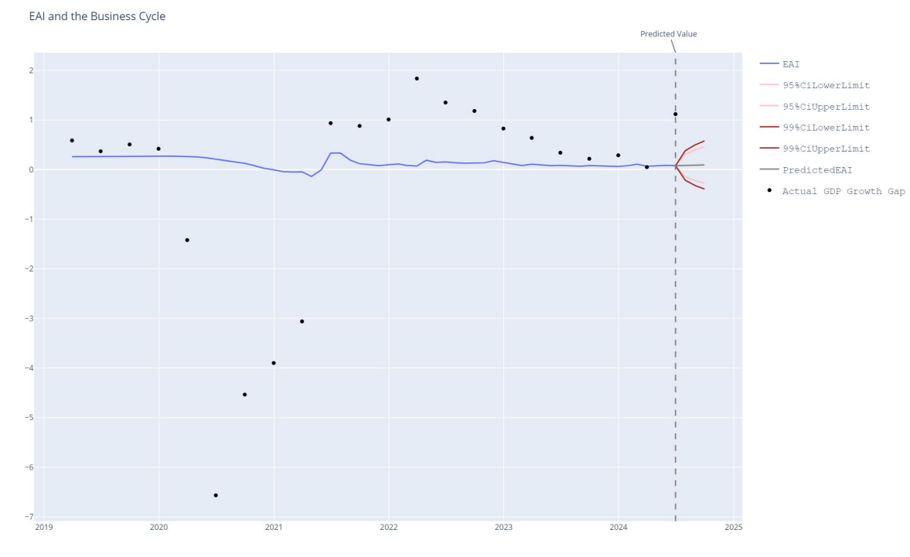
Outputs (EAI Dashboard)
The EAI and business cycle chart shows a comparison of EAI predictions and actual GDP growth gap.
Notes:
Sri Lanka’s overall economic performance has been relatively strong but economic growth has been episodic, reflecting the impact of an array of domestic factors and international conditions. The period following the economic liberalization reforms initiated in 1977 saw moderately high but volatile economic growth. Economic growth dipped in the early years of the civil conflict before recovering in the early 1990s. Sri Lanka was little affected by the 1997–1998 Asian financial crisis, but was adversely affected by the surge in world oil and food prices during 2007–2008 and the global financial crisis that followed. Despite these external shocks and the intensification of the civil war in its final stages, the economy expanded by an annual average rate of 6.1% during the second half of that decade. During the 3 years immediately following the end of the civil conflict, the country’s economy experienced one of its strongest periods of growth during the entire post-independence period. In the last 3 years, however, the growth has weakened significantly due to the global economic slowdown.

Slide 12
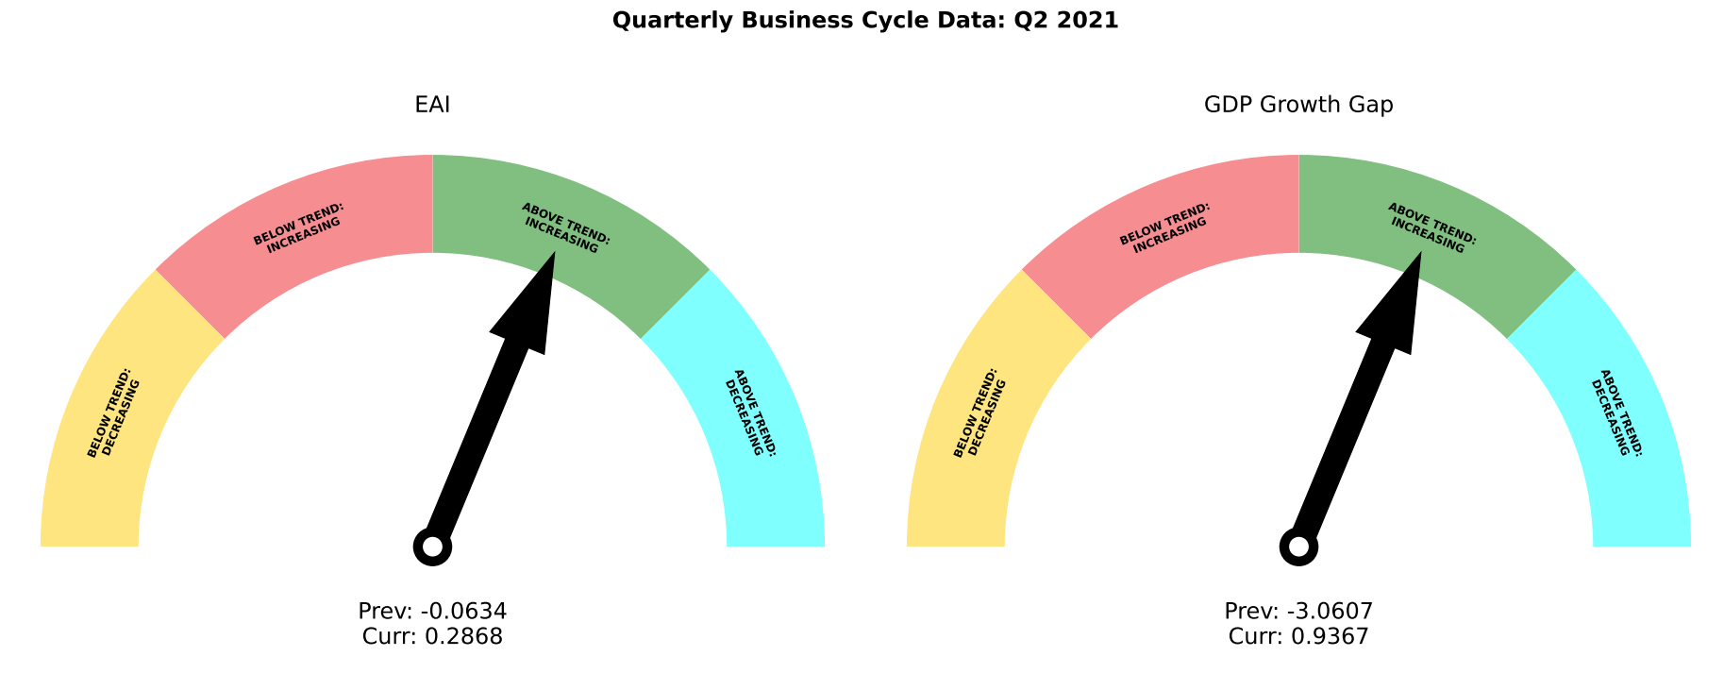
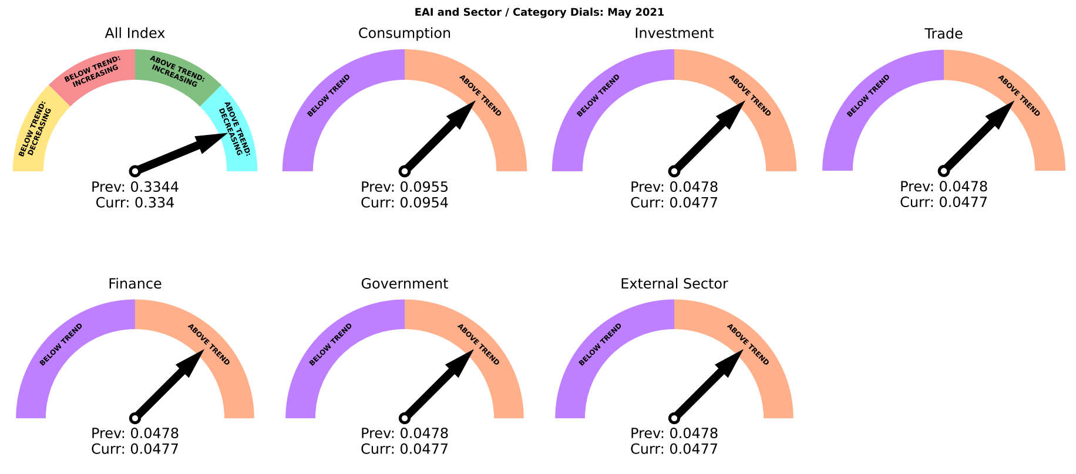
Outputs (EAI Dial Charts)
The dial charts indicate the position of the business cycle in certain quarters, together with the trend of each economic bucket during certain months.
Notes:
Sri Lanka’s overall economic performance has been relatively strong but economic growth has been episodic, reflecting the impact of an array of domestic factors and international conditions. The period following the economic liberalization reforms initiated in 1977 saw moderately high but volatile economic growth. Economic growth dipped in the early years of the civil conflict before recovering in the early 1990s. Sri Lanka was little affected by the 1997–1998 Asian financial crisis, but was adversely affected by the surge in world oil and food prices during 2007–2008 and the global financial crisis that followed. Despite these external shocks and the intensification of the civil war in its final stages, the economy expanded by an annual average rate of 6.1% during the second half of that decade. During the 3 years immediately following the end of the civil conflict, the country’s economy experienced one of its strongest periods of growth during the entire post-independence period. In the last 3 years, however, the growth has weakened significantly due to the global economic slowdown.

Slide 13
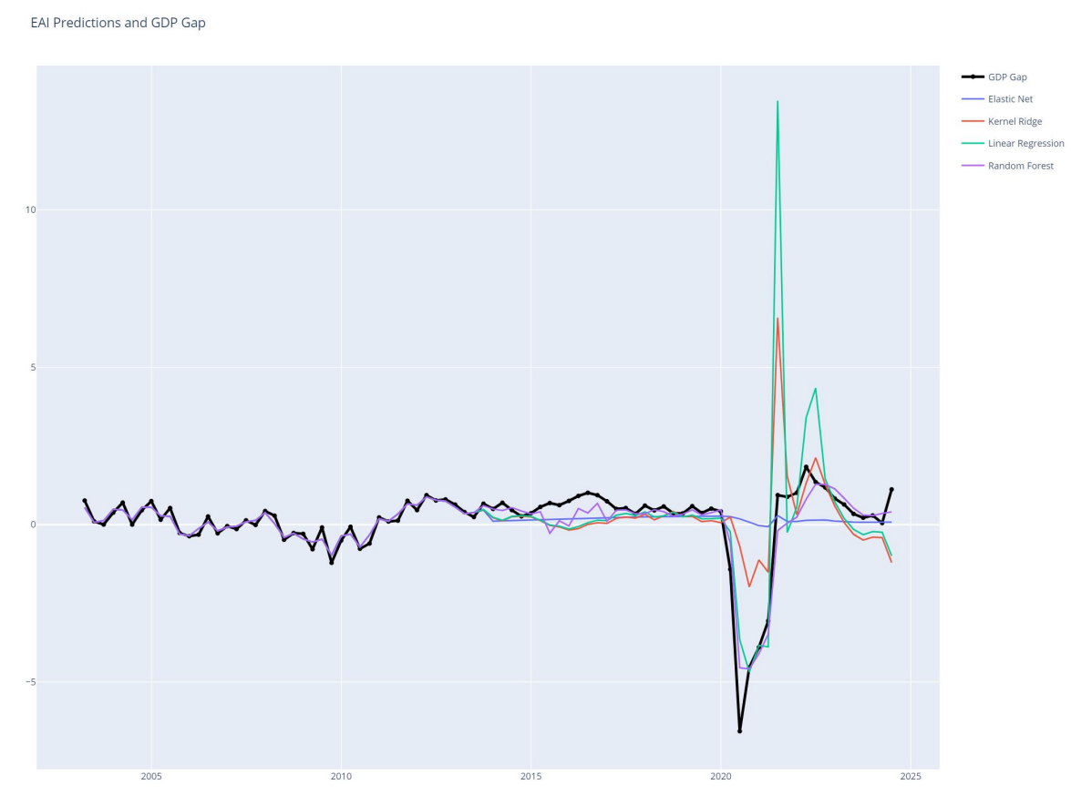
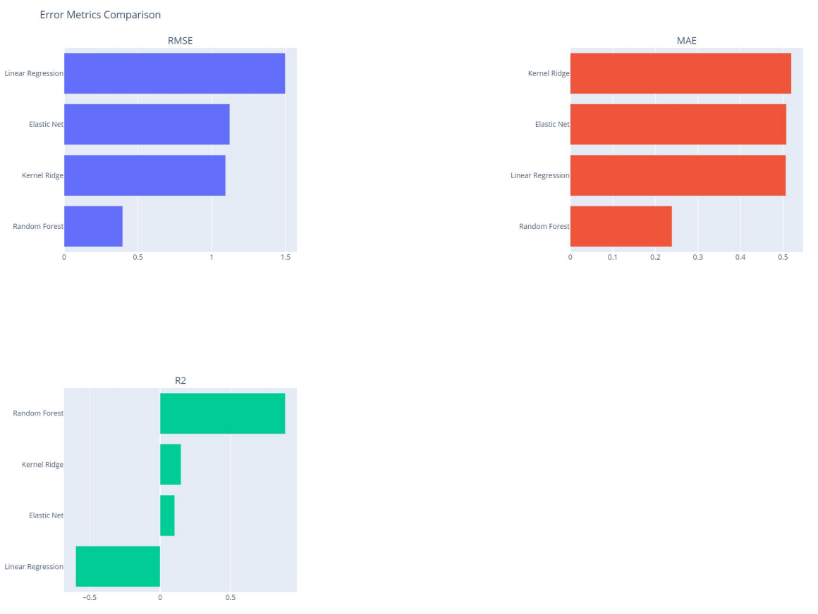
Outputs (EAI Predictions Comparison and Error Metrics)
The predictions chart compares EAI predictions for each model against the actual GDP growth gap (black line). The error metrics breaks down the RMSE, R2 and MAE for each model against actual values.
Notes:
Sri Lanka’s overall economic performance has been relatively strong but economic growth has been episodic, reflecting the impact of an array of domestic factors and international conditions. The period following the economic liberalization reforms initiated in 1977 saw moderately high but volatile economic growth. Economic growth dipped in the early years of the civil conflict before recovering in the early 1990s. Sri Lanka was little affected by the 1997–1998 Asian financial crisis, but was adversely affected by the surge in world oil and food prices during 2007–2008 and the global financial crisis that followed. Despite these external shocks and the intensification of the civil war in its final stages, the economy expanded by an annual average rate of 6.1% during the second half of that decade. During the 3 years immediately following the end of the civil conflict, the country’s economy experienced one of its strongest periods of growth during the entire post-independence period. In the last 3 years, however, the growth has weakened significantly due to the global economic slowdown.

