Slide 1
How to ‘Properly’ add GIS data to your App
P.J. Steele
pj@steele.us

Slide 2
Presentation Overview
Introduction
Teksystems
Overview of GIS
GIS Solutions
Enterprise
Client
Database
GIS Datatypes
Simple GIS Demo
Suggested GIS Database design
Sample GIS queries
Sample applications using GIS Data
QA
P.J gives advice for beer

Slide 3
Teksystems
Get info from Wes

Slide 4
Introduction
25+ years of development
Started in early 90’s
KY Lottery
Several consulting companies

Slide 5
Introduction
Co-Founder of software development company 1999
Offering consulting services
Established Southern Indian’s first Microsoft Technical Education Center (CTEC)
Billings of excess of 1.2 million annually

Slide 6
Introduction
Co-Failure of software company 2001
Dot COM Crash
9-11

Slide 7
Introduction
Return to Software Development Only early 2000’s
Much happier
Startup Companies
Codigo (aka Captive Indoor Media )
Genscape*
Churchill Downs!

Slide 8
BOLD print!
If you are going to learn one thing tonight.
DO NOT save your Latitude and Longitudes as columnar data!

Slide 9
What is GIS?
Geographic Information Systems
A process/system to capture store or display geographic data
The projection of 3D object (Geography) over a 2D object (Geometry)

Slide 10
GIS Solutions
 | Front End | Database | CRUD
Google Maps SDK | X
Google Earth | X
Open Layers | X
Highcharts (HighMaps) | X
SQL Server (2011 +) |  | X
PostGIS + PostgreSQL* |  | X
GeoServer * | X | X
MongoDB |  | X
ARCGIS | X | X | X
QGIS* |  |  | X
* Open Source

Slide 11
GIS Datatypes
Projection
Point
Line
Polygon
Multi – XXX
Point
Line
Polygon
Data Formats
KML
SHP
GeoJSON

Slide 12
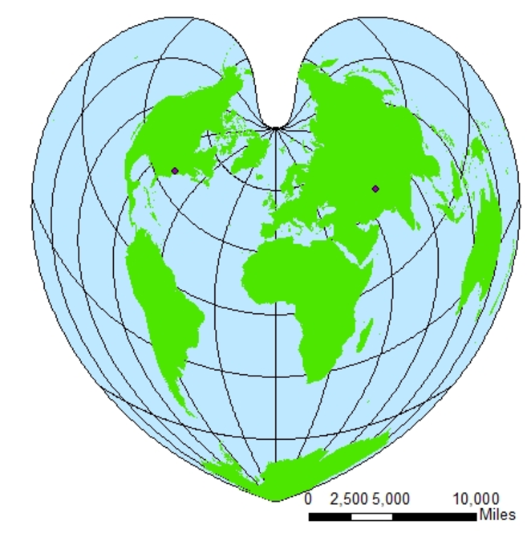
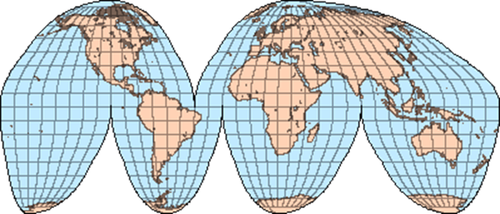
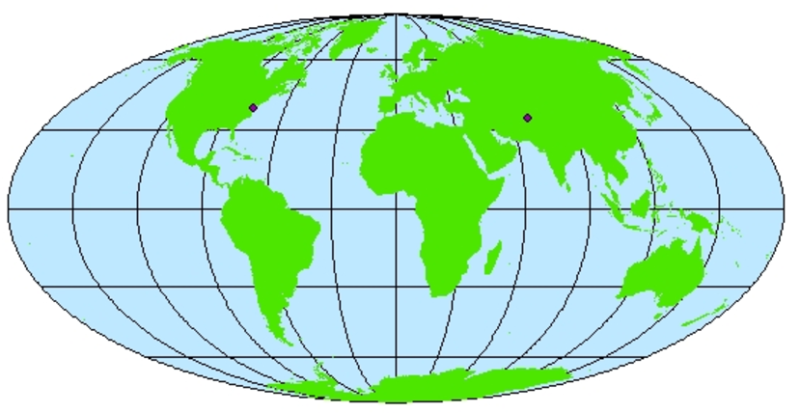
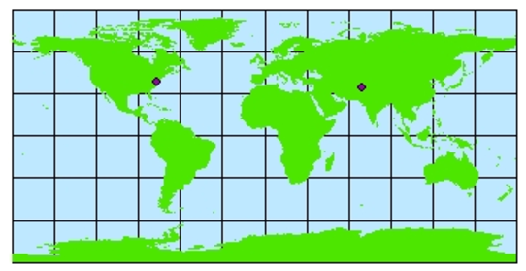
GIS Datatypes - Projection
A 3D projection onto a 2D object

Slide 13
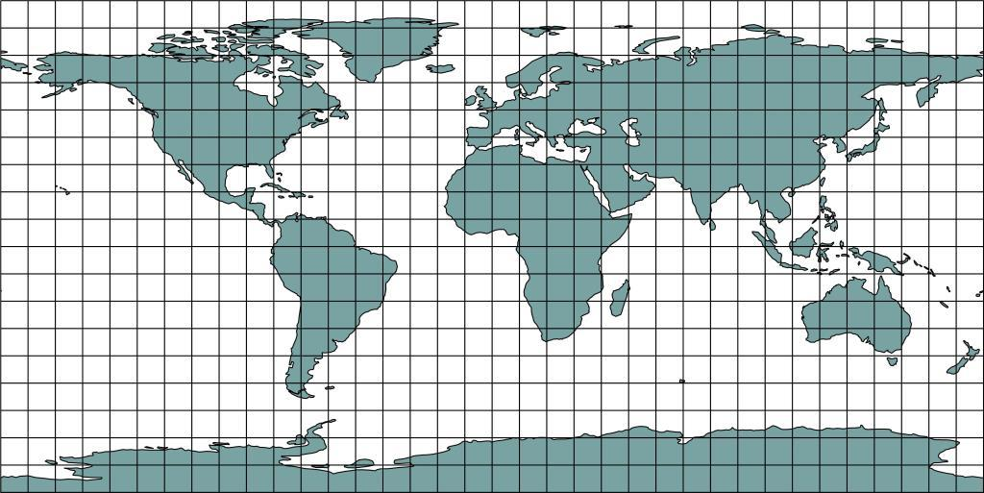
GIS Datatypes - Projection
Mercator (4326)– Google’s preference

Slide 14
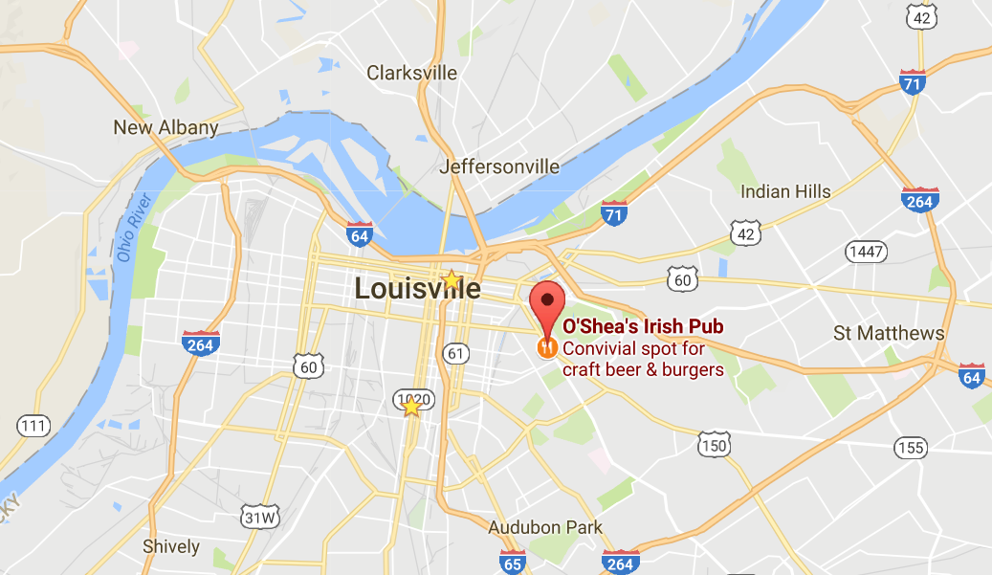
GIS Datatypes - Point
A single point
Your current location
Store location
ATM Location
SQL Server
POINT(38.2409,-85.7270)
GeoJSON
{ type: "Point", coordinates: [38.2409,-85.7270] }

Slide 15
GIS Datatypes – Polyline / Linestring
A series of points
Your bike path
Bardstown Road
SQL Server
LINESTRING (-93.822 27.811, -93.822 27.811, -93.822 27.811, …)
GeoJSON
"type": "LineString",
"coordinates": [[-93.822 27.811], [-93.822 27.811, -93.822 27.811], …]

Slide 16
GIS Datatypes - Polygon
A series of points that describes a enclosed shape
A county
A time zone
SQL Server
POLYGON (-93.822 27.811, -93.822 27.811, -93.822 27.811, …)
GeoJSON
"type": “Polygon",
"coordinates": [[-93.822 27.811], [-93.822 27.811, -93.822 27.811], …]

Slide 17
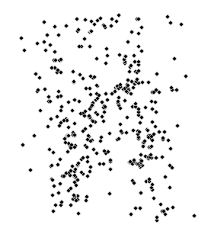
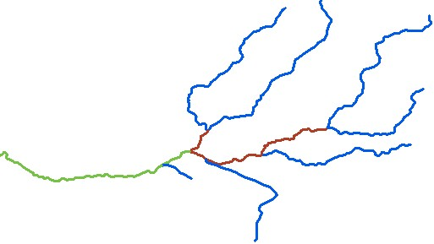
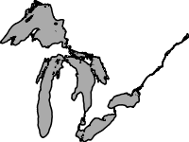
GIS Datatypes - Multi
Multi Point
ATM Locations
Multi Polyline
The Ohio River
Multi Polygon
The great lakes

Slide 18
GIS Datatypes - Formats
KML
Keyhole Markup Language
Google Earth
SHP
Shape File
ArcGIS, ESRI
GeoJSON
Open Standard. JSON Format

Slide 19
Assignment 1
Single point
Google Maps
Angular

Slide 20
Assignment 2
Multi point
Top 3000 cities by polutlation
Google Maps
Angular

Slide 21
Assignment 3
Multi point
All cities within a 100 mile radius
Google Maps
Angular

Slide 22
Assignment 3
Multi point
All cities within a 100 mile radius
Google Maps
Angular
Fail

Slide 23
Converting data
Geometry Geography
Shapefiles
GeoJSON
KML

Slide 24
Assignment 3 (again)
Multi point
All cities within a 100 mile radius
Google Maps
Angular
SQL Server Method
STDistance

Slide 25
Assignment 4
Points within a Polygon
SQL Server Method
STBuffer
STIntersects

Slide 26
Assignment 5
Linestring
Google Maps
Angular

Slide 27
Assignment 5
Linestring
Eclipse Path
Google Maps
Angular
SQL Server Method
STIntersects

Slide 28
Links
Presentation
https://github.com/pjsteele/techtalksky

Slide 29
Links
US Boundaries
http://eric.clst.org/Stuff/USGeoJSON
Olnline GeoJSON
http://geojson.io/
OpenLayers
http://openlayers.org/

Slide 30
Links
MS SQL Geography Types
https://docs.microsoft.com/en-us/sql/t-sql/spatial-geometry/ogc-methods-on-geometry-instances
https://docs.microsoft.com/en-us/sql/t-sql/spatial-geography/ogc-methods-on-geography-instances

