Slide 1
Differential gene expression networks
Michael Webb, Mallory Lai, Adam Kacmarsky

Slide 2
The Central Dogma
Notes:
DNA contains the instructions for RNA, which are the instructions for proteins. Why the middle man?

Slide 3
Differential Expression (DE)
Down-regulation: when a cell decreases the quantity of RNA (or protein) in response to a variable
Insulin resistance
Up-regulation: when a cell increases the quantity of RNA (or protein) in response to a variable
Alcohol dehydrogenase
Is there a change in RNA-seq count in the sun vs the shade?

Slide 4
Big Data Challenges
Not collecting own data
Reliant on collaborators for data
Limits the analyses you can perform
Apical meristem only taken in the shade, only one floral merisem measurement
Data visualization
Computational time
Big P small n → many genes, few replicates
Novel techniques → less literature and resources

Slide 5
Why baySeq? Why Bayesian?
Low FDR
Posteriors can be fed in as priors for other Bayesian models
Inform biophysical process models, improving predictions for plant yield
Bayesian models can be used with any distribution
Notes:
Accurate plant yield predictions are important → world hunger, global warming

Slide 6
baySeq vs edgeR
baySeq
edgeR
Estimates posterior likelihoods of DE via empirical Bayesian methods
Posterior probabilities and FDR estimates
Assumes Negative-Binomial distribution
Takes ~7hrs to run with parallel computing
Lower FDR than edgeR
Uses empirical Bayes estimation
Significance values for output
Takes seconds to run
Assumes Negative-Binomial distribution
More widely used than baySeq

Slide 7
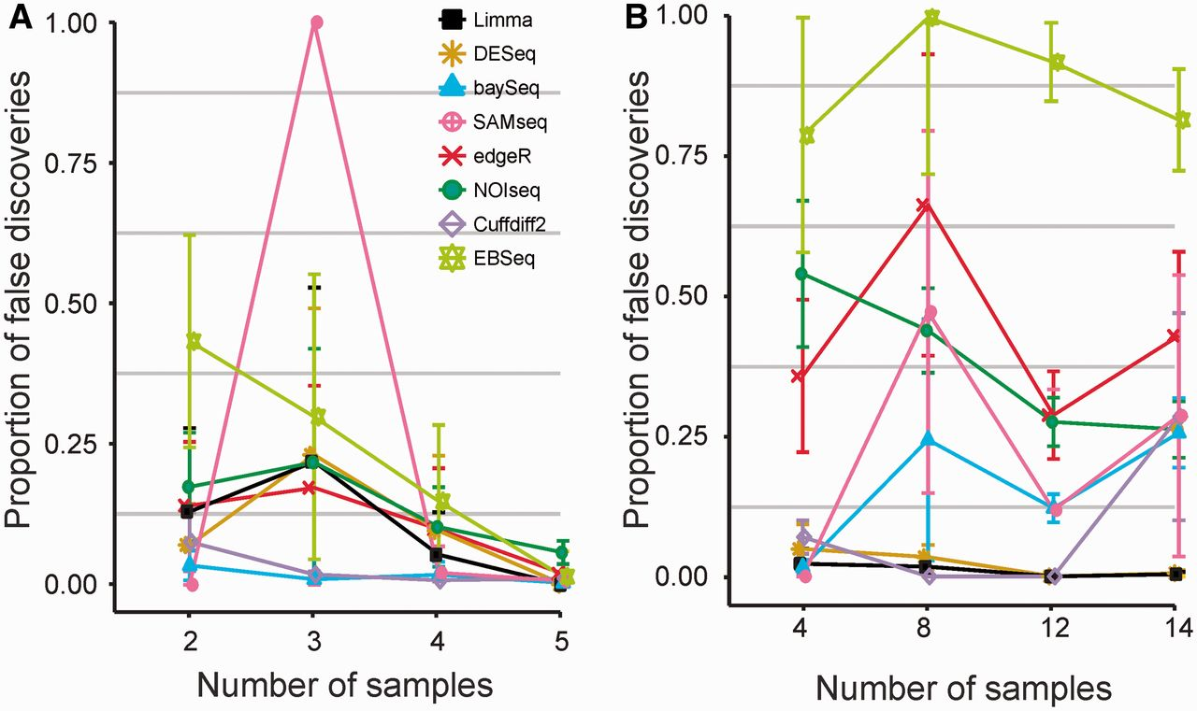
False Discovery Rate
Fatemeh Seyednasrollah et al. Brief Bioinform 2013;bib.bbt086

Slide 8
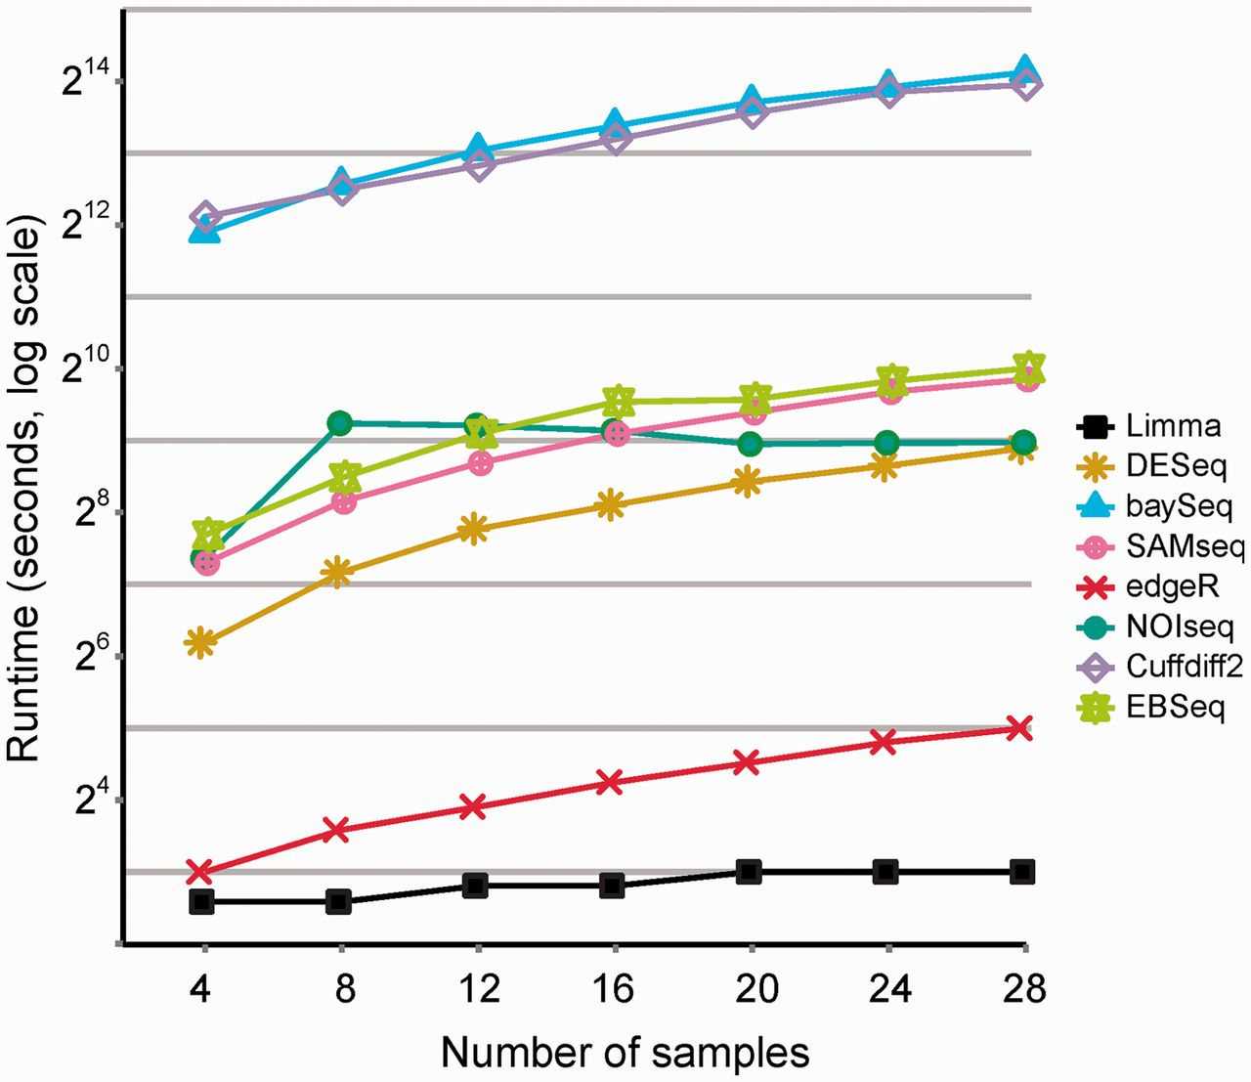
Runtime
Fatemeh Seyednasrollah et al. Brief Bioinform 2013;bib.bbt086

Slide 9
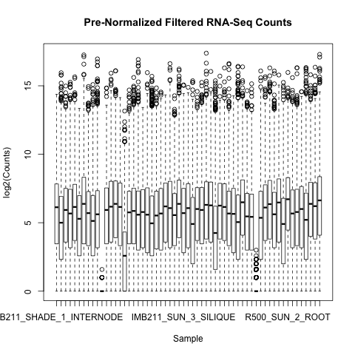
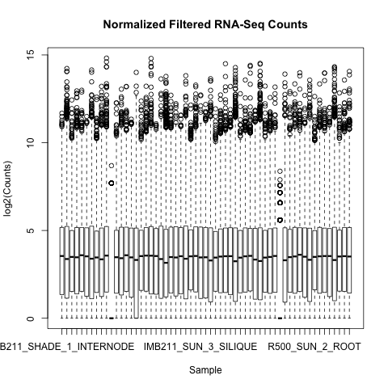
What about variance?

Slide 10
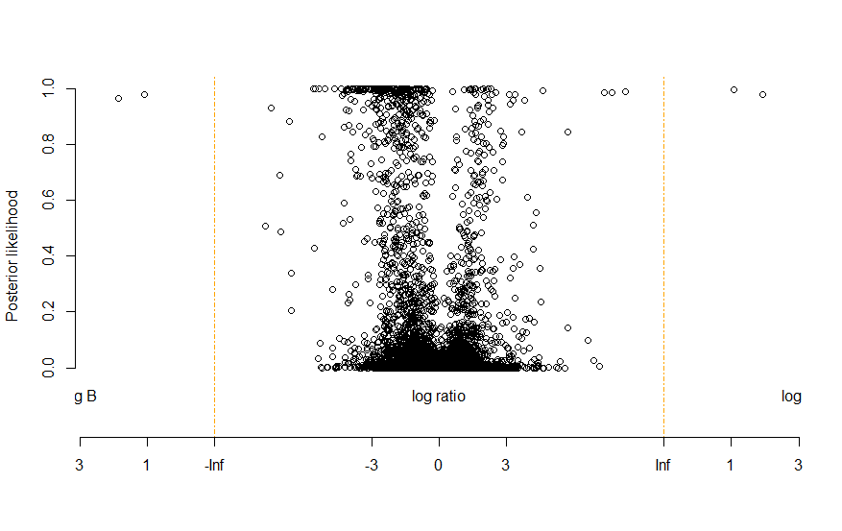
Plot of Posterior Likelihoods
Notes:
Plot of the differential genes and the posterior likelihood of the DE genes, the higher up you go the more confident we are that the gene is differentially expressed, the genes on the left are downregulated, the ones on the right are upregulated.

Slide 11
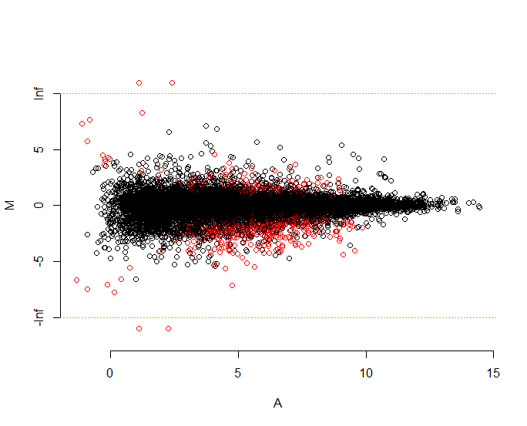
baySeq MA plot
Notes:
A is the arithmetic mean, M is the log ratio sun/shade (if they’re equal then the ratio with equal 1 and the log of 1 is zero)

Slide 12
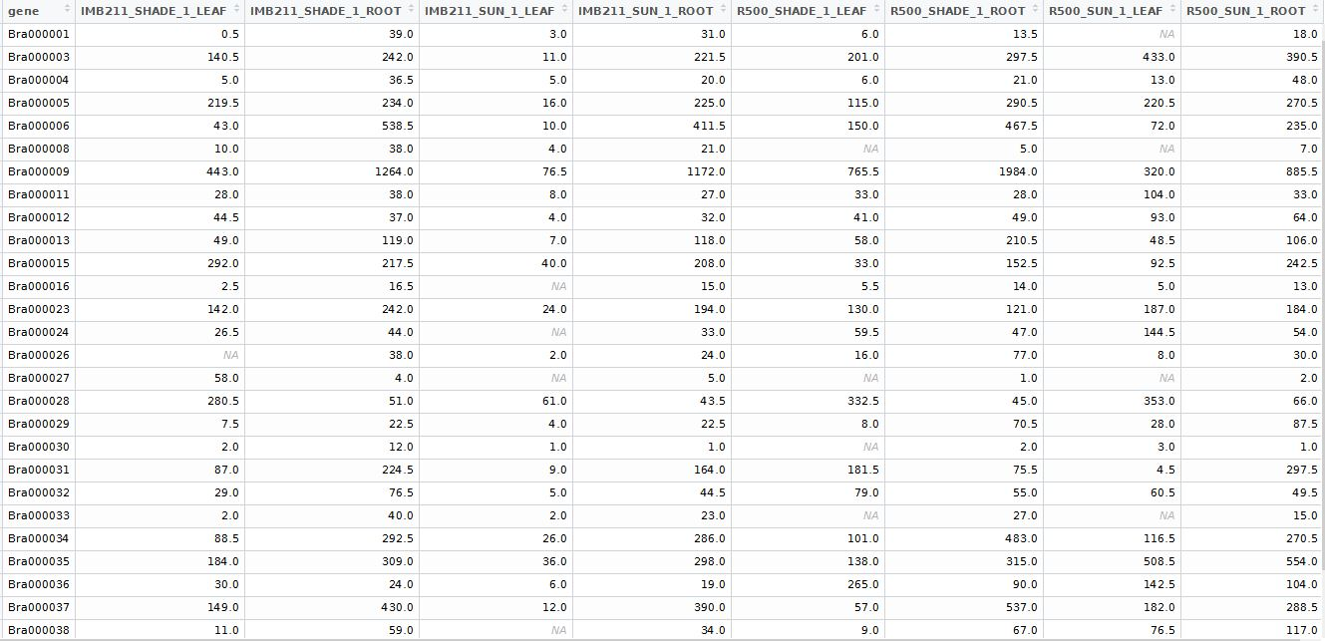
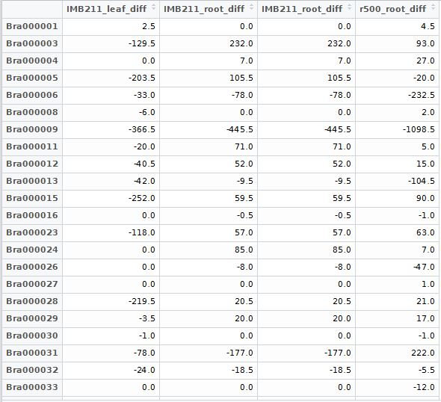
Data

Slide 13
Raw Data
Treatment
Genotype
Replicate
number
Tissue type
Differential Data
Differential data is the difference between the treatment groups’ data
Differential data = Sun data - Shade data
Missing values are changed to zeros

Slide 14
Differential Data
Transposed Differential Data
We transpose the data to look for correlation of differential gene expression between various genes.
Now the genes are treated as variables and the genotype-location-replicate data are treated as individual observations.

Slide 15
Correlated Genes
Multiple genes are activated to produce a single response
Falling asleep involves the brain, the enodcrine system, the respiratory system, the circulatory system, the immune system
Correlated genes can give us insight into physiological co-expression networks

