Slide 1
Continuous Integration in a Java Environment
Notes:
I want to start out by telling you the Clearwater Analytics story, and how we've gotten to where we are today. Rather than describe continuous integration in abstract terms, I'm going to give you a very in-depth peek into our environment, where we started, why we've done what we've done, and what things we still want to tackle. Along the way I'll introduce some of the free Java tools we use for Continuous Integration.
Clearwater Analytics was founded in 2003 as an independent provider of transparent, web-based investment portfolio reporting and analytics. The functionality was originally developed by Clearwater Advisors, a registered investment advisor focused on corporate operating funds. The founders of Clearwater Advisors had deep domain knowledge of corporate treasury and fixed income securities sales and trading.
The evolution to Clearwater Analytics occurred in three separate phases. In the first phase, Clearwater Advisors attracted assets by offering transparency into its own investment management activities. Second, the same transparency was offered into the assets managed for Clearwater clients by other investment managers. Then, finally, in response to demand for a technology-only solution, Clearwater Analytics was created as a separate entity. At that point, Clearwater Advisors became a client of Clearwater Analytics.

Slide 2
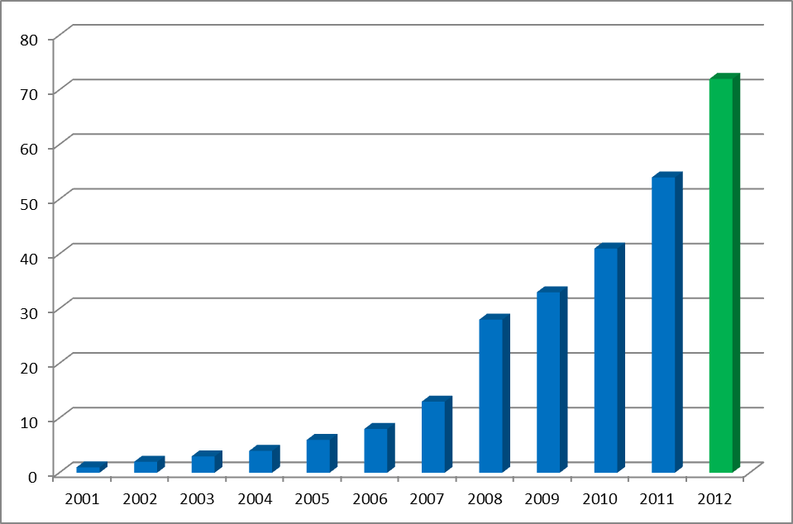
Developers/Time
Notes:
What started out with one person developing some code soon turned into three people developing some code, and then five. Each came with their own preferences for how to do things, and so the ecosystem got very diverse:
Problems
As many as 5 ways of accomplishing the same task
Little code sharing
Too little collaboration
Difficulty making database schema changes
Testing? What testing?
You own it, you fix it, you deploy it, you maintain it
No visibility into what it really takes to run the system
Code deployed to developer's machines
Why we have UPS for every developer

Slide 3

Continuous Integration
Teams integrate their work multiple times
per day.
Each integration is verified by an
automated build
Significantly reduces integration problems
Develop cohesive software more rapidly
Source: Martin Fowler

Slide 4
Five Principles of Continuous Integration
Environments based on stability
Maintain a code repository
Commit frequently and build every commit
Make the build self-testing
Store every build

Slide 5

Environments Based on Stability
Notes:
9 principles for continuous integration and how we've implemented them.

Slide 6
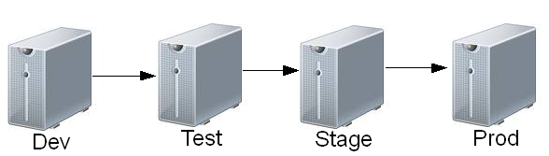
Environments based on stability
Create server environments to model code stability
Promote code to stricter environments as quality improves.
Notes:
One guiding principle is that you need to decide how many environments you need to have, and what they are used for. Integration takes place every time code migrates from one environment to the next. You want as few as you can get away with, but enough to properly support the business.
Your box → Light integration
Test → Continuous integration
Stage → Build it, isolate it, test it. Changes to this release candidate go through a more rigorous process.
Production → Your customers are your integration testers at this point.
You need to automate these integration points, if you don't you cannot run them very often, and when you do it is a painful ordeal.
Story about “First I/O” at HP.
Next I want to show you how are different environments are setup so you can see the hardware scaling factor that we've applied to each environment.

Slide 7



Production Environment Hardware
Application servers
  8 application server
    12 cores, 48 GB RAM
  10 web server
    2 cores, 2 GB RAM
Database servers
  4 web databases
    4 cores, 16 GB, 2 SSD
  1 application database
    12 cores, 48 GB RAM, 15 SSD
Notes:
If you need a certain amount of hardware in production, you need some factor of that in your integration environments.
Some of the complexity is for fault tolerance/high availability, and some is for performance.
In this environment we have clustered webservers and database replication. Not something you want to setup for every developer.

Slide 8
Stage Environment Hardware
Application servers
  7 application server
    4 cores, 4 GB RAM
  2 web server
    2 cores, 2 GB RAM
Database servers
  1 web database
    4 cores, 16 GB, 8 SAS
  1 application database
    8 cores, 16 GB RAM, 16 SATA
Continuous Integration Server
    2 cores, 4 GB RAM, 1 SATA
Notes:
You might wonder why we need both staging and test:
Because the hardware is similar, if we notice a performance problem in stage we know there will likely be a similar problem in production. People used to rationalize slow performing reports because they didn't have “reasonable” hardware to test it on, now that's no longer an acceptable excuse.
We do test replication here because invariably it has problems. Developers work in a non-replication environment and forget about the differences they need to account for in a replication environment.
We can also test the deployment to a similar environment. Each staging release finds 2-10 defects that would have been noticed by our customers, but were not problems in any of the other environments.
Some deployments require data transformation, and so you can guage the impact of those changes against the source of record database and the replicated databases. A recent example was a transformation script that took an hour to run, and that was too long, so our DBA was able to speed it up, but we also chose to do the deployment after hours to not affect many customers.
Our system is a service that has to be up all the time, so we've developed strategies for deploying to it while it is online.
Staging is almost as reliable as production.

Slide 9
Test Environment Hardware
Each team of 8 developers has a test environment
  VM server
    4 cores, 16 GB RAM
  Database servers
    4 cores, 24 GB RAM, 8 SATA drives
Continuous Integration Server
    8 cores, 16 GB RAM, 1 SATA drive
Notes:
This environment is where the massive continuous integration takes place. This is the least stable of the shared integration environments. Because of that, we do the most testing and code analysis as code enters this environment. There are a lot of frequent changes here compared with staging and production.
This topology is simpler. But the performance has to be good because of the number of developers using it.
Continuous integration server is another instance on the same hardware as staging. We need that much hardware for each to run, they just run on different cycles usually.
Describe how testing evolved:
Everyone had their own database, webserver, etc running on their own box
Small team environments, shared only by people on your project
Shared environment for most people, a few projects trying to make large changes will use their own environment. Downside is you have to setup a continuous integration for these projects.
Moral: Don't do large integration efforts if you can avoid it. Often, if you consider the possibilities, you may find a way to make large changes in small chunks that can be regularly integrated.

Slide 10
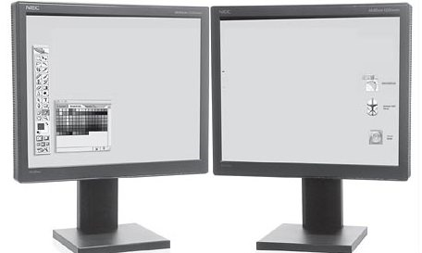
Dev Environment Hardware
Application servers
  Workstations with 4 cores, 8 GB RAM
  One per developer
Database servers
  Shared with Test environment
Notes:
Plug for dual monitors and fast machines.
Integration here is mainly running unit tests, or some throw away testing scaffolding that you create just to make some modifications to the code.
People depend on the integration environment to catch problems, to the point that some turn off unit tests (to make compiles faster) and forget to turn them on. These get caught very quickly and you get emailed if you broke the build.
We have a wide variety of experience on the team, and some common mistakes that new programmers make get caught by the continuous integration in the test environment:
Example: Forgetting to build everything that depends on an interface you just changed.

Slide 11

Maintain a Code Repository

Slide 12

Notes:
This maybe goes without saying, but when you are small enough, say just one developer, you probably are tempted to work on your files on your desktop machine. Maybe you copy the files to a network share every night. That's a good start, but you should really consider investing some time in setting up a code repository, using it, and backing it up off site.
One thing continuous integration and a source repository give you is the ability to test that you have all the artifacts needed to build your code and run your business.
Bondmath story
Fairly regularly you forget to add a new file to the source code repository. If you build it on your box it works fine, but when you try to build it elsewhere it won't run. If you don't catch this and then lose that box, you just lost the source for something your business depends on.
In our business, if we lost access to the source files, the whole business would fail. So we have onsite copies of the source code backed up every day, and we took a copy of the source on an encrypted disk offsite every day.
When we started, we had a really small team, and we had purchased Visual Studio, and with it came this source control tool called Visual Source Safe. Sometimes its good to taste the bitter so you can appreciate the sweet. In this case you might want to avoid it. Admittedly I haven't used it for years, but as I was preparing this presentation and speaking with several co-workers who had used VSS at other jobs, every one of them said “VSS got corrupted when the code base got big”.
We used CVS for a while, but we got unhappy with it's branching capabilities. I think some of our unhappiness was also a function of how we had everything organized.

Slide 13

From CVS to Subversion
Non-locking
Atomic commits
Good tool support
Good enough branching
Source of record for
build server
Notes:
Here's why we picked subversion over some of the newer source code repositories:
Mercurial/Git – Distributed version control. The complexity vs. the benefits weren't there. These are trying to solve a multi-master source code problem. Different companies or individuals each having a master copy of the source. In a single company you don't need that benefit, so the complexity can get in the way of other things that might be simpler in Subversion.
Don't forget to test the backup of subversion. Just because you think you have a backup, if you are unable to restore it, then what good is it? We test this quarterly.

Slide 14

Branching
Make a copy of the code
Isolation from other work
Why not always branch?

Slide 15

Merging
Extra complexity
Hard integration
Not continuous
Notes:
Branches are for active work, and tags are for a point in time reference. We also use branches for all our releases. Some of our stable libraries are only tagged at each release cycle, so that if we need to make a change we can create a branch from the tag. If we don't anticipate changes, we don't branch.
Branching → Appears to be an advantage to the individual because you can avoid the integration pain. But if you let the code get too stale, then decide to merge from trunk to pick up some changes that you need to depend on, you have to integrate. And then you integrate when you merge your changes back. Doing this infrequently means the work must be done all at once, rather than amortized over the life of the development.
Experimental work should be done on a branch. De-integration of something you don't really want can be difficult. Things that we've integrated that aren't stable and need to be removed have taken days to eradicate.
You need to make trunk the path of least resistance for making changes. Encourage lots of small integration that is stable, or that you can quickly stabilize. This is the zen path for software development. Keep it getting more and more stable.
We've had big destabilizations that have taken weeks to fix, causing delays in deployments, long work hours, tense co-workers. These are disruptive and should be avoided.

Slide 16

Trunk – Where integration happens
Committing Stable code to trunk
Trunk is the source of record
for the main build server
When instability is introduced,
stabilization is first priority
Notes:
We had some work done on two branches, and decided that one branch needed to depend on the other branch, and that we needed to merge them both to trunk right before our quarter end. We delayed our release (usually done mid month) and pushed all of this onto trunk at the last minute. The integration effort was painful. It took weeks to get the quality back, we were releasing lots of hotfixes, and some of those were bad because we scrambled to get them done. It took a while to get the builds to pass all the tests. We were asked to do something similar for year end but successfully shot down the request, and had a very successful year end.

Slide 17
Release Branch/Tag
Tag projects that need multiple versions
Branch projects that need a single version
Monthly create a release branch:
  buslib → buslib-release (no version numbers!)
  Not merged back to trunk
Off cycle releases:
  Cherry-pick small changes from trunk
  Code reviewed
Notes:
By keeping trunk high quality, we can create a release candidate and quickly qualify it for release. We do this with a branch, and for two reasons. First to keep it from being a moving target, but throughout the month after a release, if we need to do an emergency hot fix, we put the fix on to trunk and only allow these few checkins onto the branch. We control the quality of the release branch by not committing anything non-essential to it.

Slide 18

Commit Frequently
Build Every Commit

Slide 19

Why are you afraid to commit?
Change your habits
  Commit small, functional changes
  Unit tests!
  Team owns the code, not the
  individual
Notes:
Commit code to trunk that could be released. This requires a shift in your mindset. One might initially think that everyone should work on branches until their code is high enough quality to merge back to trunk. This is a bad idea, and I'll get into why this is bad later on. But think about this: Either you are working on brand new code that nothing else is calling, or you are fixing existing code. If its new, and no one calls it, then check it into trunk! Why branch it? If it's existing, you should follow the Boy Scout's camping motto and leave it better than you found it.
Talk about “High Priest of SCM” and code ownership.
Talk about how ThoughWorks extreme programming rotation works.
Specialization pros and cons (great to have someone who is 10 times faster than anyone else on some complex code, but really awful if that person ever leaves). Story of CQG's main architect car crash.

Slide 20

The code builds on my box...
Source code repository is the
source of record
Build server settles disputes
  Only gets code from SVN
Build server the final authority
on stability/quality
Notes:
If the code builds on one persons box and not another's, you don't know if you need to fix the source or fix someone's environment.
If it doesn't build on the build server, it's a problem, and you don't need to argue with someone who claims that it builds fine on their own box.
If it builds on the build server but not on your box, than it's a problem on your box.

Slide 21

Build every commit
Why compile frequently?
Why not integrate frequently?
Agile principles
  If it hurts, do it more often.
  Many difficult activities can be made much more straightforward by doing them more frequently.
  Reduce time between defect introduction and removal
Automate the build
  Key to continuous integration
Notes:
Computer science lab story
IDE background build after every few keystrokes, same thing with spelling and grammar checking.
If you don't commit and build frequently, you're guilty of the same thing at a higher level.

Slide 22


Free Continuous Integration Servers
Cruise Control (ThoughtWorks)
  Yucky XML configuration
  Commercial version (Cruise) is a rewrite
Continuum (Apache)
  Great Maven support
  No plugins, ok user interface, and slow builds
Hudson (Oracle)
  Self updating and easy to administor
  Many useful plugins
  Great user interface
  Scale out with additional nodes
  Best by a wide margin
Notes:
Everyone can see the results of the latest build – Fowler
Hudson
Two copies of Hudson
Proper Unit tests

Slide 23

Build Server Hardware
Maven and Java = lots of memory
Compile and unit test = lots of CPU
Static analysis = lots and lots of CPU
8 cores, 16GB RAM, 2 SATA
Ubuntu Linux
8 parallel builds
KEEP IT FAST
Notes:
Everyone can see the results of the latest build – Fowler
Hudson
Two copies of Hudson
Proper Unit tests

Slide 24

Make the Build Self-Testing
Notes:
This is very closely related to the previous principle

Slide 25

Guidelines to improving software quality
Individual programmers <50% efficient at finding their own bugs
Multiple quality methods = more defects discovered
  Use 3 or more methods for >90% defect removal
Most effective methods
  design inspections
  code inspections
  Testing
Source: http://www.scribd.com/doc/7758538/Capers-Jones-Software-Quality-in-2008
Notes:
Static code analysis
Peer code review
Unit testing
Regression testing
Manual testing
Story of the FIP Leap day refactor bug.
Continuous integration can helps you with the three most effective methods.
You can see metrics on your design with the static analysis. It can be used to find common mistakes, and it can run your tests every time you commit changes.

Slide 26
Actual Clearwater code – find the bugs
if (summaryTable.size() == 0 || summaryTable == null)
String stacktrace = getStackTrace(e, "<br />");
stacktrace.replaceAll("\n", "<br />");
if(lot.getTaxLotTransaction() == trade)
if (total != Double.NaN && Math.abs(total - 1.00) > 1e-8)
public abstract class AbstractReportController {
private Logger _log = Logger.getLogger ("abstractFrontOfficeController");
private void func1() {
List<String> val = someFunction();
func2(val == null ? null : 25d);
}
private void func2(double d) { ... }

Slide 27
Actual Clearwater code – find the bugs
if (summaryTable.size() == 0 || summaryTable == null)
String stacktrace = getStackTrace(e, "<br />");
stacktrace.replaceAll("\n", "<br />"); // replaceAll doesn't work like this
// not only using == instead of equals(), but unrelated data types
if(lot.getTaxLotTransaction() == trade)
// doesn't work, have to use Double.isNaN()
if (total != Double.NaN && Math.abs(total - 1.00) > 1e-8)
// mismatched logger
public abstract class AbstractReportController {
private Logger _log = Logger.getLogger ("abstractFrontOfficeController");
private void func1() {
List<String> val = someFunction();
func2(val == null ? null : 25d);// NPE if val == null, promotions to Double
}
private void func2(double d) { ... }

Slide 28
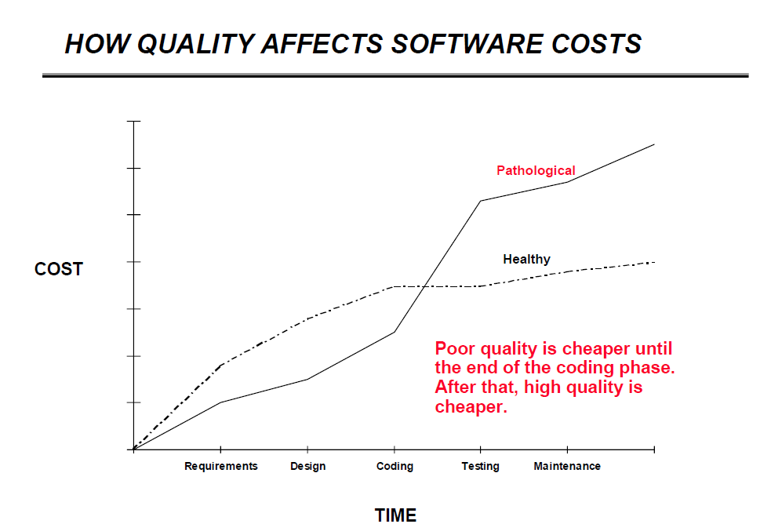
Notes:
You have to be disciplined to make continuous integration work.
There is a very high cost to re-writing things.
When you think of Hershey's, you think of chocolate. Here's something else to think about:
Hershey has a history of embracing changes. Unfortunately some of Hershey's changes were not well executed. For instance, in the summer of 1999, Hershey demonstrated a new computer system that was going to automate and modernize Hershey's operation. The computer system was going to control everything from taking candy orders to loading shipments on trucks. Instead, the new system has paralyzed Hershey's ordering and distribution system, leaving numerous stores without inventory. The problems with the implementation of the automated system created numerous problems between Hershey and their customers.
Hershey worked around the clock to fix the problems, but the problems persisted through the heavy holiday seasons. Since almost one-half of annual candy sales are made between October and December, Hershey lost significant revenues. Hershey took a considerable risk when the company decided to implement the entire computer system all at once. As a direct result of the blunder, the company's stock declined by over fifty percent from a high of over $70 in the fourth quarter of 1998 to about $35 in the first quarter of 2000.

Slide 29


Self Testing Builds
System Tests
  End-to-end test
  Often take minutes to hours to run
Unit tests
  Fast
    No database or file system
  Focused
    Pinpoint problems
  Best method for verifying builds
Notes:
Tests need to tell you two things: That you have a problem, and where the problem is. System tests are good at telling you that a problem exists, but cannot tell you which method in the code failed.
Trying to run the complete end-to-end system tests with every build is impractical, because they take too long to run.
Unit test can be run with every build, and do a great job pinpointing the problem. Our biggest projects have over a thousand unit tests and can execute all of them in under 30 seconds.

Slide 30


Automated Quality with Continuous Integration
Static code analysis
  Looks for common java bugs (Findbugs, PMD)
  Check for code compliance (Checkstyle)
Unit test analysis
  Measure coverage (Cobertura)
  Look for hotspots, areas of low testing and high complexity (SONAR)

Slide 31


SONAR + Hudson
Hudson builds the code
SONAR runs after each build
SONAR alert thresholds can 'break' the build
Automate quality improvements
Notes:
Build server hardware
Scale up/Scale out

Slide 32
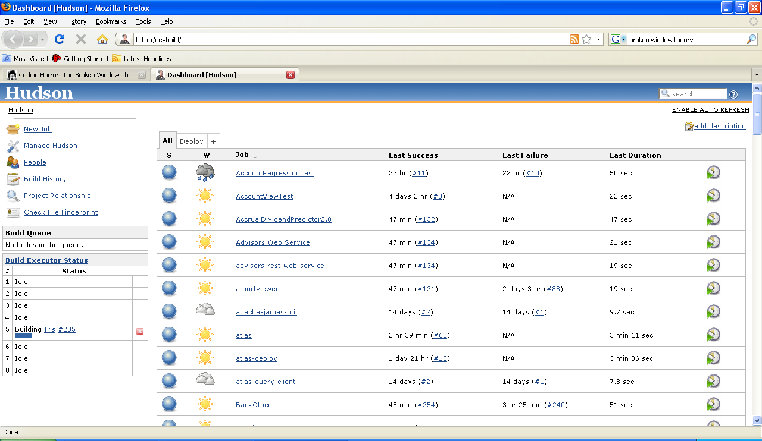
Notes:
The build status needs to be pass/fail, no ambiguity.
Once we made passing SONAR part of the build, only then did people fix the problems it was finding.

Slide 33
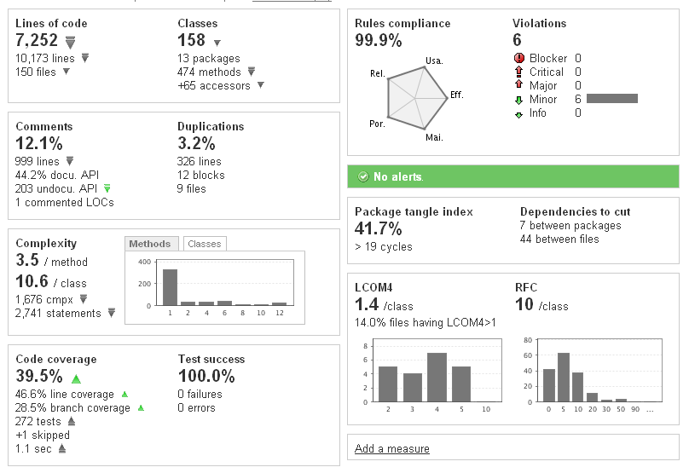
SONAR Dashboard
Notes:
Sonar integrates all of the quality tools together.
You see both an overview and a change history of quality.

Slide 34
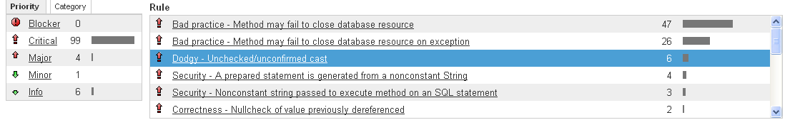
SONAR Defect Detection: Violation Drilldown
Notes:
Build every commit to isolate the source of defects for a long running test
Integrating all the tools:
Sonar
Fisheye/Crucible
Mantis

Slide 35
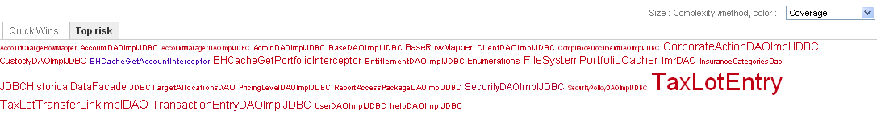
SONAR Test Coverage: Clouds
Notes:
Build every commit to isolate the source of defects for a long running test
Integrating all the tools:
Sonar
Fisheye/Crucible
Mantis

Slide 36
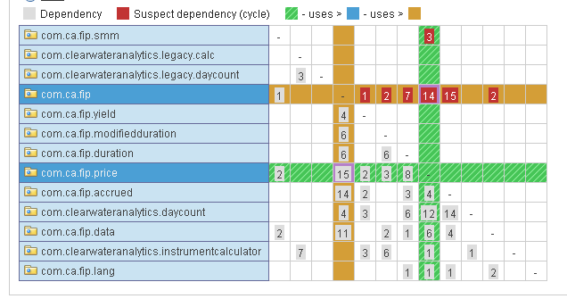
SONAR Design Analysis: Package Cycles
Notes:
Build every commit to isolate the source of defects for a long running test
Integrating all the tools:
Sonar
Fisheye/Crucible
Mantis

Slide 37
System Regression test
In general
  Long running tests are sometime necessary
  Cannot test every build
  Test as often as possible
  Localize defect to single build
Our tests
  12 hours for a full run
  Every night
  Takes hours of manual labor
  Binary search to pinpoint
Notes:
These tests take a lot of time but for our business they are crucial

Slide 38

Store Every Build
(within reason)

Slide 39


Ant vs Maven
Ant
  IDE generated files
  Large and ugly
  Not portable
Maven
  Small XML configuration
  Great cross platform support
  Automatic dependency download
  Just works (most of the time)
Notes:
Not portable – Sometimes depends on someone's file system, operating system, etc. We had problems with people trying to build on Linux vs. Windows.
Maven does require a change in mind set, as it will not build everything for you. You can set it up to build dependent projects, but you now have to store built libraries.
Story about HP build process and distributing the build and using pre-built object files.
If you use versioning with Maven it's very fast.
Versioning introduces its own problems.

Slide 40
Maven Versions
Use release versions for 3rd party libraries
Version internal libraries that need multiple active copies
Use release branches and no version for service oriented libraries (database model)
Notes:
We use third party libraries by specific release version. We do not use snapshot libraries from third parties.
We have certain shared libraries that we consider stable, that we version, and release when necessary, not as part of the monthly release cycle.
All our deployable projects and service oriented libraries are kept in lockstep. We use a branch for each release, but keep all the version numbers at 1.0-SNAPSHOT.
Talk about how versioning the deployables caused more work than it was worth, because we only ever had one version in production at a time.

Slide 41
Artifact Repository
Keep built libraries in local Maven repository
Nexus proxies Maven Central and stores local libraries
Hudson pushes to Nexus
Hudson keeps builds of deployable project
Notes:
One big problem we had initially with ANT and netbeans was third party dependencies. Someone would add a dependency on a new library, and everyone else had to figure out where to get it on the internet, make sure they got the right version, and put it in the right place on their hard drive to get the code to build again. This may seem like a little thing but it wastes valuable development time.

Slide 42
Automate Code Deployment
Deploy the Hudson-built code only, no developer builds
One click deploy from Hudson
Deploy code first to staging environment then production
Few deployment defects since adopting this method

Slide 43

Automated Database Deployment with Liquibase
SQL scripts in subversion
Deployed:
  Dev
  Test
Hudson Integration
  Immediate
  Scheduled
  After code deployment
Used to build DBA release script
Make scripts repeatable!

Slide 44
Questions?

Slide 45
Resources
Hudson (http://hudson-ci.org/)
SONAR (http://sonar.codehaus.org)
Nexus (http://nexus.sonatype.org/)
Maven (http://maven.apache.org/)
Liquibase (http://www.liquibase.org/)
SVN (http://subversion.tigris.org/)

