Slide 1
JFreeChart
Sean C. Sullivan
May 24, 2005
Portland Java Users Group

Slide 2
Agenda
JFreeChart library
Demo: Swing application
Demo: Struts application
Demo: PDF

Slide 3
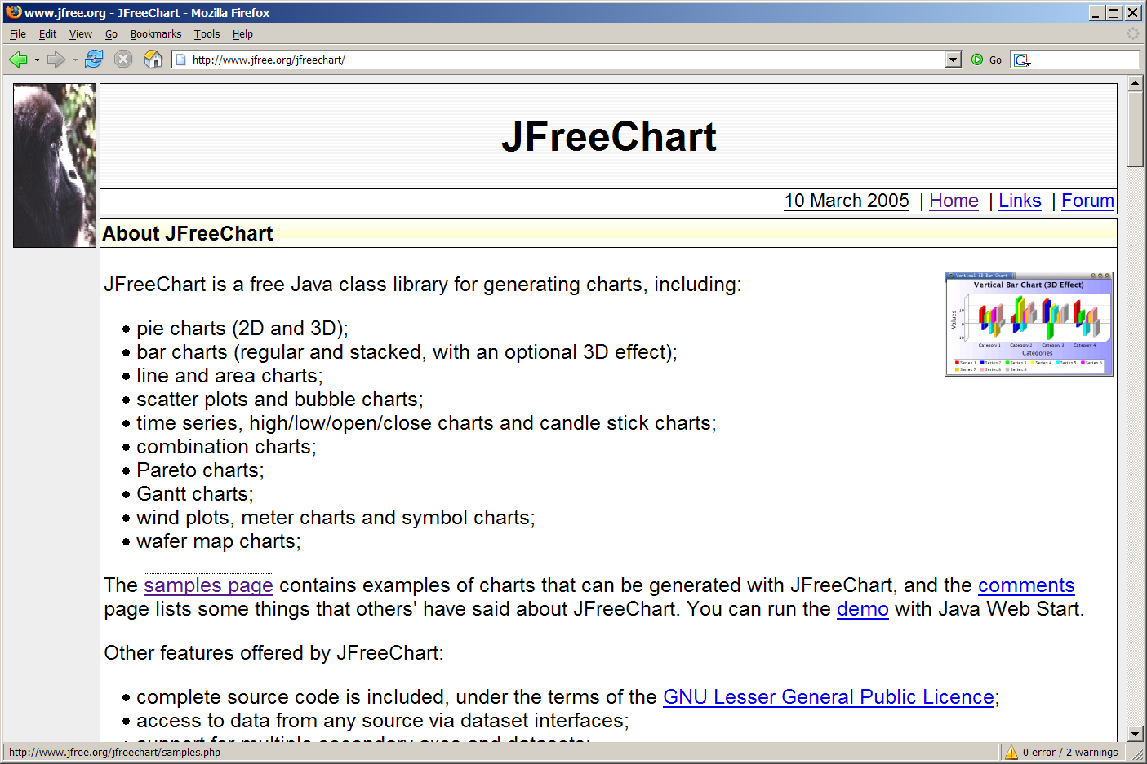
JFreeChart
http://www.jfree.org/jfreechart

Slide 4
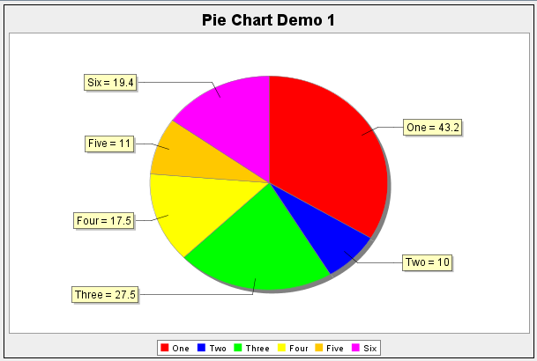
Pie chart

Slide 5
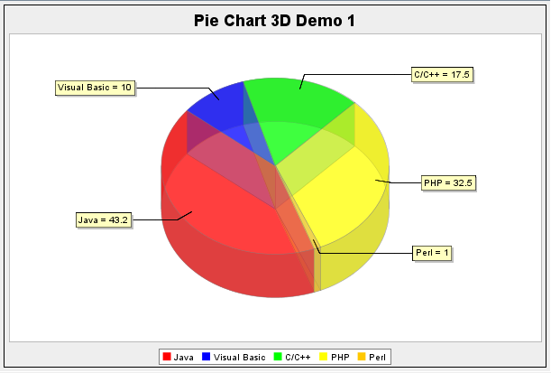
Pie chart 3D

Slide 6
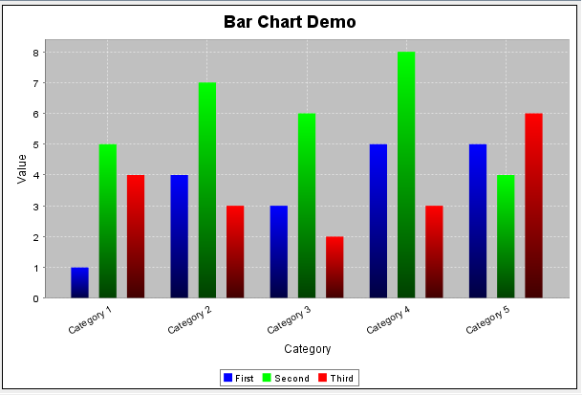
Bar chart

Slide 7
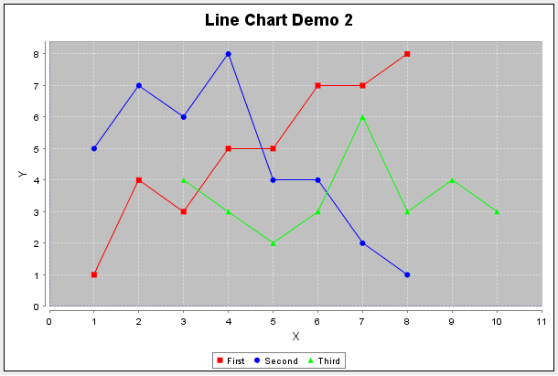
Line chart

Slide 8
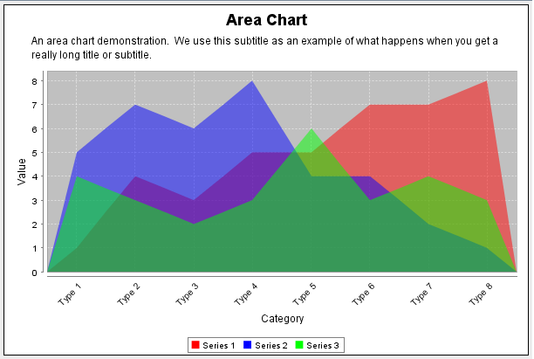
Area chart

Slide 9
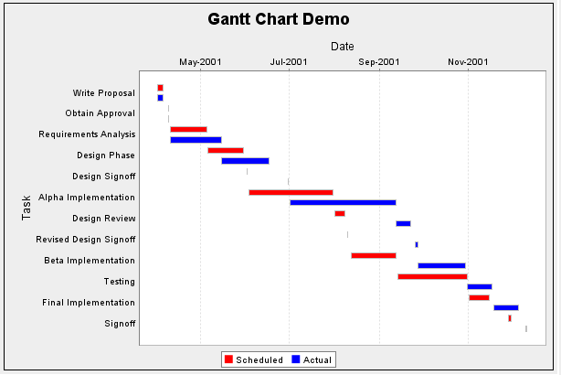
Gantt chart

Slide 10
JFreeChart API
org.jfree.chart.JFreeChart
org.jfree.chart.ChartFactory
org.jfree.data.general.Dataset
org.jfree.chart.plot.Plot
org.jfree.chart.ChartUtilities

Slide 11
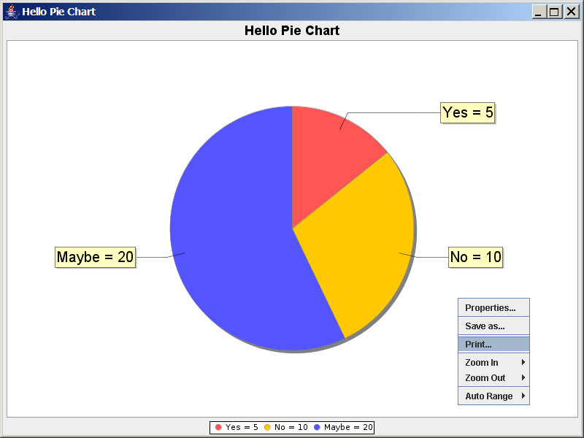
Demo: Swing application

Slide 12
Demo: Struts application
<html>
<head><title>JFreeChart</title></head>
<body>
<p>Struts and JFreeChart</p>
<% final int width = 800; %>
<% final int height = 800; %>
<img
src="generatechart.do?width=<%= width %>&height=<%= height%>"
width="800"
height="800"
border="1" />
</body>
</html>

Slide 13
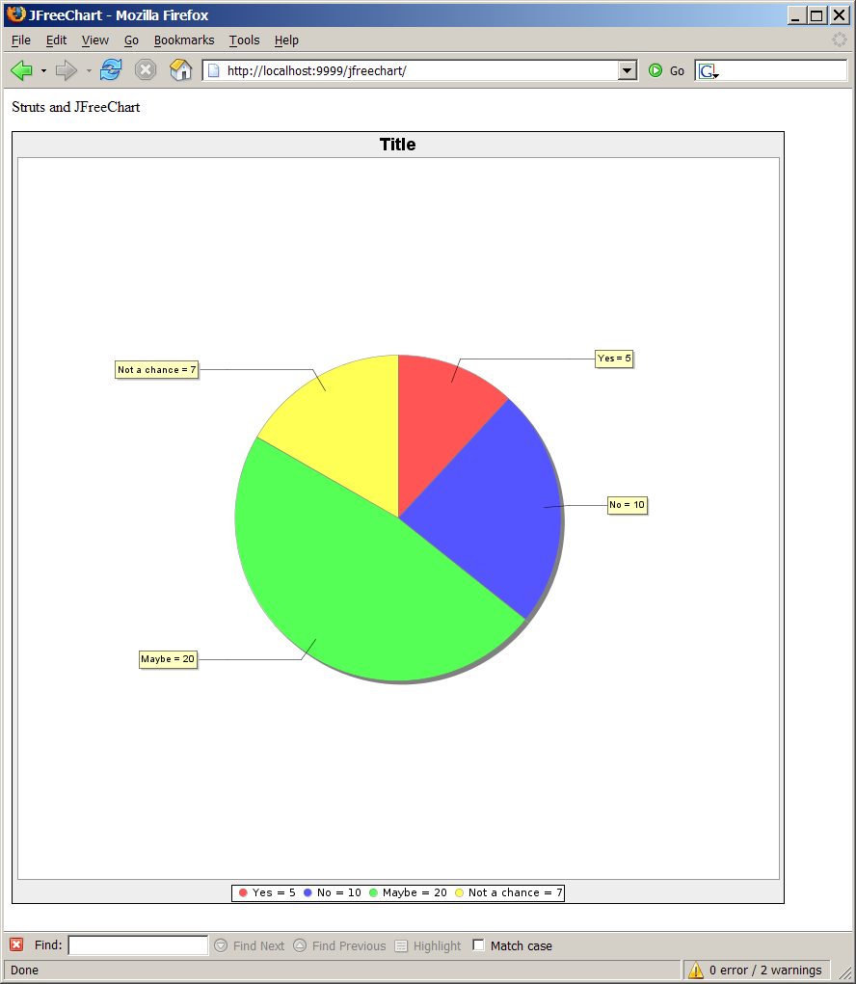
Demo: Struts application

Slide 14
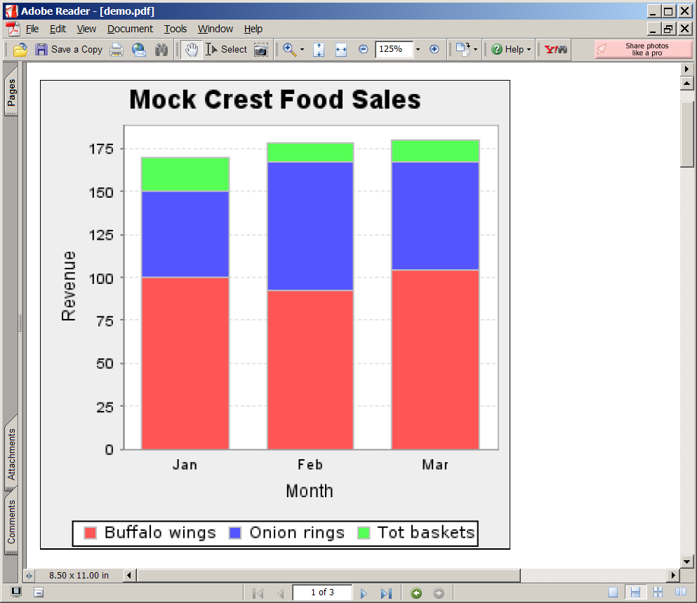
Demo: PDF

Slide 15
Questions?

