Slide 1
Eclipse WebTools
Sean C. Sullivan
January 25, 2005
Portland Java Users Group

Slide 2
Eclipse-based
J2EE development tools
Sysdeo Tomcat Plugin
Lomboz
JBossIDE
MyEclipse IDE
IBM Websphere Studio 5.x
IBM Rational Application Developer 6.0
Eclipse WebTools

Slide 3
Web application development
Edit
Compile
Build WAR file
Deploy WAR file
Re-start WAR
Debug
Notes:
Debug: remote debug?

Slide 4
Web application development with Eclipse WebTools
Edit
Compile
Build WAR file
Deploy WAR file
Re-start WAR
Debug

Slide 5
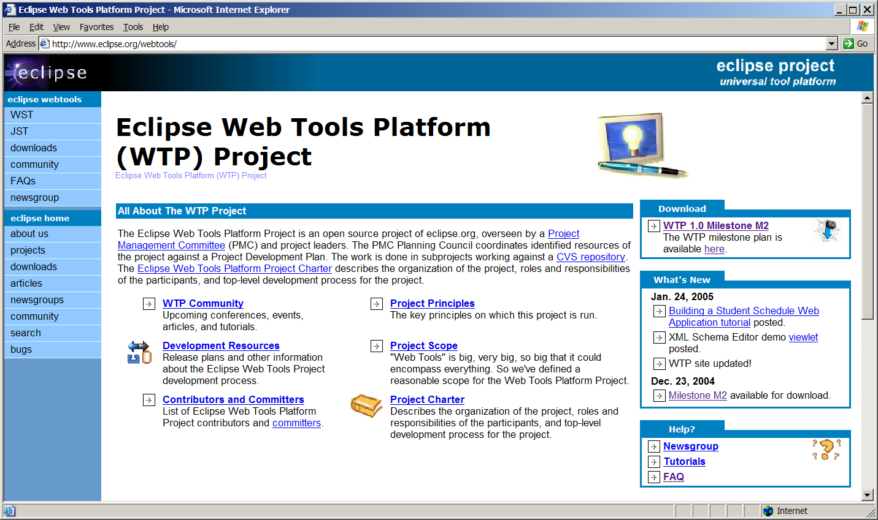
Eclipse WebTools Platform
http://www.eclipse.org/webtools

Slide 6
WebTools features
editors
wizards
debug server-side applications
server management
data tools

Slide 7
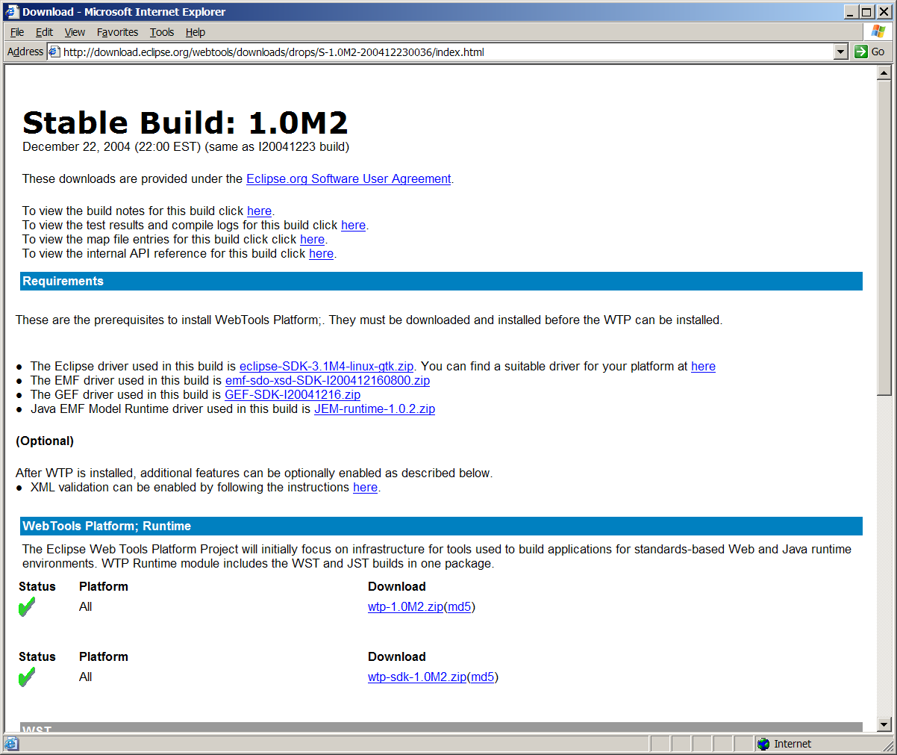
WebTools runtime

Slide 8


WebTools server support
Jakarta Tomcat
JBoss

Slide 9
Project types
Java projects
Web projects (WAR)
Enterprise Application projects (EAR)
EJB projects

Slide 10
WebTools debugging
Java debugging
JSP debugging

Slide 11



Demo - Eclipse WebTools
Eclipse 3.1 M4
Eclipse WebTools 1.0 M2
J2SE 5.0
Firefox 1.0
Jakarta Tomcat 5.5.4

Slide 12
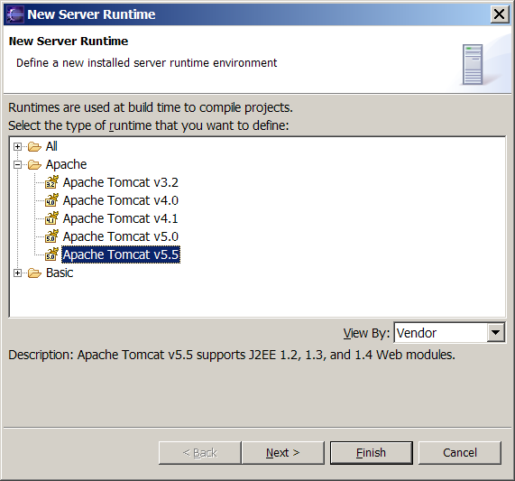
Server Runtime setup

Slide 13
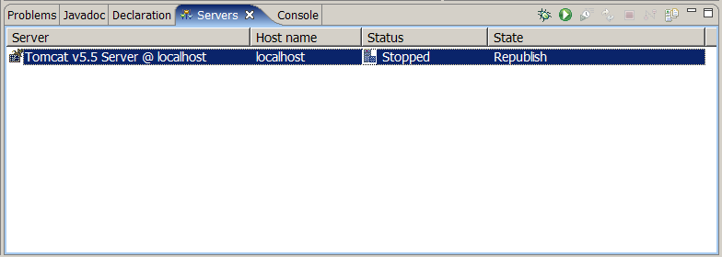
Servers view

Slide 14
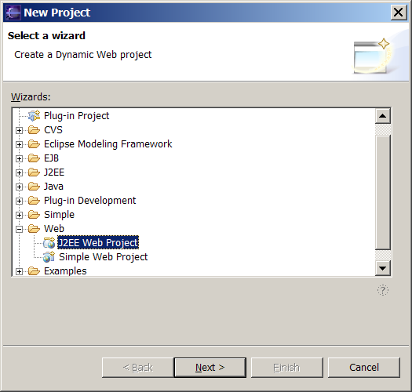
New Web Project

Slide 15
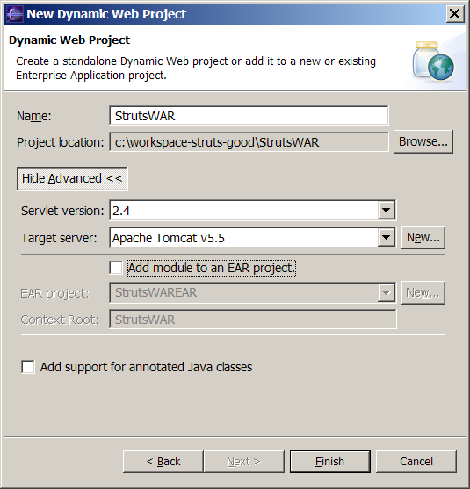
Project wizard

Slide 16
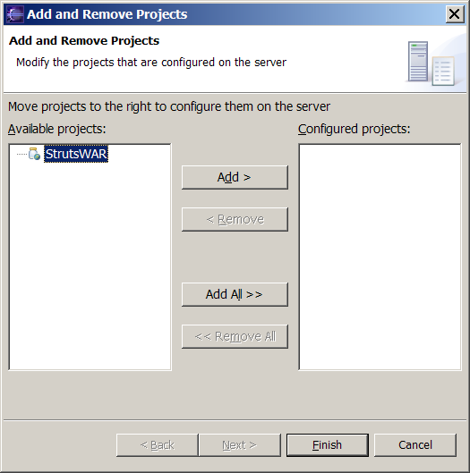
Add and Remove projects

Slide 17

Demo - IBM RAD 6.0
IBM Rational Application Developer 6.0
Firefox 1.0

Slide 18
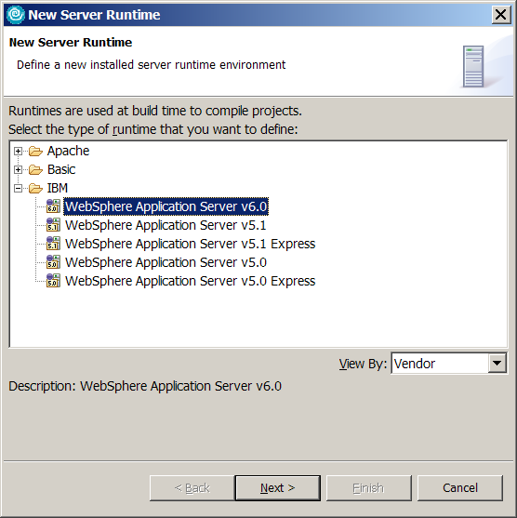
IBM RAD 6.0

Slide 19

Summary
+ WebTools =

