Slide 1
Template-based Email
Sean C. Sullivan
March 22, 2005
Portland Java Users Group

Slide 2
Agenda
Email templates
StringTemplate
JavaMail
MIME

Slide 3
Using email templates
SMTP
server
Java application
Email
Template
Email
Template
Mail
client

Slide 4
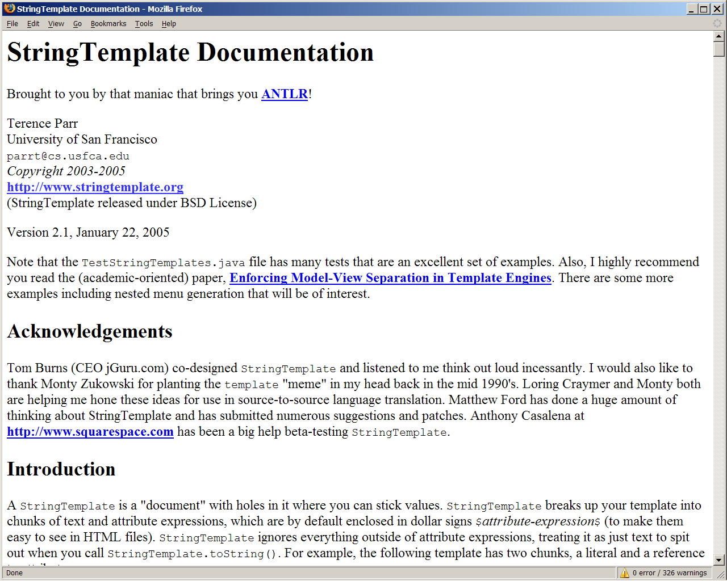
StringTemplate
http://www.stringtemplate.org/

Slide 5
StringTemplate 101
<p>
Hello $name$
</p>

Slide 6
StringTemplate 101
import org.antlr.stringtemplate.*;
StringTemplate t = ...
t.setAttribute("name", "Napoleon");
System.out.println(t.toString());

Slide 7
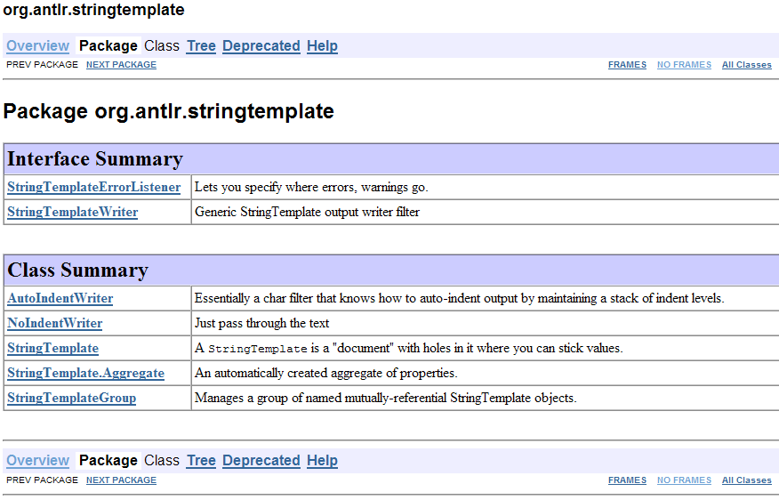
StringTemplate API

Slide 8
StringTemplate API

Slide 9
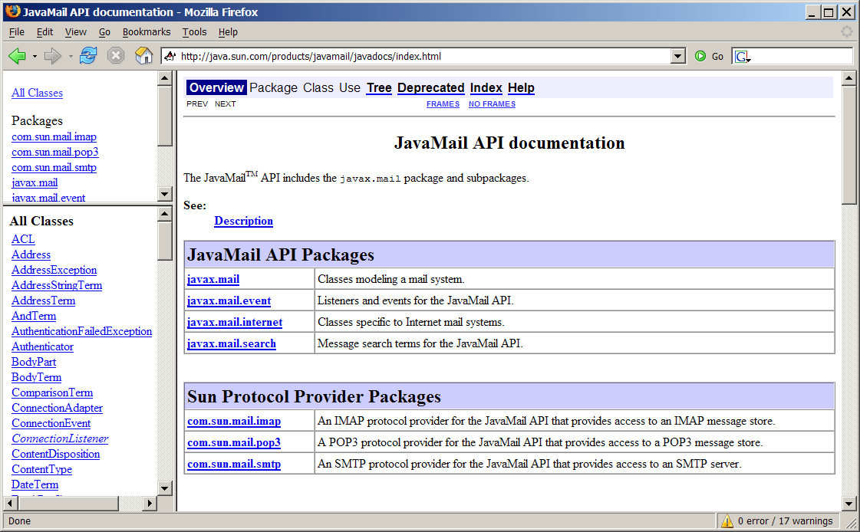
JavaMail API
http://java.sun.com/products/javamail/javadocs/index.html
Notes:
http://java.sun.com/products/javamail/

Slide 10



Demo
Thunderbird 1.0
J2SE 5.0
Template
StringTemplate 2.1
James 2.2.0

Slide 11
Summary
StringTemplate
JavaMail
MIME

