Slide 1
The DOT Service Shall…
Utilize the DOT library
Support iGrid-10 model-based paradigm
Minimize a scalar-valued function
Maximize a scalar-valued function
Enforce scalar-valued inequality constraints
Enforce scalar-valued equality constraints
Perform unconstrained optimization
Accept user configuration via ASCII file
Accept user configuration via API
Default to standard configuration in absence of user configuration

Slide 2
The DOT Service Shall… (cont)
Return the identities of the objective and constraints to be evaluated
Return the identities of gradients to be evaluated
Return values of design variables at which to evaluate
Accept values of objective and constraints requested
Accept values of gradients requested
Access run state via API
Provide feedback mechanism to allow progress reporting (interface callback/Job Monitor tie-in/file URL)
Report to a comma-delimited file
Report to a Tecplot formatted file
Report to a gnuplot formatted file
Allow user selection of no, one, or multiple file formats

Slide 3
The DOT Service Shall… (cont)
Return DOT library output files in entirety
Organize output files in uniquely identifiable directory
Report the optimized design back to the requestor
Perform multiple optimizations in series without requiring service republishing
Optionally provide diagnostic information
Halt the optimization process if notification is received from an analysis provider that a design is inadmissible

Slide 4


Use Cases
Owner
Start Service
Stop Service
DOT Service
Publish Service
Destroy Service
Generate Design
Make Request
Init/Config
Opt
<<extend>>
<<extend>>
Requestor
Update Design
Analysis Model
Receive Notification
Terminate
Opt
<<include>>
Receive Request
<<include>>
Request Responses
Query
Provide Responses
Report Progress
Update Responses
Receive Report
Query
Listener/Monitor

Slide 5
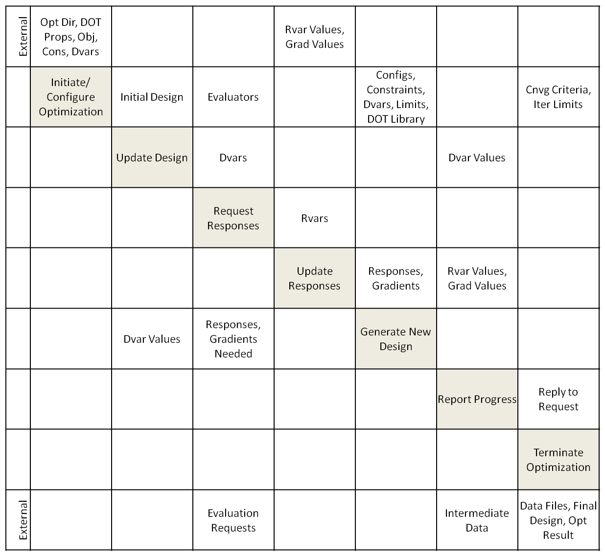
Data Flow

Slide 6
Activities
Requestor
Optimizer
Analysis Model
Request Opt
Initialize Opt
Update Dvars
Request Evals
Evaluate
Update Rvars
Report Progress
Generate Dsgn
Converged?
Finalize Opt
Receive Result
Report Progress

Slide 7
Init/Config Optimization
Update Design Variables
Create DOT Data Directory
Open Output Files
Instantiate Opti Object
  Load DOT Library
Parse DOT Config Params
Identify Objective
Identify Constraints
Identify Design Vars
Synchronize Model Design Variables and DOT Design Variable Vector

Slide 8
Request Evaluations
Update Response Variables
Identify and Mark Responses Requiring Evaluation
Signal Evaluation Request
Synchronize Model Response Variables and DOT Objective and Constraint Vectors

Slide 9
Report Progress
Generate Design
Send optimizer state, design variable, objective, constraint, and/or gradient information to logger, console, file, monitor, listener, and/or return context
Call DOT Library
Check Convergence

Slide 10
Finalize Optimization
Report Progress
Set Opti Object to null
  Removes Reference to DOT Library
Close Output Files
Copy Output to DOT Data Directory
Set DOT Data Directory to null
  No Further Access to Directory Contents

Slide 11
Class Diagram
DotOptimizer
1
1
DotOptimizerJna
1
1
*
1
DotOptimization
1
1
1
0…2
1
DotProblem
DotHistory
1
DotStrategy
<<interface>>
DotConstants
*
DotWriter
DotWriterTecplot
DotWriterCsv
DotWriterGnuplot

