Slide 1
Installations and Environment Setup
Machine Learning – Crash Course
Day 1

Slide 2
Why Python
General Purpose
Object Oriented
Design Philosophy: Clean and easy to learn Syntax
Free & Open Source
Compiles and runs on wide variety of UNIX, Windows and MacOS and other platforms including IoT
For simplicity and availability of the auxiliary libraries for Data Science such as numpy, pandas etc.

Slide 3
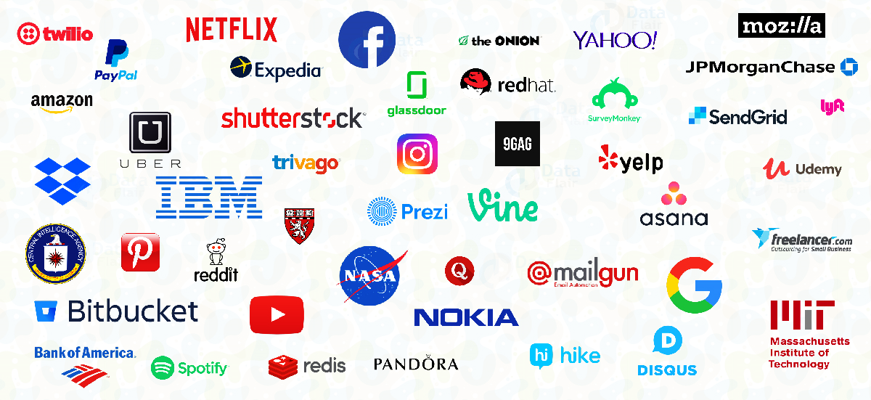
Python Footprint

Slide 4
Anaconda
Download Anaconda and Install it: here
Installation guide link: see this
Environment Creation:
conda create --name my_environment
With specific Python version:
conda create -n myenv python=3.6
Anaconda prompt
Listing all environments:
conda env list
Activating:
conda activate name_of_env
Package installation:
conda install -c conda-forge tree
Environment related guide: here

Slide 5
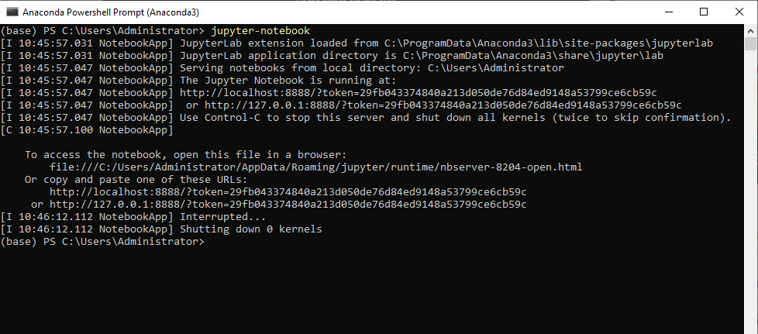
Jupyter Notebook
In anaconda prompt: jupyter-notebook

Slide 6
Conda Vs Pip
Pip
Package Management System
Uses PyPI (Python Package Index) Repository
Installs source distributions in .whl format
No package dependency resolver for conflicting packages
Conda
Cross platform package manager PLUS environment manager
Uses different channels: anaconda, conda-forge, bioconda etc
Installs binaries
SAT: Satisfiability solver to resolve conflicting packages

Slide 7
Environment creation via .yml file
Already working environment can be exported via:
conda env export > environment.yml
conda env create –f environment.yml

Slide 8


Other Integrations
PyCharm and VSCode

