Slide 1
Descriptive Stats and Probability
Statistical Methods for Machine Learning
Abdullah Mansoor –

Slide 2
Lecture 9

Slide 3
STATISTICS

Slide 4
Introduction to Statistics
Statistics is a collection of tools that you can use to get answers to important questions about data.
You can use descriptive statistical methods to transform raw observations into information that you can understand and share.
You can use inferential statistical methods to reason from small samples of data to whole domains.
Statistics is generally considered a prerequisite to the field of applied machine learning.
We need statistics to help transform observations into information and to answer questions about samples of observations.
Statistics is a collection of tools developed over hundreds of years for summarizing data and quantifying properties of a domain given a sample of observations.

Slide 5
Stats and Machine Learning
Machine learning and statistics are two tightly related fields of study. So much so that statisticians refer to machine learning as applied statistics or statistical learning rather than the computer-science-centric name. Machine learning is almost universally presented to beginners assuming that the reader has some background in statistics.
Why Learn Stats:
Raw observations alone are data, but they are not information or knowledge. Data raises questions, such as:
What is the most common or expected observation?
What are the limits on the observations?
What does the data look like?
What variables are most relevant?
What is the difference in an outcome between two experiments?
Are the differences real or the result of noise in the data?

Slide 6
What is Statistics?
Statistics is a subfield of mathematics.
It refers to a collection of methods for working with data and using data to answer questions.

Slide 7
Descriptive Statistics
Descriptive statistics refer to methods for summarizing raw observations into information that we can understand and share.
Commonly, we think of descriptive statistics as the calculation of statistical values on samples of data in order to summarize properties of the sample of data, such as the common expected value (e.g. the mean or median) and the spread of the data (e.g. the variance or standard deviation).
Descriptive statistics may also cover graphical methods that can be used to visualize samples of data.
Charts and graphics can provide a useful qualitative understanding of both the shape or distribution of observations as well as how variables may relate to each other.

Slide 8
Inferential Statistics
Inferential statistics is a fancy name for methods that aid in quantifying properties of the domain or population from a smaller set of obtained observations called a sample.
Commonly, we think of inferential statistics as the estimation of quantities from the population distribution, such as the expected value or the amount of spread.

Slide 9
Statistics VS ML
The machine learning practitioner has a tradition of algorithms and a pragmatic focus on results and model skill above other concerns such as model interpretability.
Statisticians work on much the same type of modeling problems under the names of applied statistics and statistical learning. Coming from a mathematical background, they have more of a focus on the behavior of models and explainability of predictions.

Slide 10
Examples of Statistics in Machine Learning
1. Problem Framing
Exploratory Data Analysis. Summarization and visualization in order to explore ad-hoc views of the data. Data Mining. Automatic discovery of structured relationships and patterns in the data.
2. Data Understanding Summary Statistics. Methods used to summarize the distribution and relationships between variables using statistical quantities. Data Visualizations. Methods used to summarize the distribution and relationships between variables using visualizations such as charts, plots, and graphs.
3. Data Cleaning
Outlier detection. Methods for identifying observations that are far from the expected value in a distribution. Imputation. Methods for repairing or filling in corrupt or missing values in observations.

Slide 11
4. Data Selection
Not all observations or all variables may be relevant when modeling. The process of reducing the scope of data to those elements that are most useful for making predictions is called data selection.
Two types of statistical methods that are used for data selection include:
Data Sample. Methods to systematically create smaller representative samples from larger datasets.
Feature Selection. Methods to automatically identify those variables that are most relevant to the outcome variable.
5. Data Preparation Data can often not be used directly for modeling. Some transformation is often required in order to change the shape or structure of the data to make it more suitable for the chosen framing of the problem or learning algorithms. Data preparation is performed using statistical methods. Some common examples include:
Scaling. Methods such as standardization and normalization.
Encoding. Methods such as integer encoding and one hot encoding.
Transforms. Methods such as power transforms like the Box-Cox method.

Slide 12
6. Model Evaluation
A crucial part of a predictive modeling problem is evaluating a learning method. This often requires the estimation of the skill of the model when making predictions on data not seen during the training of the model. Generally, the planning of this process of training and evaluating a predictive model is called experimental design. This is a whole subfield of statistical methods.
Experimental Design. Methods to design systematic experiments to compare the effect of independent variables on an outcome, such as the choice of a machine learning algorithm on prediction accuracy.
As part of implementing an experimental design, methods are used to resample a dataset in order to make economic use of available data in order to estimate the skill of the model. These methods are another subfield of statistical methods.
Resampling Methods. Methods for systematically splitting a dataset into subsets for the purposes of training and evaluating a predictive model.

Slide 13
7. Model Configuration
A given machine learning algorithm often has a suite of hyperparameters that allow the learning method to be tailored to a specific problem. The configuration of the hyperparameters is often empirical in nature, rather than analytical, requiring large suites of experiments in order to evaluate the effect of different hyperparameter values on the skill of the model.
The interpretation and comparison of the results between different hyperparameter configurations is made using one of two subfields of statistics, namely:
Statistical Hypothesis Tests. Methods that quantify the likelihood of observing the result given an assumption or expectation about the result (presented using critical values and p-values).
Estimation Statistics. Methods that quantify the uncertainty of a result using confidence intervals.

Slide 14
8. Model Selection
One among many machine learning algorithms may be appropriate for a given predictive modeling problem. The process of selecting one method as the solution is called model selection.
As with model configuration, two classes of statistical methods can be used to interpret the estimated skill of different models for the purposes of model selection. They are:
Statistical Hypothesis Tests. Methods that quantify the likelihood of observing the result given an assumption or expectation about the result (presented using critical values and p-values).
Estimation Statistics. Methods that quantify the uncertainty of a result using confidence intervals.
9. Model Presentation
Once a final model has been trained, it can be presented to stakeholders prior to being used or deployed to make actual predictions on real data. A part of presenting a final model involves presenting the estimated skill of the model. Methods from the field of estimation statistics can be used to quantify the uncertainty in the estimated skill of the machine learning model through the use of tolerance intervals and confidence intervals.
Estimation Statistics. Methods that quantify the uncertainty of a result using confidence intervals.

Slide 15
10. Model Predictions
As part of making predictions, it is important to quantify the confidence of the prediction. Just like with the process of model presentation, we can use methods from the field of estimation statistics to quantify this uncertainty, such as confidence intervals and prediction intervals.
Estimation Statistics. Methods that quantify the uncertainty of a result using confidence intervals.

Slide 16
FOUNDATION

Slide 17
Topics
Data Types and Visualization
Gaussian and Summary Stats
Random Numbers
Law of Large Numbers
Central Limit Theorem

Slide 18
Data Types and Visualization
Quantitative versus Qualitative Data
The distinction between quantitative and qualitative data is the most fundamental way to divide types of data.
Quantitative: The information is recorded as numbers and represents an objective measurement or a count. Temperature, weight, and a count of transactions are all quantitative data. Analysts also refer to this type as numerical data.
Qualitative: The information represents characteristics that you do not measure with numbers. Instead, the observations fall within a countable number of groups. In fact, this type of variable can capture information that isn’t easily measured and can be subjective. Taste, eye color, architectural style, and marital status are all types of qualitative variables (Categorical Variables).

Slide 19
Types of Quantitative Data:
Continuous
Discrete
Types Qualitative Data:
Categorical/Nominal
Binary
Ordinal

Slide 20
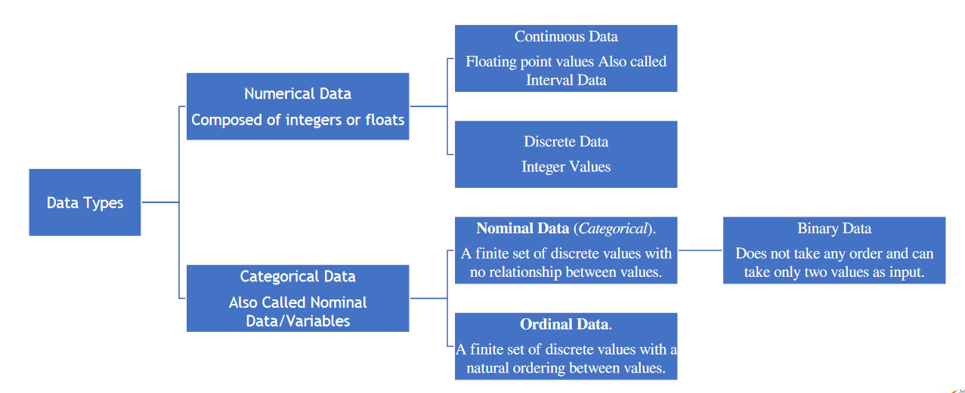

Slide 21
Numerical data, as its name suggests, involves features that are only composed of numbers, such as integers or floating-point values.
Categorical data are variables that contain label values rather than numeric values. The number of possible values is often limited to a fixed set. Categorical variables are often called nominal.
A “pet” variable with the values: “dog” and “cat“.
A “color” variable with the values: “red“, “green“, and “blue“.
A “place” variable with the values: “first“, “second“, and “third“.
Here, each value represents a different category. Some categories may have a natural relationship to each other, such as a natural ordering.
The “place” variable above does have a natural ordering of values. This type of categorical variable is called an ordinal variable because the values can be ordered or ranked.
The “color” variable has multiple values but there is no natural order or relationship between them. It is a nominal variable.
The “pet” variable holds only two types of values and the values do not have any relationship among one another. It is a binary variable.

Slide 22
Age | Height | Gender | Pet | Class Position
19 | 5.0 | M | Dog | First
27 | 5.7 | M | Cat | Second
18 | 6.9 | F | Rabbit | Third
33 | 5.4 | F | Parrot | Fourth
Numeric Discrete | Numeric Continuous | Categorical (Nominal) Binary | Categorical Nominal | Categorical Ordinal

Slide 23
Continuous Data:
The data is classified into numeric data and can take any value in a specified interval. These types of data are also called interval, float or numeric data. Mean and standard deviation are the arithmetic operations that can be performed on continuous data. The statistical operations such as Pearson correlation coefficient and t-test and F-test can also be applied to this data to gain insights into it.
Examples: Height or Weight of an individual, Rate of Interest on loans, etc.

Slide 24
Discrete Data:
The data which can take on only integer values are said to be discrete data. This type of data is usually used in counting the number of occurrences of the event. The discrete data cannot take on floating or decimal values.
Examples: Student count in a class, Colour count in a Rainbow.

Slide 25
Nominal Data:
Nominal data can be categorized into categorical that has no explicit ordering associated with it. The nominal data are plainly used as labelled data. No statistical operations such as calculation of mean, median or standard deviation can be performed on the nominal data as performing such statistical operations on such data doesn’t imply anything insightful.
Examples: States in a country, zip codes of areas.

Slide 26
Ordinal Data:
The data which has an explicit ordering associated with it is known as Ordinal data. The ordinal data is also a type of categorical data and has a specific definitive order with it. Calculations like frequency distribution, percentage of total calculation and other non-parametric statistics with ordinal data. However, mean calculation, standard deviation calculation and other parametric tests of statistics makes no sense for this kind of data.
Examples: Ratings for a restaurant (e.g. very good, good, bad, very bad), Level of Education of an individual (e.g. Doctorate, Post Graduate, Undergraduate), etc.

Slide 27
Binary Data:
This is a special case of Nominal data which does not take any order and can take only two values as input. The kind of operations that can be performed on this data are the same as that are performed on the nominal data.
Examples: Gender (male or female), Fraudulent transaction (Yes or No), Cancerous Cell (True or False).

Slide 28
Converting Numerical Variable to Ordinal Variable
A numerical variable can be converted to an ordinal variable by dividing the range of the numerical variable into bins and assigning values to each bin. For example, a numerical variable between 1 and 10 can be divided into an ordinal variable with 5 labels with an ordinal relationship: 1-2, 3-4, 5-6, 7-8, 9-10. This is called discretization.

Slide 29
Visualization Types
Line Plot
Bar Chart
Histogram Plot
Box and Whisker Plot
Scatter Plot
Pie Chart

Slide 30
Gaussian Distribution and Summary Stats
Sample of Data:
A sample of data is a snapshot from a broader population of all possible observations that could be taken of a domain or generated by a process.
Interestingly, many observations fit a common pattern or distribution called the normal distribution, or more formally, the Gaussian distribution.
It is also called NORMAL Distribution because it is the distribution that a lot of data falls into.
A lot of natural phenomena is in this form.
It is helpful when data is Gaussian or when we assume a Gaussian distribution for calculating statistics. This is because the Gaussian distribution is very well understood.
Much of the data we work with in machine learning often fits a Gaussian distribution. Examples include the input data we may use to fit a model and the multiple evaluations of a model on different samples of training data.
Not all data is Gaussian, and it is sometimes important to make this discovery either by reviewing histogram plots of the data or using statistical tests to check.

Slide 31
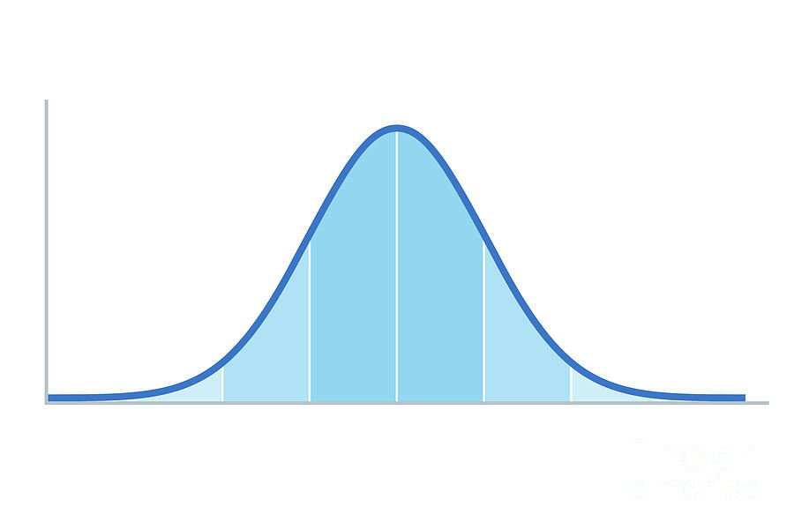

Slide 32
Lecture 10

Slide 33
Central Tendency
Mean:
The mean of a sample is calculated as the sum of the observations divided by the total number of observations in the sample.
Types: Arithmetic, Geometric, Harmonic, Weighted mean.
Variance:
The variance of a distribution refers to how much on average that observations vary or differ from the mean value.
It is useful to think of the variance as a measure of the spread of a distribution.
low variance will have values grouped around the mean (e.g. a narrow bell shape), whereas a high variance will have values spread out from the mean (e.g. a wide bell shape.

Slide 34
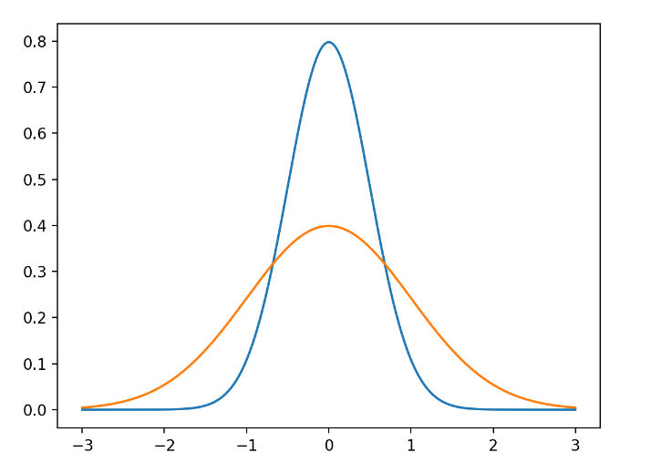

Slide 35

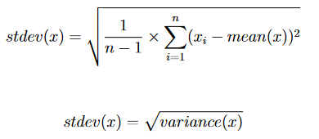
The variance of a data sample drawn from a Gaussian distribution is calculated as the average squared difference of each observation in the sample from the sample mean:
Where variance is often denoted as s2 or the lowercase Greek letter sigma σ2, clearly showing the squared units of the measure.
You may see the equation without the (−1) from the number of observations, and this is the calculation of the variance for the population, not the sample.
It is hard to interpret the variance because the units are the squared units of the observations.
We can return the units to the original units of the observations by taking the square root of the result. This is called standard deviation.
Where the standard deviation is
often written as s or as the Greek
lowercase letter sigma (σ).

Slide 36
Describing a Gaussian
In applied machine learning, you will often need to report the results of an algorithm. That is, report the estimated skill of the model on out-of-sample data. This is often done by reporting the mean performance from a k-fold cross-validation, or some other repeated sampling procedure.
When reporting model skill, you are in effect summarizing the distribution of skill scores, and very likely the skill scores will be drawn from a Gaussian distribution.
It is common to only report the mean performance of the model. This would hide two other important details of the distribution of the skill of the model.
Results Reproduction / Method Transparency: As a minimum it is recommend reporting the two parameters of the Gaussian distribution of model scores and the size of the sample. Ideally, it would also be a good idea to confirm that indeed the model skill scores are Gaussian or look Gaussian enough to defend reporting the parameters of the Gaussian distribution. This is important because the distribution of skill scores can be reconstructed by readers and potentially compared to the skill of models on the same problem in the future.

Slide 37
Summary Stats
1- Measures of Frequency
Discrete Frequency Distribution
Continuous Frequency Distribution
2- Measures of Central Tendency
Mean
Mode
Median
Mid-Range
3- Measures of Dispersion
Range
Variance
Standard Deviation
Co-efficient of Variation
Skewness
Kurtosis
4- Measures of Skewness and Kurtosis
5- Measures of Position
Z-Score
Percentile
Quartile

Slide 38
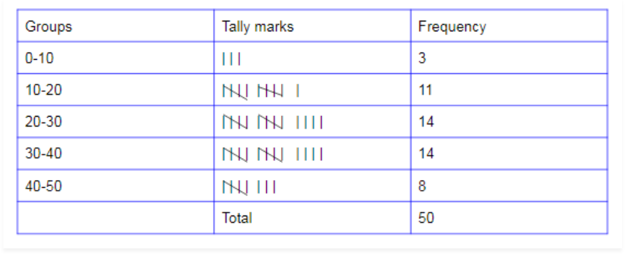
1- Measures of Frequency
Discrete Frequency Distribution
The minimum and maximum observation in the data will be found and then the values of the variable will be written in the variable column from minimum to maximum. The observations will be recorded by using Tally Marks represented by vertical bar. After counting the tally marks, the frequency will be written in the frequency column.

Slide 39
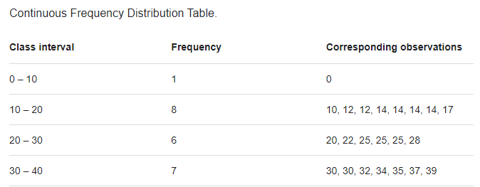
1- Measures of Frequency
Continuous Frequency Distribution
A continuous frequency distribution is a series in which the data are classified into different class intervals without gaps and their respective frequencies are assigned as per the class intervals and class width.

Slide 40
1- Measures of Frequency
Continuous Frequency Distribution
Class limits: The minimum and maximum values attached with a class or group are called class limits. The minimum value is called the lower class limit as in the class interval 0-20, 0 is the lower class limit while 20 is the upper class.
Class Boundaries: In continuous frequency distribution, class boundaries is a frequently used term. For making class boundaries, a simple rule is followed by reducing 0.5 from the lower class limit and adding 0.5 to the upper class limit i.e;10-30 will be written as 9.5-30.5.
Midpoint or Class Mark: For a given class, the average of the class is obtained by dividing the sum of upper and lower class limits by 2,it is called midpoint or class mark.

Slide 41
1- Measures of Frequency
Other Measures of Frequency:
Relative Frequency Distribution
Cumulative Frequency
Relative Cumulative Frequency
Graphical Representation of Frequency Distribution
The following are the details of a graphical representation of a frequency distribution. (i) Bar Graph: Bar graphs are graphs that use rectangular bars of constant width with equal spacing among them to show data.
(ii) Histograms: Histograms are graphical representations of data that use rectangular bars of different heights. There is no space between the rectangular bars in a histogram.
(iii) Pie chart: It is a diagram based on a circle and is useful if you want to show what proportion of a whole each part represents.
(iv) Frequency Polygon: A frequency polygon is a graphical form of representation of data. It is used to depict the shape of the data and to depict trends. It is usually drawn with the help of a histogram but can be drawn without it as well.

Slide 42

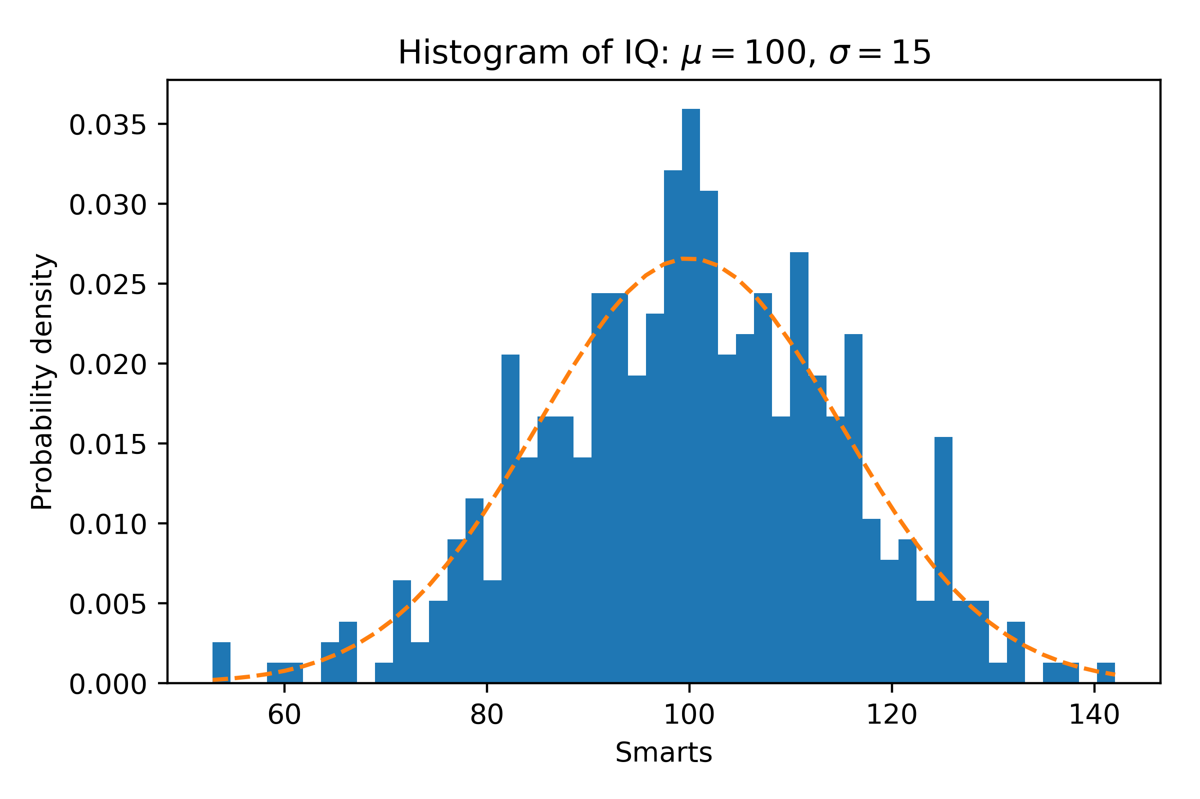
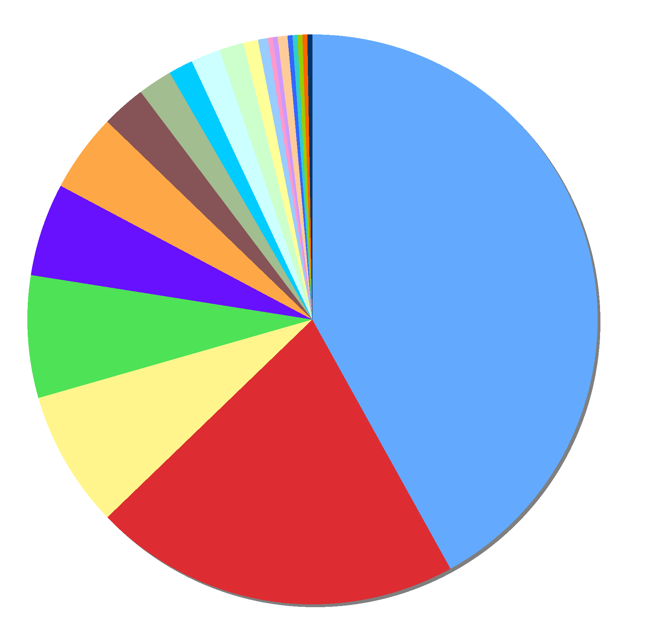
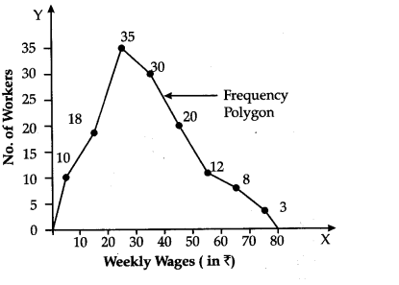

Slide 43
2- Measures of Central Tendency
Mode
The mode in statistics refers to a number in a set of numbers that appears the most often.
The mode is considered to be the least informative measure in the central tendency measures.
For example, if a set of numbers contained the following digits, 1, 1, 3, 5, 6, 6, 7, 7, 7, 8, the mode would be 7, as it appears the most out of all the numbers in the set.
The modal class (or number) is 2 which is appearing 7 times in the data.
There are three different types of mode in statistics:
Unimodal distribution – A single unique mode.
Bimodal distribution – The data has two modal values.
Multimodal distribution – It has more than two values of mode.
Class | 1 | 2 | 3 | 4 | 5 | 6
Frequency | 2 | 7 | 3 | 4 | 2 | 4

Slide 44
2- Measures of Central Tendency
Median
The Median is that value, in an array of numerical data which separates the array into two equal parts; i.e., 50% above the median and 50% below the median.
Example
Data ordered ascending: 7, 8, 9, 10, 11, 12, 15, 18, 19, 20, 22, 30, 34
The number of data points is 13.
(13+1)/2 = 7
We see that 15 is the seventh element in the array. Thus, the median = 15

Slide 45
2- Measures of Central Tendency
Mid-Range
The Mid-Range is another value that can be used to check on the center of any data. It is rarely used but it will give an indication when compared to the measures of central tendency. The Midrange is the average of the two extreme values in the data, i.e. the average of the maximum and the minimum in the array, i.e.,
Mid-Range = (Max + Min)/2.
In previous example, the minimum is 7 and the maximum is 34. Therefore, the Mid-Range is: MR = (7 + 34)/2 = 20.5

Slide 46
3- Measures of Dispersion
Range
Co-efficient of Variation
Skewness
Kurtosis

Slide 47
3- Measures of Dispersion
There are two main types of dispersion methods in statistics which are:
Absolute Measure of Dispersion
The types of absolute measures of dispersion are:
Range
Variance
Standard Deviation
Relative Measure of Dispersion
There are four relative measures of dispersion:
Coefficient of Range.
Coefficient of Quartile Deviation.
Coefficient of Mean deviation.
Coefficient of variation.

Slide 48
3- Measures of Dispersion
Range
The simplest measure of dispersion is the range. Thus, the Range, R, of a variable is the difference between the largest and the smallest values in the ordered data.
R = Largest data value − smallest data value = Maximum − minimum.
Co-efficient of Variation
The Coefficient of Variation (CV) is a measure that allows for the easy comparison of two or more variables measured on different scales. It gives the relative variability in terms of the mean of the variable. It is a ratio and thus, it has no units of measurement. The lower the Coefficient of Variation is the better. In that it will show a small variability in the data. As it as for the measures of center and variation, there are two Coefficients of Variation, namely one for a population and another one for a sample. This measure is applicable more often on a sample rather than on a population, and it is expressed as percentage.
CV = [Standard Deviation / Mean] * 100

Slide 49
4- Measures of Skewness & Kurtosis
Skewness
Skewness is a measure of asymmetry or distortion of symmetric distribution. It measures the deviation of the given distribution of a random variable from a symmetric distribution, such as normal distribution.
Positive Skewness: If the given distribution is shifted to the left and with its tail on the right side, it is a positively skewed distribution. It is also called the right-skewed distribution. A tail is referred to as the tapering of the curve differently from the data points on the other side.
Negative Skewness: If the given distribution is shifted to the right and with its tail on the left side, it is a negatively skewed distribution. It is also called a left-skewed distribution. The skewness value of any distribution showing a negative skew is always less than zero.

Slide 50
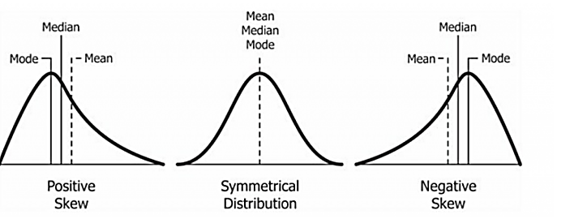
4- Measures of Skewness & Kurtosis

Slide 51
4- Measures of Skewness & Kurtosis
Skewness
Coefficient of Skewness = 3[(Mean – Median)/Standard deviation]
The value of this measure usually lies between -3 and +3, i.e. -3 < CS < 3. The closer is the value to -3, the more indication that the distribution is negatively skewed. On the other hand, the closer is the value to +3, the more indication that the distribution is positively skewed. Moreover, a value of zero shows a symmetric distribution. See the previous figures.

Slide 52
4- Measures of Skewness & Kurtosis
Kurtosis
Kurtosis is a statistical measure that defines how heavily the tails of a distribution differ from the tails of a normal distribution. In other words, kurtosis identifies whether the tails of a given distribution contain extreme values.
There are three types of kurtosis:
Mesokurtic
Leptokurtic
Platykurtic
POINT: The above three coefficients, namely CV, CS, and CK are of theoretical value, as well as for checking on the quality of the data for later analysis.

Slide 53
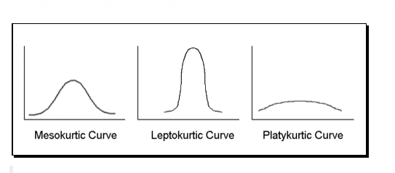
4- Measures of Skewness & Kurtosis

Slide 54
5- Measures of Position
A measure of position determines the position of a single value in relation to other values in a sample or a population data set.
There are three main types of measures of position that are listed below:
Percentiles
Deciles
Quartiles

Slide 55
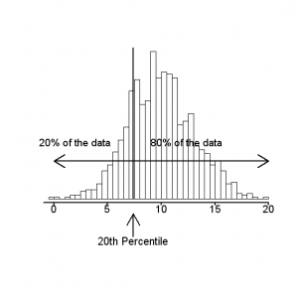
5- Measures of Position
Percentile
In statistics, a percentile is a term that describes how a score compares to other scores from the same set.
You might know that you scored 67 out of 90 on a test. But that figure has no real meaning unless you know what percentile you fall into. If you know that your score is in the 90th percentile, that means you scored better than 90% of people who took the test.
Percentiles are commonly used to report scores in tests, like the SAT, GRE and LSAT. for example, the 70th percentile on the 2013 GRE was 156. That means if you scored 156 on the exam, your score was better than 70 percent of test takers.
The 25th percentile is also called the first quartile.
The 50th percentile is generally the median.
The 75th percentile is also called the third quartile.
The difference between the third and first quartiles is the interquartile range.

Slide 56
5- Measures of Position
Decile
A decile is a quantitative method of splitting up a set of ranked data into 10 equally large subsections. A decile rank arranges the data in order from lowest to highest and is done on a scale of one to 10 where each successive number corresponds to an increase of 10 percentage points.
To find the decile, first order the data from least to greatest.
Then, divide the data by 10. This indicates the number of observed values within each decile.

Slide 57
5- Measures of Position
Quartile
Quartiles are numbers that separate the data into quarters. Quartiles may or may not be part of the data. To find the quartiles, first find the median or second quartile. The first quartile, Q₁, is the middle value of the lower half of the data, and the third quartile, Q₃, is the middle value, or median, of the upper half of the data.
However, quartiles aren’t shaped like pizza slices; Instead they divide your data into four segments according to where the numbers fall on the number line. The four quarters that divide a data set into quartiles are:
Q1: The lowest 25% of numbers.
Q2: The next lowest 25% of numbers (up to the median).
Q3: The second highest 25% of numbers (above the median).
Q4: The highest 25% of numbers.

Slide 58
5- Measures of Position
To get the idea, consider the same data set:
1; 1; 2; 2; 4; 6; 6.8; 7.2; 8; 8.3; 9; 10; 10; 11.5
The median or second quartile is 7. The lower half of the data are 1, 1, 2, 2, 4, 6, 6.8. The middle value of the lower half is 2.
1; 1; 2; 2; 4; 6; 6.8
The number 2, which is part of the data, is the first quartile. One-fourth of the entire sets of values are the same as or less than two and three-fourths of the values are more than two.
The upper half of the data is 7.2, 8, 8.3, 9, 10, 10, 11.5. The middle value of the upper half is 9.
The third quartile, Q3, is 9. Three-fourths (75%) of the ordered data set are less than 9. One-fourth (25%) of the ordered data set are greater than 9. The third quartile is part of the data set in this example.
The interquartile range is a number that indicates the spread of the middle half or the middle 50% of the data. It is the difference between the third quartile and the first quartile.

Slide 59

Section Ends Here

Slide 60
Application of Stats in Machine Learning: Random Numbers
Randomness is a big part of machine learning.
Randomness is used as a tool or a feature in preparing data and in learning algorithms that map input data to output data in order to make predictions.
The source of randomness in machine learning is a mathematical trick called a pseudorandom number generator.

Slide 61
Randomness in Machine Learning:
Randomness in Data
There is a random element to the sample of data that we have collected from the domain that we will use to train and evaluate the model. The data may have mistakes or errors. More deeply, the data contains noise that can obscure the crystal-clear relationship between the inputs and the outputs.
Randomness in Evaluation
We do not have access to all the observations from the domain. We work with only a small sample of the data. Therefore, we harness randomness when evaluating a model, such as using k-fold cross-validation to fit and evaluate the model on different subsets of the available dataset. We do this to see how the model works on average rather than on a specific set of data.
Randomness in Algorithms
Machine learning algorithms use randomness when learning from a sample of data. This is a feature, where the randomness allows the algorithm to achieve a better performing mapping of the data than if randomness was not used. Randomness is a feature, which allows an algorithm to attempt to avoid overfitting the small training set and generalize to the broader problem.
Algorithms that use randomness are often called stochastic algorithms rather than random algorithms. This is because although randomness is used, the resulting model is limited to a more narrow range, e.g. like limited randomness.
one clear examples of randomness used in machine learning algorithms include:
The shuffling of training data prior to each training epoch in stochastic gradient descent.
The random subset of input features chosen for split points in a random forest algorithm.
The random initial weights in an artificial neural network.

Slide 62
Pseudorandom Number Generators
A random number generator is a system that generates random numbers from a true source of randomness.
Often something physical, such as a Geiger counter, where the results are turned into random numbers. There are even books of random numbers generated from a physical source that you can purchase, for example: A Million Random Digits with 100,000 Normal Deviates.
We do not need true randomness in machine learning. Instead we can use pseudorandomness. Pseudorandomness is a sample of numbers that look close to random, but were generated using a deterministic process.
Shuffling data and initializing coefficients with random values use pseudorandom number generators. These little programs are often a function that you can call that will return a random number. Called again, they will return a new random number.
Seed:
The numbers are generated in a sequence. The sequence is deterministic and is seeded with an initial number. If you do not explicitly seed the pseudorandom number generator, then it may use the current system time in seconds or milliseconds as the seed. The value of the seed does not matter. Choose anything you wish. What does matter is that the same seeding of the process will result in the same sequence of random numbers.

Slide 63
Random Number Generation: Python
# seed the pseudorandom number generator from random import seed from random import random
# seed random number generator seed(1)
# generate some random numbers print(random(), random(), random()) # reset the seed seed(1)
# generate some random numbers print(random(), random(), random())

Slide 64
Random Number Generation: Python
# generate random integer values
from random import seed from random import randint
# seed random number generator seed(1)
# generate some integers for _ in range(10): value = randint(0, 10) print(value)

Slide 65
Random Number Generation: Python
Random floating point values can be drawn from a Gaussian distribution using the gauss()function.
# generate random Gaussian values from random import seed from random import gauss
# seed random number generator seed(1)
# generate some Gaussian values for _ in range(10): value = gauss(0, 1) print(value)

Slide 66
Random Number Generation: Python
Random subsample From a List:
# select a random sample without replacement from random import seed from random import sample
# seed random number generator seed(1)
# prepare a sequence sequence = [i for i in range(20)] print(sequence)
# select a subset without replacement subset = sample(sequence, 5) print(subset)

Slide 67
Random Number Generation: Python
Randomly Shuffle a List
Randomness can be used to shuffle a list of items, like shuffling a deck of cards. The shuffle()function can be used to shuffle a list. The shuffle is performed in place, meaning that the list provided as an argument to the shuffle() function is shuffled rather than a shuffled copy of the list being made and returned.
# randomly shuffle a sequence from random import seed from random import shuffle
# seed random number generator seed(1)
# prepare a sequence sequence = [i for i in range(20)] print(sequence)
# randomly shuffle the sequence shuffle(sequence)s print(sequence)

Slide 68
Law of Large Numbers
We have an intuition that more observations are better. This is the same intuition behind the idea that if we collect more data, our sample of data will be more representative of the problem domain.
There is a theorem in statistics and probability that supports this intuition that is a pillar of both of these fields and has important implications in applied machine learning.
The name of this theorem is the law of large numbers.
The law of large numbers supports the intuition that the sample becomes more representative of the population as its size is increased.

Slide 69
Law of Large Numbers
Implications of this Law in Machine Learning
Training Data:
The data used to train the model must be representative of the observations from the domain.
Testing Data:
This is often neglected with the blind use of 80/20 spits for train/test data or the blind use of 10-fold cross-validation, even on datasets where the size of 1/10th of the available data may not be a suitable representative of observations from the problem domain.
Modal Skill Evaluation:
Consider the law of large numbers when presenting the estimated skill of a model on unseen data. It provides a defense for not simply reporting or proceeding with a model based on a skill score from a single train/test evaluation. It highlights the need to develop a sample of multiple independent (or close to independent) evaluations of a given model such that the mean reported skill from the sample is an accurate enough estimate of population mean.
Practical Notes and Thoughts on Law of Large Numbers:
https://machinelearningmastery.com/a-gentle-introduction-to-the-law-of-large-numbers-in-machine-learning/

Slide 70
Other Topics is Stats application in Applied Machine Learning:
Central Limit Theorem
Statistical Distributions
Density Functions: Probability Density Func, Cumulative Density Func
Guassian distribution, Student’s t-distribution, Chi-squared distribution
Critical Values
Covariance and Correlation
Significance Tests
Resampling Methods:
Estimation with Bootstrap
Estimation with Cross-Validation
Estimation Stats:
Tolerance, Confidence, and Prediction Intervals

