Slide 1
Lecture : 18
Machine Learning Pipeline
Abdullah Mansoor

Slide 2
Types of Learning
Machine Learning
Supervised Learning
Unsupervised Learning
Reinforcement Learning

Slide 3
Machine Learning Pipeline
A machine learning pipeline is:
A way to codify and automate the workflow it takes to produce a machine learning model.
Machine learning pipelines consist of multiple sequential steps that perform operations from data extraction and preprocessing to model training and deployment.

Slide 4
Classic Machine Learning Pipeline
Data Gathering
Data Preprocessing
Feature Crafting
Model Training
Model Validation, Testing & Evaluation
Model Deployment

Slide 5
Data Preprocessing: Why?
The majority of the real-world datasets for machine learning are highly susceptible to be missing, inconsistent, and noisy due to their heterogeneous origin.
Applying machine learning algorithms on this noisy data would not give quality results as they would fail to identify patterns effectively. Data Processing is, therefore, important to improve the overall data quality.
Duplicate or missing values may give an incorrect view of the overall statistics of data.
Outliers and inconsistent data points often tend to disturb the model’s overall learning, leading to false predictions.
Quality decisions must be based on quality data. Data Preprocessing is important to get this quality data, without which it would just be a Garbage In, Garbage Out scenario.

Slide 6
Data Preprocessing
Missing Data
Ignore the missing data
Remove the missing data
Manually fill by some value
Fill by some computed value
Fill by mean
Fill randomly from a distribution such as Gaussian or Standard
Fill using machine learning algorithms such as KMeans

Slide 7
Data Preprocessing
Noise Removal
Noise reduction via outlier detection and removal
Binning & Discretization
Clustering
Manually Removing
Undesired features’ removal
Undesired features are also considered noise.
Noise Addition

Slide 8
Data Preprocessing
Balancing of Imbalanced Datasets:
Resampling
Up sampling
Down sampling
Synthetic Samples addition
Resizing (cropping, making docs of a certain length etc.)
Data Encoding
(whole section coming up on next slide)

Slide 9
Data Encoding
ML algorithms require all input and output variables to be numeric.
Before feeding the data to ML models, they need to be converted into numerical variables.
The data is divided into two types: Structured and Unstructured
Structured Data is further divided into Numeric and Categorical.
Some of the common structured data types that are used in Machine Learning and Data Science point of view are:
Continuous Data (Interval Data)
Discrete Data
Nominal Data
Ordinal Data
Binary Data

Slide 10
Data Encoding Types of Data
Data Types
Numerical Data
Composed of integers or floats
Categorical Data
Also Called Nominal Data/Variables
Nominal Data (Categorical).
A finite set of discrete values with no relationship between values.
Ordinal Data.
A finite set of discrete values with a natural ordering between values.
Continuous Data
Floating point values Also called Interval Data
Discrete Data
Integer Values
Binary Data
Does not take any order and can take only two values as input.

Slide 11
Data Encoding Types of Data
Numerical data, as its name suggests, involves features that are only composed of numbers, such as integers or floating-point values.
Categorical data are variables that contain label values rather than numeric values. The number of possible values is often limited to a fixed set. Categorical variables are often called nominal.
A “pet” variable with the values: “dog” and “cat“.
A “color” variable with the values: “red“, “green“, and “blue“.
A “place” variable with the values: “first“, “second“, and “third“.
Here, each value represents a different category. Some categories may have a natural relationship to each other, such as a natural ordering.
The “place” variable above does have a natural ordering of values. This type of categorical variable is called an ordinal variable because the values can be ordered or ranked.
The “color” variable has multiple values but there is no natural order or relationship between them. It is a nominal variable.
The “pet” variable holds only two types of values and the values do not have any relationship among one another. It is a binary variable.

Slide 12
Data Encoding Types of Data
Age | Height | Gender | Pet | Class Position
19 | 5.0 | M | Dog | First
27 | 5.7 | M | Cat | Second
18 | 6.9 | F | Rabbit | Third
33 | 5.4 | F | Parrot | Fourth
Numeric Discrete | Numeric Continuous | Categorical (Nominal) Binary | Categorical Nominal | Categorical Ordinal

Slide 13
Data Encoding Types of Data
Continuous Data:
The data is classified into numeric data and can take any value in a specified interval. These types of data are also called interval, float or numeric data. Mean and standard deviation are the arithmetic operations that can be performed on continuous data. The statistical operations such as Pearson correlation coefficient and t-test and F-test can also be applied to this data to gain insights into it.
Examples: Height or Weight of an individual, Rate of Interest on loans, etc.

Slide 14
Data Encoding Types of Data
Discrete Data:
The data which can take on only integer values are said to be discrete data. This type of data is usually used in counting the number of occurrences of the event. The discrete data cannot take on floating or decimal values.
Examples: Student count in a class, Colour count in a Rainbow.

Slide 15
Data Encoding Types of Data
Nominal Data:
Nominal data can be categorized into categorical that has no explicit ordering associated with it. The nominal data are plainly used as labelled data. No statistical operations such as calculation of mean, median or standard deviation can be performed on the nominal data as performing such statistical operations on such data doesn’t imply anything insightful.
Examples: States in a country, zip codes of areas.

Slide 16
Data Encoding Types of Data
Ordinal Data:
The data which has an explicit ordering associated with it is known as Ordinal data. The ordinal data is also a type of categorical data and has a specific definitive order with it. Calculations like frequency distribution, percentage of total calculation and other non-parametric statistics with ordinal data. However, mean calculation, standard deviation calculation and other parametric tests of statistics makes no sense for this kind of data.
Examples: Ratings for a restaurant (e.g. very good, good, bad, very bad), Level of Education of an individual (e.g. Doctorate, Post Graduate, Undergraduate), etc.

Slide 17
Data Encoding Types of Data
Binary Data:
This is a special case of Nominal data which does not take any order and can take only two values as input. The kind of operations that can be performed on this data are the same as that are performed on the nominal data.
Examples: Gender (male or female), Fraudulent transaction (Yes or No), Cancerous Cell (True or False).

Slide 18
Data Encoding
Converting Numerical Variable to Ordinal Variable
A numerical variable can be converted to an ordinal variable by dividing the range of the numerical variable into bins and assigning values to each bin. For example, a numerical variable between 1 and 10 can be divided into an ordinal variable with 5 labels with an ordinal relationship: 1-2, 3-4, 5-6, 7-8, 9-10. This is called discretization.

Slide 19
Data Encoding Encoding Schemes
Different Data Encoding Schemes:
Integer Encoding / Label encoding
One-hot Encoding
Dummy Variable Encoding
*****************************
Binary Encoding
Frequency Encoding
Hash Encoding
Helmert Encoding
Using Bayesian Encoders

Slide 20
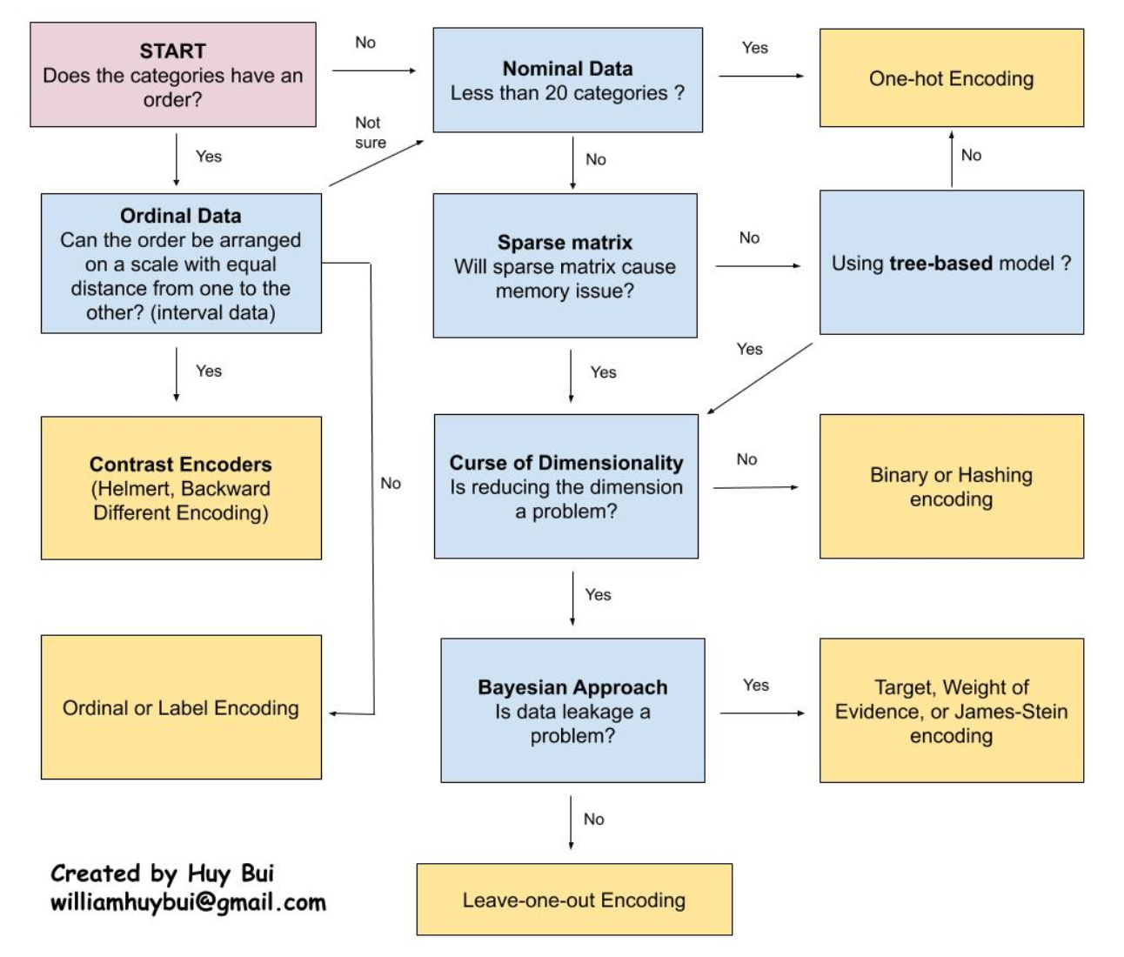
Data Encoding Encoding Schemes

Slide 21
Data Encoding
Some algorithms can work with categorical data directly. For example, a decision tree can be learned directly from categorical data with no data transform required (this depends on the specific implementation).
Many machine learning algorithms cannot operate on label data directly. They require all input variables and output variables to be numeric.
In general, this is mostly a constraint of the efficient implementation of machine learning algorithms rather than hard limitations on the algorithms themselves.
Some implementations of machine learning algorithms require all data to be numerical. For example, scikit-learn has this requirement.
This means that categorical data must be converted to a numerical form. If the categorical variable is an output variable, you may also want to convert predictions by the model back into a categorical form in order to present them or use them in some application.

Slide 22
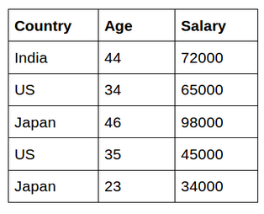
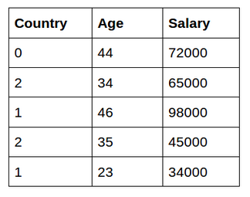
Data Encoding Encoding Schemes
Integer Encoding/Label Encoding

Slide 23
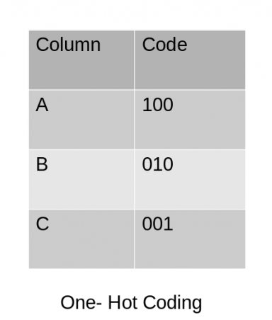
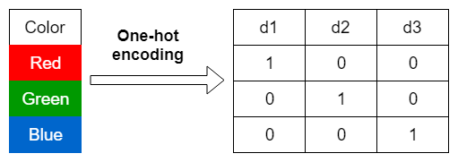
Data Encoding Encoding Schemes
One Hot Encoding
In one-hot encoding, we create a new set of dummy (binary) variables that is equal to the number of categories (k) in the variable.

Slide 24
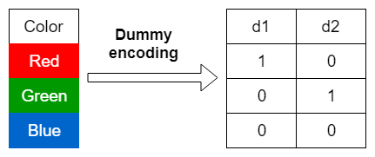
Data Encoding Encoding Schemes
Dummy Encoding
Dummy encoding also uses dummy (binary) variables. Instead of creating a number of dummy variables that is equal to the number of categories (k) in the variable, dummy encoding uses k-1 dummy variables.

Slide 25
Feature Crafting
Feature Selection/Extraction
Finding most influential features in the dataset which heavily influence the prediction/outcome.
All of the features we find in the dataset might not be useful in building a machine learning model to make the necessary prediction. Using some of the features might even make the predictions worse. So, feature selection plays a huge role in building a machine learning model.
Algos: IG, MI, Chi-Square
Some measures to select features on their basis: correlation, p-value
Extracting features from the data on the basis of certain criteria such as how many times a feature is occurring.
Algos: TF, TF-IDF, PCA
Handcrafted Features Vs Learned Features
Hand crafted: features that are manually engineered by the data scientist.
Learned features: are ones that are automatically obtained from a deep learning algorithm

Slide 26
Model Training, Testing & Evaluation
Model Training: Learning through data in iterative process.
It is carried out in iterative cycles called epochs.
Common approaches to train a neural network are:
Full-Batch (Weights are updated after one epoch)
Mini-Batch (Weights get updated several times over an epoch)
Online Learning (Weights are updated after each example)
Testing:
Train, Validation & Test Split
K-Fold Testing
Leave-on-out Testing
Evaluation:
Confusion Matrix : TP, FP, TN, FN
Precision, Recall, F1-Measure, Accuracy, Kappa Score, etc.
Further Reading Encoding Schemes: Link

Slide 27
Model Deployment
Saving the ML model:
Pickle converts a python object to a bitstream and allows it to be stored to disk and reloaded at a later time. It provides a good format to store machine learning models provided that their intended applications are also built in python.
ONNX the Open Neural Network Exchange format, is an open format that supports the storing and porting of predictive model across libraries and languages. Most deep learning libraries support it and Scikit-Learn also has a library extension to convert their model to ONNX’s format.
Machine Learning Model as a Micro-Service
Kubernetes - Kubeflow
Docker

Slide 28
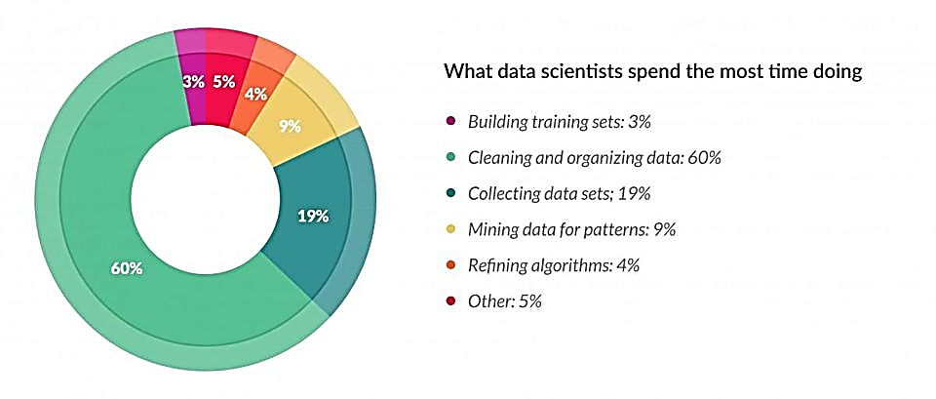
ML Pipeline – A Temporal View
Data preparation accounts for about 80% of the work of data scientists

Slide 29
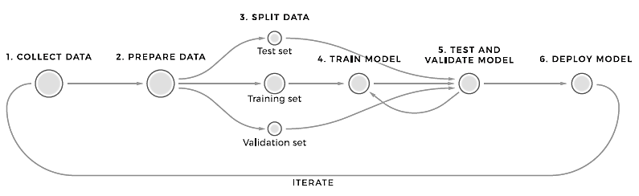
ML Pipeline – A Software Engineering View
A machine learning pipeline (or system) is a technical infrastructure used to manage and automate ML processes in the organization.
The pipeline logic and the number of tools it consists of vary/change depending on the ML needs. But, in any case, the pipeline would provide data engineers with means of managing data for training, organizing models, and managing them on production.

Slide 30
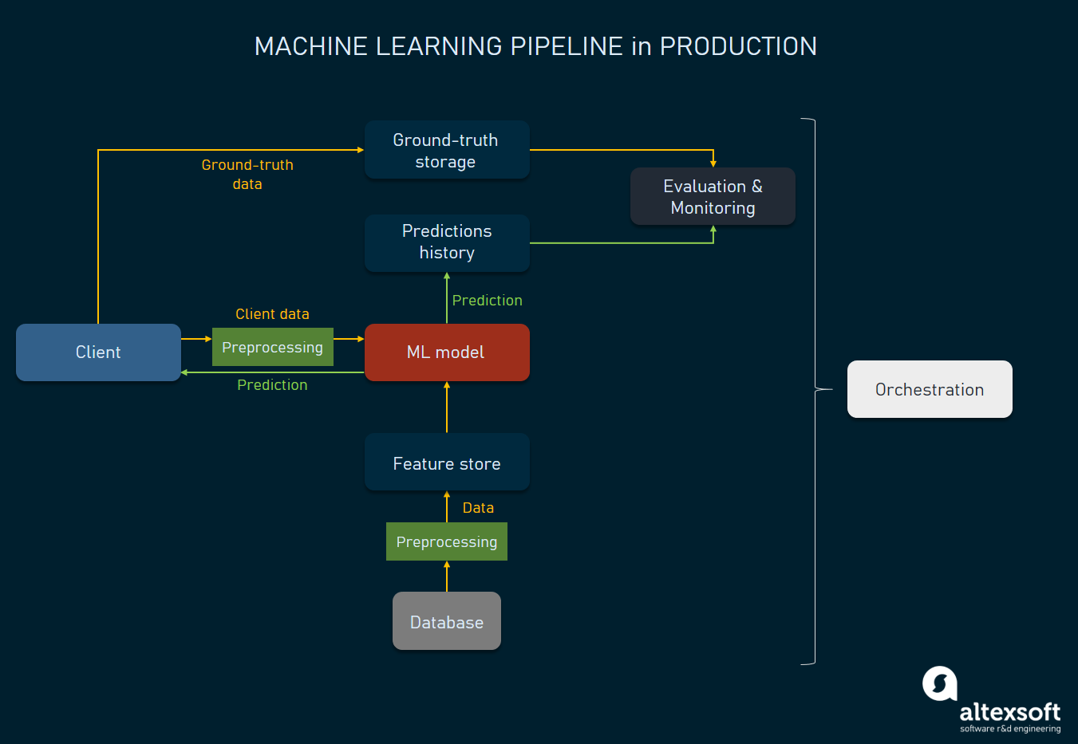
ML Pipeline – A Software Engineering View

Slide 31
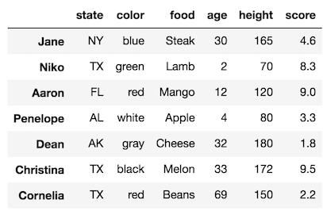
Terminologies
Example
Ground Truth / Label
Model (used in two senses)
ML Algorithm
The trained Model (Structural design and weights and biases)
Annotating/Labeling the data & annotated / labeled data

Slide 32
Data Pipeline VS ETL Pipeline
Data Pipeline Is an Umbrella Term of Which ETL Pipelines Are a Subset
ETL Pipelines Always Involve Transformation
In the extraction part of the ETL Pipeline, the data is sourced and extracted from different systems like CSVs, web services, social media platforms, CRMs, and other business systems. In the transformation part of the process, the data is then molded into a format that makes reporting easy. Sometimes data cleansing is also a part of this step. In the loading process, the transformed data is loaded into a centralized hub to make it easily accessible for all stakeholders.
The purpose of the ETL Pipeline is to find the right data, make it ready for reporting, and store it in a place that allows for easy access and analysis. An ETL tool will enable developers to put their focus on logic/rules, instead of having to develop the means for technical implementation. This frees up a lot of time and allows your development team to focus on work that takes the business forward, rather than developing the tools for analysis.

