Slide 1
Lecture : 22
Logistic Regression
Abdullah Mansoor

Slide 2
Classification
Benign Malign Tumor Detection
Spam, Not Spam
Covid +ve, –ve
Cat, Dog
Snowfall, no snowfall

Slide 3
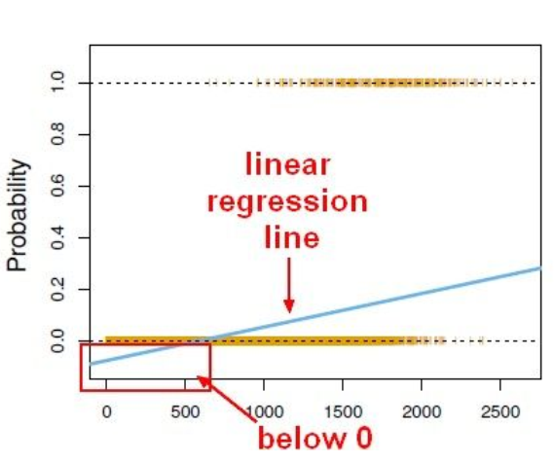
Logistic Regression
Regression problems: where we try to predict a continuous value
Classification: Discrete value (0 or 1)
The convention for binary classification is to have two classes 0 and 1
Linear Regression
In a binary classification problem, what we are interested in is the probability of an outcome occurring.
The probability is ranged b/w 0 and 1.
Whereas Linear Regression gives continuous value.
Also, normal linear regression model does not lead to a good fit. For example:
Y-axis = probability of belonging to a class
1 = paying back the loan ; 0 = not paying back the loan
X-axis = paycheck value
Lower pay , lower chance of not paying back the loan
We end up predicting probabilities below 0% which shows a bad fit and does not make any sense

Slide 4
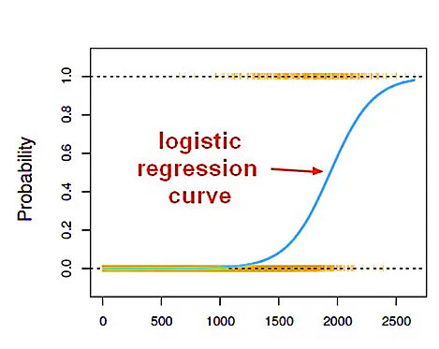
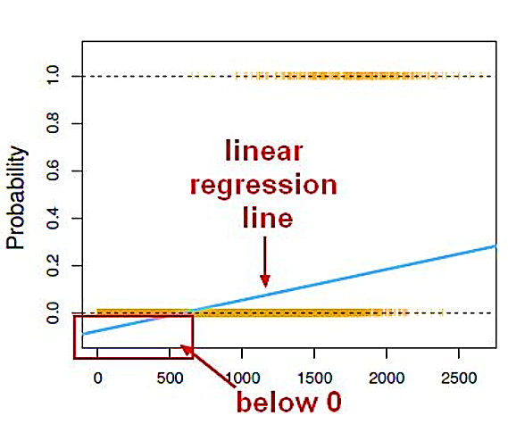
Linear regression can be transformed into logistic regression curve.
Linear regression
Logistic regression
B/W 0 and 1 – No negative probabilities

Slide 5
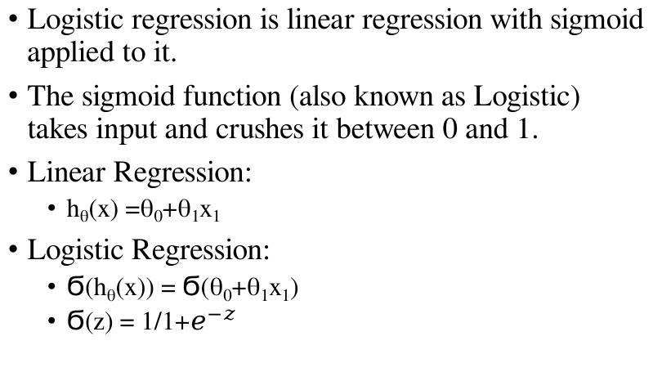
Sigmoid Function
Logistic regression is linear regression with sigmoid applied to it.
The sigmoid function (also known as Logistic) takes input and crushes it between 0 and 1.
Linear Regression:
h_{θ}(x) =θ₀+θ₁x₁
Logistic Regression:
Ϭ(h_{θ}(x)) = Ϭ(θ₀+θ₁x₁)
Ϭ(z) = 1/1+$e^{−z}$

Slide 6
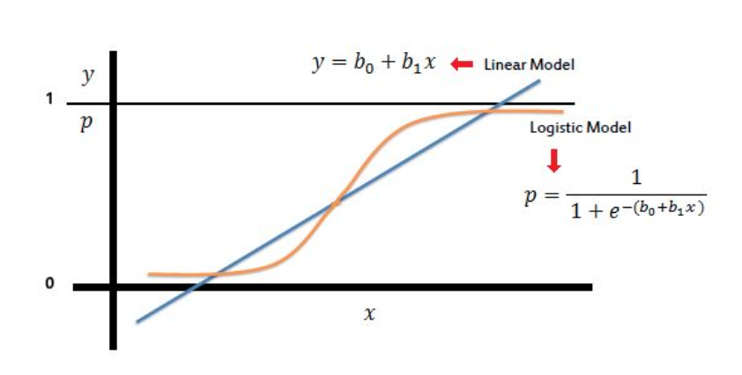
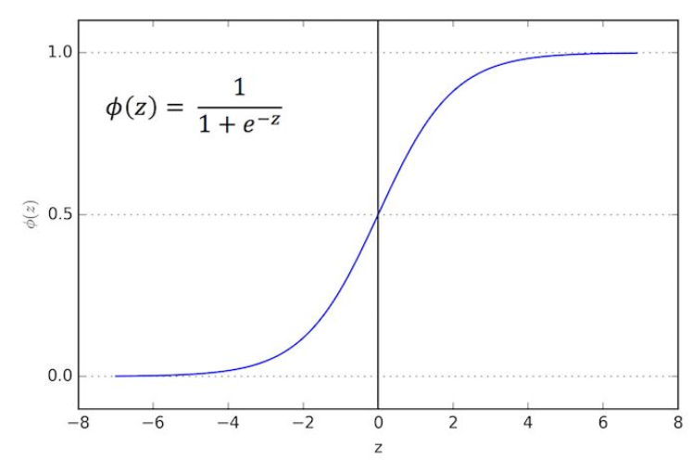
Sigmoid Function

Slide 7
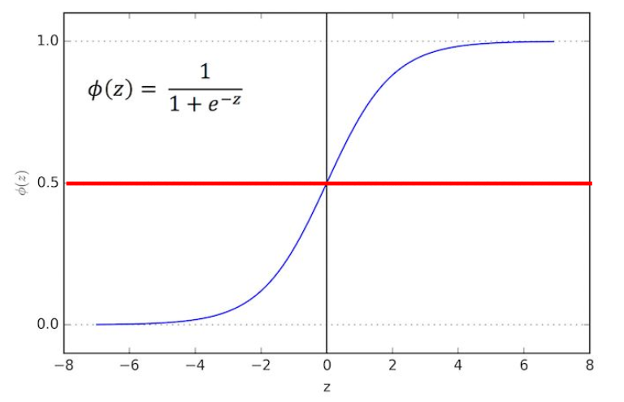
Sigmoid Function
Cut-off/Threshold
Above: Class 1
Below: Class 0

Slide 8
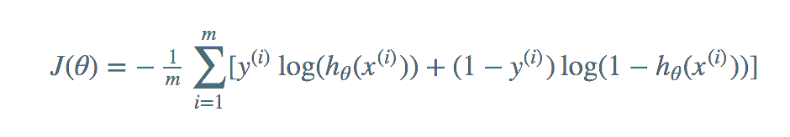
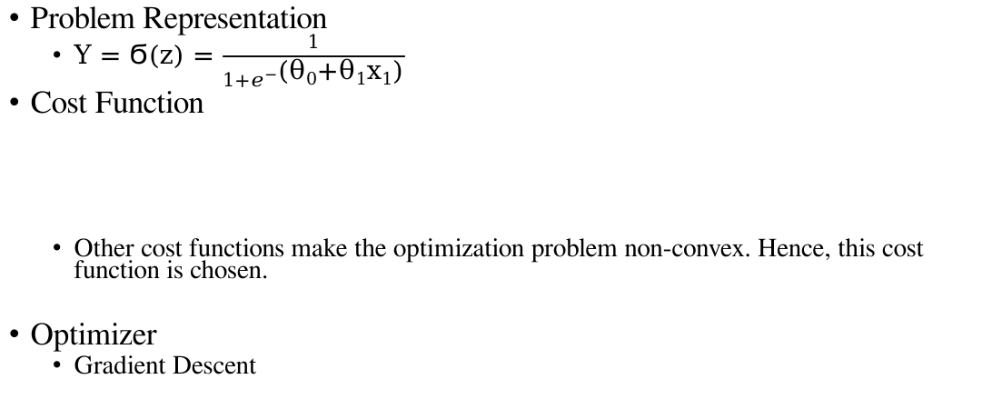
Supervised Learning Perspective
Problem Representation
Y = Ϭ(z) = $\frac{1}{1+e^{−\text{(}\text{θ}\text{0}\text{+}\text{θ}\text{1}\text{x}\text{1}\text{)}}}$
Cost Function
Other cost functions make the optimization problem non-convex. Hence, this cost function is chosen.
Optimizer
Gradient Descent

