Slide 1
Lecture : 26
Model Evaluation
Abdullah Mansoor

Slide 2
Evaluation
Why can’t we train our machine learning algorithm on our dataset and use predictions from this same dataset to evaluate machine learning algorithms?
Due to: Overfitting
Evaluation Techniques:
Train and Test Sets
K-fold Cross Validation
Leave-One-Out Cross Validation
Repeated Random Test-Train Splits

Slide 3
Train and Test Sets
Split size depends upon dataset size
Commonly 67% 33%
High speed compared to other techniques
Downside: High variance
Probability of learning too much from the training data - overfitting
Differences in the training and test dataset can result in meaningful differences in the estimate of accuracy

Slide 4
K-fold Cross Validation
Evaluation approach with less variance than a single train-test split
Dataset is split in k-parts/folds. E.g. k=5
Training on k-1 folds.
1 fold is held out for testing.
Repeated so that each fold of the data is given a chance at testing.
k performance scores are generated
Summary is generated using a mean and standard deviation

Slide 5
Leave-One-Out Cross Validation
If k=total no. of examples
Computationally very expensive
Enhances transparency of the method and aids reproducibility of results

Slide 6
Repeated Random Train-Test Splits
Another variation on k-fold cross validation
Create a random split of the data like the train/test split
Repeat the process of splitting and evaluation of the algorithm multiple times, like cross validation
Pros:
Speed of Train-Test Split
Low variance of k-fold cross validation
Cons:
Random splits will have same examples i.e. redundancy

Slide 7
Classification Evaluation Metrics

Slide 8
Evaluation Metrics
Confusion Matrix
Accuracy
Precision
Recall
F1-Score
Area Under the ROC Curve

Slide 9
Accuracy
accuracy = right choices made / total choices
acc = will die + will not die / all people
acc = triumphs / total

Slide 10
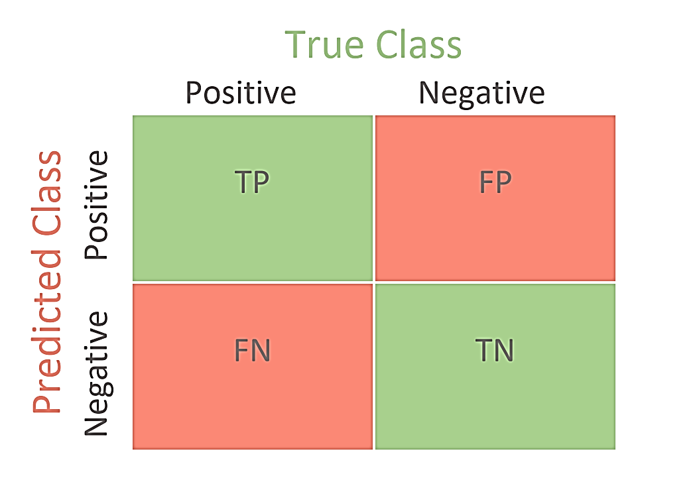
Confusion Matrix

Slide 11
TP, TN, FP, FN
true positive (TP)
equivalent with hit
true negative (TN)
equivalent with correct rejection
false positive (FP)
equivalent with false alarm, type I error or underestimation
false negative (FN)
equivalent with miss, type II error or overestimation

Slide 12



Accuracy, Precision, Recall, F1
Accuracy
Precision
Recall
F1
Mean of Precision and Recall

Slide 13
ROC-AUC Score
Area Under the ROC Curve
It is a probability curve that plots the TPR against FPR
Performance metric for binary classification
The Area Under the Curve (AUC) is the measure of the ability of a classifier to distinguish between classes and is used as a summary of the ROC curve.
Its value represents a model’s ability to discriminate between positive and negative classes
An area of 1.0 = All predictions made correctly
An area of 0.5 = no better accuracy than chance

Slide 14


ROC-AUC Score
The higher the AUC, the better the performance of the model at distinguishing between the positive and negative classes.

