Slide 1
Lecture : 27
Unsupervised Machine Learning k-Means
Abdullah Mansoor

Slide 2
Unsupervised Machine Learning
Labeled data is not needed
Unsupervised ML used for:
Clustering
Dimensionality Reduction
Feature selection/extraction
Examples
To group similar customers together
Reducing the number of variables/features in the data
Fraudulent Transaction Detection in banking
Network intrusion detection

Slide 3
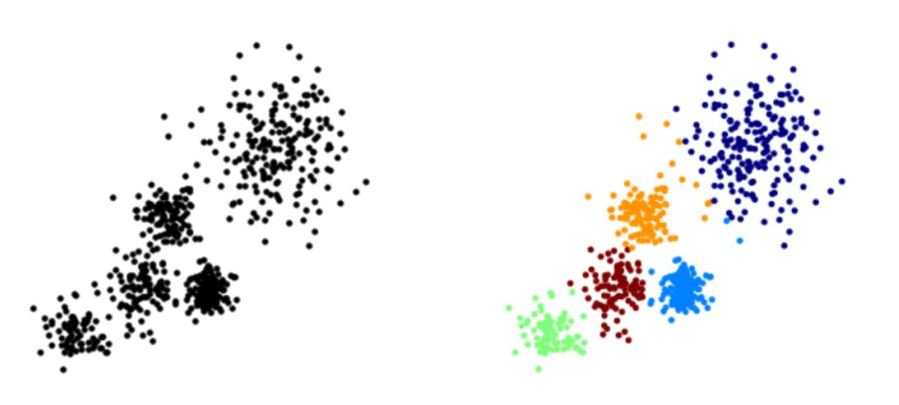
K-Means
K Means Clustering is an unsupervised learning algorithm
Attempts to group similar clusters together
Cluster Similar Documents
Cluster Customers based on Features
Market Segmentation
Identify similar physical groups
The overall goal is to divide data into distinct groups such that observations within each group are similar

Slide 4
K Means Algorithm
First we choose a number of Clusters “K”
Then we randomly assign each point in the data to a cluster
Then, until clusters stop changing we repeat the following steps:
For each cluster, we compute the cluster centroid by taking the mean vector of points in the cluster
Then each point in the data is assigned to the cluster whose centroid is the closest to it

Slide 5
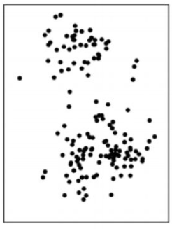
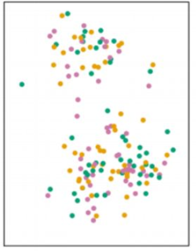
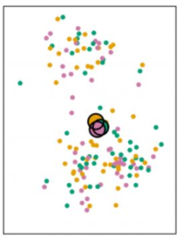
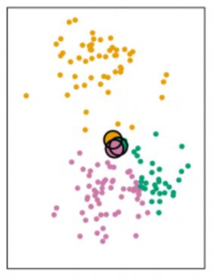
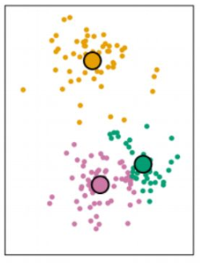
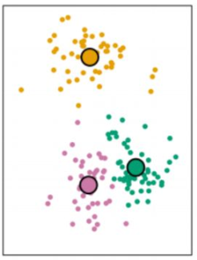
1
2
3
4
5
Data
Each observation is randomly assigned to a cluster, k=3
Centroids for the clusters are computed. Initially centroids are almost overlapping because of random assignment of data points to the clusters
Then, each data point is assigned to the nearest centroid
Again, centroids are computed
The process repeats till no new clusters are formed i.e. data points are not reassigned to a new cluster centroid then we have the final result :

Slide 6
