Slide 1
Lecture : 28
Supervised: Support Vector Machine SVM
Abdullah Mansoor

Slide 2
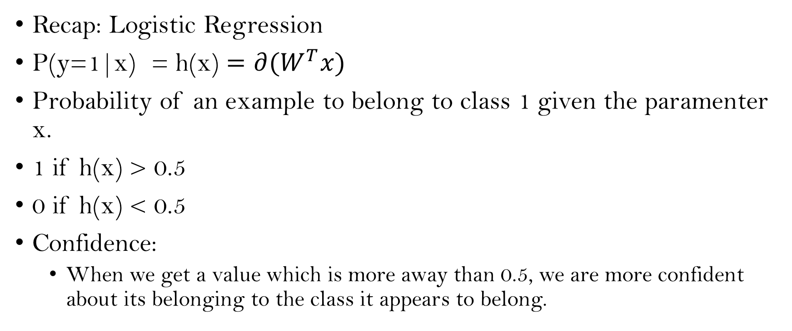
Support Vector Machine (SVM)
Recap: Logistic Regression
P(y=1|x) = h(x) $=∂(W^{T}x)$
Probability of an example to belong to class 1 given the paramenter x.
1 if h(x) > 0.5
0 if h(x) < 0.5
Confidence:
When we get a value which is more away than 0.5, we are more confident about its belonging to the class it appears to belong.

Slide 3
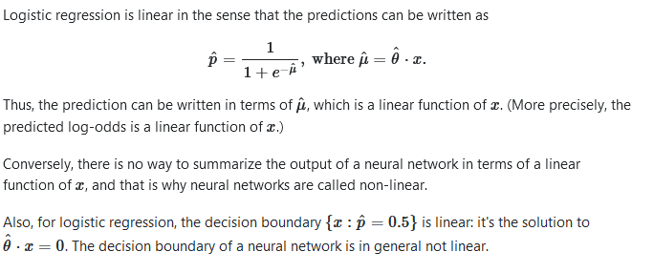
SVM
Logistic Regression gives us a linear classifier.

Slide 4
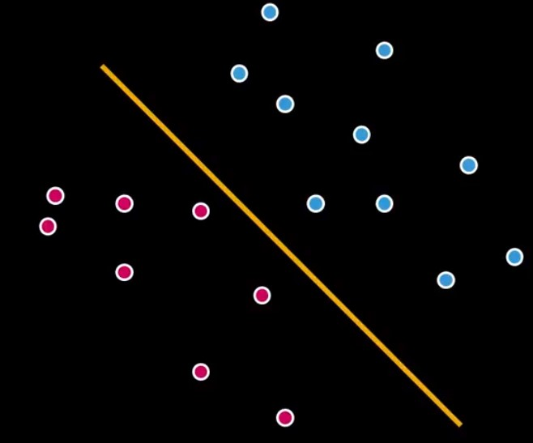
SVM
If we want to separate classes using a line.
We’ll have less confidence value for the data points near the decision line.
The more away from the decision line we are, the better confidence value we have for a data point belonging to a particular class.
We need to find a classifier that separates two classes using a line such that it maximizes the margin between the two classes.

Slide 5
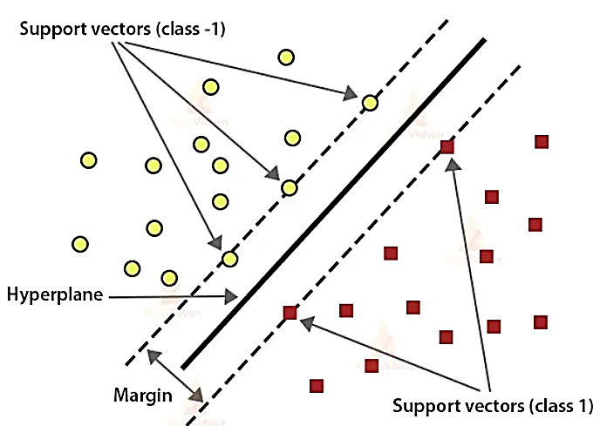
SVM

Slide 6
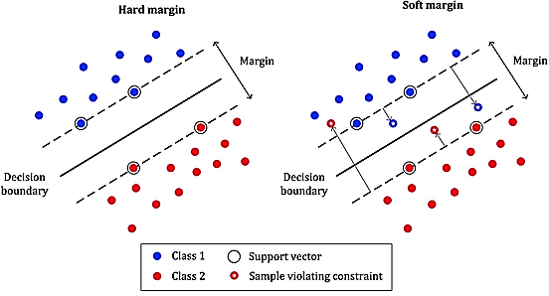
SVM
Margin Types:
Soft Margin
Hard Margin

Slide 7
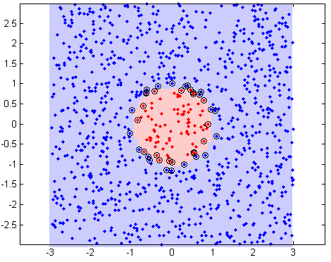
Separating Non-linearly Separable Classes
Classes are non linearly separable if a line cannot separate them.
If we find a way to map the data from 2-dimensional space to three dimensional space, we will be able to find a decision surface that clearly divides between different classes.

Slide 8
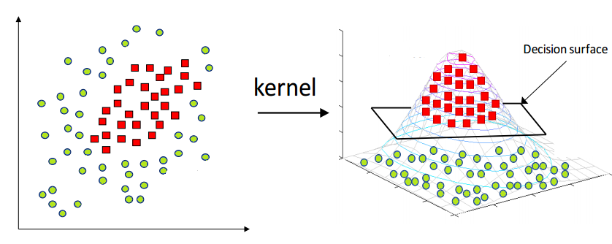
Separating Non-linearly Separable Classes

Slide 9
Kernel Trick
However, when there are more and more dimensions, computations within that space become more and more expensive.
This is when the kernel trick comes in. It allows us to operate in the original feature space without computing the coordinates of the data in a higher dimensional space. (Mathematics Involved!)
There are different kernels. The most popular ones are the polynomial kernel and the radial basis function (RBF) kernels.
The kernel trick sounds like a “perfect” plan. However, one critical thing to keep in mind is that when we map data to a higher dimension, there are chances that we may overfit the model. Thus choosing the right kernel function (including the right parameters) and regularization are of great importance.

Slide 10
Resources
For further details view these:
https://medium.com/@zxr.nju/what-is-the-kernel-trick-why-is-it-important-98a98db0961d
https://towardsdatascience.com/truly-understanding-the-kernel-trick-1aeb11560769

