Slide 1
Lecture : 29
Supervised: Decision Tree DT
Abdullah Mansoor

Slide 2
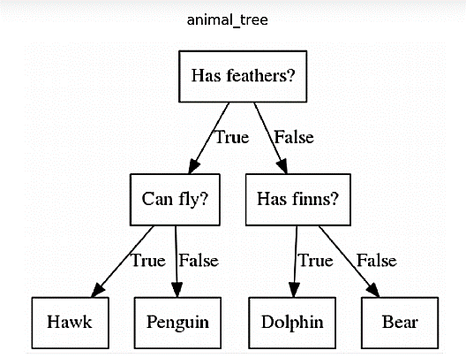
Decision Tree
It is a supervised machine learning algorithm.
Can be used for both classification and regression.
Mostly used for classification.
A decision tree follows a set of if-else conditions to visualize the data and classify it according to the conditions.
It is a binary tree that recursively splits data until we are left with pure leaf nodes i.e. data with only one type of class.

Slide 3
Tree Terminology
Root Node:
This attribute is used for dividing the data into two or more sets. The feature attribute in this node is selected based on Attribute Selection Techniques.
Branch or Sub-Tree:
A part of the entire decision tree is called a branch or sub-tree.
Splitting:
Dividing a node into two or more sub-nodes based on if-else conditions.
Decision Node:
After splitting the sub-nodes into further sub-nodes, then it is called the decision node.
Leaf or Terminal Node:
This is the end of the decision tree where it cannot be split into further sub-nodes.
Pruning:
Removing a sub-node from the tree is called pruning.

Slide 4
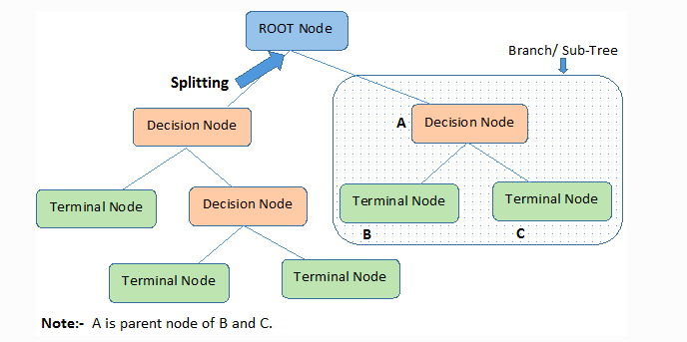
Tree Terminology

Slide 5
Working Fundamentals
The root node feature is selected based on the results from the Attribute Selection Measure(ASM).
The ASM is repeated until a leaf node, or a terminal node cannot be split into sub-nodes.

Slide 6
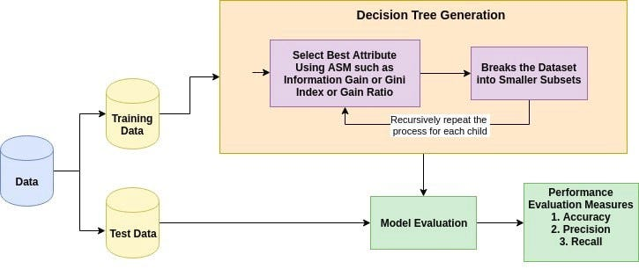
Working Fundamentals

Slide 7
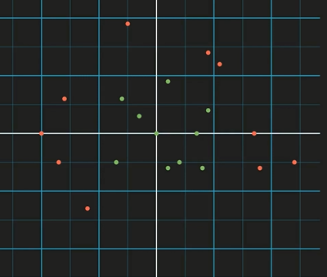
Decision Tree Working
Data with 2 features: x0 and x1
Data points/examples/records Plotted as in figure
There are 2 classes
Both are not linearly separable
Recap: What is a Decision Tree??
A binary tree that recursively splits the dataset until we are left with pure leaf nodes i.e. data with only one type of class

Slide 8
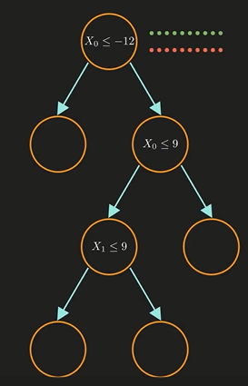
Decision Tree Working
To start from end: Consider a trained decision tree
2 types of nodes: Decision nodes and leaf nodes.
Decision nodes contain a condition to split the data and leaf nodes help us decide the class of a data point
All data is at root node and now the splitting will take place as per the conditions

Slide 9
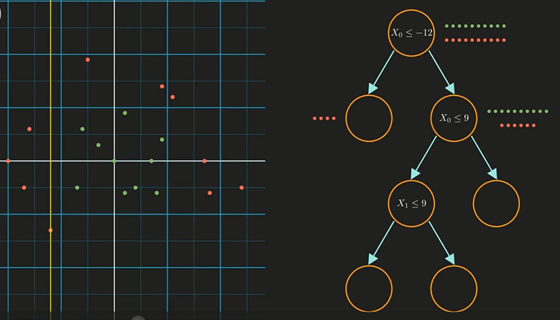
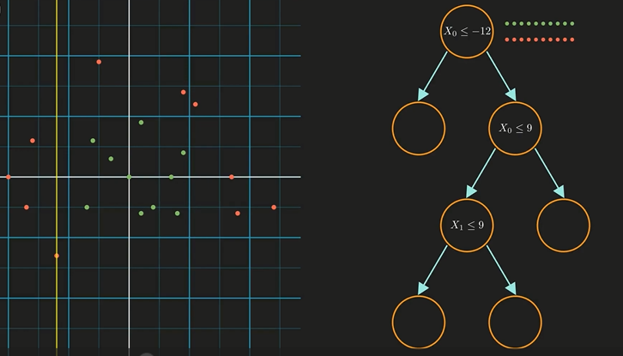
Decision Tree Working
For the condition x0 <= -12, all data points that satisfy it will be on the leaf node (left side)
The condition is a line in yellow in the plot
Points that do not fulfill this condition go to the right node
This rule is followed for the remaining nodes also
The left child contains only RED points so it’s a pure node. We don’t need to split further

Slide 10
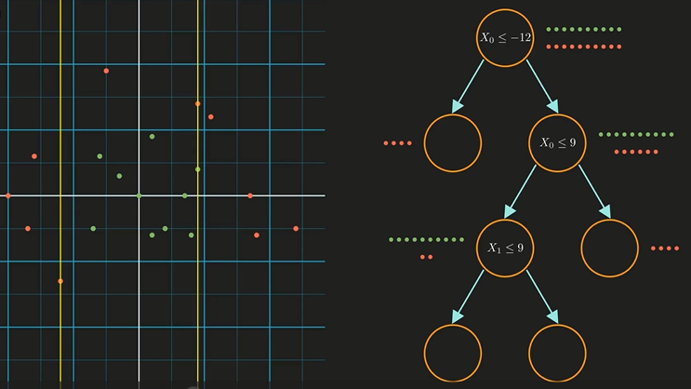
Decision Tree Working
For the decision node x0=9 we have another decision line as in figure
The right one is a pure node. Remaining data points need to be classified using condition x1<=9

Slide 11
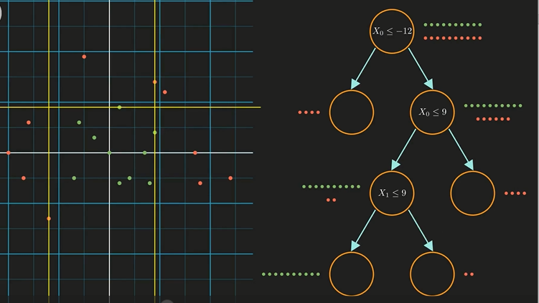
Decision Tree Working
For x1<=9, we have a horizontal line (as x1 is on y axis and x0 is on x axis)
Here we have a perfect decision tree with each leaf node as pure node.

Slide 12
Majority Voting
In more complex data, we do not always get 100% pure leaf nodes.
In this situation, we perform Majority Voting or Max Voting.
The majority class is assigned to the data point.
Why? There will be other decision trees that are performing worse than this one. So, during training we are left with this one only and it has false positives in this node. But these false positives are less than other decision trees configurations we tried during training.

Slide 13
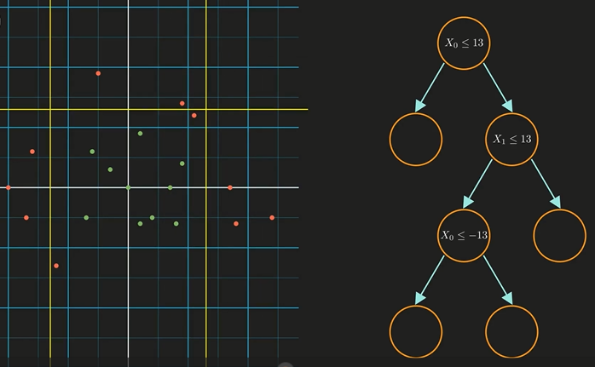
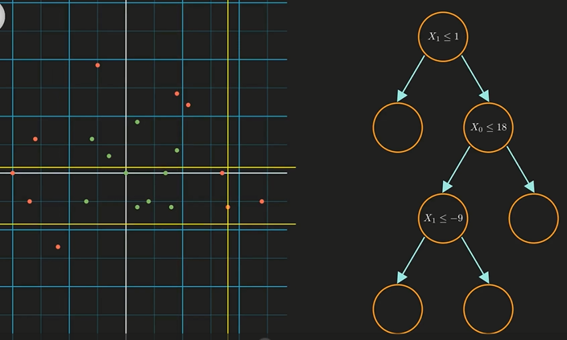
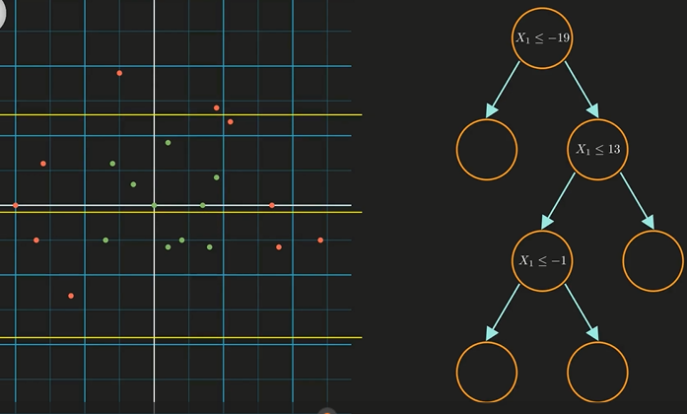
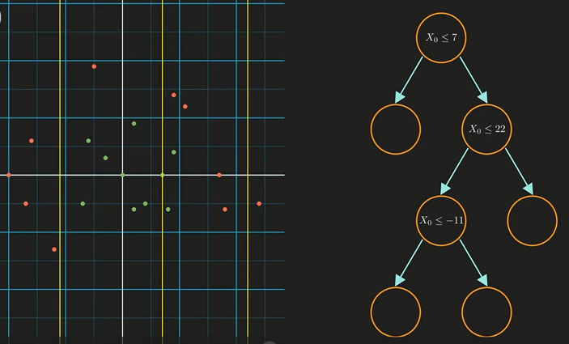
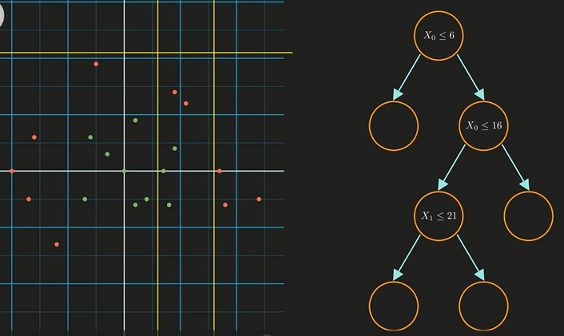
Machine Learning in Decision Trees
Where ML fits in this scenario?
The splitting conditions could be many. Which one is the most optimal one? As we cannot exhaustively check all.
A couple conditions are in figures:
The model needs to learn which features to take and corresponding values to optimally split the data
This is why it is machine learning

Slide 14
Machine Learning in Decision Trees
ML is an Optimization problem.
Hence we use optimization techniques to find out the best tree configuration for the problem at hand.
The cost function could be : Gini Index or Information gain both rely on a concept called Entropy.
Which split condition is better than the other? We do this through cost estimation using aforementioned measures: Gini Index or Information Gain.
The model will choose a split that maximizes the information gain.
IG in a state is calculated using Entropy. Entropy is a measure of noise/chaos.

Slide 15
A Note:
Gradient descent is not used for training decision trees. Not every machine learning algorithm uses a general optimization algorithm (e.g. gradient descent) for training, some of them use specialized algorithms for training them. Examples of such algorithms are k-NN, naive Bayes, or decision trees, in case of those algorithms we don't train them by directly minimizing some loss function to find best set of parameters.
In fact, k-NN, or decision tree don't have parameters per se, but have their own algorithms for finding the solutions.
As a side note, gradient descent is even not always used for the algorithms that do train by directly minimizing loss function.
It is only one of the many optimization algorithms. Moreover, it is not even the most efficient algorithm, as there are many algorithms that work better for some problems.
Gradient descent got popular mostly because it is easy and efficient to use for training neural networks, but that does not make it "one size fits all" algorithm.

Slide 16
What is Attribute Selective Measure(ASM)? Cost Function
Attribute Subset Selection Measure is a technique used in the data mining process for data reduction.
The data reduction is necessary to make better analysis and prediction of the target variable.
The two main ASM techniques are
Gini index
Information Gain(ID3)

Slide 17
Gini index
The measure of the degree of probability of a particular variable being wrongly classified when it is randomly chosen is called the Gini index or Gini impurity.
Gini Index works as a COST Function.
Its lowest value is sought as it gives lowest probability of a variable being wrongly classified.
When we use the Gini index as the criterion (i.e. cost function) for the algorithm to select the feature for the root node. The feature with the least Gini index is selected.

Slide 18
Bagging and Boosting the Decision Trees
Boosting: Gradient Boosted Decision Trees
https://towardsdatascience.com/gradient-boosted-decision-trees-explained-9259bd8205af
Bagging: Random Forest
https://towardsdatascience.com/decision-tree-and-random-forest-explained-8d20ddabc9dd

