Slide 1
Lecture : 30
Unsupervised: Principal Component Analysis PCA
Abdullah Mansoor

Slide 2
The curse of dimensionality
High-dimensional data is hard to work with
As the number of features/dimensions in the data increase, the amount of data needed to be generalized accurately increases exponentially.
Solution:
Select only those features that explain most of the variation in the data i.e. Reduce the dimensionality
Feature Selection: Principal Component Analysis

Slide 3
Principal Components Analysis
Regression:
Fits a single line to a data set
PCA:
Fits several orthogonal lines to the data set
Finds out which lines explain most of the variation/spread of the data
Orthogonal = At right angles to each other

Slide 4
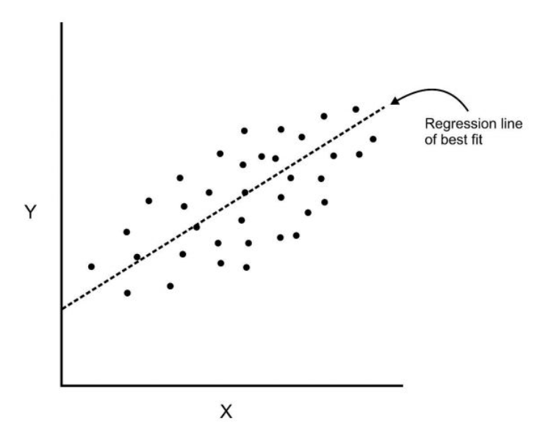
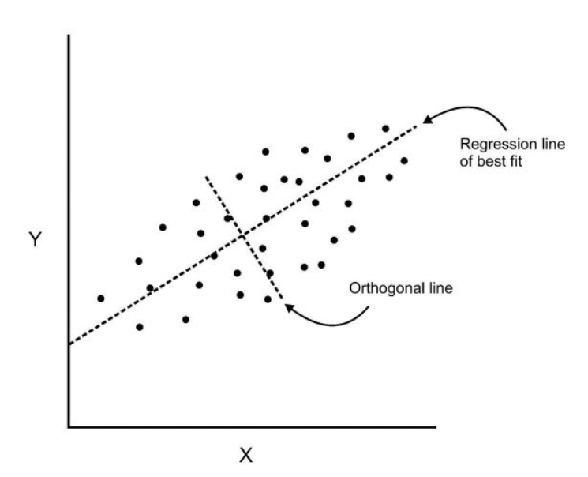
Regression VS PCA

Slide 5
General Idea
PCA is an unsupervised technique used to:
Examine the interrelations among a set of variables
It tries to understand the underlying structures of these variables
It can tell which feature is the most valuable in explaining the data
So we take these features only and discard the rest
Components of the data
Each orthogonal line is called Component
Theoretically, Components equal the number of features/variables in the data
Components are calculated such that the first one explains the most variance, then second one then the next one and so on.

Slide 6
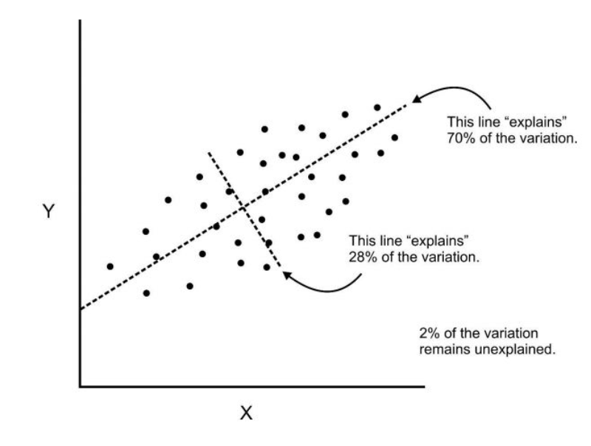
General Idea
We can also reduce higher dimensional data to 2 or three dimensions to visualize it with reasonable explain-ability
If we use this technique on a data set with a large number of variables, we can compress the amount of explained variation to just a few components

