Slide 1
Neural Network
Machine Learning – Crash Course
Day 3

Slide 2
Lecture : 32
Neural Networks
Abdullah Mansoor

Slide 3
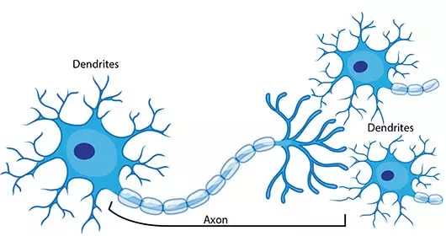
Neuron
The Neuron is made up of three major components:
Dendrites
Cell body
Axon

Slide 4
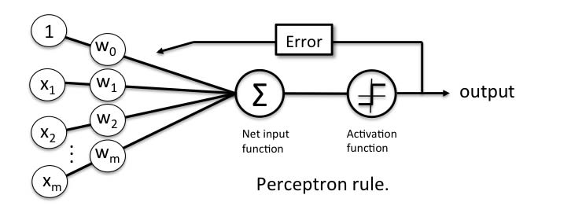
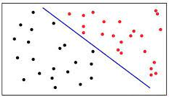
Perceptron
A computer model of neuron.
Invented in 1958.
One Perceptron – One Line
Separates linearly separable classes just like Logistic Regression

Slide 5
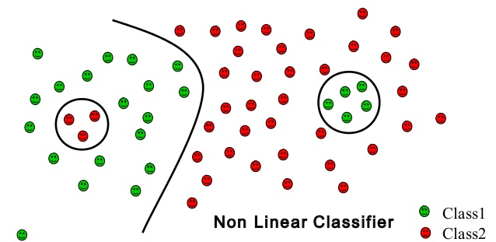
Non-Linearly Separable Classes
Multilayer Perceptron can model non-linearly separable classes

Slide 6
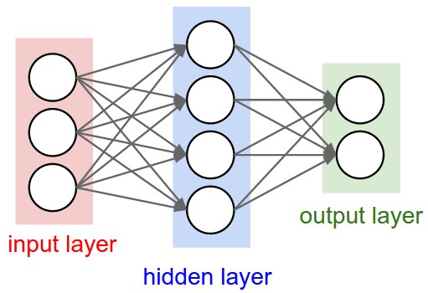
Multilayer Perceptron
Width of NN
Depth of NN

Slide 7
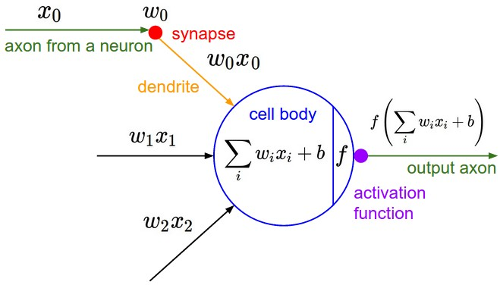
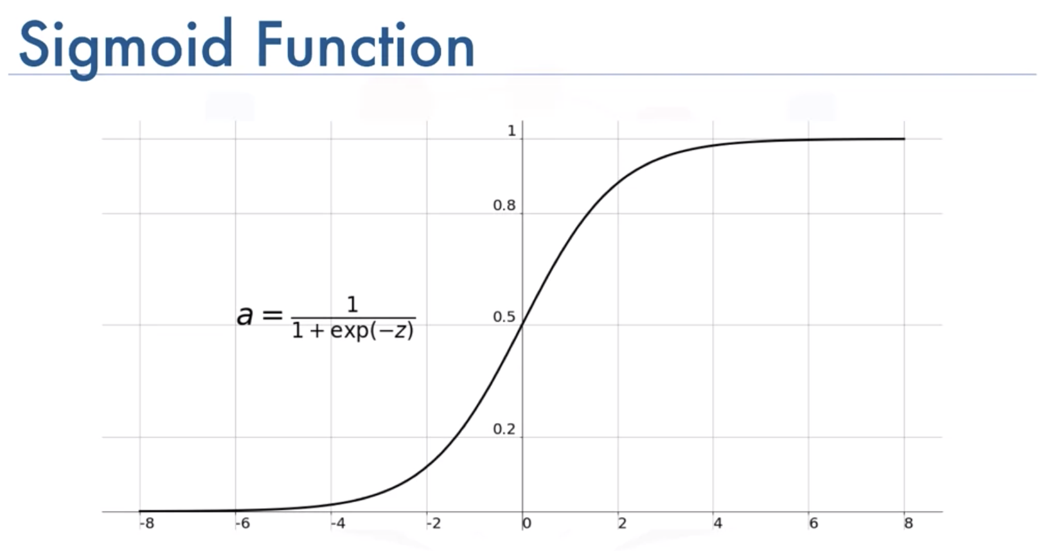
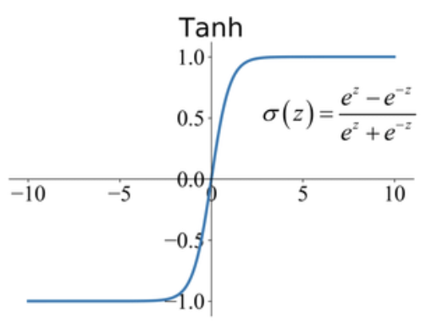
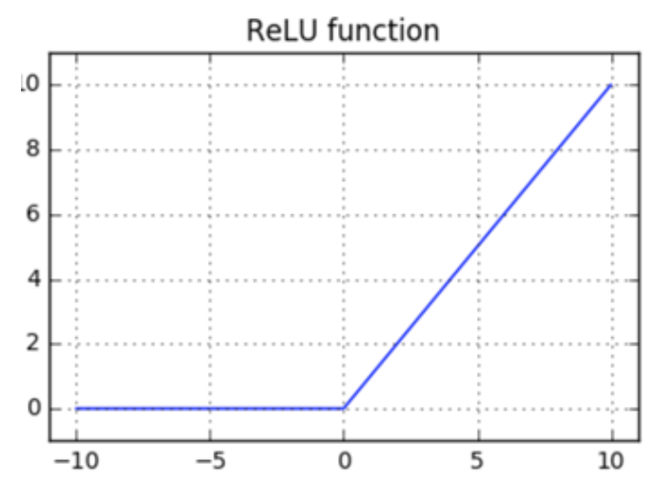
Neuron
Neurons are simple computational units that have weighted input signals and produce an output signal using an activation function
Weights
Bias
Activation Function
The weighted inputs are summed and passed
through an activation function
It is a non-linear function
Sigmoid
Tanh
ReLU

Slide 8
Neuron
Output Layer
For regression only one neuron (may have no activation function)
For Binary classification: one neuron with sigmoid as activation function
We can use threshold value for class identification as:
If above threshold, class = 1
If below threshold, class = 0
For multi-class classification: One neuron for each class
Activation Function = Softmax
Softmax outputs a probability value of a class

Slide 9
Forward and Backward Pass
Training is carried out in:
Forward and Backward Passes
Process is:
Data is passed through the network
The difference between the predicted class and the actual class is checked
If the prediction is wrong, the weights are adjusted so that the error can be smaller next time.
Cost Function (Square of difference of predicted and actual value) calculates the error
Binary cross entropy
Sum of square diff
Categorical cross entropy
How to adjust weights automatically to reduce the cost?
Solution = Gradient descent
Compute the gradient of the cost function
Take small steps in the downhill direction
Till it reaches the minimum position

Slide 10
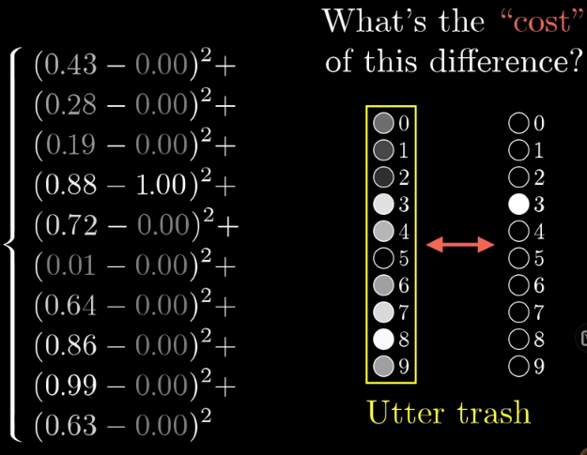
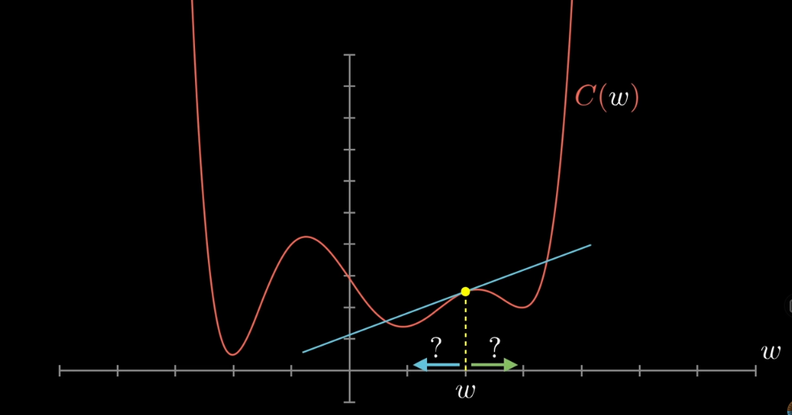
Forward and Backward Pass
Cost Estimating
Finding the values of weights that decrease the cost
Gradient Descent

Slide 11
Resources
Detailed Study
3BlueOneBrown

