Slide 1
Lecture : 34
Convolutional Neural Networks
Abdullah Mansoor

Slide 2
Convolutional Neural Nets
Convolutional neural networks have superior performance with:
Image
Speech
Audio signals
There are three types of layers in a Convolutional Neural Network:
Convolutional Layers
Pooling Layers
Fully-Connected Layers

Slide 3
Process
1- Apply Convolution
Filter of weights applied to a patch of the input image
Element-wise Multiplication b/w filter and patch
Adding the results
Add the bias
Apply non-linearity (ReLu)
Slide the filter by a stride of some pixel value (say:2)
Repeating this over the complete image generates a Feature Map
Local Connectivity:
One Neuron Sees only the Patch compared to fully connected (MLP)
This setting preserves the 2D structure of the image

Slide 4
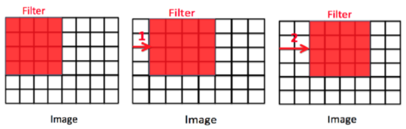
Feature Map Generation
Stride

Slide 5
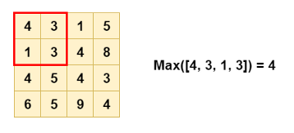
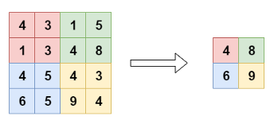
Process
2- Pooling
Used to reduce the dimensionality

Slide 6
Padding
After convolution, image size shrinks
Pixels present in the corners of the image are used lesser no. of times than pixels present in the middle
This can lead to information loss
Solution: Padding
Zero padding

Slide 7
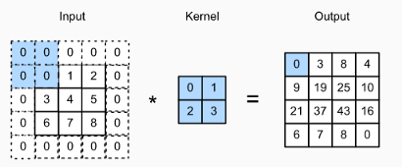
Padding

Slide 8
General Architecture
Generally CNNs have multiple sets of convolutional and pooling layers
Initial conv. layers can detect simple patterns
edges, lines, curves
Later conv. Layers can detect higher abstractions that are formed using the simple patterns
eyes, ears, etc.
Classification:
Fully connected layers are added to the end

Slide 9
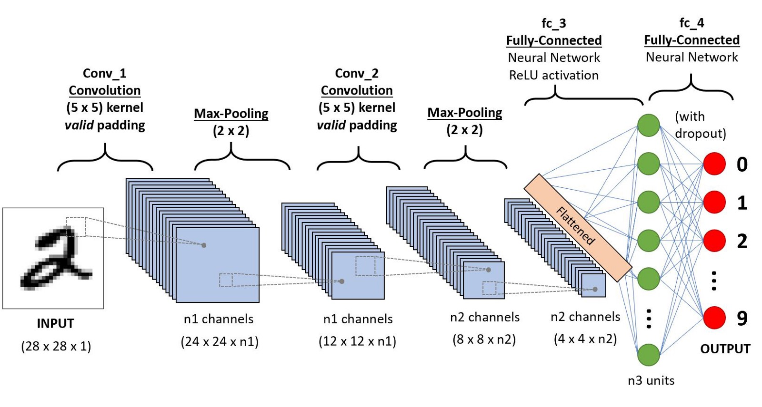
General Architecture

