Slide 1
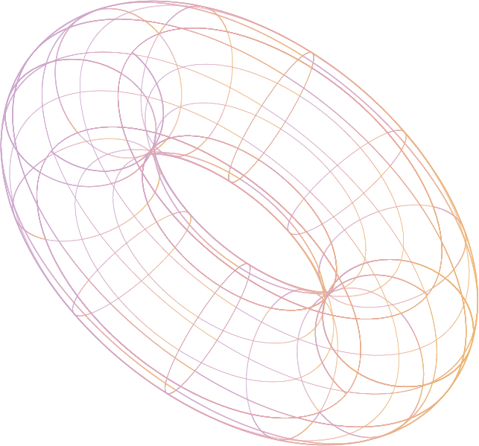

Gradient Boosted Decision Tree
Presented By : Muhammad Asad

Slide 2
Table of contents
01
02
03
Ensemble Learning
Boosting Technique
Gradient Boosting
Ensemble Learning helps improve machine learning results by combining several models. This approach allows the production of better predictive performance compared to a single model.
Boosting is an ensemble meta-algorithm for primarily reducing bias, and also variance in supervised learning, and a family of machine learning algorithms that convert weak learners to strong ones
Gradient Boosting is a machine learning technique used in regression and classification tasks, among others.It gives a prediction model in the form of an ensemble of weak prediction models.

Slide 3
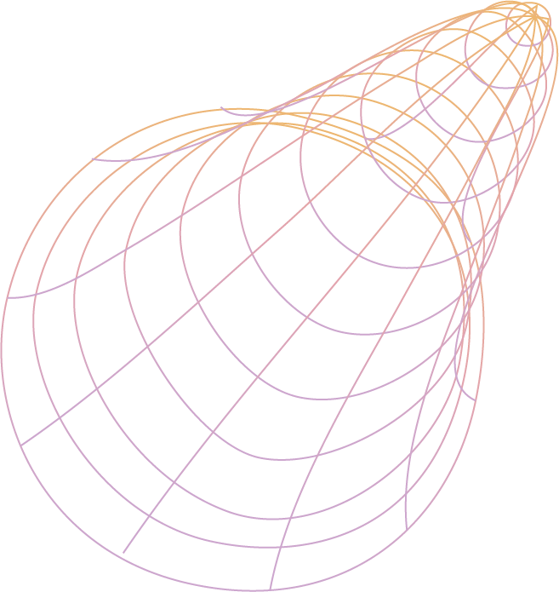
01
Ensemble
Learning
What is Ensemble Learning?

Slide 4

Ensemble Learning
Ensemble learning is a machine learning technique that combines the predictions of multiple models to obtain better performance than any single model alone. There are three main types of ensemble learning methods: bagging, stacking, and boosting.
Bagging involves creating multiple models from different subsets of the training data, and then averaging their predictions.
Boosting involves adding new models to the ensemble sequentially, where each new model tries to correct the errors made by the previous models.

Slide 5
02
Boosting
Technique
What is Boosting Technique in ML?

Slide 6

Boosting Technique
Boosting is a machine learning technique that combines multiple weak learners, usually decision trees, to create a strong learner that can make accurate predictions. Boosting works by iteratively adding new trees to the ensemble, where each tree tries to correct the errors made by the previous trees. The algorithm uses a loss function to measure how well the ensemble fits the data, and a learning rate to control how much each tree contributes to the ensemble. The algorithm stops when a predefined number of trees is reached, or when the loss function cannot be improved further.

Slide 7
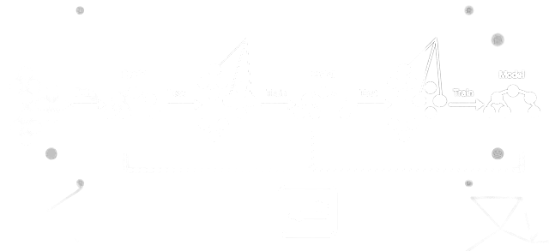
Boosting Technique

Slide 8
03
Gradient Boosted Decision Tree
What are Gradient Boosted Decision Trees?

Slide 9

Gradient Boosted Decision Tree
Like bagging and boosting, gradient boosting is a methodology applied on top of another machine learning algorithm. Informally, gradient boosting involves two types of models:
a "weak" machine learning model, which is typically a decision tree.
a "strong" machine learning model, which is composed of multiple weak models.
In gradient boosting, at each step, a new weak model is trained to predict the "error" of the current strong model (which is called the pseudo response).

Slide 10
Steps
Initialize the ensemble with a single tree that predicts the mean (for regression) or the mode (for classification) of the target variable.
Calculate the residuals, which are the differences between the actual and predicted values of the target variable.
Fit a new tree to the residuals, using a subset of features and a subset of data points (to introduce randomness and prevent overfitting).
Update the ensemble by adding the new tree with a weight proportional to the learning rate.
Repeat steps 2-4 until the stopping criterion is met.

Slide 11
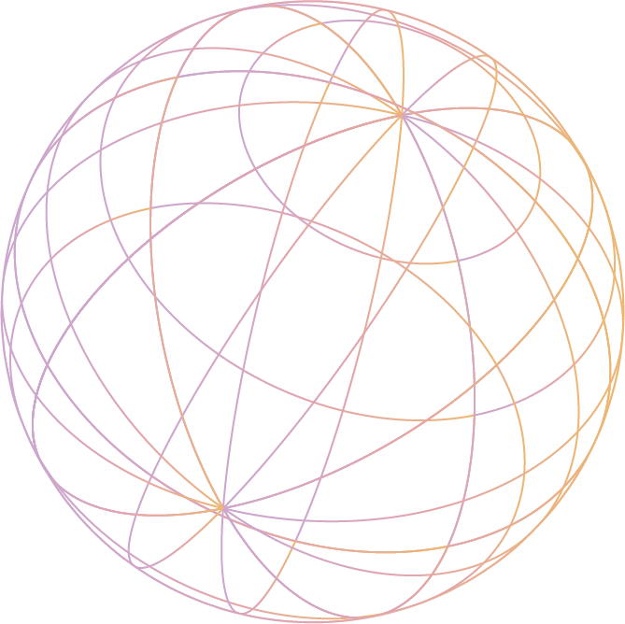
Thanks!
Do you have any questions?

